Slide 1
CTF Administrative Committee Meeting
September 9, 2024

Slide 2
(1) Introductions

Slide 3
(2) Public Comments on Non-Agenda Items

Slide 4
(3) Agenda Review

Slide 5
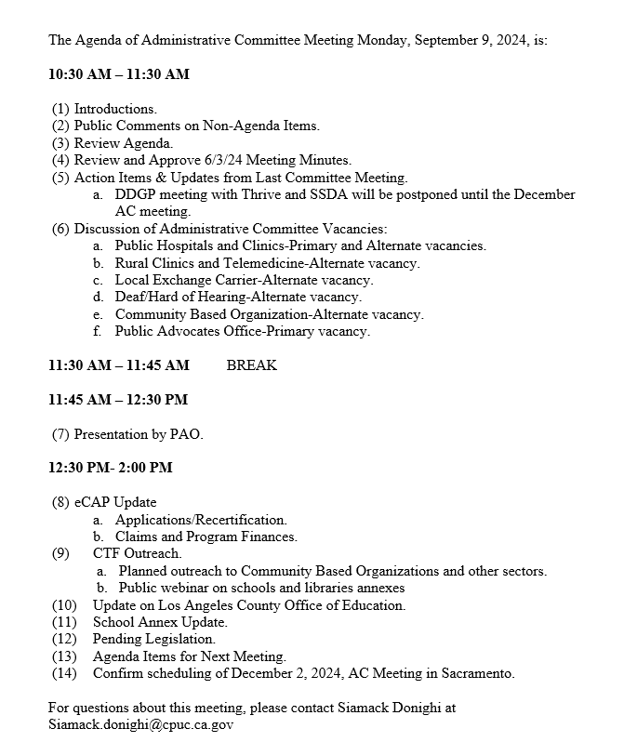
Agenda

Slide 6
(4) Review and Approve Prior Meeting Minutes

Slide 7
(5) Action Items from Last Committee Meeting
DDGP meeting with Thrive and SSDA will be postponed until the December AC meeting.

Slide 8
(6) Discussion of Current CTF-AC Vacancies
Public Hospitals and Clinics-Primary and Alternate vacancies
Rural Clinics and Telemedicine-Alternate vacancy
Local Exchange Carrier-Alternate vacancy
Deaf/Hard of Hearing-Alternate vacancy
Community Based Organization- Alternate vacancy
Public Advocates Office- Primary vacancy

Slide 9
(7) Presentation by PAO

Slide 10
(8) Status of CTF and E-CAP
Applications/Recertification
Claims and Program Finances

Slide 11
California Teleconnect Fund Applications received from May 1, 2024 through August 27, 2024
 | CBO | Healthcare CBO | Gov Hospitals | Community Colleges | Libraries | Private Schools | Charter Schools | Public Schools | 2-1-1 Provider | Total
Count of Intake Number | 109 (50.5%) | 53 (24.5%) | $$7$$ (3.2%) | 0 (0.0%) | 0 (0.0%) | 11 (5.1%) | 9 (4.2%) | 27* (12.5%) | 0 (0.0%) | 216 (100%)
Approved | 15 | 39 | 1 | 0 | 0 | 10 | 4 | 24 | 0 | 93
Ineligible/Rejected | 65 | 4 | 4 | 0 | 0 | 0 | 3 | 0 | 0 | 76
Pending Info. | 19 | 9 | 2 | 0 | 0 | 1 | 1 | 3 | 0 | 35
In Analyst Review | 10 | 1 | 0 | 0 | 0 | 0 | 1 | 0 | 0 | 12
*Non-Charter Public Schools

Slide 12
California Teleconnect Fund
Fund Status Report through June 30, 2024
Data collected August 26, 2024
CTF Local Assistance Budget vs. Claim Projections and Payments
 | FY 2021-2022 | FY 2022-2023 | FY 2023-2024
Local Assistance Budget | $105,000,000 | $105,000,000 | $105,000,000
Claim Projections | $67,000,000 | $60,000,000 | $60,000,000
Claim Paid | $52,000,000 | $40,000,000 | $41,000,000
Budget less Paid | $53,000,000 | $65,000,000 | $64,000,000

Slide 13
California Teleconnect Fund
Cash Balance as of June 30, 2024
State Controllers Office Fund Reconciliation Report
Report Date | FY / period | Beginning Cash Balance | Revenues | Expenses | Ending Cash Balance
3/31/2024 | FY23 P09 | $ 90,314,621 | $ 10,407,271 | $ 1,629,000 | $ 99,092,892
4/30/2024 | FY23 P10 | $ 99,092,892 | $ 10,003,147 | $ 3,632,000 | $ 105,464,039
5/31/2024 | FY23 P11 | $ 105,464,039 | $ 8,191,681 | $ 4,012,000 | $ 109,643,720
6/30/2024 | FY23 P12 | $ 109,643,720 | $ 9,486,585 | $ 2,602,000 | $ 116,528,306

Slide 14
California Teleconnect Fund Claims received from April 2024 through June 2024

Slide 15
eCAP Update
CBO and HCCBO Applications
Future eCAP developments

Slide 16
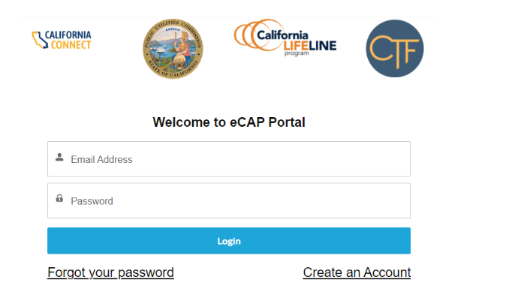
How to Process CTF Application
1) Log into eCAP account with username(email) and password
2) Each application is assigned a case number. To begin a new application, applicant will click “ New CTF Application” button.
Log into your eCAP account with your username(email) and password

Slide 17
How to process CTF Application
3) The system will present a series of questions. Select “No” until you see the question that best describes your organization and select “ Yes”
4) Enter the requested information on the Basic Information Tab.

Slide 18
How to process CTF Application
5) Libraries: Mobile Broadband Services:
The next tab will ask if the Applicant is requesting the CTF discount for mobile broadband services.
6) Libraries: Terms and Conditions and Submission

Slide 19
How to process CTF Application
7) Libraries” Save for Later”. If the application is saved for a later submittal, it will appear in the list of applications with a status of Draft and will be assigned a Case Number.
8) Libraries: Submission. Once submitted, a confirmation message will appear, and the application ‘s status will change to submitted.

Slide 20
(9) CTF Outreach Planned outreach to Community Based Organizations and other sectors

Slide 22
(10) LACOE Update

Slide 23
(11) School Annex Update

Slide 24
(12) Pending Legislation

Slide 25
(13) Agenda items for next meeting

Slide 26
(14) December 2024 AC Meeting

