Slide 1

California Teleconnect Fund (CTF) Program-
Claims
Presented by CTF Staff

Slide 2
The program aims to bring every Californian direct access to advanced communications services in their local communities, particularly those with lower rates of internet adoption and greater financial need. – California Teleconnect Fund

Slide 3
Presentation Guide
Introduction
Importance of Claims
Understanding CTF Claims
CTF Claims Submission Eligibility & Criteria
Live Demonstration-Navigating the Claims Process in eCAP
Tips for Successful CTF Claim Submissions
Conclusion
Q&A Session
Resources & Additional Support

Slide 4
Importance of CTF Claims
To help ensure all Californians have direct access to advanced communications services in their local communities
To provide support for the cost of advanced communications services to approved participants, including schools, libraries, hospitals, health clinics, community colleges, 2-1-1 referral providers, and community-based organizations (CBOs)
To promote innovation in the delivery and use of advanced communication services, encourage the diversity of choices among services and providers, and ensure for affordable and widespread access to California’s broadband networks and technology.

Slide 5
Understanding CTF Claims

Slide 6
Definition & Purpose of Claims
What is the concept of a CTF claim?
  Submitting a CTF claim is the method by which service providers are reimbursed for the CTF discounts they had provided to CTF participants.
    Service providers provide CTF discounts to CTF participants.
    After applying the discount, carriers are required to file claims for reimbursement of the discount with the Communications Division. Currently, 80+ carriers file claims for reimbursement for discounts provided to CTF participants.
    In D.96-10-066, the Commission set initial parameters for the reimbursement process:
      “In order for the carriers to claim reimbursement from the California Teleconnect Fund, the carriers will be required to file a monthly report with the Telecommunications Division in a format to be prescribed. Among the items the report shall contain are the number of qualifying institutions or organizations in each of the discount programs, and the amount the carrier is seeking reimbursement for.”

Slide 7
Definition & Purpose of Claims
What is the Importance of Claims in Maximizing Participant Benefits?
  The program aims to bring every Californian direct access to advanced communications services in their local communities, particularly those with lower rates of internet adoption and greater financial need.
  Since CTF’s inception in 1996, it has supported over 14,000 participants by bridging the Digital Divide through access and adoption to broadband services at discounted rates in their community.
  Provides discounts to small Community Based Organizations (CBO’s), schools, libraries, government hospitals to diffuse access and adoption to broadband services.
  During the pandemic in 2020-21, the Distance Learning initiative provided 413 School Districts a total of 110,630 mobile hot spots, ensuring remote access to state testing for students.

Slide 8
Eligibility Criteria for Claims
Eligible Services are categories of advanced communication services that are eligible to receive the CTF discount. The following eligible services are
Asynchronous Transfer Mode
Cable Modem
Digital Subscriber Line
Digital Signal, DS1, DS2, etc.
Ethernet
Fiber Optics, including leased dark fiber and leased lit fiber
Fixed Wireless Internet Access

Slide 9
Eligibility Criteria for Claims(Cont.)
Frame Relay
Integrated Services Digital Network
Mobile Broadband Service – with certain restrictions*
Multi-Protocol Label Switching
Optical Carrier, OC1, OC2, etc.
Satellite Internet Access
Switched Multimegabit Data Service
Trunk Level, T1, T2, etc.
Wide Area Network (WAN)¹
Restrictions on Mobile Broadband Services: Mobile Broadband Services may be eligible for certain participants. In these instances, the participant’s Approval Letter must explicitly state that the participant is eligible to receive discounts on Mobile Broadband Services. If the participant’s Approval Letter includes restrictions on the eligibility of Mobile Broadband Services (for example, restrictions on the number of lines or on the types of eligible services), the service provider can only apply the CTF discount in accordance with those restrictions.
¹ Wide Area Network connections that form a data network between multiple participants are eligible for the CTF discount. Local Area Network, Managed Internal Broadband Services, and other connections that from a data network for a single participant service address or campus are not eligible for the CTF discount.

Slide 10

Documentation / Information Requirements
Keep contact information up to date in eCAP Portal
A certificate of Public Convenience and Necessity (CPCN)
Payee Data Record
Service Provider Claim Worksheet

Slide 11

Accuracy in Claims Submission
  No duplicated claim submission
  The alert tab in eCAP
  The error tab in eCAP
  Deficiency email notification

Slide 12
CTF- Live Demonstration
Objectives:
Claim Process Workflow
View ECAP Portal Claim Queues
View Claim Submission Process

Slide 13
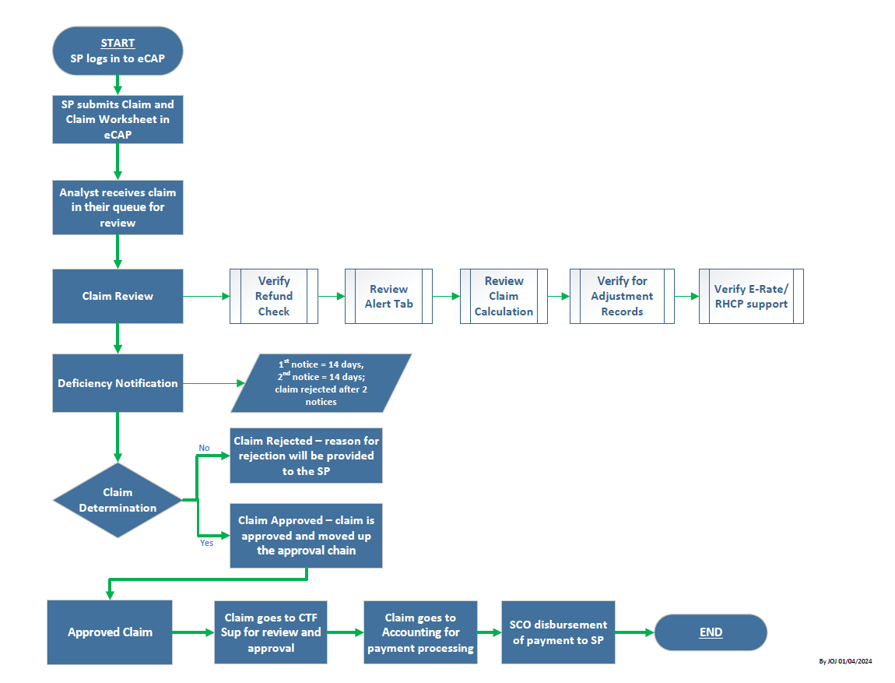
CTF Claims Process Workflow

Slide 14

CLAIMS SUBMISSION IN ECAP
The following will be CTF staff presenting live demonstrations regarding Service Providers submitting CTF claims.
eCAP Web Portal:
https://ecap.cpuc.ca.gov/
Completion of the Service Provider Claim Workbook
Claim Queues within the eCAP Portal
Submission of Claims
Validation of Claims
Common Submission Challenges
Service Providers must utilize eCAP to manage their participation in the CTF program, including submitting claims, maintaining contact information, and engaging in CTF outreach activities.

Slide 15
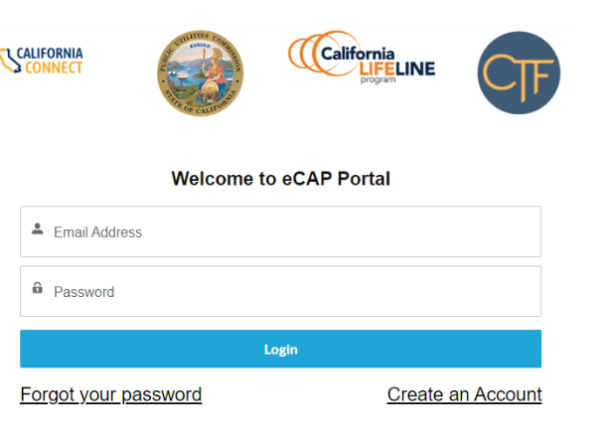
General Information

Slide 16
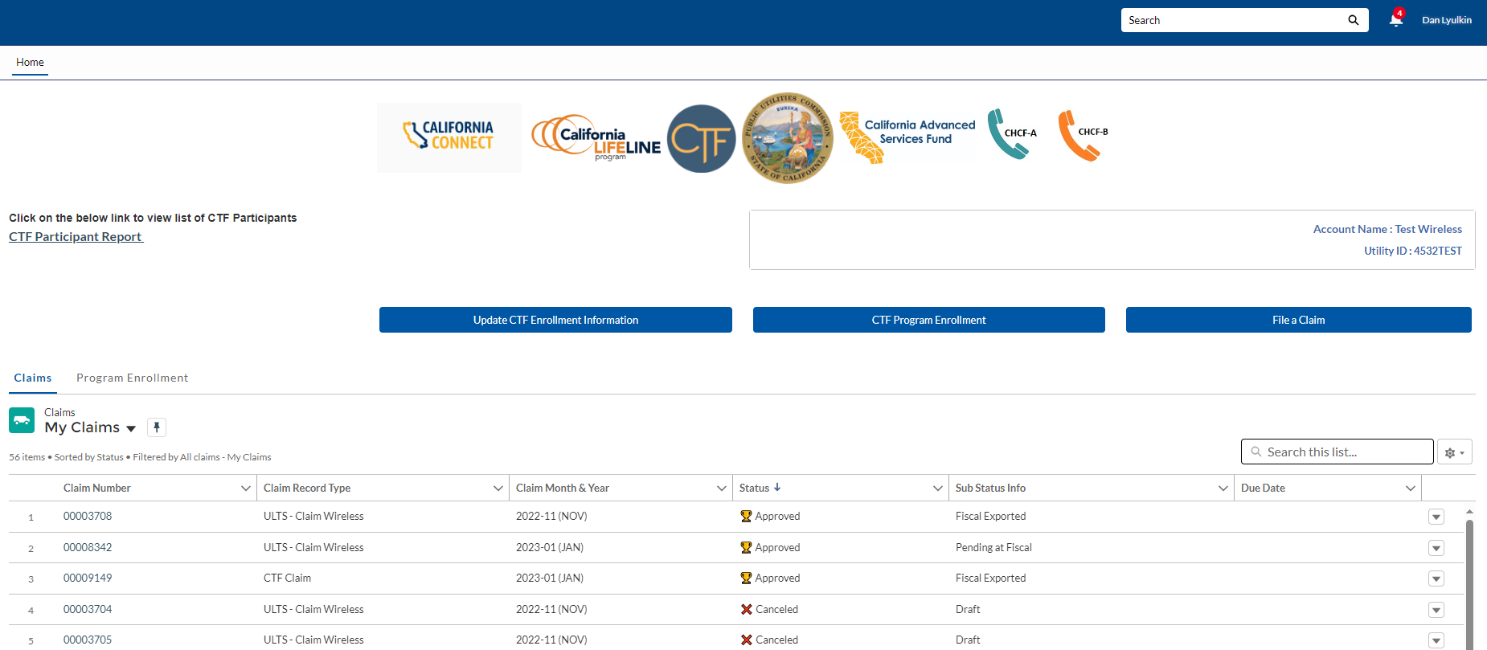
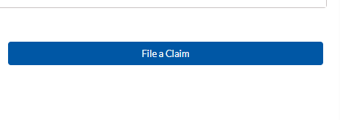
List of submitted and in-process claims
Each claim is assigned a claim number
“My Claims” queue will show all claims in various modes such as “approved, rejected, pending information, draft”
To begin a new claim, service provider will click “File a Claim” button.

Slide 17
LIVE DEMONSTRATION

Slide 18
Common Mistakes to Avoid

Slide 19
Claims: Common Mistakes to Avoid
Incomplete Claim Worksheet
Claim Entry Errors
Missing Claims Submission Deadlines

Slide 20
Error Tab
Alert Tab
Provide Service Category
Quantity Required
Participant Category does not match that of CTF ID/ App Number
Invalid Service Month
Invalid Provider DBA
App Number or CTF ID Required
Claim Amount/CTF Discount incorrect
E-Rate must be between 1% to 100%
E-Rate Average must be between 1% to 100%
RHCP Support must be between 1% to 100%
CTF Discount exceeds E-Rate support

Slide 21
Tips for Successful CTF Claims

Slide 22

Best Practices for Documenting Expenses and Proper Documentation
Record retention
Consistent email communication
Ensure correct claim totals
Consider final formatting

Slide 23

Timely Submission
Per CPUC Resolution T-17666, the due date and time limit for carriers to submit claims for reimbursement shall be 60 days from the end of the month for claims submitted for March-2020 and thereafter.
  Example: A claim with a Service Month of January 2024 must be submitted by March 31, 2024.
The requirement to use the statewide average E-rate support level as a placeholder enables service providers to apply the CTF discount, and then submit claims within 60-days, even when a customer’s actual E-rate support level is unknown.
A Few Tips on Submitting Claims on Time
Ensure contact information is up to date
Access and view eCAP notifications

Slide 24

Online Resources and Support
Access CTF Online Resources such as eCAP Q&A
  From the CPUC homepage (https://www.cpuc.ca.gov), click Financial Assistance. Click California Teleconnect Fund (CTF). There, you will find links to helpful resources including General eCAP Help and FAQ and CTF program Help and FAQ for eCAP.
Utilize CTF Service Provider Manual.
  CTF Service Provider Manual
Check out the “Program Outreach & Education” webpage for a recording of this webinar and past CTF webinars.
Service providers can contact CTFClaims@cpuc.ca.gov for additional help or inquiries regarding eCAP.

Slide 25
Conclusion

Slide 26
Conclusion
CTF ensures affordable and diverse access to advanced communication services for all Californians, including schools and healthcare.
CTF claims ensure service providers are reimbursed for offering discounts, supporting affordable access to advanced communication services in California.
Common claims mistakes to avoid are claim entry errors, incomplete claim worksheet, and missing claims submission deadlines.
For successful claim submission, service providers need to maintain organized records, use clear and consistent email communication with CTF staff, double-check claim accuracy, and review their final excel sheet formatting.
It’s crucial to keep contact information updated and access eCAP notifications promptly for program-related updates.

Slide 27
Questions?

Slide 28
Resources
Information on the previous webinar is
Available at:
Program Outreach and Education
For more information:
https://www.cpuc.ca.gov/CTF
CTF Service Provider Manual
E-CAP Frequently Asked Questions:
Help - FAQs (ca.gov)

