Slide 1
California LifeLine Third Party Administrator
Presentation to the ULTS Administrative Committee
December 9, 2025

Slide 2



Contents
Completed Initiatives
Upcoming Initiatives
Program Reports

Slide 3
Completed Initiatives
Consent to Transfer Process for Wireless Service Providers
Correct OCN Submission
Wireless Service Providers must submit the accurate Operating Company Number (OCN) for the subscriber’s current provider
If a subscriber does not know their current Service Provider, they must contact the TPA Call Center, or log into their Customer Portal account to confirm their Service Provider’s identity
Human-created Signatures
Images of human-created signatures must be submitted when benefit transfers are initiated by wireless Service Providers
24-Hour Transfer Freeze
Submitting an incorrect OCN for the current Service Provider will trigger a 24-hour freeze for the subscriber
Key Dates
Friday, October 3 – soft launch
Thursday, October 23 – hard launch

Slide 4
Completed Initiatives
Consent to Transfer Process for Wireless Service Providers
Month | Wireless Transfers (SPIA) | Unauthorized Transfer Complaints Reported to the TPA
June 2025 | 173,780 | 1,738
July 2025 | 233,433 | 2,657
August 2025 | 250,995 | 2,452
September 2025 | 238,812 | 2,610
October 2025 | 198,816 | 2,218
November 2025 | 91,986 | 1,254

Slide 5
Completed Initiatives
New Review Queue Categories for Income-Based Enrollment & Renewal Applications
Due to a recent rise in suspicious income-based documentation, on Thursday, October 16, the TPA introduced two new Regular Queue review categories:
New Application – Income-based
Renewal Application – Income-based
These new categories enable the TPA system to route eligibility determination tasks based on the qualification method
The CPUC directed the TPA to apply enhanced scrutiny to income-based eligibility documentation. Reviewers have up to five (5) business days to complete eligibility decisions for income-based enrollment and renewal applications

Slide 6
Completed Initiatives
Annual Renewal Recertification Requirement
Beginning November 6, 2025, subscribers, whose continuing LifeLine eligibility is not verified by checking an eligibility database, must submit qualifying eligibility documentation to successfully renew their LifeLine benefits
On November 6, the TPA began utilizing the Department of Health Care Services’ Automated Eligibility Verification System to check for current Medi-Cal participation for subscribers whose renewals cannot be completed based on CalFresh Confirm checks if the TPA has the subscribers’ Medi-Cal Client Index Numbers

Slide 7
Upcoming Initiatives
California LifeLine Home Broadband Pilot
Commission Decision
Issued August 28, 2025
Decision Number: D.25-08-050
Program Overview
Duration: 3-year pilot
Purpose: Allows eligible California households to apply the California LifeLine subsidy to qualifying broadband plans. The pilot is technology-neutral
TPA System Changes
Deployment Target Date: Monday, January 26, 2026

Slide 8
Upcoming Initiatives
Other Upcoming Initiatives
TBD – Establishing an API connection with the Department of Health Care Services Medi-Cal database to confirm applicants’ and subscribers’ eligibility for enrollments and renewals
TBD – Customer Portal 2.0, which will introduce a direct enrollment pathway between qualified California residents and the TPA

Slide 9
Program and Operations Reports
Program Participation – Active LifeLine Subscribers
Program Participation – Active LifeLine Subscribers – Trend – November 2024 through November 2025
Active Subscribers – Top 5 Service Providers By Subscriber Count
Active Subscribers – Top 5 Service Providers by Subscriber Count and by Technology
Active Subscribers – By Funding Type – June 2025 through November 2025
Active Subscribers - Top 20 State Senate Districts
Active Subscribers - Top 20 State Assembly Districts
Active Subscribers – Top 20 Counties
Active Subscribers – Top 20 ZIP Codes
Active Subscribers – Written Language Preferences
Active Subscribers – Average Ages

Slide 10
Program and Operations Reports
Customer Portal – Registered Users
Subscriber Reported Demographics – Household Income
Subscriber Reported Demographics – Gender
Subscriber Reported Demographics – Race
Subscriber Reported Demographics – Asian Ethnicity
Subscriber Reported Demographics – Pacific Islander Ethnicity
Response & Approval Rates – All Form Types – June 2025 through November 2025
Enrollment Application Volume by Received Channel – June 2025 through November 2025
Renewal Form Volume by Received Channel – June 2025 through November 2025
Enrollment Eligibility Methods – Program Versus Income
Enrollment Eligibility Methods – By Qualifying Program

Slide 11
Program and Operations Reports
Top 5 Denial Reasons – Enrollment Applications – June 2025 through November 2025
Top 5 Denial Reasons – Renewal Forms – June 2025 through November 2025
Renewal Rate – Renewal Processes Starting September 6, 2024, through September 5, 2025
CalFresh Confirm Match Rates – Renewal Processes Starting September 6, 2024, through September 5, 2025
Standalone Household Worksheet Volume by Received Channel – June 2025 through November 2025
Call Center – Calls Offered – June 2025 through November 2025
Call Center – Average Seconds to Answer (ASA) – June 2025 through November 2025
Call Center – Inbound Calls Handled – English & Spanish – June 2025 through November 2025
Call Center – Inbound Calls Handled – Other Supported Spoken Languages – June 2025 through November 2025
Call Center – Webchats Handled – June 2025 through November 2025
Call Center – Emails Handled – June 2025 through November 2025
Call Center – Forms Manually Processed – June 2025 through November 2025

Slide 12
Program Participation – Active LifeLine Subscribers
Active LifeLine Subscribers – December 1, 2025
Total: 1,782,086
Wireless: 1,698,374
Wireline: 83,712
1.05% decrease of total subscribers
Active LifeLine Subscribers – September 1, 2025
Total: 1,801,008
Wireless: 1,711,739
Wireline: 89,269

Slide 13
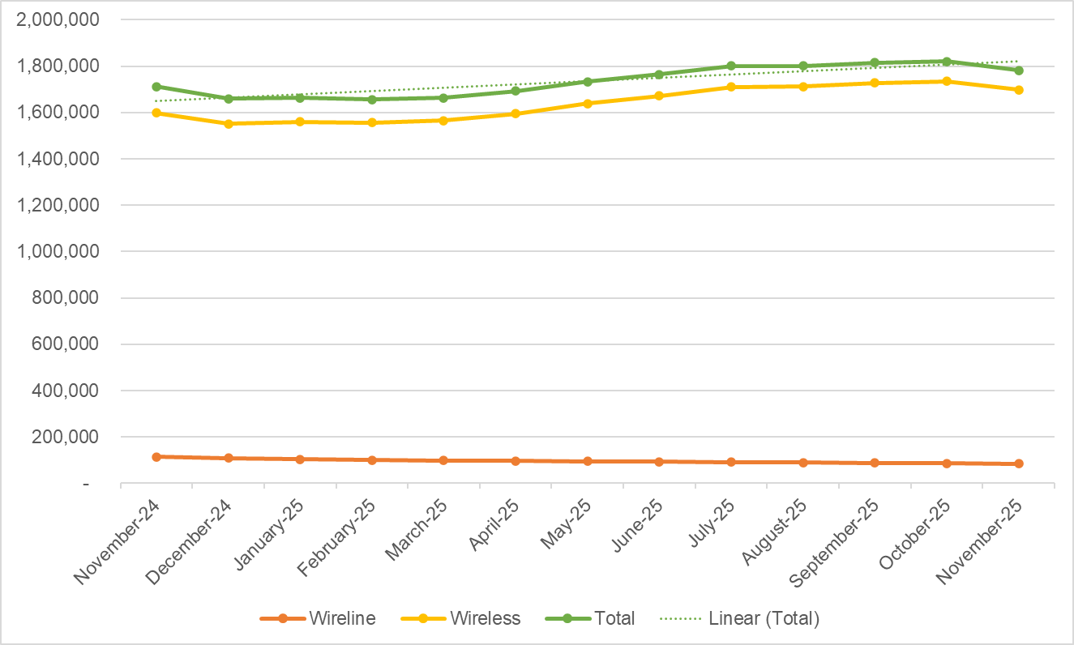
Program Participation – Active LifeLine Subscribers - Trend

Slide 14
Active Subscribers Top 5 Service Providers By Subscriber Count
Service Provider | Active Subscribers
TruConnect | 665,167
Verizon Value, Inc. fka Tracfone Wireless, Inc. | 237,478
AmeriMex dba SafetyNet Wireless | 179,590
AirVoice Wireless dba AirTalk Wireless | 144,995
Gen Mobile | 105,953

Slide 15
Active Subscribers Top 5 Service Providers by Subscriber Count and by Technology
Wireless
Service Provider | Active Subscribers
TruConnect | 665,167
Verizon Value, Inc. fka Tracfone Wireless, Inc. | 237,478
AmeriMex dba SafetyNet Wireless | 179,590
AirVoice Wireless dba AirTalk Wireless | 144,995
Gen Mobile | 105,953
Wireline
Service Provider | Active Subscribers
Pacific Bell dba AT&T California | 52,131
Frontier Communications dba Frontier CA | 13,051
Charter Communications dba Time Warner Cable | 6,220
Cox Communications | 3,687
ConnectTo Communications, Inc. | 2,211

Slide 16
Active Subscriber By Funding Type June 2025 through November 2025

Slide 17
Active Subscribers - Top 20 State Senate Districts
September 2025
State Senate District | Active Subscribers
18 | 85,662
31 | 76,546
29 | 73,222
14 | 73,114
28 | 72,420
16 | 70,484
35 | 67,997
23 | 65,407
19 | 62,795
26 | 60,970
33 | 58,511
8 | 57,047
39 | 55,036
22 | 50,259
34 | 48,018
1 | 47,755
30 | 44,123
20 | 43,896
5 | 41,448
7 | 41,256
December 2025
State Senate District | Active Subscribers
31 | 96,775
29 | 80,019
18 | 76,313
14 | 75,409
23 | 74,873
19 | 70,184
16 | 69,616
28 | 69,147
35 | 66,414
26 | 56,857
33 | 56,345
8 | 55,829
32 | 52,754
39 | 51,403
22 | 50,730
34 | 49,074
1 | 47,458
12 | 42,012
7 | 41,112
30 | 41,047

Slide 18
Active Subscribers - Top 20 State Assembly Districts
September 2025
State Assembly District | Active Subscribers
36 | 60,431
60 | 54,932
57 | 53,847
39 | 47,589
45 | 46,397
31 | 45,082
35 | 42,474
65 | 38,232
54 | 36,827
79 | 35,540
6 | 33,281
34 | 31,932
17 | 30,728
33 | 30,043
13 | 30,007
58 | 29,719
52 | 29,688
80 | 29,499
61 | 29,452
10 | 28,814
December 2025
State Assembly District | Active Subscribers
60 | 69,121
36 | 55,261
39 | 54,047
57 | 51,454
45 | 49,729
31 | 46,305
35 | 41,831
65 | 38,267
34 | 37,759
58 | 35,596
54 | 34,637
6 | 33,332
79 | 33,176
63 | 31,453
50 | 31,194
17 | 30,063
27 | 29,916
33 | 29,820
13 | 28,757
3 | 28,604

Slide 19
Active Subscribers - Top 20 Counties
September 2025
County | Active Subscribers
Los Angeles | 514,001
Riverside | 169,757
San Bernardino | 147,670
San Diego | 124,955
Orange | 100,406
Sacramento | 84,652
Fresno | 65,241
Kern | 65,200
Alameda | 53,244
Santa Clara | 49,069
San Joaquin | 40,357
San Francisco | 39,492
Imperial | 37,284
Contra Costa | 31,720
Tulare | 27,929
Stanislaus | 27,779
Ventura | 19,284
Monterey | 17,931
Merced | 16,465
Solano | 16,024
December 2025
County | Active Subscribers
Los Angeles | 475,298
Riverside | 201,108
San Bernardino | 171,316
San Diego | 116,207
Orange | 100,401
Sacramento | 83,027
Fresno | 65,940
Kern | 63,680
Alameda | 52,851
Santa Clara | 45,163
San Francisco | 38,294
San Joaquin | 38,207
Contra Costa | 30,419
Tulare | 27,744
Imperial | 27,020
Stanislaus | 26,874
Ventura | 17,916
Monterey | 16,507
Merced | 16,404
Solano | 15,539

Slide 20
Active Subscribers - Top 20 ZIP Codes
September 2025
ZIP Code | Active Subscribers
92243 | 13,582
90044 | 11,253
92553 | 9,897
92530 | 9,764
90003 | 9,622
93535 | 9,503
90011 | 9,076
93307 | 8,858
92404 | 8,395
95823 | 8,040
92543 | 7,790
92231 | 7,596
92324 | 7,593
92570 | 7,536
92410 | 7,371
90805 | 7,291
92376 | 7,254
93550 | 7,208
92227 | 7,146
92335 | 7,086
December 2025
ZIP Code | Active Subscribers
92553 | 12,370
92557 | 10,633
90044 | 10,334
92345 | 10,207
92530 | 9,816
92324 | 9,450
90003 | 9,026
93535 | 8,934
92243 | 8,915
92570 | 8,865
93307 | 8,704
92543 | 8,506
90011 | 8,419
92404 | 8,415
92376 | 8,357
92392 | 8,203
92571 | 8,017
92592 | 7,764
95823 | 7,670
92410 | 7,425

Slide 21
Active Subscribers – Written Language Preferences
September 2025
Language Code | Active Subscribers
English | 1,744,959
Spanish | 42,106
Chinese | 8,938
Vietnamese | 3,262
Korean | 1,383
Tagalog | 220
Japanese | 140
December 2025
Language Code | Active Subscribers
English | 1,729,960
Spanish | 39,342
Chinese | 8,187
Vietnamese | 3,092
Korean | 1,212
Tagalog | 175
Japanese | 117

Slide 22
Active Subscribers – Average Ages
Anniversary Month & Year | Subscribers’ Average Ages
September 2025 | 48
October 2025 | 48
November 2025 | 52
December 2025 | 53
January 2026 | 53
February 2026 | 51
March 2026 | 53
April 2026 | 51
May 2026 | 50
June 2026 | 49
July 2026 | 48
August 2026 | 48

Slide 23
Customer Portal – Registered Users
Metric | 09/02/2025 Counts | 12/01/2025 Counts
Registered Users | 250,864 | 282,615
Wireless Registered Users | 222,910 | 252,263
Wireline Registered Users | 27,954 | 30,352
At least one LifeLine form submitted via the Portal after registering | 107,433 | 122,361

Slide 24
Subscriber Reported Demographics Household Income
Household Income | September 2025 | December 2025 | % Change
0-9,999 | 116,156 | 132,690 | 14.23%
10,000 - 19,999 | 48,824 | 54,270 | 11.15%
20,000 - 29,999 | 25,108 | 27,856 | 10.94%
30,000 - 39,999 | 10,748 | 11,869 | 10.43%
40,000+ | 10,083 | 11,165 | 10.73%
Prefer Not To Respond | 38,341 | 44,884 | 17.07%

Slide 25
Subscriber Reported Demographics Gender
Gender | September 2025 | December 2025 | % Change
Female | 126,329 | 142,161 | 12.53%
Male | 109,704 | 124,628 | 13.60%
Prefer Not To Respond | 11,719 | 14,164 | 20.86%
Nonbinary | 758 | 961 | 26.78%
Transgender | 750 | 820 | 9.33%

Slide 26
Subscriber Reported Demographics Race
Race | September 2025 | December 2025 | % Change
Hispanic | 76,688 | 86,360 | 12.61%
White | 64,815 | 72,987 | 12.61%
Asian | 31,494 | 36,545 | 20.06%
Prefer Not To Respond | 30,439 | 34,287 | 8.87%
Black American | 28,478 | 32,494 | 14.10%
Other | 12,074 | 14,186 | 17.49%
American Indian | 3,767 | 4,164 | 10.54%
Pacific Islander | 1,505 | 1,711 | 13.69%

Slide 27
Subscriber Reported Demographics Asian Ethnicity
Asian Ethnicity | September 2025 | December 2025 | % Change
Chinese | 10,211 | 10,966 | 7.39%
Vietnamese | 9,134 | 9,887 | 8.24%
Other Asian | 3,702 | 4,098 | 10.70%
Filipino | 3,181 | 3,565 | 12.07%
Indian | 2,014 | 2,219 | 10.18%
Korean | 1,309 | 1,417 | 8.25%
Cambodian | 885 | 955 | 7.91%
Japanese | 584 | 643 | 10.10%
Laotian | 452 | 516 | 14.16%
Prefer Not To Respond | 22 | 0 | -100.00%
Note: Registered users can change their responses. For example, the decrease of “Prefer Not To Respond” might represent a user who changed their response

Slide 28
Subscriber Reported Demographics Pacific Islander Ethnicity
Pacific Islander Ethnicity | September 2025 | December 2025 | % Change
Other Pacific Islander | 802 | 893 | 11.35%
Native Hawaiian | 266 | 331 | 24.44%
Samoan | 286 | 317 | 10.84%
Guamanian | 151 | 170 | 12.58%

Slide 29
Response & Approval Rates – All Form Types June 2025 through November 2025
Month | Total | Responded | % Responded | Approved | % Approved | % Qualified or Renewed
June | 374,063 | 331,282 | 88.6% | 259,478 | 78.3% | 69.4%
July | 422,044 | 379,784 | 90.0% | 304,205 | 80.1% | 72.1%
August | 408,058 | 363,859 | 89.2% | 294,268 | 80.9% | 72.1%
September | 408,196 | 367,530 | 90.0% | 299,725 | 81.6% | 73.4%
October | 429,315 | 387,436 | 90.2% | 312,301 | 80.6% | 72.7%
November | 362,430 | 323,936 | 89.4% | 253,545 | 78.3% | 70.0%
Totals | 2,404,106 | 2,153,827 | 89.6% | 1,723,522 | 80.0% | 71.7%
Responded / Total = % Responded
Approved / Responded = % Approved
Approved / Total - % Qualified or Renewed

Slide 30
Enrollment Application Volume by Received Channel June 2025 through November 2025

Slide 31
Renewal Applications Submitted by Received Channel
June 2025 through November 2025
# Renewal forms received

Slide 32
Enrollment Eligibility Methods – Program Versus Income

Slide 33
Enrollment Eligibility Methods – By Qualifying Program

Slide 34
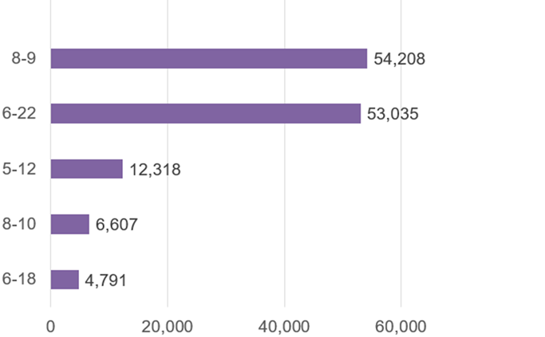
Top 5 Denial Reasons – Enrollment Applications
June 2025 through November 2025
Denial Code | Type | Description
8-9 | Hard Denial | Enrollment application was not submitted
6-22 | Correctible Denial | Documentation submitted does not meet eligibility guidelines
5-12 | Hard Denial | Active Phone Number & Service Start Date not received within 30 days of status code 53
8-10 | Hard Denial | Enrollment application was returned undeliverable as addressed
6-18 | Correctible Denial | Chose to qualify through a program but did not provide eligibility proof

Slide 35
Top 5 Denial Reasons – Renewal Applications
June 2025 through November 2025
Denial Code | Type | Description
22-15 | Soft Denial | Initial renewal form not returned by the due date
24-8 | Hard Denial | Second chance renewal form not returned by the due date
24-9 | Hard Denial | 2nd chance form returned undeliverable as addressed
22-13 | Correctible Denial | Subscriber failed to print their first and last name on the renewal form
22-17 | Correctible Denial | Subscriber failed to initial the 1 per household certification

Slide 36
Renewal Rate Renewal Processes Starting September 6, 2024, through September 5, 2025*
Total renewal processes started: 1,517,832
Total Hard Denials: 380,419
Renewal Rate: 74.94%
*Note: Final dispositions have been recorded for all renewal processes started for the selected period

Slide 37
CalFresh Confirm Match Rates Renewal Processes Starting September 6, 2024, through September 5, 2025*
Day 0 – 55.38% [837,710 subscribers matched and passed]
Before issuing a soft denial for nonresponse – 5.24% [5,863 subscribers matched and passed]
Before issuing a hard denial for nonresponse – 4.21% [15,980 subscribers matched and passed]

Slide 38
Standalone Household Worksheet Volume by Received Channel
June 2025 through November 2025

Slide 39
Call Center – Calls Offered June 2025 through November 2025

Slide 40
Call Center – Average Seconds to Answer (ASA) June 2025 through November 2025

Slide 41
Call Center – Inbound Calls Handled English & Spanish June 2025 through November 2025

Slide 42
Call Center – Inbound Calls Handled Other Supported Spoken Languages June 2025 through November 2025

Slide 43
Call Center – Webchats Handled June 2025 through November 2025

Slide 44
Call Center – Emails Handled June 2025 through November 2025

Slide 45
Call Center – Forms Manually Processed June 2025 through November 2025

Slide 46
Questions or Comments for the TPA
Please submit questions or comments for the TPA to TPA@CaliforniaLifeLine.com

