Slide 1

Building Decarbonization Best Practices and Future Pathways Workshop – Day 2
Building Decarbonization Proceeding (R.19-01-011)
January 22, 2026

Slide 2
Welcome & Opening Remarks

Slide 3
UN Sustainability Collaboration

Slide 4
Introducing The Enniscorthy International Forum
and its
Buildings Action Coalition
Tangible Actions to Deliver the 2030 Agenda for Sustainable Development and the Paris Agreement/Climate Agenda

Slide 5

BAC Vision
A world that achieves high performance in the built environment to meet climate and resource challenges while delivering quality of life

Slide 6

BAC Mission
Raise the performance of buildings and the built environment. Make real and rapid improvements at scale

Slide 7

BAC/UN MOU elements
BAC/UN collaboration:
Advocate for market transformation
Catalyze real action.
Develop specific projects/activities (e.g., best practices).
Track progress.
Develop policy guidance and build capacity.
Support attaining the Buildings Breakthrough Target.

Slide 8
Continuation of the elements of the MOU that EIF has with the United Nations
BAC/UN collaboration (cont):
Advance the science of buildings.
Comprehensive education of professional communities.
Extend BAC networks.
Mobilize resources and develop joint projects.
Disseminate knowledge, experience and best practices.
Provide demonstrations and proofs of concept.

Slide 9
Delivering High Performance in buildings and the Built Environment
Envelope
Materials Design
Construction
High Performance Buildings Deliver
Quality of Life:
Comfort,
Health,
Affordability, Efficiency, Sustainability
Mobility
City design
Low-C mobility
Systems
HVAC
Plug-ins
Transacting
Financing
Insurance
Realty Markets
Energy
On-site
Off-site
Services
Food
Water
Waste
ICT
Smart Connect
& Monitor
Planning/
Regulating
Zoning Inspecting
Certifying

Slide 10

Buildings Action Coalition
  International Centres of Excellence in USA Ireland, Scotland, England, Germany, Greece, Canada
  Regional Hubs: Pacific NA; Black Sea; N. Atlantic; N. Sea; Indian Ocean
  Industry Leadership Group: case studies of best practices
  Academic Network
  Monthly webinars to share learnings
  Annual Summit in Ireland; Global Summit in California in 8/26
  Annual meetings in regions
  On going collaboration among Centres/Hubs on specific projects

Slide 11
Thank you!!!
Come Join the
Buildings Action Coalition!
www.enniscorthyforum.org
Contact: ba@enniscorthyforum.org
Phone: +353 87-6736966

Slide 12


EU POLICIES AND Support Instruments on Energy Efficiency OF BUILDINGS
Member of the UNECE Group of Experts on Energy Efficiency
Member of the Advisory Board of the International Passive House Conference
Member of the Consultation Board of the Bulgarian Green Building Council
Member of the National NZEB Council and National Green Deal Council
Dragomir Tzanev, Center for Energy Efficiency EnEffect - Bulgaria
Building Decarbonization Best Practices and Future Pathways Workshop
San Francisco and online, 22.01.2021

Slide 13
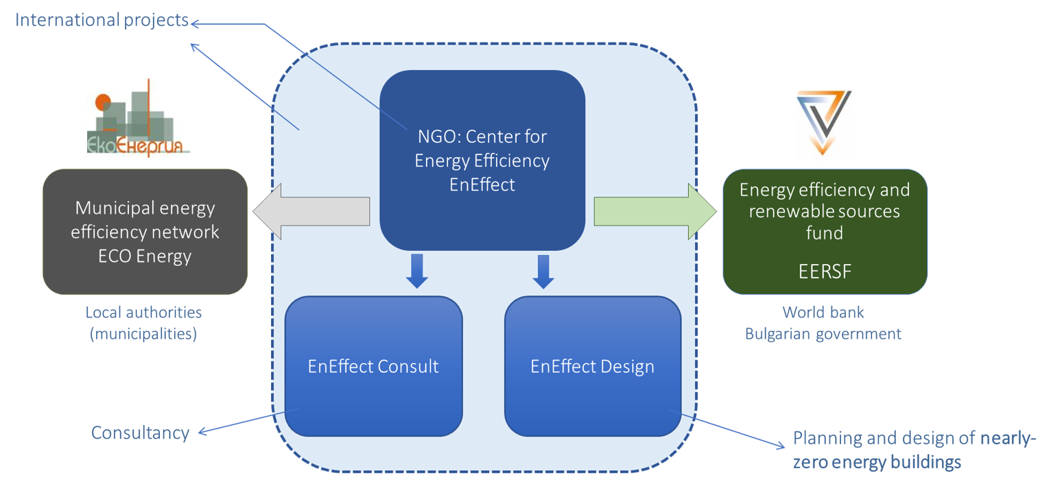
Organisational structure
EnEffect

Slide 14
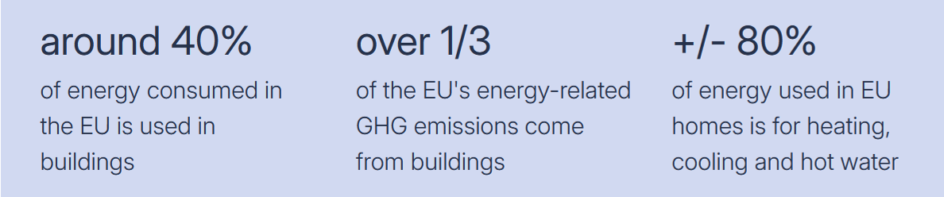
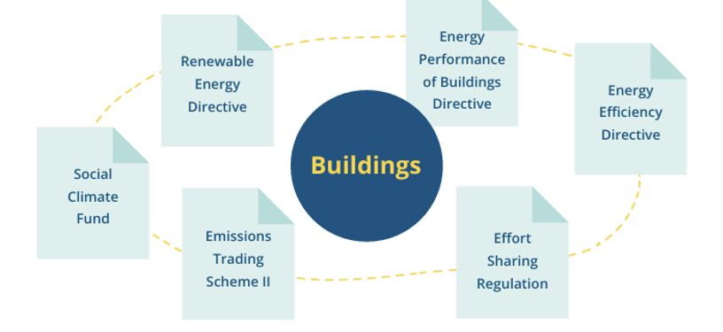
Key facts on energy and buildings and supportive legislation
EU energy and climate policy
Sources: 1) European Commission: Energy performance building directive; 2) BPIEs-Guide-to-EPBD-Implementation-final-version.pdf

Slide 15
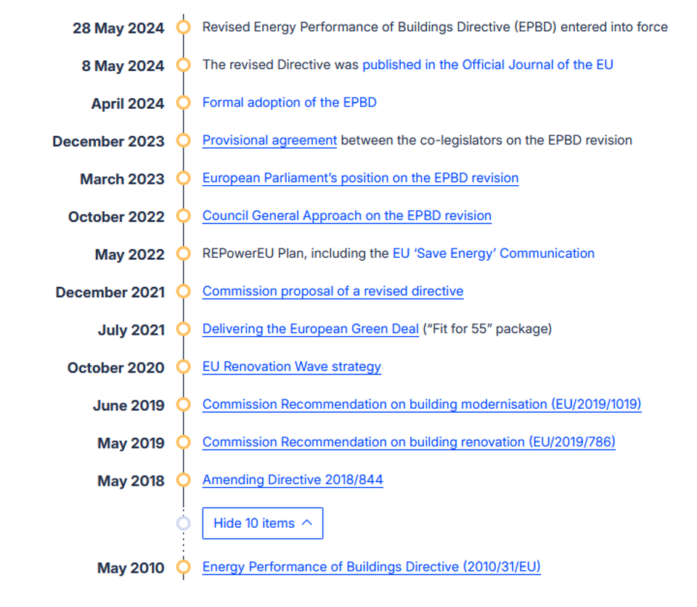
Energy Performance of Buildings Directive: Timeline
EU energy and climate policy
Source: European Commission: Energy performance building directive

Slide 16
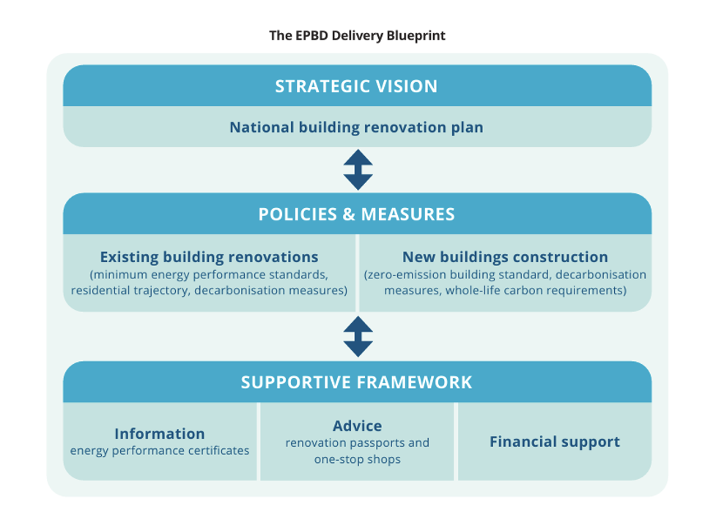
Energy Performance of Buildings Directive: Conceptual Approach
EU energy and climate policy
Source: BPIEs-Guide-to-EPBD-Implementation-final-version.pdf

Slide 17
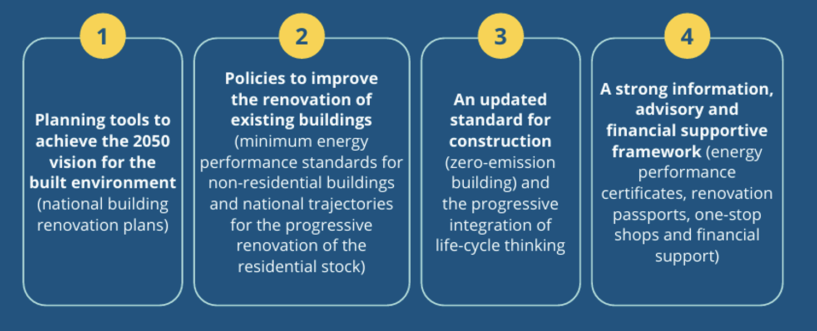
Energy Performance of Buildings Directive: Most Impactful Provisions
EU energy and climate policy
Source: BPIEs-Guide-to-EPBD-Implementation-final-version.pdf

Slide 18
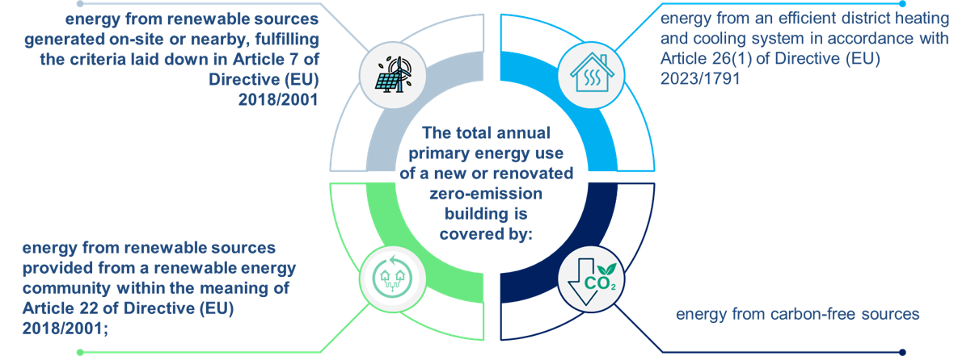
Nearly zero-energy (2010) vs. Zero-emission building (2024)
EPBD: Definitions
Energy Performance of Buildings Directive 2010/31/EU: “A nearly zero-energy building is a building that has a very high energy performance. The nearly zero or very low amount of energy required should be covered to a very significant extent by energy from renewable sources, including energy produced on-site or nearby.”
Energy Performance of Buildings Directive 2024/1275/EU: “Zero-emission building shall not cause any on-site carbon emissions from fossil fuels. A zero-emission building shall, where economically and technically feasible, offer the capacity to react to external signals and adapt its energy use, generation or storage.”
Sources: 1) European Commission: Energy performance building directive; 2) BPIEs-Guide-to-EPBD-Implementation-final-version.pdf

Slide 19
Key articles in the Energy Performance of Buildings Directive
EPBD: Systems approach
Article 3. National building renovation plan
Article 5. Setting of minimum energy performance requirements
Article 7. New buildings
Article 8. Existing buildings
Article 9. Minimum energy performance standards for non-residential buildings and trajectories for progressive renovation of the residential building stock
Article 10. Solar energy in buildings
Article 11. Zero-emission buildings
Article 12. Renovation passport
Article 14. Infrastructure for sustainable mobility
Article 15. Smart readiness of buildings
Article 17. Financial incentives, skills and market barriers
Article 18. One-stop shops for the energy performance of buildings
Article 22. Databases for the energy performance of buildings
Article 26. Certification of professionals
Article 27. Independent control system
Article 29. Information

Slide 20
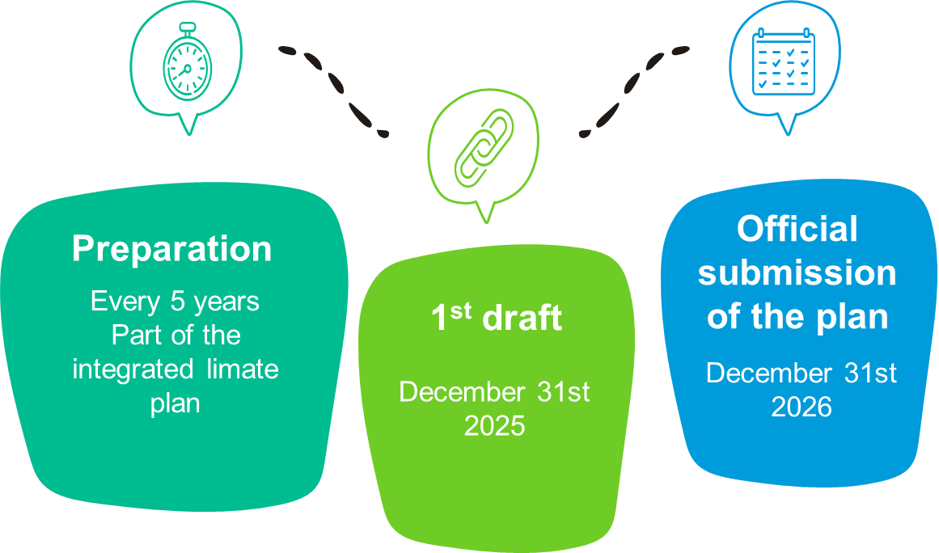
National Building Renovation Plans
EPBD: DECARBONISATION VISION
Thresholds of new and renovated zero-emission buildings, referred to in Article 11: operational GHG emissions thresholds of new ZEBs; annual primary energy use thresholds of new ZEBs
Minimum energy performance standards for non-residential buildings: maximum energy performance thresholds, pursuant to Article 9(1)
National trajectory for the progressive renovation of the residential building stock: including the 2030 and 2035 milestones for average primary energy use in kWh/(m2.y), pursuant to Article 9(2)

Slide 21
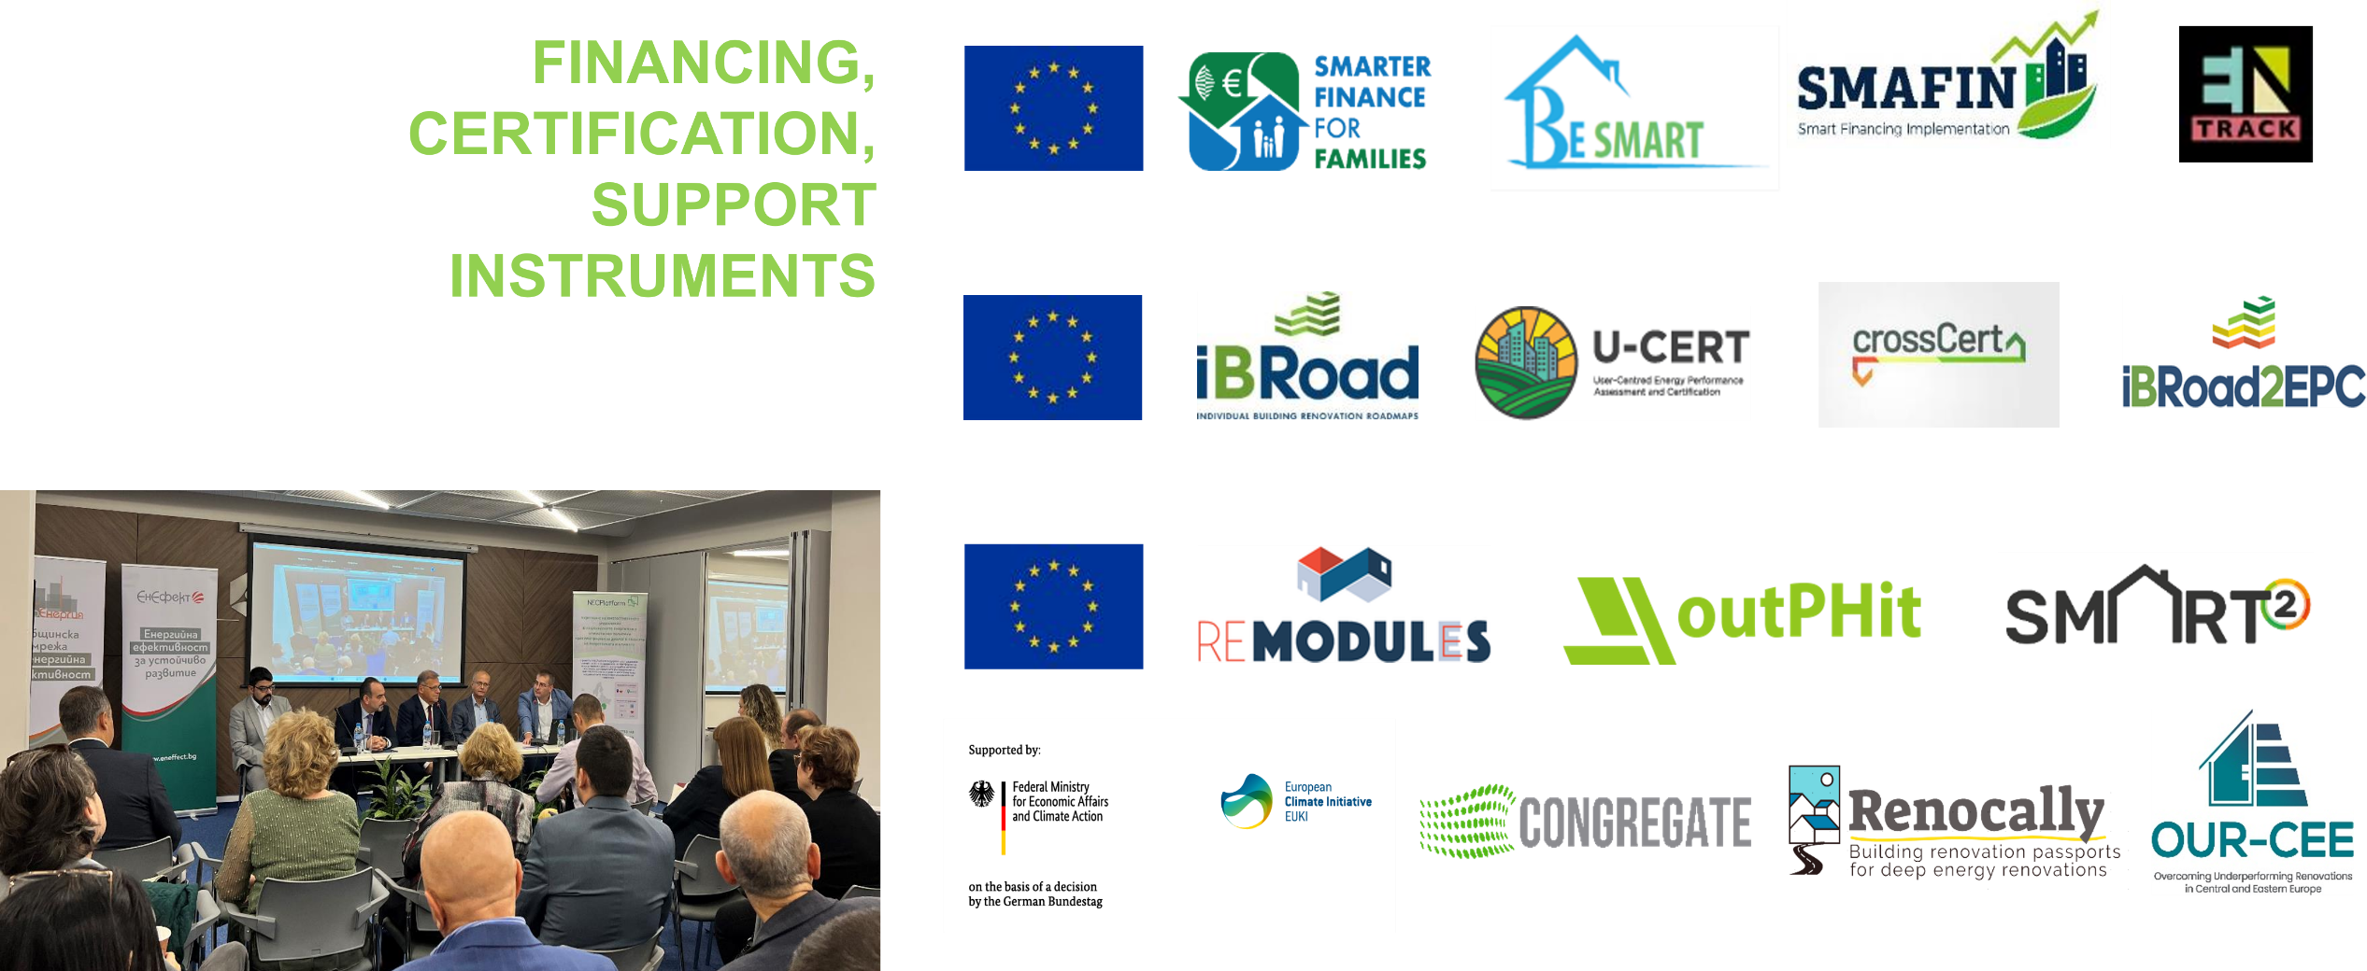
What are our projects and activities?
POLICY SUPPORT ACTION

Slide 22
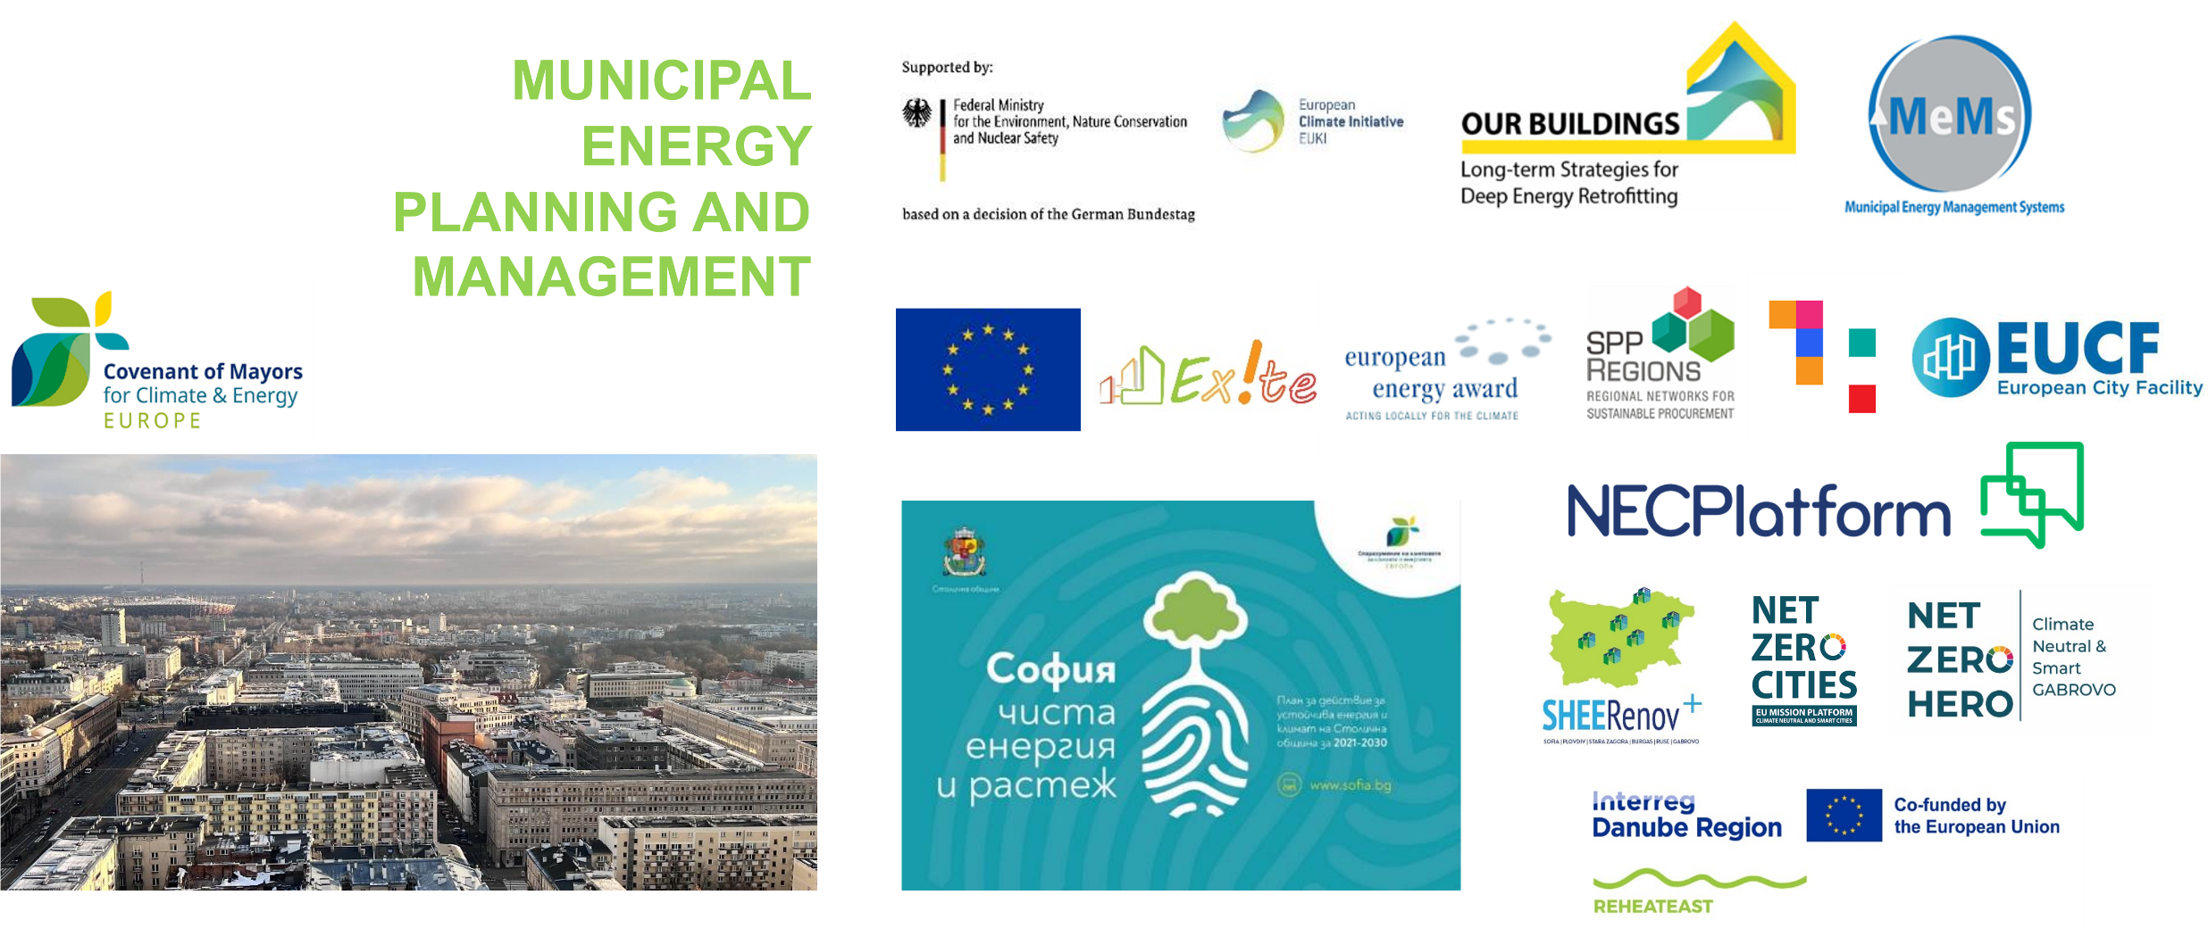
What are our projects and activities? 2
POLICY SUPPORT ACTION

Slide 23
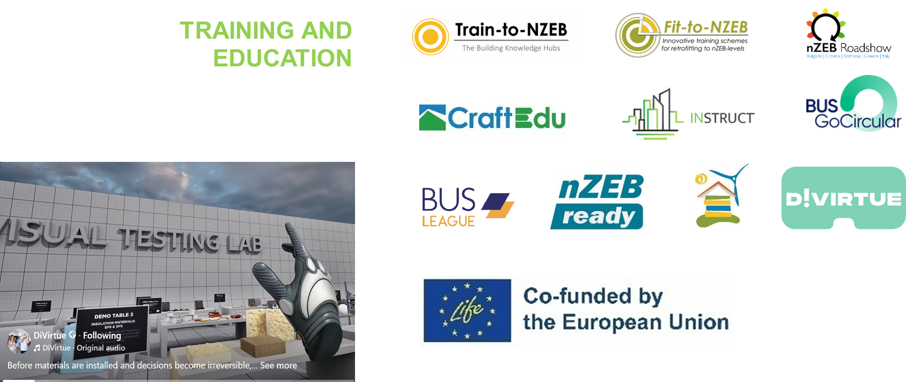
What are our projects and activities?
POLICY SUPPORT ACTION

Slide 24
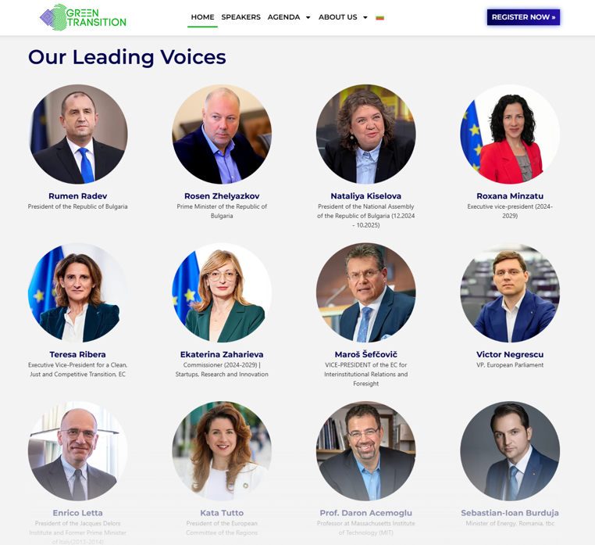
Green Transition Forum 6.0, 1-5th June, Sofia
POLICY SUPPORT ACTION

Slide 25
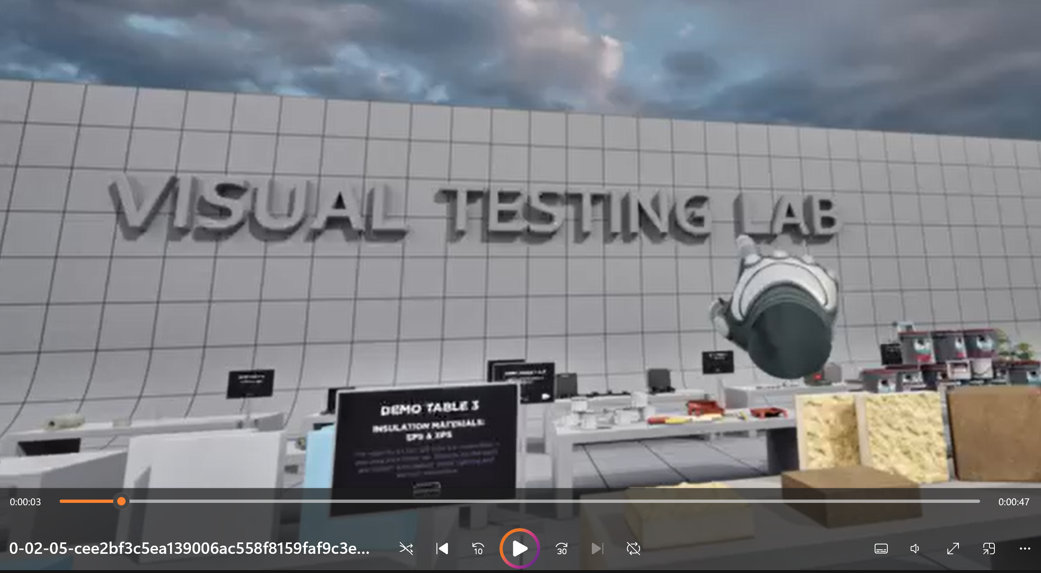
Thank you for your attention!
https://www.linkedin.com/posts/divirtue_divirtue-probujdenie-pgsa-activity-7413905647483772928-R0KO?utm_source=share&utm_medium=member_desktop&rcm=ACoAAANAIAkBnTJZoLjG8nhpQjUdRv1Zj1xcBow

Slide 26

Systems Thinking Applied to Building Decarbonization
Kay Aikin
Systems Architect –
Bachelors of Engineering
(Energy) from Penn State
Electric Grid Visionary
DOE Gridwise Architecture Council Board Member
Senior Advisor-UN Environmental Program
Notes:
When we talk about building decarbonization, we often frame it as a building problem — efficiency, electrification, retrofits.
But from a system perspective, buildings are now one of the primary drivers of distribution grid impacts, peak demand growth, and long-term cost trajectories.
That means decarbonization success or failure shows up not just in emissions numbers, but in rates, reliability, and infrastructure investment decisions — which makes this a systems problem, not a technology problem.

Slide 27
Building Decarbonization is a Systems Challenge
Buildings drive emissions, peak demand and grid infrastructure
Electrification changes when and where energy is used
Building decarbonization programs succeed or fail at the system level
Building decarbonization is both grid and systems problem
Notes:
When we talk about building decarbonization, we often frame it as a building problem — efficiency, electrification, retrofits.
But from a system perspective, buildings are now one of the primary drivers of distribution grid impacts, peak demand growth, and long-term cost trajectories.
That means decarbonization success or failure shows up not just in emissions numbers, but in rates, reliability, and infrastructure investment decisions — which makes this a systems problem, not a technology problem.

Slide 28

Systems Thinking?
Focus on interactions and feedback loops
Account for timing, scale and incentives
Avoid unintended consequences
Optimizing Outcomes, not Components
Notes:
Systems thinking simply means we stop optimizing individual components in isolation and start optimizing outcomes across the whole system.
In the building-grid context, that means understanding how efficiency, electrification, DERs, grid planning, and rate design interact over time.
Many regulatory conflicts exist where both sides are technically right — but they’re optimizing different layers of the system. Systems thinking helps reconcile that.

Slide 29
Buildings are Dynamic
Heat pumps, EVs, storage, controls
Load shape now matters as much a load size
Location matters
Buildings can be assets or liabilities
Electrified Buildings need to be active grid participants
Value Potential for Grid Integrated Buildings in the GSA Portfolio, Rocky Mountain Institute p. 10
Notes:
Electrification fundamentally changes the role of buildings.
Heat pumps, EV charging, batteries, and controls turn buildings into dynamic, fast-changing grid participants.
Two identical buildings with the same annual energy use can have very different grid impacts depending on location, timing, control, and coordination.
That’s why treating electrification as just a fuel switch is no longer sufficient.

Slide 30
The Distribution Grid Wasn’t Designed - it Grew
The old grid – designed for predictable, slow load growth
Now seeing fast ramps and coincident peaks with damaging and expensive localized effects
Risk: costly over building and stranded assets
A mismatch between current grid architecture and the dynamics of buildings
Notes:
Distribution grids were designed for a very different world — predictable growth, one-way power flow, and infrequent peaks.
Today we’re seeing fast ramps, coincident electrification loads, and localized constraints.
This isn’t a utility failure — it’s an architecture mismatch.
If we respond only with traditional infrastructure expansion, we risk higher rates, equity concerns, and stranded investments.

Slide 31
Why Buildings - Grid Integration?
Peak management and local hosting capacity
Deferred or avoided CAPEX
Greater DER at the edge
Improved affordability and resilience
Risk: poor operational coordination
Building Grid Integration is the difference between affordability and energy poverty
Notes:
Buildings-grid integration is not about making buildings serve the grid — it’s about reducing total system cost while achieving decarbonization goals.
Coordinated buildings can reduce peaks, increase hosting capacity, and defer expensive upgrades.
From a regulatory perspective, this directly affects ratepayer impacts, affordability, and long-term system risk.

Slide 32
Australia as a Test Case
World-leading rooftop solar penetration
Rapid electrification and DER growth
Distribution System now a system constraint
Response: reframing of problem as a system-design challenge
What happens when buildings become grid-scale actors
Notes:
Australia is a useful case study because it didn’t plan to become a DER laboratory — it became one by adoption speed.
In several regions, over 40% of homes have rooftop solar, and electrification is accelerating. Buildings shifted from passive loads to material grid actors faster than planning frameworks evolved.
The result wasn’t failure — it was stress. Voltage limits, reverse power flows, protection challenges, and rising coordination costs all showed up first at the distribution level.
Australia demonstrates that building decarbonization succeeds or fails at the grid interface, not at the appliance level.

Slide 33
What Australia Changed?
Shift from passive consumers to participants
Grid-aware DER integration
Human-centered, system-level objectives
Replaced technology development centric approach to a system design centric approach
https://energycatalyst.au/futuregrid/
CSIRO: The Commonwealth Scientific and Industrial Research Organisation is Australia's national science agency,
AEMO: Australian Electric Market Operator
Notes:
Australia’s response has been instructive. Rather than simply slowing DERs, regulators and system planners began reframing the problem as a system-design challenge.
CSIRO and AEMO articulated eight Future Customer and Societal Objectives — dependable, affordable, sustainable, equitable, empowering, expandable, adaptable, and beneficial — explicitly recognizing that customers are now participants and investors, not just ratepayers
.
That led to new focus areas: dynamic operating limits, flexible export, distribution system coordination, and portfolio-based thinking.
The key lesson for California is this:
High DER penetration doesn’t fail because of technology — it fails when system architecture and program design lag reality.

Slide 34
A Systems Thinking Path Forward
Coordinate building portfolios: incentives, regulation, utility business model reform, and technology.
Flexible interconnection and Flexible (Dynamic) Operating Envelopes
Performance-based outcomes
Even well intentioned and well-designed programs can create system risks.
Notes:
A systems-oriented approach shifts us from isolated programs to coordinated portfolios. Including different incentives at the utility level and consumer level, regulation reform stressing cost and technical performance, utility business model reform and technology innovation.
That includes flexible interconnection, dynamic operating envelopes, and performance metrics tied to capacity delivery, emissions reduction, and cost control.
Importantly, this approach supports zonal and neighborhood-scale strategies that align well with equity and affordability goals.

Slide 35
Decarbonization is a Design Choice
Decarbonization is achievable
Systems design driven by systems thinking determines cost and equity within the system.
Integration enables scale
We can design for new better outcomes or pay for the consequences for unaffordability that emerge
Notes:
We know how to decarbonize buildings.
We know how to modernize grids.
The open question is whether we design the system intentionally, or allow it to emerge through fragmented decisions — usually at much higher cost.
Systems thinking and buildings-grid integration give regulators and program designers the tools to scale decarbonization while protecting ratepayers.
That’s the opportunity in front of us.

Slide 36
Thank you
Dynamic Grid www.dynamicgrid.ai
Personal Website www.INOV8futures.com
kay.aikin@dynamicgrid.ai

Slide 37
Break – 15 Minutes

Slide 38
State Agency Panel

Slide 39


Equitable Building Decarbonization
Direct Install Program
CPUC Building Decarbonization Best Practices and Future Pathways Workshop
January 22, 2026

Slide 40
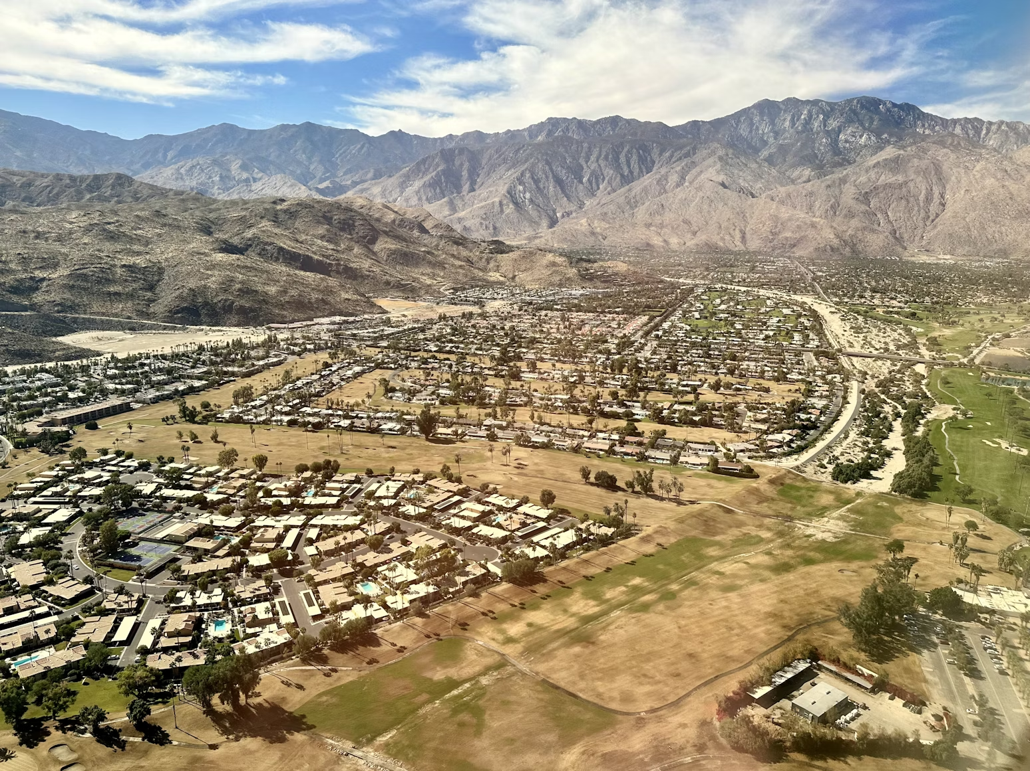
Building Decarbonization and Equity
Building decarbonization must prioritize low-income, disadvantaged, and
tribal communities, who bear the highest energy burden and have suffered the most from historical environmental injustices, economic disparities, and the current climate crisis.
- Equitable Building Decarbonization Statewide Direct Install Program Guidelines

Slide 41
Equitable Building Decarbonization Program Subprograms
Statewide Direct Install Program
Tribal Direct Install Program
Statewide Incentive Program
$339.25 million
(State funds)
+
$154.25 million
(Federal HOMES funds)
$30 million
(State funds)
$20 million
GoGreen Financing
(State funds)
+
$290 million
(Federal HEEHRA funds)

Slide 42


Statewide Direct Install Program Public Process and Timeline
Participant Enrollment Begins
(varies by region)
Public Process to Develop Guidelines
Solicitation for Regional Administrators Released
Approval of Regional Administrator Agreements
Initial Community Focus Areas Announced
Contractor Enrollment Begins
(varies by region)
Guidelines Adopted
Retrofits Begin
Dec 2022 – Fall 2023
Oct 2023
April 2024
Nov 2024
Aug 2025
Nov 2025
Dec 2025
Early 2026
5 regional workshops
  Fresno, Indio, Los Angeles, San Francisco, Santa Rosa
5 online-only workshops
(including evenings and weekend)
2 tribal listening sessions
Interpreters & translation

Slide 43
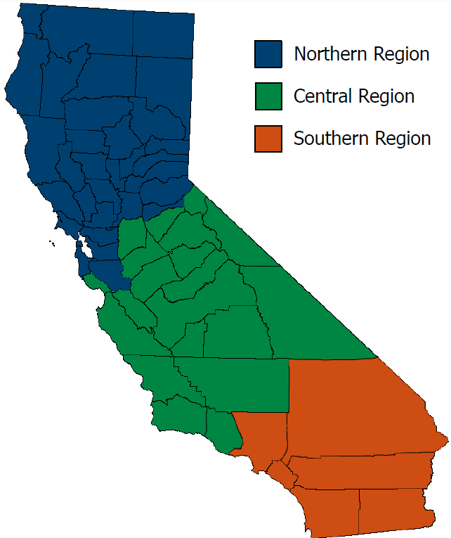
Regional Administrators
Region | Regional Administrator | % of Funding* | Funding: State | Funding: Federal | Funding: Total
North | Association for Energy Affordability | 23% | $78,027,500 | $35,478,190 | $113,505,690
Central | Center for Sustainable Energy | 19% | $64,457,500 | $29,308,070 | $93,765,570
South | County of Los Angeles | 58% | $196,765,000 | $89,466,740 | $286,231,740
Total | All Regions | 100% | $339,250,000 | $154,253,000 | $493,503,000
* Funding allocation based on population of underresourced communities in each region

Slide 44



Statewide Direct Install Program Overview
The direct install program serves…
Low-Income Households
Single-family
Underresourced Communities
Disadvantaged communities
Low-income communities
Multifamily
Manufactured and mobile homes
Owner-occupied and rented
(with tenant protections)

Slide 45






How Were Communities Selected?
Local partnerships for
culturally appropriate outreach
Likelihood of bill savings from decarbonization
Vulnerable to extreme heat, high fire risk, air pollution
High energy burden
Underserved by existing programs

Slide 46
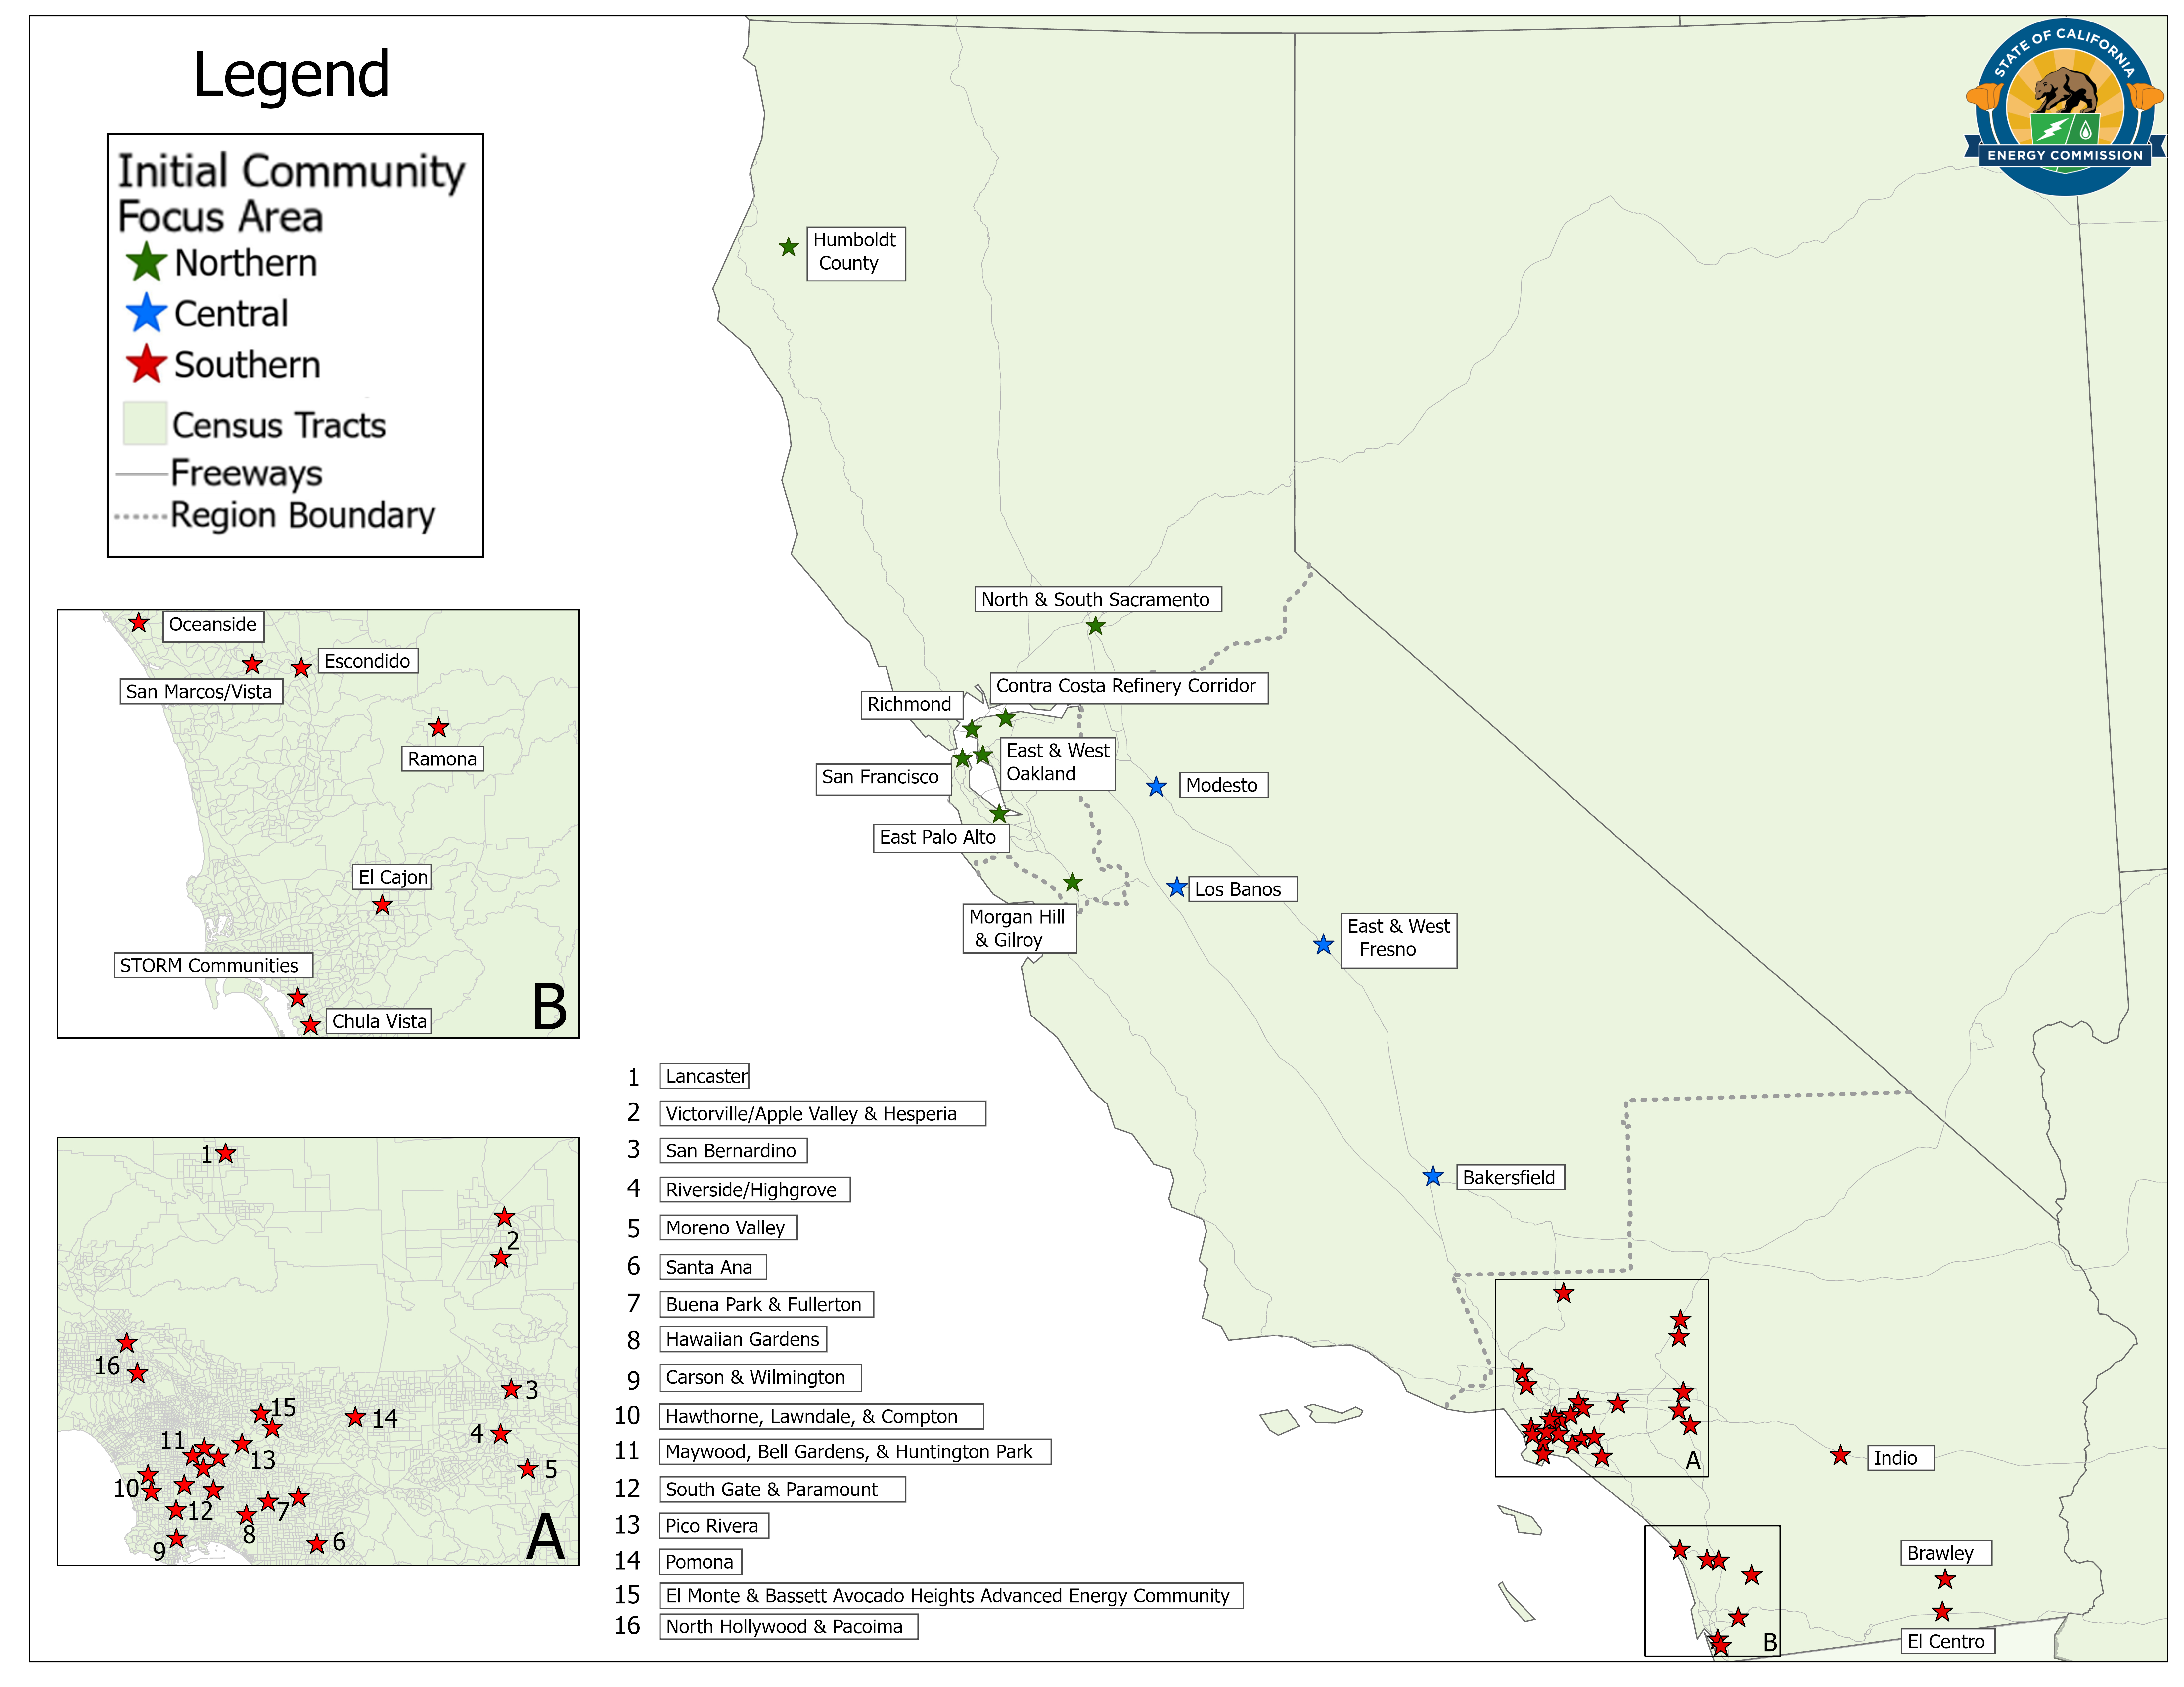
Initial Community Focus Areas

Slide 47

Community Application Process
Beyond the initial community focus areas, there will be an opportunity for other communities to participate
Each regional administrator will develop a community application process in 2026

Slide 48
Eligible Measures
Heating and Cooling
Heat pump
Smart thermostat
Ceiling fan, whole-house fan
Water Heating
Heat pump water heater
Low-flow showerheads and faucets
Duct testing/sealing
Building Envelope
Insulation
Air sealing
Solar window film
Cooking, Laundry
Induction range or cooktop
Air Quality, Lighting
Air filtration
Electrical and Remediation
Remediation and safety
Electrical wiring and panel upgrades
Electric clothes dryer
LED lights
Solar and storage are not eligible for EBD funding,
but regional administrators are encouraged to coordinate with programs that fund these measures.

Slide 49

Using Utility Meter Data to Inform Outreach and Measure Results
Customer Targeting
  Analysis of customer meter data to identify homes most likely to benefit from retrofits (support from Recurve Analytics)
  Address lists generated for each regional administrator to inform CBO outreach
Measurement & Verification
  Meter data will be used to determine weather-normalized energy savings and bill impacts for EBD projects

Slide 50
Contact
Diana Maneta
Policy and Technical Lead for Equitable Building Decarbonization Programs
diana.maneta@energy.ca.gov
Website: https://www.energy.ca.gov/programs-and-topics/programs/equitable-building-decarbonization-program
Docket: 22-DECARB-03

Slide 51
Zero-Emission Space and Water Heaters + Refrigerants
CPUC Building Decarb Workshop
Jan 22, 2026

Slide 52
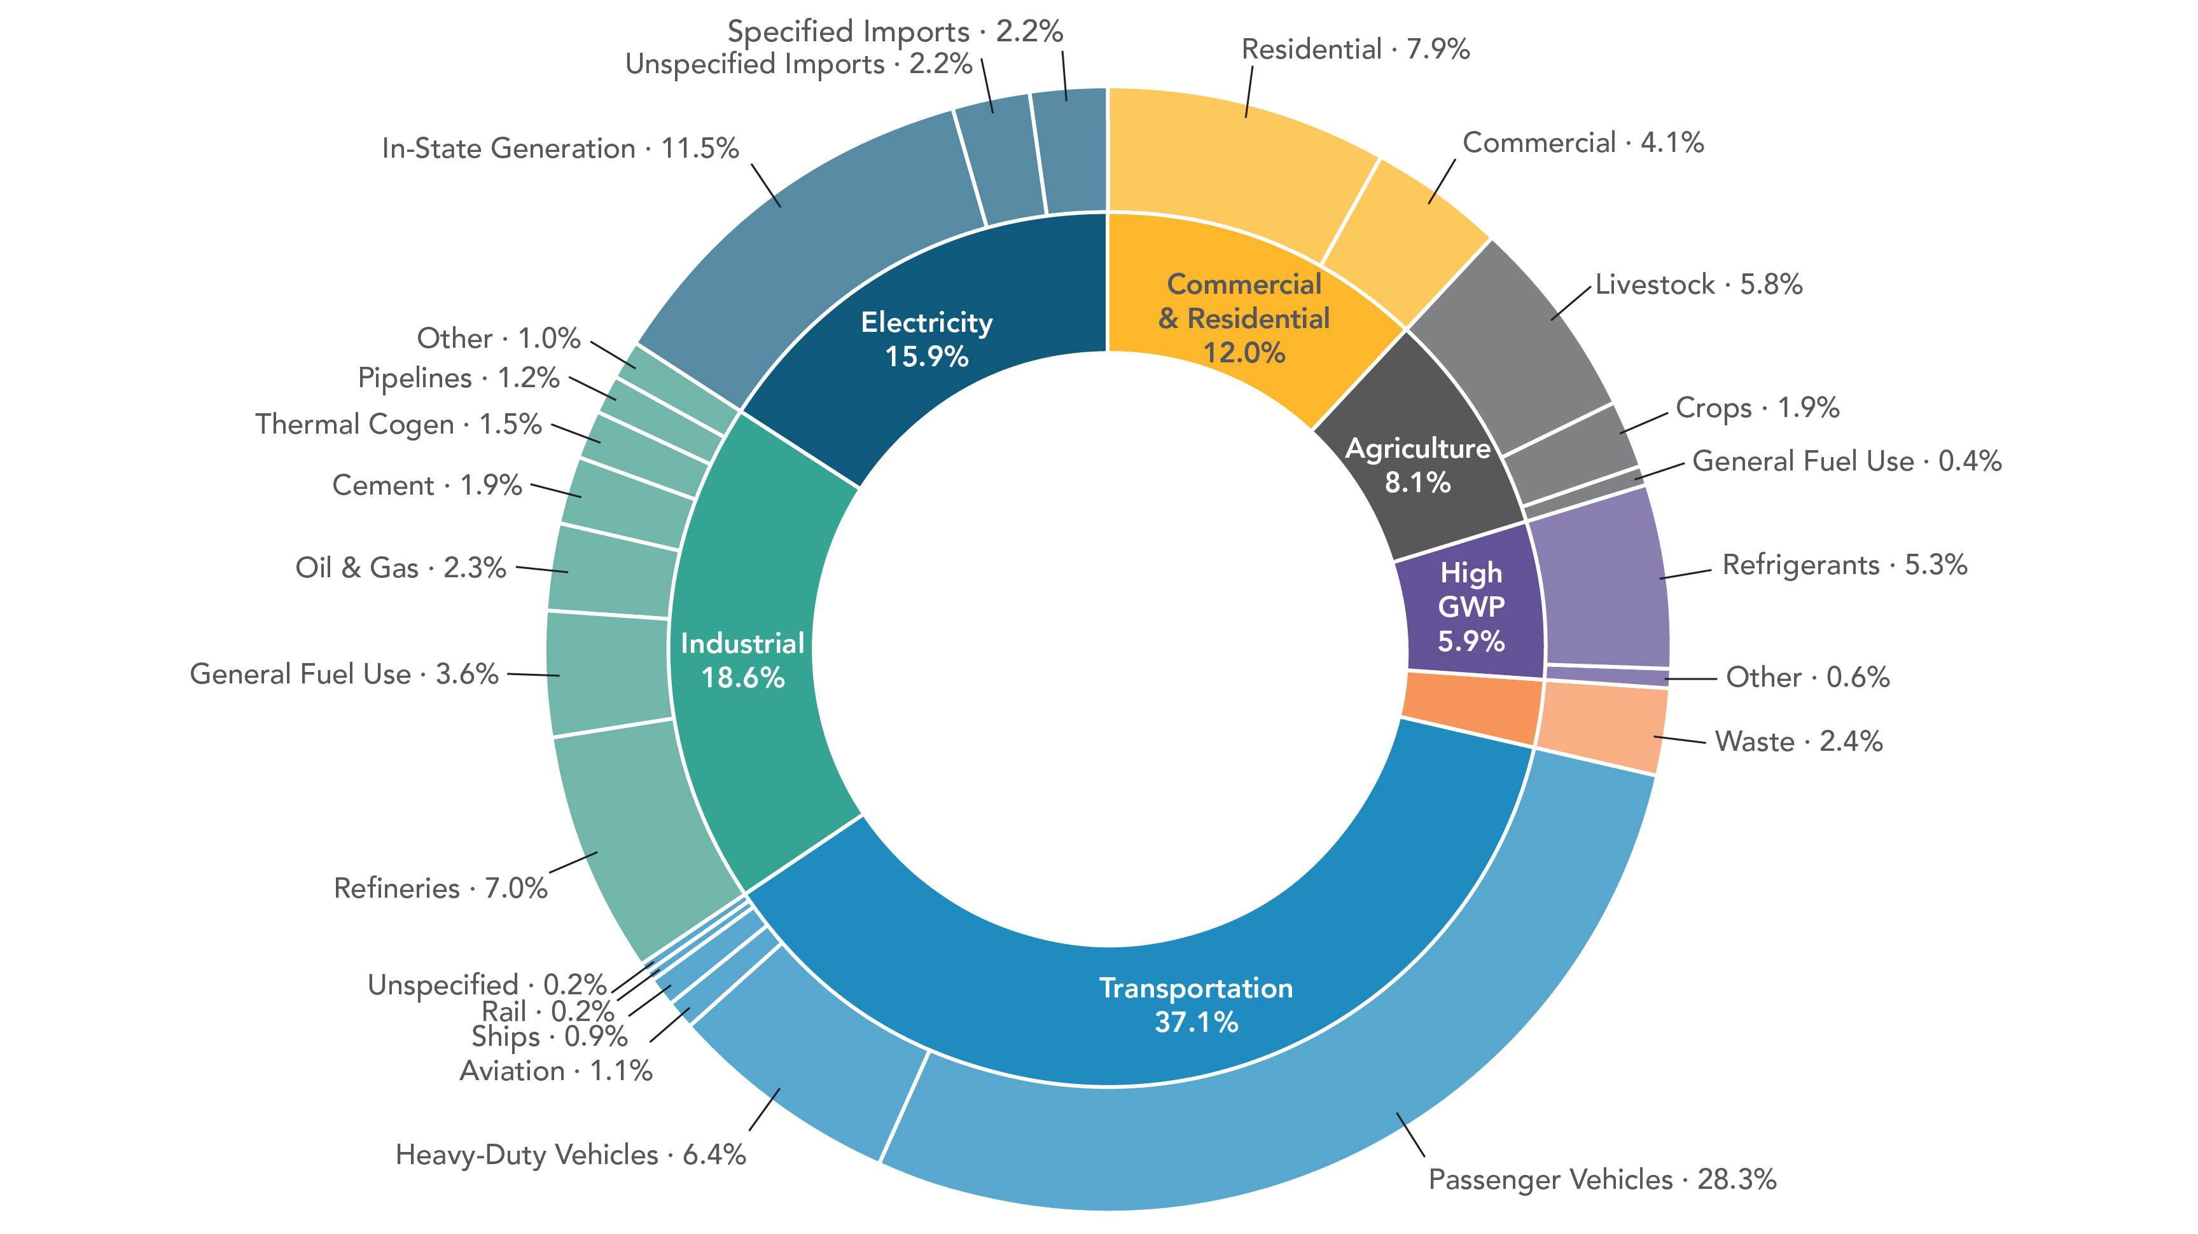
Statewide Greenhouse Gas Emissions (2023)
Notes:
Let’s start with the relative importance of hydrofluorocarbon or HFC emissions compared with statewide greenhouse gas emissions in California.
The chart here is annual GHG emissions from all sectors in 2023.
If you look in the purple segment on the right towards the center, you can see a category of high-GWP gases. Over 98% of high-GWP gases are HFCs, which are predominantly used as refrigerants. It’s not a very large category but as California phases out fossil fuels, the % of HFCs is expected to rise. As a key strategy of building decarbonization is to increase the deployment of heat pump technologies which use refrigerants, HFCs for the most part, leading to a potential increase in HFCs.

Slide 53
Zero-Emission Space and Water Heater
Regulatory Concept Evolution
2022 State SIP Strategy Concept:
100% sales must meet zero-GHG emission targets starting in 2030
May 2024 Concept:
Different types and sizes of equipment must meet zero-GHG emission targets starting in 2027 and ending in 2033
December 2025 Proposal:
Emissive sales limits combined with a credit system to provide flexibility to address regulated entity and end user challenges

Slide 54
Emissive Sales Limit
Revised Regulatory Proposal
      Emissive Equipment Sales _{Manufacturer} ≤ Total Equipment Sales _{Manufacturer} x Emissive Sales Limit (%)
      Where sales refers to equipment produced
      and delivered for sale or sold in California.
      Equipment with a rated heat input capacity
      up to 2,000,000 Btu/hour must comply with
      emissive sales limits (%) starting on
      January 1, 2030.
Proposed Statewide Emissive Sales Limits
Year | Space Heating | Water Heating | Pool Heating
2030 | 40% | 60% | 60%
2031 | 39% | 59% | 40%
2032 | 37% | 58% | 40%
2033 | 36% | 57% | 40%
2034 | 34% | 56% | 40%
2035 | 33% | 55% | 40%
2036 | 31% | 54% | 40%
2037 | 30% | 53% | 40%
2038 | 28% | 52% | 40%
2039 | 27% | 51% | 40%
2040+ | 25% | 50% | 40%

Slide 55
Emissive Sales Baseline and Proposed Emissive Limits

Slide 56
Potential Credits
Focused Primarily on Emission Reductions
Credit Earning Actions | Rationale | Proposed Value of Credit
Pre-2030 Early Compliance | Reduces emissions prior to target date | 1.0
Emissive Sales Below the Limit | Encourages fewer emissive sales below limit | 1.0

Slide 57
Potential Credits
Focused Primarily on End User Issues and Equity
Credit Earning Actions | Rationale | Proposed Value of Credit
Innovative ZE Technology: Cold-climate certified heat pumps Low-power (120 Volt) water heater heat pumps Equipment with integrated battery storage Large capacity (>300,000 Btu/hr) packaged rooftop units | Addresses some end user issues: Supports heating in cold climate regions Addresses electrical panel constraints; may reduce retrofit costs Improves resiliency and reduces retrofit needs Helps decrease retrofit costs in large buildings | 1.05 – 2.5
Donate: Donate or discount ZE equipment to equitable decarbonization incentive programs (e.g., California Energy Commission’s Equitable Building Decarbonization program.) | Addresses equity by reducing upfront costs in priority communities | 2.5

Slide 58
Potential Credits
Focused on Reducing the Impacts of Refrigerants
Credit Earning Actions | Rationale | Proposed Value of Credit
New equipment using refrigerants with ultra-low GWPs (GWP<10 as defined in SB 1206). Reclaimed refrigerants for new equipment. | Reduces short lived climate pollutants Encourages recovery of HFCs from existing equipment, limiting the production of new HFCs | Up to 2.5 (scaling based on refrigerant charge size)
Credit generating actions would encourage further reductions of HFC emissions beyond those required by existing statute, such as using refrigerants with GWP levels lower than those currently found in equipment available on the market.

Slide 59
Statewide Greenhouse Gas Emissions (2023)
Notes:
Let’s start with the relative importance of hydrofluorocarbon or HFC emissions compared with statewide greenhouse gas emissions in California.
The chart here is annual GHG emissions from all sectors in 2023.
If you look in the purple segment on the right towards the center, you can see a category of high-GWP gases. Over 98% of high-GWP gases are HFCs, which are predominantly used as refrigerants. It’s not a very large category but as California phases out fossil fuels, the % of HFCs is expected to rise. As a key strategy of building decarbonization is to increase the deployment of heat pump technologies which use refrigerants, HFCs for the most part, leading to a potential increase in HFCs.

Slide 60
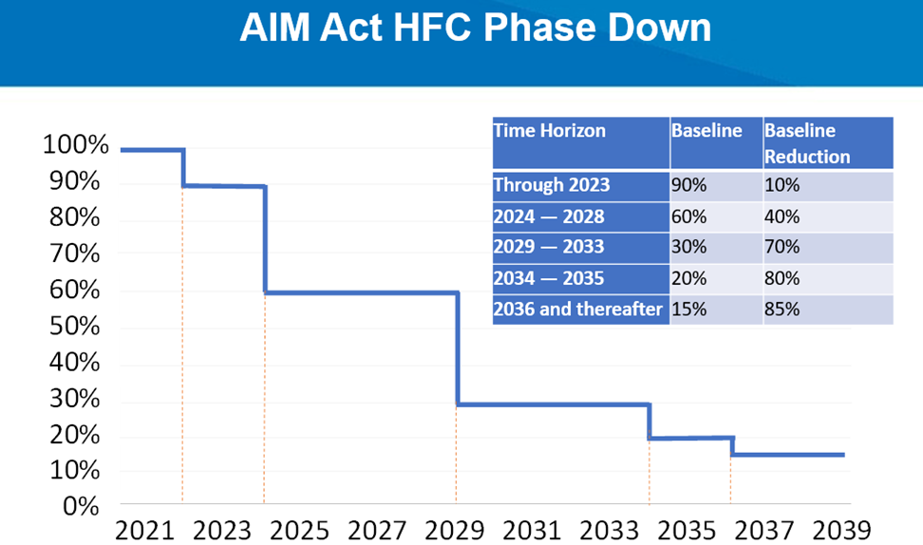
CARB’s HFC Regulation (2020) and the National HFC Phasedown
Stationary HVAC
GWP < 750
Stationary Refrigeration (> 50 lbs.)
GWP < 150
Similar GWP limits were adopted by the U.S. EPA under the AIM Act
Notes:
California has been directed to reduce HFC emissions by 40% from 2013 levels via SB 1383 given they are short-lived climate pollutants. To make progress towards the SB 1383 emission reduction target, CARB passed a first-of-its-kind HFC Regulation in 2020, which places GWP limits on the refrigerants used in stationary air conditioning and refrigeration equipment shown here on the left, which are the largest sources of HFC emissions. The HVAC sector is projected to become the largest source of HFC emissions by the end of the decade.
Also in 2020, Congress passed the AIM Act, which lays out a national HFC phasedown shown here on the right, and directs the U.S. EPA to adopt rules to implement this phasedown. This national phasedown also aligns with the ongoing international phasedown of HFCs per the Kigali Amendment to the Montreal Protocol. Ultimately resulting in an 85% reduction in the production and consumption of HFCs in the U.S. by 2036.
CARB’s work paved the way for federal adoption. The US EPA adopted similar GWP standards in 2023 in their final Technology Transition Rule under the AIM Act and a national transition for all HVAC equipment was completed in 2025.
Currently there are no standards for heat pump water heaters or pool and spa heat pumps.

Slide 61

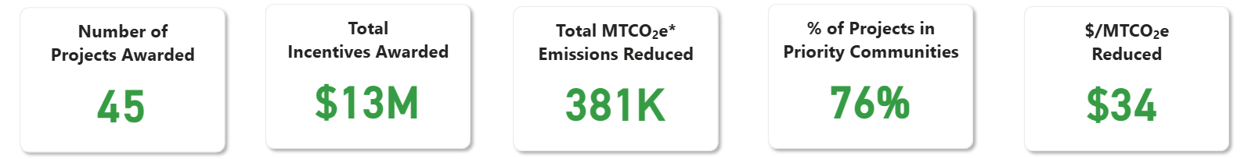
FRIP: F-gas Reduction Incentive Program
Commercial and Industrial (C&I) Refrigeration: funding grants for existing facilities to install ultra-low-GWP (<10 GWP) technologies.
Workforce Development: Increase recruitment and train 500+ technicians in ultra-low-GWP refrigeration technologies.
Risk assessment of A3 monobloc air-to-water heat pumps.
Literature review of the environmental and health impacts of HFOs and other byproducts synthetic refrigerants.
Residential air conditioning recovery and reclamation pilot (REFRESH).
fripfunding.com
Notes:
Financial incentives play an important role in transitioning the market beyond regulatory measures.
CARB’s F-gas Reduction Incentive or FRIP has received a total of $66 million dollars from the California legislature to promote the adoption of climate-friendly ultra-low-GWP (< 10 GWP) refrigerant technologies and alleviate markets barriers. With these funds, we’ve launched several FRIP sub-programs.
One important subprogram is focused on reducing emissions from industrial and commercial refrigeration systems and alleviating cost barriers to the adoption of ultra-low-GWP refrigeration equipment. This is a first come, first serve program and so far we’ve awarded $13 million across 45 projects. FRIP also supports a successful industry transition by pairing the installation of new ultra-low-GWP refrigeration technologies with targeted workforce development.
FRIP’s most recent sub-program is for a complete risk assessment of residential monobloc air-to-water heat pumps using A3, or flammable, refrigerants, to inform codes and standards setting organizations in the North American market.
Additionally, FRIP has also funded a literature review project, so CARB can best understand the current science on the environmental and health impacts of degradation products of next-generation synthetic gases, the goal of this is to avoid unforeseen consequences of synthetic materials that have happened with previous generations of refrigerants.
Finally, FRIP funding will be used to help increase recovery and reclamation of high-GWP material from the residential HVAC sector, where refrigerant recovery rates are low, through our REFRESH Pilot Program.
I’ll share some more information about this program on the following slide.
You can visit fripfunding.com to learn more and keep up to date on additional sub-programs coming soon.

Slide 62





REFRESH Pilot Program:
Refrigerant Recovery Process
Technician or contractor recovers refrigerant from decommissioned equipment into a refrigerant cylinder.
Recovery rates in the residential HVAC sector are low.
Refrigerant cylinders are uniquely barcoded.
Reclaimers receive the cylinders, process the recovered refrigerant, and send technician or contractor an empty cylinder in exchange.
After processing refrigerant purity, money is sent to the technician or contractor.
Technicians and contractors used to be charged for “dirty” gas.
Monthly report with cylinder and refrigerant data shared with CARB and CEC.
fripfunding.com
Notes:
Here I’ll dive into a little more detail about CARB’s new REFRESH Pilot Program. CARB has set aside up to $5 million in FRIP funding to help increase recovery and reclamation of high-GWP material from the residential HVAC sector in California. We are targeting this sector specifically because recovery rates of refrigerant from residential HVAC equipment have been very low.
CARB’s REFRESH program is currently partnering with CEC’s Equitable Building Decarbonization direct install program, and we are very interested in expanding REFRESH to partner with other state agencies and utilities to incentivize recovery and reclamation from the residential sector, especially as new heat pump technologies are deployed in this sector.
This slide shows a brief overview of the refrigerant recovery process for the REFRESH Program:
This begins with a contractor recovering the refrigerant from decommissioned HVAC equipment into a refrigerant cylinder. Contractors will recover refrigerant from multiple pieces of equipment until the cylinder is full, or nearly full.
All refrigerant cylinders are uniquely barcoded for tracking purposes.
Then our partner U.S. EPA certified refrigerant reclaimers, which for this program include Hudson Technologies and A-Gas, will retrieve or ship the refrigerant at no cost to the contractor then process the recovered refrigerant, and send the contractor an empty cylinder in exchange.
After the reclaimer has processed the refrigerant, money is sent to the contractor via check or direct deposit, regardless of the purity level of the refrigerant. In the past, contractors were charged fees for sending in “dirty” refrigerant gas.
Finally, the reclaimers send a monthly report to CARB detailing cylinder, refrigerant, and payment data.

Slide 63

California SB 1206 (2022):
The Future of HFCs in California
Assessment report with plan to transition HFC sectors to ultra-low-GWP (<10 GWP) and no-GWP alternatives by 2035.
    Sector specific approach
    Maximize recovery and reclamation
    Increase the adoption of new technologies
    Workforce development
    Identify demonstration projects and incentives
Notes:
Finally, I’ll highlight California’s SB 1206 which lays out the future of HFC use in California. ​
​
SB 1206 prohibits the sale of bulk or newly produced, high-GWP HFCs and requires reclaimed HFCs to be used in the servicing of existing equipment.
In addition, SB 1206 also directs CARB to write an assessment report specifying how to transition all HFC sectors in California to ultra-low GWP or no-GWP alternatives no later than 2035. And then initiate rulemaking to achieve that transition.
The assessment will also include an analysis of the refrigerant reclamation industry from the California Energy Commission, recommendations for workforce development and training, how to increase the adoption of new technologies, and the role of incentive funding to support a successful transition of the market.
Ultimately, SB 1206’s message is that California’s future is ultra-low-GWP and HFC free.
​

Slide 64
Thank you
ZESWH Team:
buildingdecarb@arb.ca.gov
Draft Regulatory Language shared publicly in first quarter of 2026.
Economic analysis released in first quarter of 2026.
CARB HFC Reduction Program: HFCReduction@arb.ca.gov
CARB FRIP Incentive Program: FRIP@arb.ca.gov
info@fripfunding.com

Slide 65
Publicly Owned Utility and Community Choice Aggregator Panel

Slide 66

Building electrification in the Sacramento region
Jennifer Venema, Senior Strategic Business Planner
January 22, 2026

Slide 67
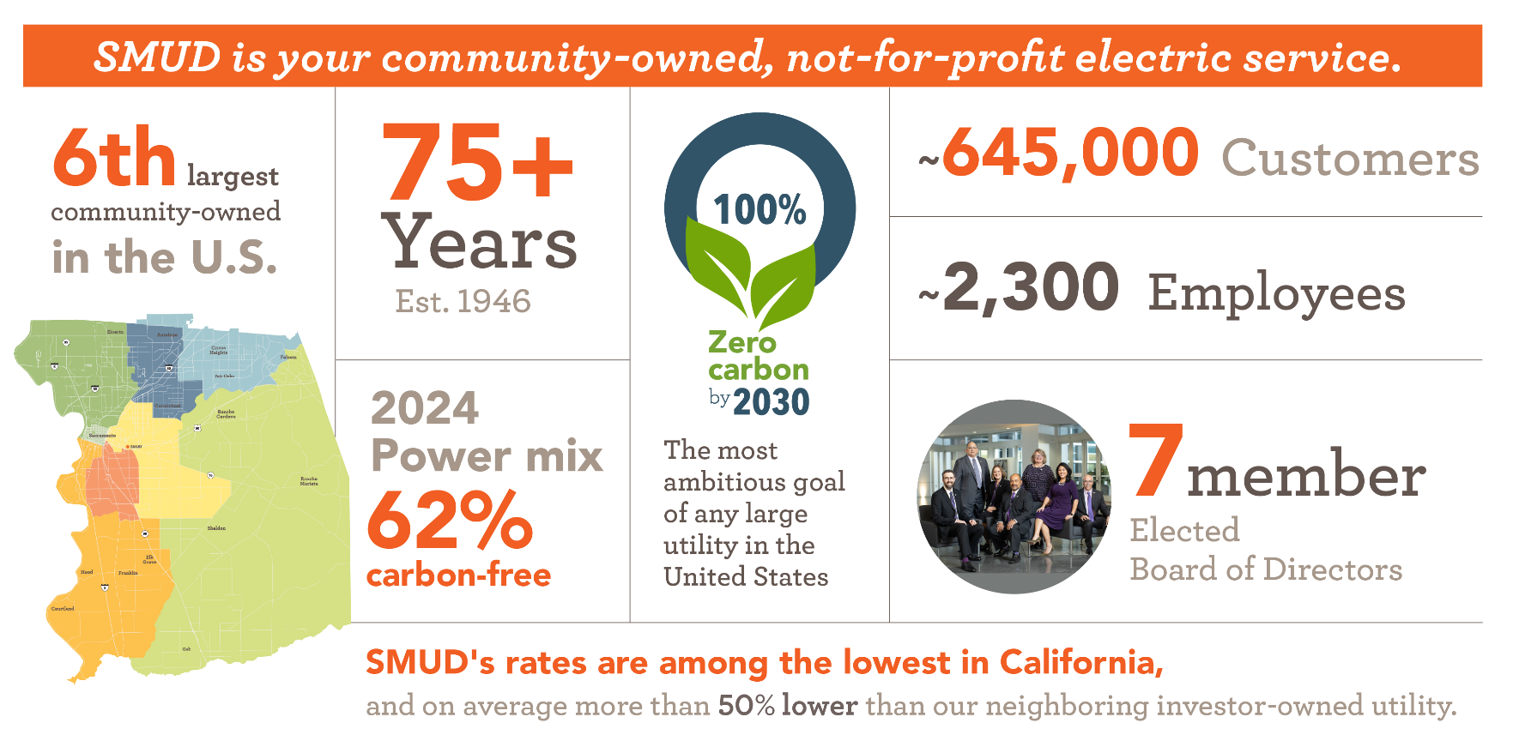
About SMUD
Notes:
SMUD is a community-owned, not-for-profit electric company.
We’re governed by a 7-member elected Board of Directors that sets our rates and establishes our policy direction.
Because we’re community-owned, there are no shareholders. That means we make decisions that are in the best interest of our customers and community.
We’re one of the cleanest utilities in the nation, with more than half of our power coming from carbon free resources. In 2024, we were 62% carbon free. The amount of carbon-free energy can change from year to year based on a number of factors, particularly the weather, which drives the amount of hydro energy.
And, we have an ambitious goal of zero carbon emissions by 2030, which is anchored in reliability and affordability. In fact, our customers’ electric bills on average are more than 50% lower than our neighboring investor-owned utility.

Slide 68
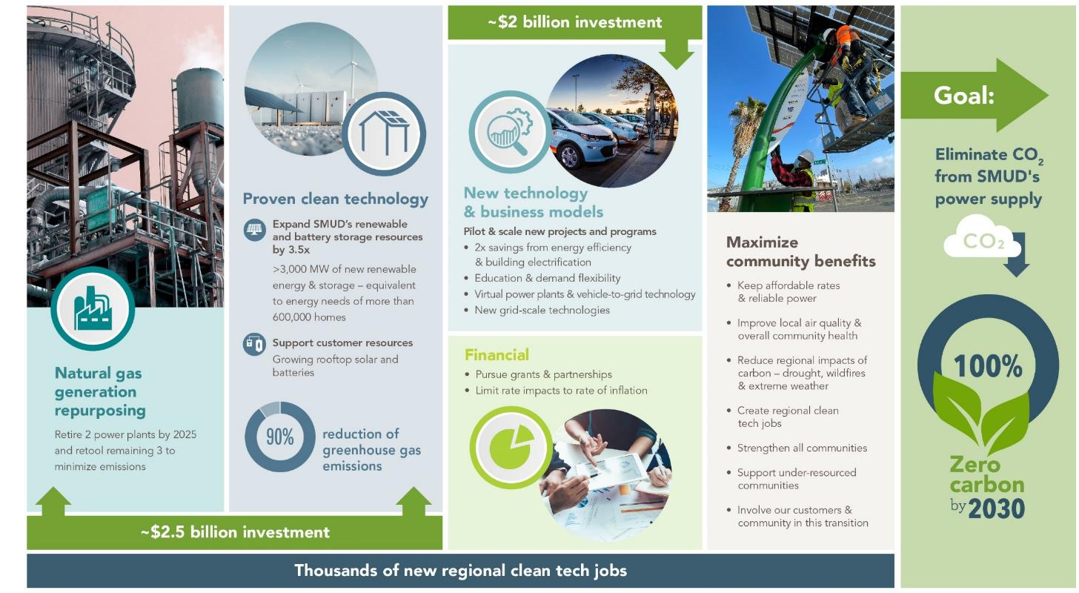
Zero Carbon Plan

Slide 69
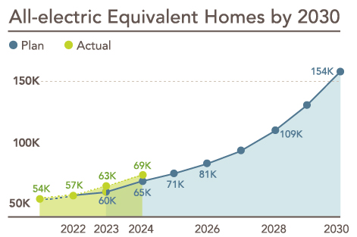
Building electrification goals
Aiming to electrify the equivalent of 154,000 homes by 2030.
>69,000 equivalent all-electric homes to date (cumulative)

Slide 70
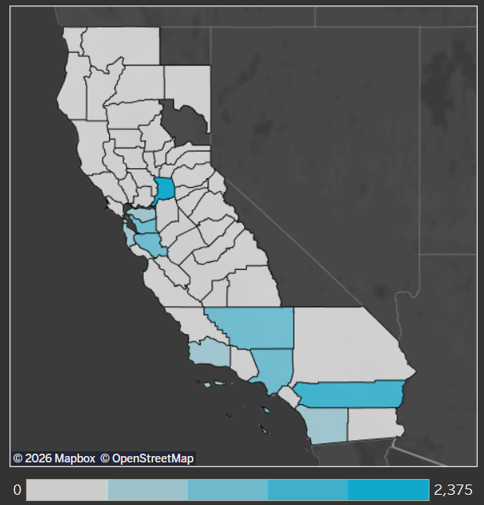
Early wins in single-family electrification
Over 20,000 residential heat pumps incentivized since 2018 supported by SMUD’s Contractor Network.
SMUD.org/GoElectric
TECH Clean California Project Installs*
14% of heat pump projects incentivized by TECH Clean CA program
(8,559 heat pumps)
Estimated residential
savings in SMUD territory:
Up to
$500 energy savings/year today
When replacing conventional water and space heating equipment with heat pumps
*For single-family installs through 12/31/25. Image and data accessed 1/15/26: TECH Clean California (2025). Heat pump data visuals. Heat pump data. https://techcleanca.com/heat-pump-data/heat-pump-data-visuals/.

Slide 71
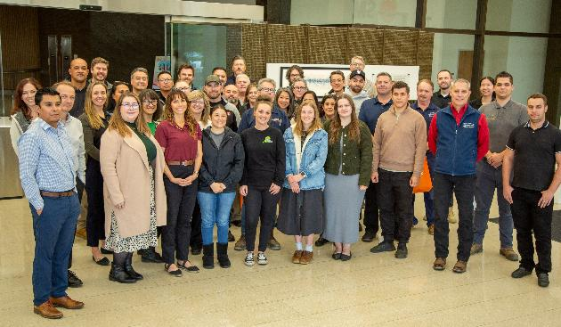

Maximizing the impact of the trade ally network and external funds
Importance of the contractor
Planning for and maximizing impact of external funding
Optimizing the customer adoption journey and energy benefits
SMUD Contractor Network 2024 End-of-Year Event
SMUDContractorNetwork.org
402 approved contractors

Slide 72
Finding opportunities for cost efficiencies
Total project count = 538
Median HPWH installation cost: $6,017
19% Program Share
≤6% Program Share
32% Program Share
36% Program Share

Slide 73
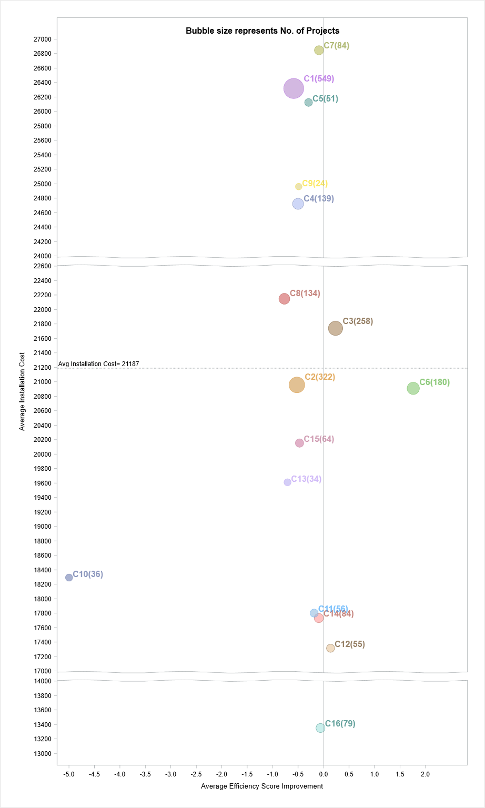
Variation in cost and performance by installer
Variable speed heat pump HVAC installation cost and improvement in energy efficiency by contractor:
Below average install costs
Improvement in efficiency
(Post- minus pre-efficiency score)

Slide 74
Understanding technology impacts and installation practices of heat pump HVACs
Estimated HP HVAC annual and seasonal savings (kWh) - overall and by technology type
9% overall savings
Highlights:
5% overall summer savings
Evaluation of ~ 4K installs 2020 – 2022
No significant difference in savings or new winter load between two-stage and variable-speed heat pumps
Wide variation in energy outcomes by installer
90% confidence interval
Statistical evaluation included matched comparison groups, site-level weather modeling, difference-in-difference model, and pre- and post-analysis.

Slide 75

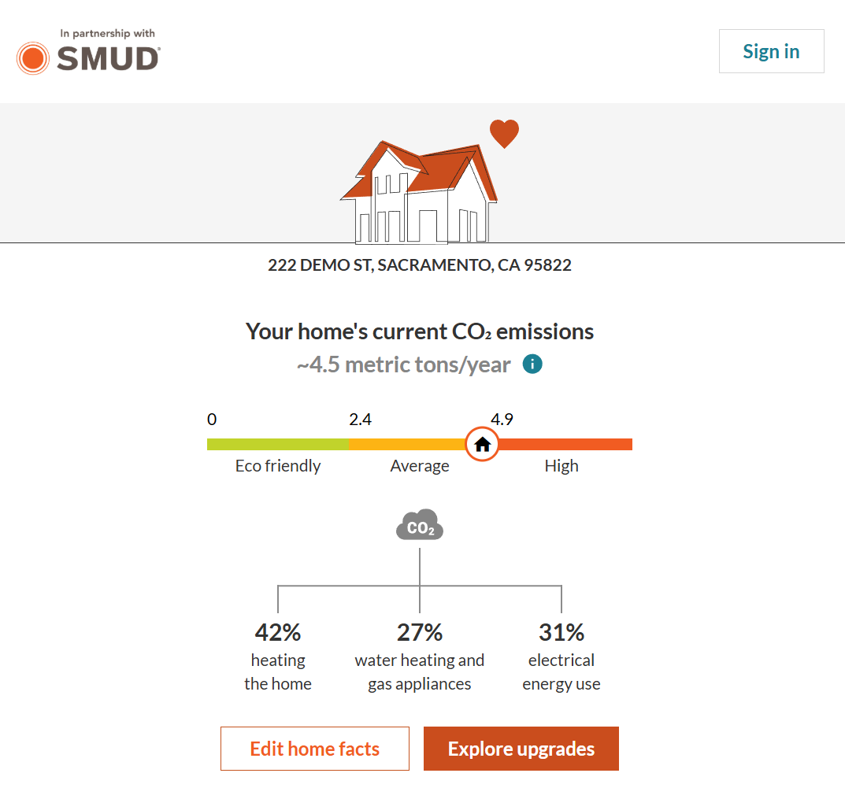


Scaling marketing and engagement
Targeted marketing and collaboration
Customer education
XeroHomeTM Tool
SMUD.XeroHome.com
SMUD.org/GoElectric

Slide 76
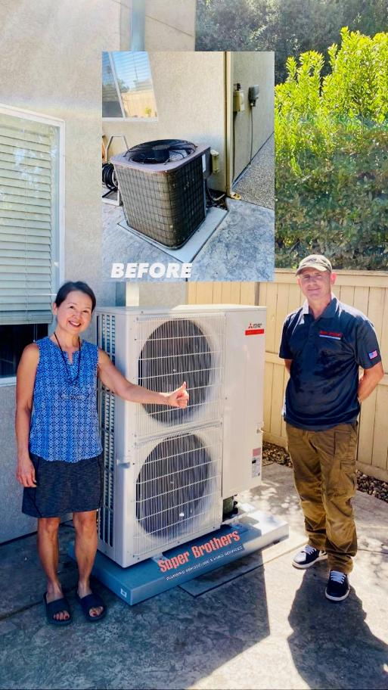
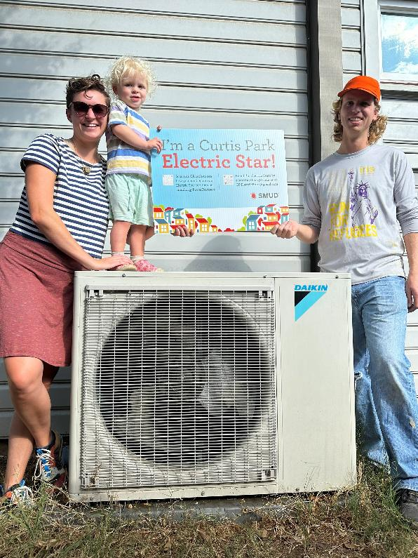
Neighborhood Power Partners
Curtis Park Electric Stars

Slide 77
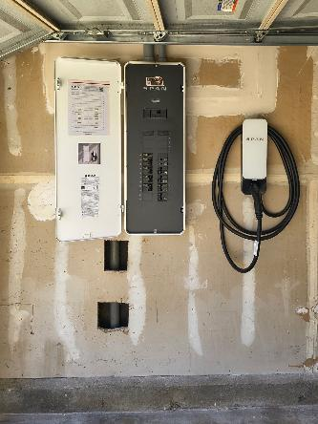
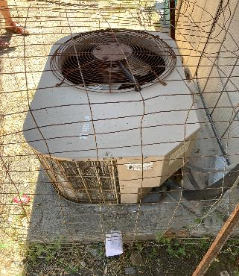

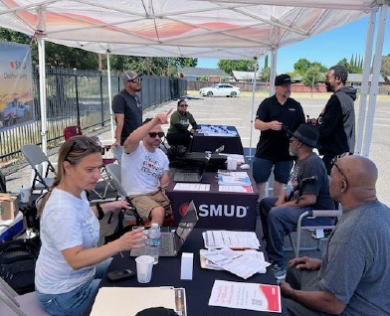
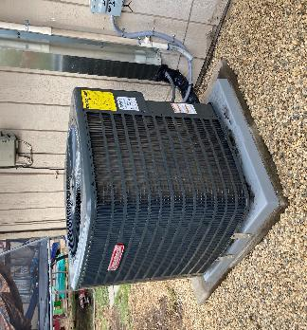
Leaving no community behind
BEFORE
>1,600 heat pumps installed through income-eligible direct install since 2023
Meadowview Neighborhood Electrification project in-350 homes (including efficiency and weatherization) and over 1K measures installed
Collaboration with nonprofits and agency partners to leverage resources
AFTER
“Prior to having this unit, we were cold during the winter and hot during the summer… I suffered the most, having high blood pressure and osteoarthritis.”

Slide 78





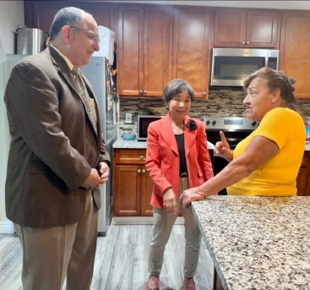
Working with community
Free is not enough
Community-based outreach and engagement with trusted leaders
In-language while finding the right message
SMUD.org/Meadowview

Slide 79






Take-aways
“Free” is not enough to help vulnerable neighborhoods: Partnership, trust, early market research
Opportunity for targeted offerings, cost efficiencies, and outreach
Continued focus on growing the active contractor base, improving performance, and reducing costs
Importance of external funding and planning certainty
Role of tools and data, to help residents and businesses understand operational and energy bill impacts
Creative collaboration for broader market awareness, customer education, and support on the adoption journey

Slide 80
Wrap-up
Thank you
Jennifer.Venema@SMUD.org

Slide 81



Decarbonization
in Palo Alto
California Public Utilities Commission Building Decarbonization Proceeding
January 22, 2026
PaloAlto.gov

Slide 82

About the City of Palo Alto
Electric and gas utilities (and water, sewer, dark fiber)
Carbon Neutral Electric Portfolio since 2013
2023 Sustainability and Climate Action Plan with goal of 80% reductions in carbon emissions by 2030 (80x30)
Progress to-date: 47% reductions (2022 inventory)
2022 GHG Emissions Inventory
82

Slide 83
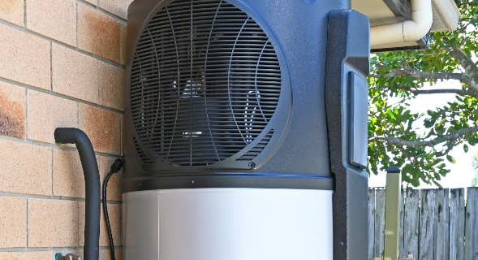




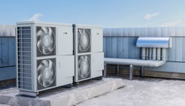


Results To-Date
750+ HPWH (heat pump water heaters), ~ 20% of turnover
Over 300 all-electric single-family homes (2% of total)
EV chargers serving over 1,300 multi-family units (12% of total)
About 20% of Palo Altans commuting via bikes/walking/transit
20+ HPWH in income-qualified single-family homes
10+ rooftop HVAC electrification projects in progress
Affordable housing building and vehicle electrification pilots
Over 20% of Palo Alto cars are EVs (55% of new sales)
83

Slide 84

Current Decarbonization Programs
New Construction Requirements
Hourly source energy requirements (replaced all-electric requirements)
Single-Family Buildings
Rebates, assessments, direct install, on-bill financing, EV promotion
Multi-Family Buildings
EV chargers and EV promotion, affordable housing grants, rebates
Non-Residential Buildings
Packaged HVAC pilot, custom electrification rebates, technical assistance
Permit Streamlining
Instant online permits for heat pump water heaters, solar, and mechanical, electrical, and plumbing permits
84

Slide 85

Grid Modernization Program
Long-term program to modernize electric grid – improving reliability, adding capacity:
  Reconductoring sub-transmission line
  Converting 4kV lines to 12kV
  Substation reconstructions
  Upgrading line transformers, strengthening feeder ties
Completed a 900-home pilot upgrade area in mid-2025
Reviewed program approach, discussing with policy makers focusing on aging infrastructure, with capacity additions to manage electrification as needed, in a timely manner
Cost-efficient approach
85

Slide 86
Grid Modernization Program 2
Completed cost-benefit analysis of using batteries to defer distribution investment
Costs exceeded benefits at this time
Continuing to promote and reduce barriers to voluntary adoption of distributed energy resources
86

Slide 87

Gas System Transition Study
Identify physical and financial impacts of widespread building electrification on the gas utility and identify mitigations
Methodology:
  Use gas usage patterns to predict equipment in homes
  Simulate future gas use patterns under various high electrification scenarios
  Use gas system model to evaluate physical impacts of high electrification scenarios
  Use financial models to evaluate financial and rate impacts
Note: City of Palo Alto gas utility is highly networked – valves at nearly every intersection, easy to isolate blocks
87

Slide 88
Gas System Transition Study 2
Preliminary results presented in fall 2025:
  More electric equipment predicted than had been expected, especially in multi-family
  About 40% of gas utility costs are fixed
  With random electrification, little gas main abandonment seen until reaching very high levels of electrification
  Still analyzing financial impacts, but simulation results imply non-trivial potential rate impacts if not mitigated
Next steps: improved simulations, physical/financial modeling
Brainstorm mitigations, discuss with policy makers
88

Slide 89

Future Decarbonization Strategic Planning
Planning and research studies in progress over 2024-2025, final drafts to our City Council in February
  Funding source survey
  Funding model
  EV charging needs assessment
  Studies of single-family, multi-family, non-residential electrification opportunities
Plan to use models to develop policy options with varying paces, levels of assistance, and funding/financing needs
Piloting different cost-efficient program models and financing strategies in 2026-2027
89

Slide 90

Final slide
Jonathan Abendschein
Assistant Director for Climate Action
jonathan.abendschein@paloalto.gov

Slide 91


How to unlock the power of local jurisdictions to advance statewide decarbonization
January 22nd, 2026

Slide 92

Local jurisdictions are key to achieving building decarb goals but often lack the technical resources to fully leverage their power.
92

Slide 93













SVCE is the Community Choice Aggregator for 13 Santa Clara County communities.
Mission: Reduce dependence on fossil fuels by providing carbon free, affordable, and reliable electricity and innovative programs for the SVCE community.
Campbell | Cupertino | Gilroy | Los Altos | Los Altos Hills
Los Gatos | Milpitas | Monte Sereno | Morgan Hill
Mountain View | Santa Clara County | Saratoga | Sunnyvale

Slide 94
Best Practices SVCE Has Gathered
Strategic coordination with local building departments can catalyze electrification.
Provide technical training to empower building officials to support right-sized panels and best practices for heat pump installs.
Support building officials to adopt electrification readiness codes to drastically reduce the cost and time for emergency replacements.
Leverage utility allowances for affordable housing (through county Housing Authority).
1
2
3

Slide 95
Training for local building officials and permitting staff has streamlined decarbonization.
Challenge: Data supports right-sizing panels for more cost-effective electrification but building departments who are charged with protecting health and safety often push for panel upgrades.
Solution: SVCE has provided training and resources for all 13 member jurisdictions:
Education and resources on panel right-sizing
Training on emerging technologies (e.g., 120V HPWHs, circuit-splitters, automated EV load management systems)
Best practices for heat pump installations
SVCE has been able to empower city and county staff because of the strong relationships it has built by providing ongoing support.

Slide 96
Electrification readiness codes pave the way for future neighborhood decarbonization.
Challenge: In "emergency" situations electrification is more expensive, complicated, and time consuming, but it is very difficult to get people to proactively prepare.
Solution: SVCE provided technical support to city staff and building officials.
Five out of thirteen jurisdictions have adopted electric readiness codes that will lower cost and reduce common barriers to electrification.
Several agencies also provide handouts on prewiring and preparing for air district rules at their permit counter.
SVCE provides incentives for prewiring ($500-750 per circuit/device).

Slide 97
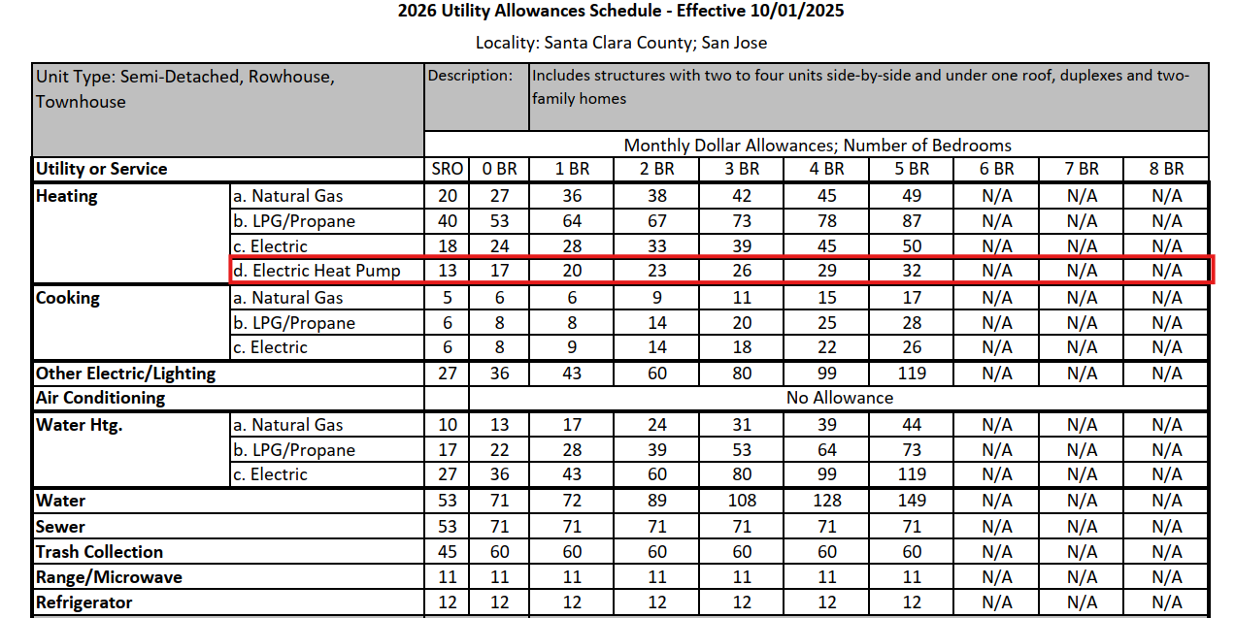
Removing barriers to decarbonizing affordable multifamily housing.
Challenge: County Utility Allowance Schedule did not include heat pumps and penalized affordable housing property owners for installing them.
Solution: SVCE worked with the Santa Clara Housing Authority to add heat pump space heating to the 2026 Utility Allowance Schedule, with HPWH to follow.
This barrier was identified through our Multifamily Direct-Install program's Property Owner Listening Sessions.

Slide 98
Strategies to Leverage
As a locally governed agency, SVCE has been able to build key relationships and provide technical support that unlocks the superpowers of building officials.
Streamline decarbonization by providing education and resources to building officials and permitting staff:
  Reduce wasteful service upgrades saving ratepayers time and money.
  Advance local policy that aligns with state goals and prepares communities for zonal decarb through preparation.
  Uncover hidden barriers to electrification and quickly advance solutions like modernized utility allowances.
98

Slide 99

Peter Mustacich, PE
peter.mustacich@svcleanenergy.org
Technical Manager of Decarbonization Strategy and Planning

Slide 100
Lunch

Slide 101
Ratepayer Advocate and Community-Based Organization Panel

Slide 102
California Public Advocates Office
Stephen Castello

Slide 103

BEEP Community Listening Sessions Findings
Hallazgos de las Sesiónes de Escucha Comunitaria de BEEP
CPUC Building Decarbonization Best Practices and Future Pathways Workshop
January 22, 2026

Slide 104
Background Antecedentes
Se han llevado a cabo sesiones presenciales y/o virtuales en el Valle de San Joaquín, el Área de la Bahía de San Francisco y Los Ángeles. También llevamos una sesión “estatal” que todos estuvieron invitados a unirse.
Hemos escuchado las inquietudes de los miembros de la comunidad en torno a la accesibilidad a los programas energéticos, la contaminación energética dentro y fuera de los hogares, y el impacto de la electrificación en las facturas y la asequibilidad.
In-person and/or virtual sessions have been held in the San Joaquin Valley, San Francisco Bay Area, and Los Angeles. We also held one virtual “statewide” session that everyone was welcome to join.
We have heard community members concerns around accessibility to energy programs, energy pollution inside & outside of homes, and the electrification impact on bills and affordability

Slide 105



CARB, CPUC, and CEC regulatory purview
CARB: Regulates air quality by setting plans for emissions reductions by the local Air Quality Management Districts (AQMDs).
CARB: Regula la calidad del aire estableciendo planes de reducción de emisiones por parte de las AQMD locales.
CPUC: Regulates energy service (via utilities & energy providers) provided to buildings, incl. costs, infrastructure, & externalities of the energy system. CPUC: Regula el servicio energético (a través de empresas de servicios públicos y proveedores de energía) prestado a los edificios, incluidos los costes, la infraestructura y las externalidades del sistema energético.
BEEP targets
Indoor air quality & emissions reduction through the appliance standard rulemaking
‘Whole’ home retrofits through the Equitable Building Decarbonization Program to provide electric appliances & home upgrades.
BEEP se dirige a
La calidad del aire interior y la reducción de emisiones a través de la normativa sobre electrodomésticos y
La modernización integral de viviendas a través del Programa de Descarbonización Equitativa de Edificios para proporcionar electrodomésticos y mejoras domésticas.
CEC: Covers energy system planning, building performance, & budgets for programs and regulations like codes & standards.
CEC: cubre la planificación de sistemas energéticos, el rendimiento de los edificios y los presupuestos de programas y regulaciones como códigos y normas.

Slide 106
Concerns
Inquietudes
Energy Pollution Inside & Outside Homes | Contaminación Energética dentro y fuera de los hogares
Accessibility to Energy Programs | Accesibilidad a Programas Energéticos
Electrification Impact on Bills & Affordability | Impacto de la electrificación en las facturas y la asequibilidad

Slide 107
Preliminary Solutions
Soluciones preliminares

Slide 108
Solutions for Energy Pollution Inside & Outside Homes (Cumulative Effects)
Soluciones para la contaminación energética dentro y fuera de los hogares (efectos acumulativos)
Electrification and decommissioning gas systems when we can, especially when gas systems are right in front of community homes Address what powers, integration of other clean energy pieces Energy programs need to address asbestos, mold, other sources of toxic pollution | Electrificación y desmantelamiento de los sistemas de gas cuando sea posible, especialmente cuando estos se encuentren justo frente a las viviendas de la comunidad. Abordar las fuentes de energía y la integración de otras fuentes de energía limpia. Los programas energéticos deben hacer frente al amianto, el moho y otras fuentes de contaminación tóxica.

Slide 109
Solutions for Accessibility to Energy Programs Soluciones para la accesibilidad a los programas energéticos
One-stop place for people to get information on decarbonization technologies. All this information is hard to understand for someone that’s not in this space Funnelling existing rebate/incentives funding into an EBD type approach Clear points of contact for questions/issues pre and post installation Increasing quality/accountability of contractors Evaluation periods for energy programs to ensure goals are being met One/simple application form for multiple programs: unified applications Tenant protections: coordination at state level, enforcement, issue of tenants being informed Partnership with CBOs to help with outreach and support | Un lugar centralizado donde las personas pueden obtener información sobre tecnologías de descarbonización. Toda esta información es difícil de entender para alguien que no está familiarizado con este campo. Canalizar los fondos existentes para descuentos/incentivos hacia un enfoque de tipo EBD. Puntos de contacto precisos en caso de preguntas o problemas antes y después de la instalación. Aumentar la calidad y la responsabilidad de los contratistas. Períodos de evaluación de los programas energéticos para garantizar el cumplimiento de las metas. Un único formulario de solicitud sencillo para múltiples programas: solicitudes unificadas. Protección de los inquilinos: coordinación a nivel estatal, aplicación de la ley, asunto de la información a los inquilinos. Asociación con organizaciones comunitarias para ayudar con la divulgación y el apoyo.

Slide 110
Solutions for Electrification Impact on Bills & Affordability Soluciones para el impacto de la electrificación en las facturas y la asequibilidad
Holistic installation approach to entire home to reduce energy consumption and minimize impact on residents Neighborhood/zonal approach to maximize cost efficiencies, ensure grid capacity upgrades are happening Ensure folks are enrolled in CARE/FERA and Emergency resources for folks who are at risk of having power turned off | Enfoque de instalación integral en toda la vivienda para reducir el consumo energético y minimizar el impacto en los residentes. Enfoque por vecindarios/zonas para maximizar la rentabilidad y garantizar que se realicen las mejoras necesarias en la capacidad de la red eléctrica. Garantizar que las personas estén inscritas en CARE/FERA y en los recursos de emergencia para aquellas personas que corren el riesgo de que les suspendan el suministro eléctrico.

Slide 111
Next Steps from Listening Sessions Próximos pasos tras las Sesiones de Escucha
A report on these sessions will be published early this year.
BEEP will continue to use your input to advocate for equitable building decarbonization across California!
Join our email list if you want to stay informed at beepcoalition.org
A principios de este año se publicará un informe sobre estas sesiones.
¡BEEP continuará aprovechando sus aportaciones para promover la descarbonización equitativa de los edificios en toda California!
Si desea mantenerse informado, suscríbase a nuestra lista de correo electrónico en beepcoalition.org

Slide 112
Thanks! Gracias!
Stay in touch! ¡Manténgase en contacto!
info@beepcoalition.org
beepcoalition.org
CRÉDITOS: Esta plantilla de la presentación fue creada por Slidesgo, e incluye iconos de Flaticon, e infografías e imágenes de Freepik

Slide 113
Investor-Owned Utility Panel

Slide 114
Building Decarbonization
Best Practices & Future Pathways
January 22, 2026
Leah Catanzarite, Building Electrification and Efficiency Strategy, Principal

Slide 115

Purpose of Presentation
Share PG&E's mid- to long-term vision for building decarbonization
Summarize lessons learned gained from past and present building decarbonization initiatives and best practices to carry forward
Highlight future opportunities to help unlock building decarbonization at scale

Slide 116
Building decarbonization at PG&E
Building decarbonization is a critical component of PG&E’s decarbonization strategy
PG&E has a goal to achieve a net zero energy system by 2040
Core customer gas usage constituted ~35% of PG&E's scope 1-3 greenhouse gas emissions in 2024
Appliance electrification and replacing natural gas delivery with clean fuels can reduce building emissions

Slide 117




Building electrification (BE) vision
Electrification & Decarbonization Vision Statement
We're creating an electrified California where customers choose efficient and decarbonized buildings.
2026
2027-2030
2030+
Potential Future State
Scaling a Managed Transition
Medium Term Plan
Adapting Based on
Learning & Testing
Immediate Actions
Simplify Customers' Electrification Journey
Electrification is fast, easy, affordable, and accessible to all customers
---
Electrification contributes to a managed transition of the gas system
---
Building electrification is integrated into gas and electric planning and enabled by policy
---
PG&E is the trusted BE energy advisor
Improve the economics of building electrification
---
Leverage learnings to scale successes and continuously improve customer experience
---
Collaborate with local partners & leverage data-driven tools to pursue cost‑effective zonal electrification projects
Design a building electrification experience that enables an easy and timely transition for customers
---
Focus on existing pilots and programs where PG&E can drive near‑term BE adoption, test and learn rapidly, and generate insights to scale

Slide 118
Where we are today & lessons learned
Key PG&E BE Initiatives*
Lessons Learned
Successful customer engagement varies greatly; there is no one-size-fits-all
Customer acceptance barriers are diverse
Remediation is expensive and common
Every building is unique, making scaling a challenge
Regulatory certainty and reliable cost‑recovery mechanisms are crucial for effective program design
Closed Active Future
San Joaquin Valley Pilots
($20M over 7 years)
Empower My Home
($9M over 3 years)
CSUMB Application
($17M proposed)
Energy Savings Assistance (ESA)
BE-related Programs
($97M over 6 yrs)
Alternative Energy Program
($30M over 2 years)
Santa Nella Mobile Home Electrification
($4M over 2 years)
Electrify My Block
($6M over 3 years)
Powerful Neighborhoods
($6M over 3 years)
SB 1221 Pilots
(budget TBD)
*this is a sample of PG&E’s BE initiatives, not an exhaustive list

Slide 119
Supporting customers every step throughout the electrification journey
Pre-Installation
Installation
Post-Install
Customer Action
Awareness
Consideration
Decision
Load Evaluation
Service
Upgrade
Panel/Appliance Upgrade
Rate Update
First Bill
Ongoing Experience
Vision
Choosing electric is simple, transparent, and affordable
Installation without unnecessary delays, confusion, or rework
Customers are satisfied with their electric appliances
How PG&E intends to support customers
Support customers early with resources & tools to inform their decision
Deploying solutions to reduce costs & install time
Continuing to evolve electric rates to improve affordability

Slide 120




Opportunities to scale building decarbonization
External funding pathways to address full cost of electrification
Innovative solutions for challenging electrification situations
Flexible long-term asset management framework
Coordinated statewide implementation framework

Slide 121
Building Decarbonization Workshop
January 22, 2026
Presented by: Melodee Black

Slide 122
Current Efforts
  SCE supports Building Electrification (BE) by:
  Conducting and supporting pilots and programs that advance BE, including Energy Savings Assistance (ESA), ESA BE Pilot, TECH, Energy Efficiency (EE), and Clean Energy Optimization Pilot among others
    Installed over 28,894 residential and 3,044 commercial heat pumps
    Retrofitted 470 single-family homes for income-qualified customers
  Offering classes and workforce training
    Discuss heat pump space and water heaters in related training courses offered at our Energy Education Centers
    Offer a Contractor Demand Building Program that educates licensed contractors on the proper installation and benefits of heat pump water heaters
  Collaborating on codes and standards
    Provide BE and flexible demand technical assistance to regulatory agencies and interested jurisdictions
    Developing the Building Inventory Geospatial database to characterize regional electrification and flexible demand potential and energy needs, providing inputs to CEC initiatives such as Building Performance Standards (BPS) and Home Energy Rating and Labeling for existing buildings

Slide 123
Lessons Learned & Opportunities
Durable incentive funding for BE is needed, but must be balanced with affordability
    TECH program had 30+ start/stops across all categories (statewide), a significant pain point for customers and contractors
  Opportunities
    Leverage multiple funding sources and stacking incentives whenever possible
    Consider opportunities to modify existing rules/requirements that make it challenging to offer BE measures within existing IOU Energy Efficiency programs
Coordination across utilities and programs can help increase alignment and avoid barriers
    Barriers may include inconsistent requirements, such as requirements that contractors participate in training deemed appropriate by the program – instead of having a standardized training requirement
  Opportunities
    Collaborating across programs and with IOUs and relevant stakeholders on future program design and BE activities
    Align training curricula
    Streamline governance and simplify program and technical rules

Slide 124
Lessons Learned & Opportunities continued
Greater awareness is needed on the advantages and benefits of decarbonization
    ESA BE Pilot found that consumers were initially apprehensive to participate due to perceived upfront and longer-term operating costs
    TECH Solar campaign found that personalized outreach that reflects individual usage patterns enhances engagement
  Opportunities
    Continue to use bill and rate analysis (and associated tools) to help customers make informed decisions
    Support customer and contractor understanding how electrification impacts them (dispel myths)
    Collaboration with multiple stakeholders can also help create awareness of benefits

Slide 125
Conclusion
There is a mix of short- and long-term opportunities for advancing BE:
Short Term
Leverage multiple funding sources and stacking incentives whenever possible
Continue to educate workforce/contractors on the installation and benefits of electrification
Collaborate with multiple stakeholders on program development and awareness
Coordinate with agencies and programs to advance BE codes to achieve decarbonization targets
Longer Term
Addressing challenges that prevent existing programs from being used to advance BE
Collaborating with IOUs and relevant stakeholders on future program design and BE activities
Simplify program and technical rules
Developing a framework that provides an expedited process for proposing BE programs (SB 1221, etc.)

Slide 126
Thank you.
For additional information contact, Melodee Black at Melodee.Black@sce.com

Slide 127
CPUC Building Decarbonization Best Practices and Future Pathways Workshop
Alton Kwok, Decarbonization & Resiliency Portfolio Manager

Slide 128
Current Landscape and Programs
Incentive Programs
Assistance Programs
Pricing Plans
Building Electrification Support

Slide 129
Challenges and Lessons Learned
High Upfront Costs​
Process Complexity​
Electrical Capacity Limits​​
Equity and Access Issues​
Limited Awareness or Understanding
Contractor Capacity and Quality Variability
Uncertainty About Bill Impacts

Slide 130


Opportunities and Vision
Customer Home Electrification Readiness Program (CHERP)
Electric Program Investment Charge (EPIC) Project:
Zonal Electrification with Distributed Energy Resources for Operational Flexibility project

Slide 131
Break – 15 Minutes

Slide 132
Gas Utility and Networked Geothermal Panel

Slide 133
Gas decarbonization and non-pipeline Alternative Discussion
Building Decarbonization Workshop
January 22, 2026

Slide 134
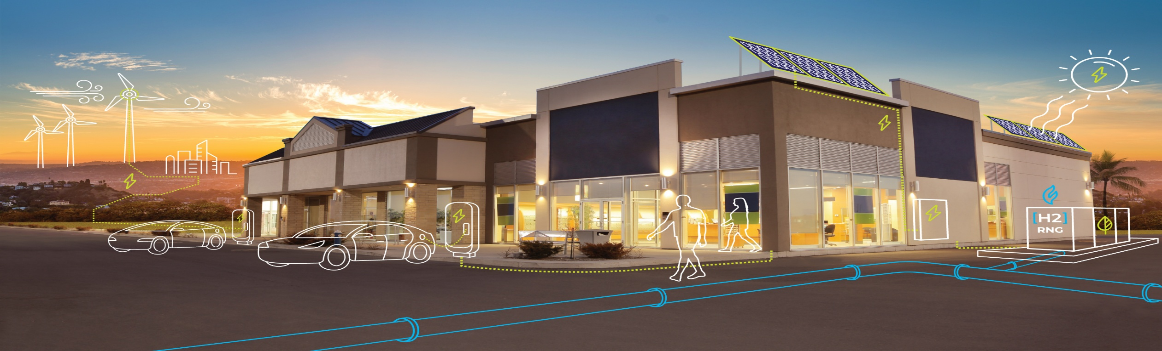
Economy-wide Decarbonization Requires Economy-wide Solutions
The interconnectedness of our energy system requires careful planning on both the integrated gas and electric grids to optimize reliability and resiliency while facilitating an affordable transition to more renewable energy
Meeting California’s decarbonization goals will require a diverse set of tools and strategies
A holistic combination of solutions is key to achieving a safe, reliable, resilient, and affordable energy transition

Slide 135
Non-Pipeline Alternatives (NPAs) May Offer a Nexus for Gas Utilities to Explore Zonal Decarbonization
Comparing gas investments against zonal decarbonization require a proper design to support long-term success
SAFE
RELIABLE
AFFORDABLE
  Safety is a leading driver for gas infrastructure investments and is the primary driver for proactive investments with the highest potential for NPA review.
  How can NPA review be designed to streamline project approvals and not negatively impact the timing of the investment?
  As California’s energy system is interconnected, it will be crucial to understand direct and indirect impacts to customers and to both the integrated gas and electric grids.
  What controls are needed to ensure viable and cost-effective NPAs can be pursued while maintaining a reliable and resilient energy system capable of serving all Californians?
  The program should be designed to prioritize affordability including to identify the most cost-effective opportunities, while supporting potential co-benefits, like decarbonization.
  How can the NPA funding be designed to protect ratepayers and energy affordability for all customers?

Slide 136

Tapping the Thermal Energy Opportunity
Zeyneb Magavi, CPUC Workshop, 01/21/2026

Slide 137
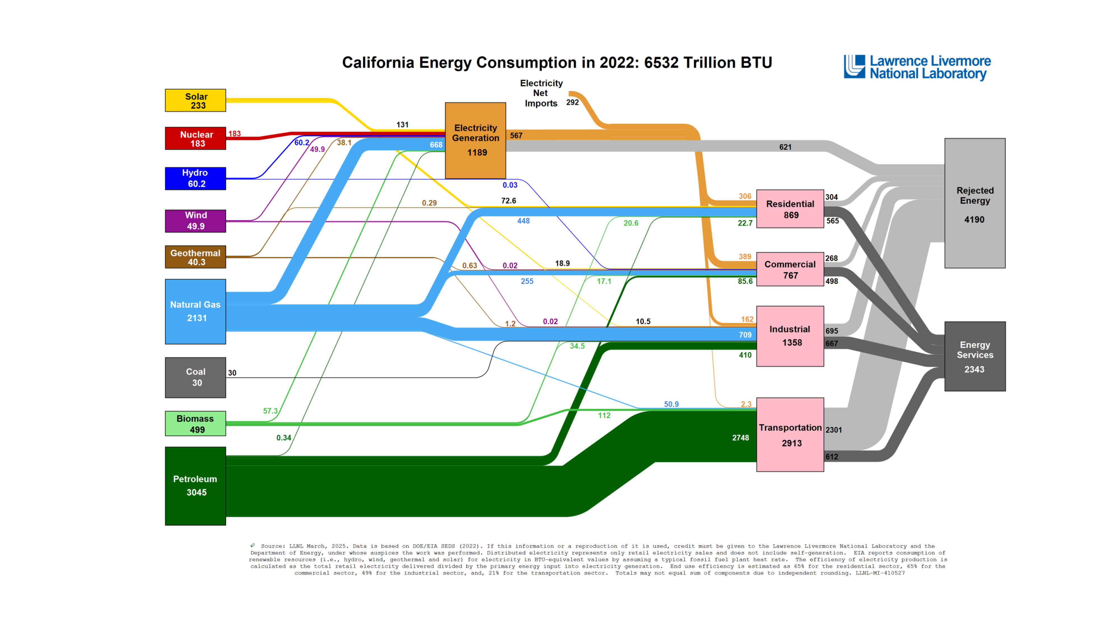
WHAT IS ANTHROTHERMAL ?
All the thermal energy resulting from human activity including:
1. The waste thermal of our energy system, buildings, sewage, and industrial processes (yes, data centers too!)
2. The excess thermal energy absorbed by the earth – which annually exceeds all energy humanity uses

Slide 138
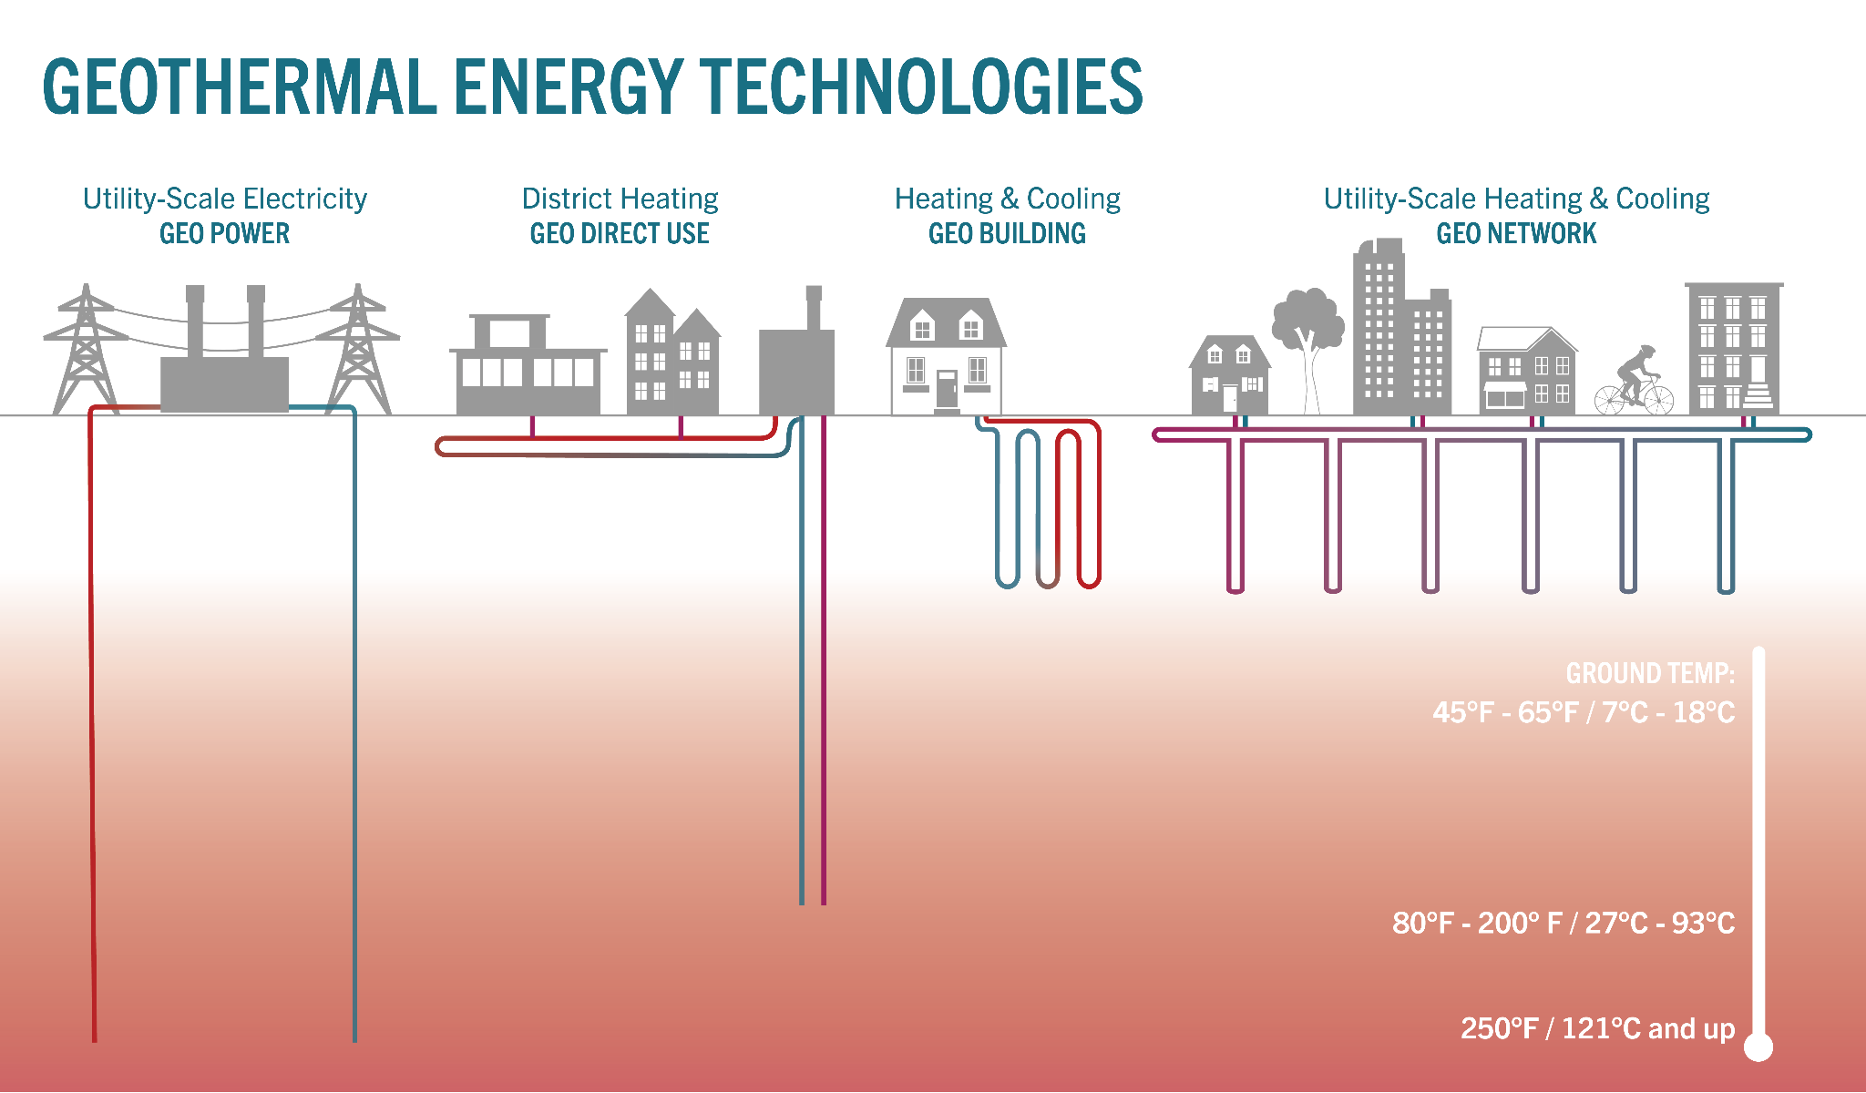
WHAT IS GEOTHERMAL ?
All the natural thermal energy at or below the surface of the earth.
Geothermal Technologies
use this STABLE ‘rock-solid’ non-intermittent Geothermal Energy.
Ambient (a.k.a. shallow) geothermal energy is everywhere and technologies that tap it can provide heating and cooling nearly anywhere on earth with zero emissions.

Slide 139
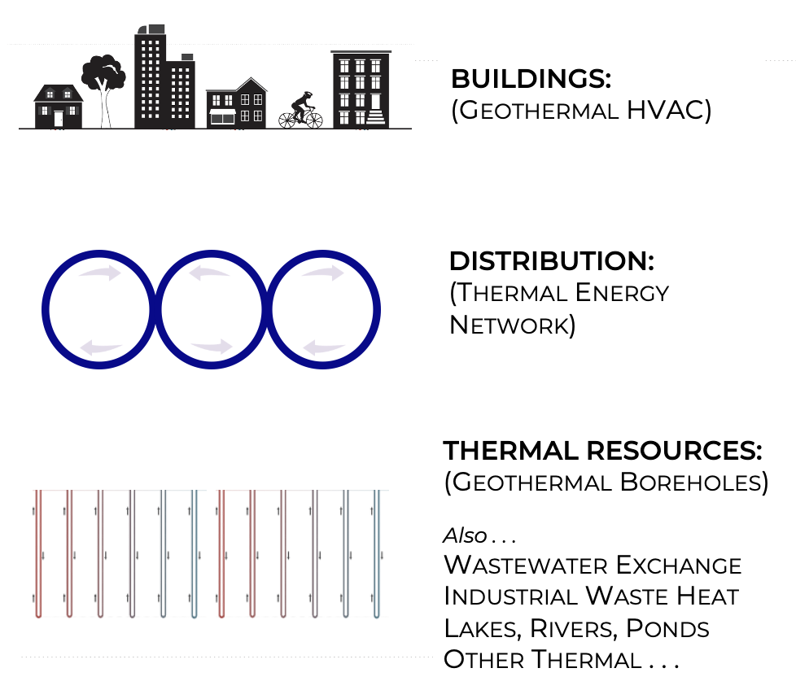
WHAT IS A THERMAL ENERGY NETWORK ?
An evolution of district energy that taps ambient thermal and moves it between buildings in pipes filled with water. Every component of a Thermal Energy Network contributes efficiencies. Together they are the most efficient heating and cooling.
Each component is OLD TECH. Together they are NEW TECH.

Slide 140
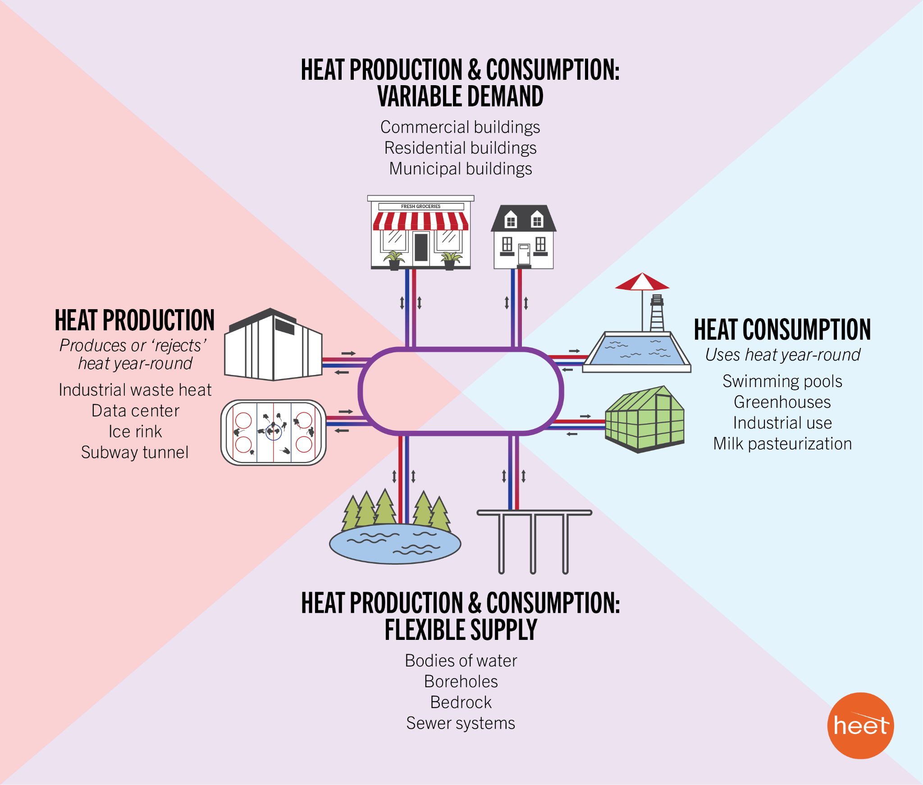
WHAT IS A THERMAL ENERGY RESOURCE ?
A thermal utility is responsible for optimizing the interconnection of thermal resources to thermal demands across space and time.
It should prioritize closest, least cost thermal resources. The defining parameters are illustrated in four quadrants. The flexible supply quadrant is the MOST valuable resource.

Slide 141
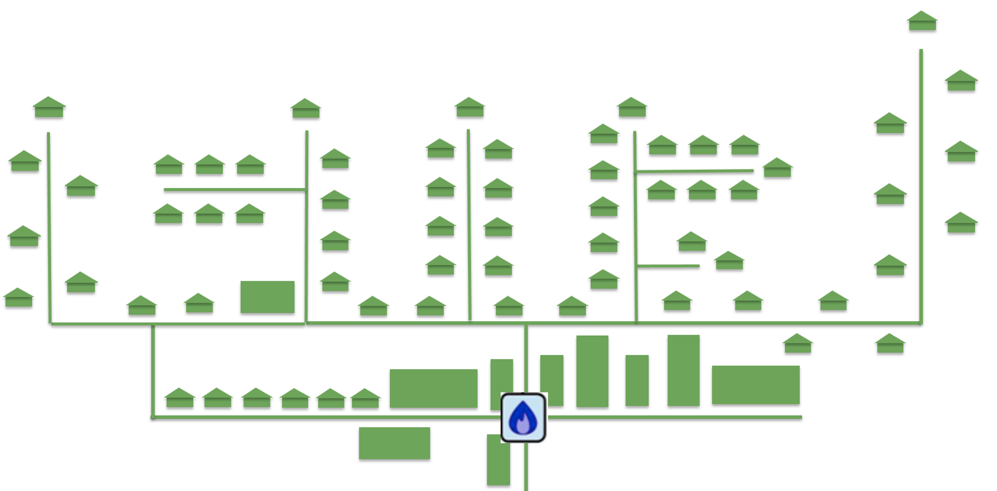
WHAT IS A THERMAL UTILITY?
This technology is a natural monopoly, making it a ‘utility’ whether owned by investors, by municipalities, or others. By investing in street-scale thermal energy infrastructure (TENs) and interconnecting them over time to increase efficiency any allowed entity can grow a regional thermal utility.
This creates a thermal market, transforming the ambient thermal energy all around us, including waste, into assets or thermal resources.

Slide 142

WHY BOTHER WITH A THERMAL UTILITY?
☐ High Safety & Security
☐ 100% Combustion-Free
☐ Reliable & Resilient
☐ Scalable & Adaptable
☐ Workforce Transition
☐ Ethical Access
☐ Affordable for consumer
☐ Economic for utility
☐ Speed & Scale needed
☐ Benefits Electric Grid
✓
✓
✓
✓
✓
✓
✓
✓
✓
✓
Notes:
TENs are passionately supported by a diverse bipartisan coalition: climate activists, republican legislators, unions, advocates for EJ/Housing/Jobs, underemployed youth, clean energy startups, the fossil fuel industry, and more…

Slide 143
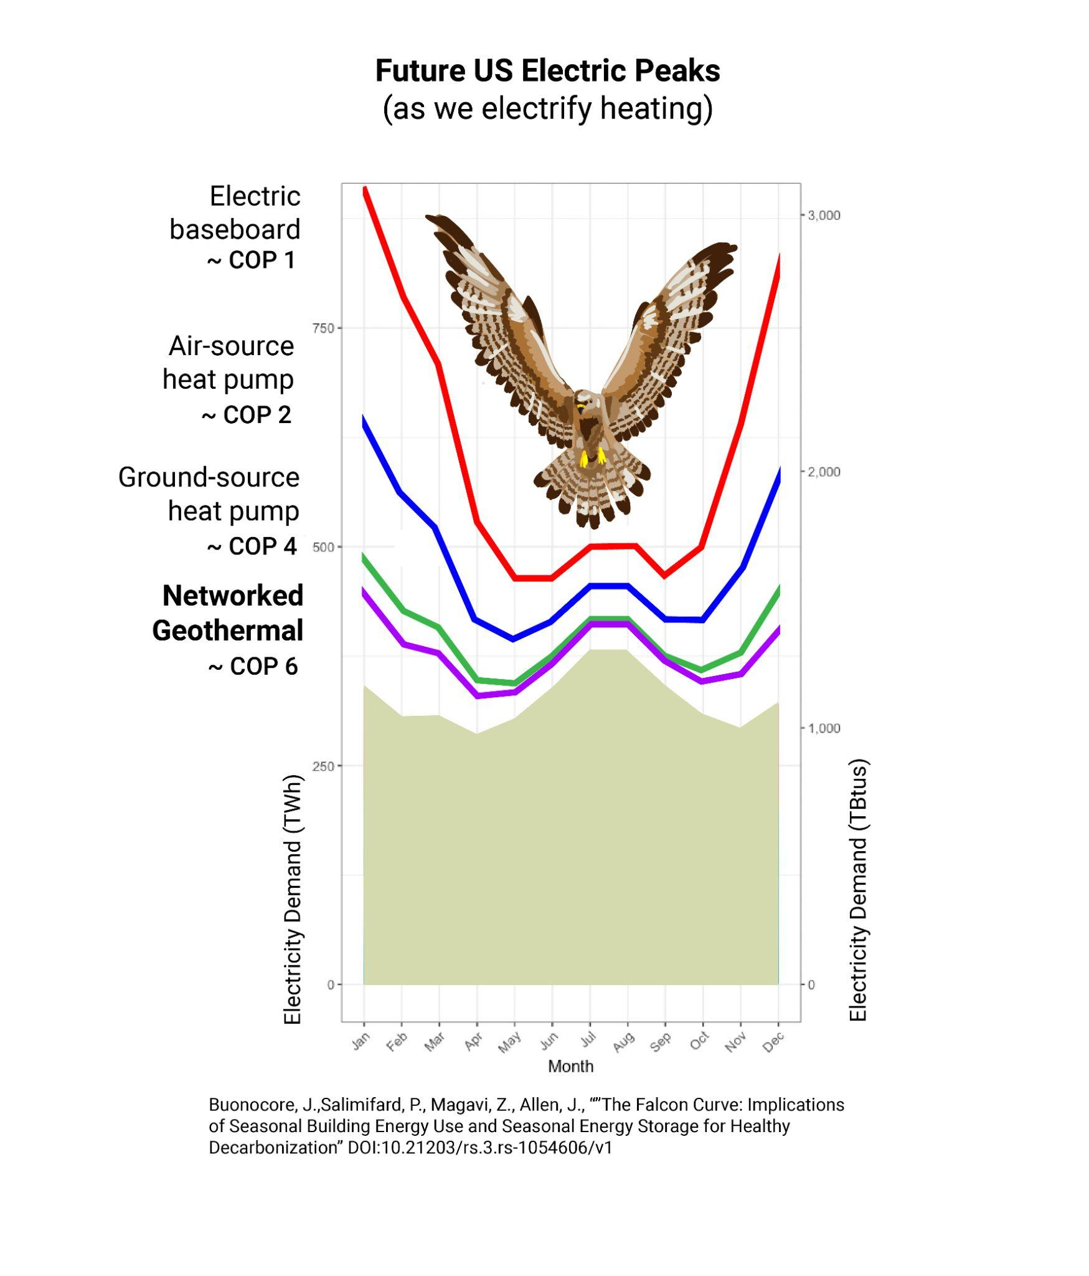

GRID BENEFITS
The Falcon Curve illustrates why higher efficiency technologies with flatter annual load profiles save money on the electric grid. A 2024 Oak Ridge National Lab analysis calculated a $1.6 Trillion (NPV) electric grid benefit by 2050 in an ‘all electrification’ scenario with geothermal heating and cooling as compared to air-source heat pumps..
Buonocore, J. J., Salimifard, P., Magavi, Z., & Allen, J. G. (2022). Inefficient Building Electrification Will Require Massive Buildout of Renewable Energy and Seasonal Energy Storage. Scientific Reports, 12(1), 11931–11931. https://doi.org/10.1038/s41598-022-15628-2

Slide 144

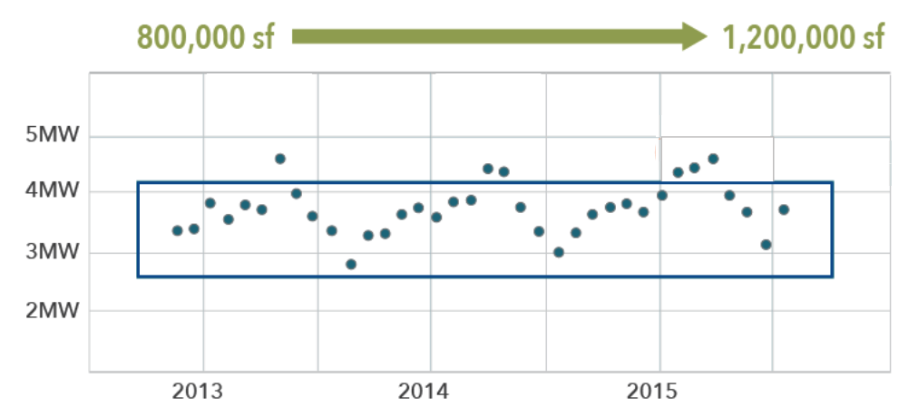
COLORADO MESA PROJECT
The oldest and largest operating single-pipe ambient-temperature geothermal network, this campus system is now in it’s sixth phase of expansion since 2008. Growth increased efficiency, decreased costs, all while grid load remained flat.
Initial Cost/ton: $7,400
Additional Cost/ton: $3,284

Slide 145
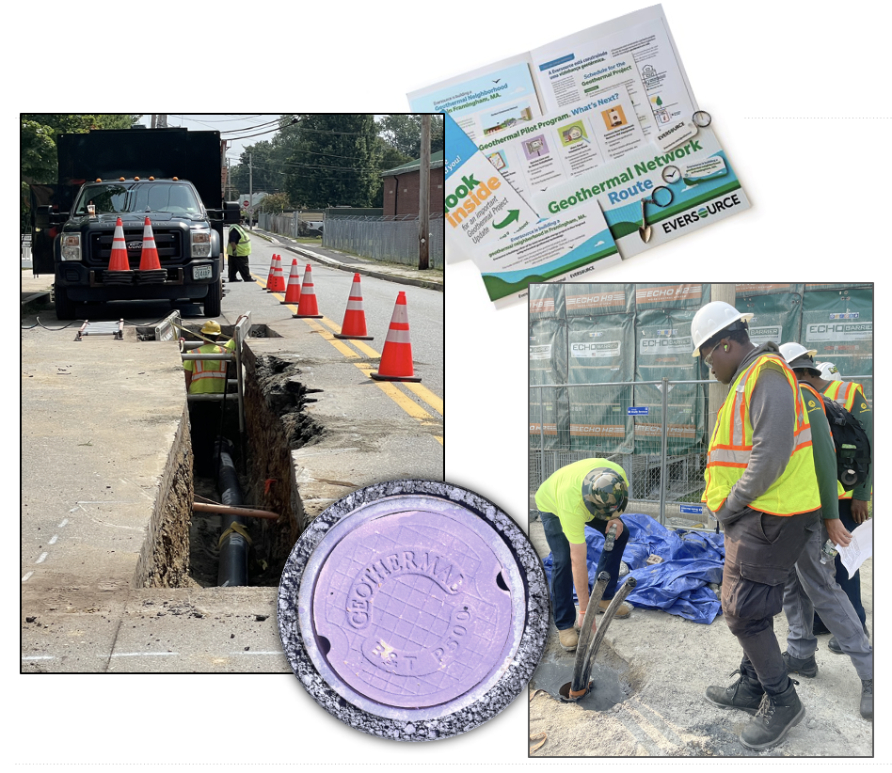
WORKFORCE
Gas utility workforces can transition to marketing and installing geothermal networks with less than a day of training. Water well and geotechnical drillers need a few weeks. One union leader described thermal networks as the first viable workforce transition pathway they had encountered in the decarbonization space. Unions have supported this tech across the country.

Slide 146
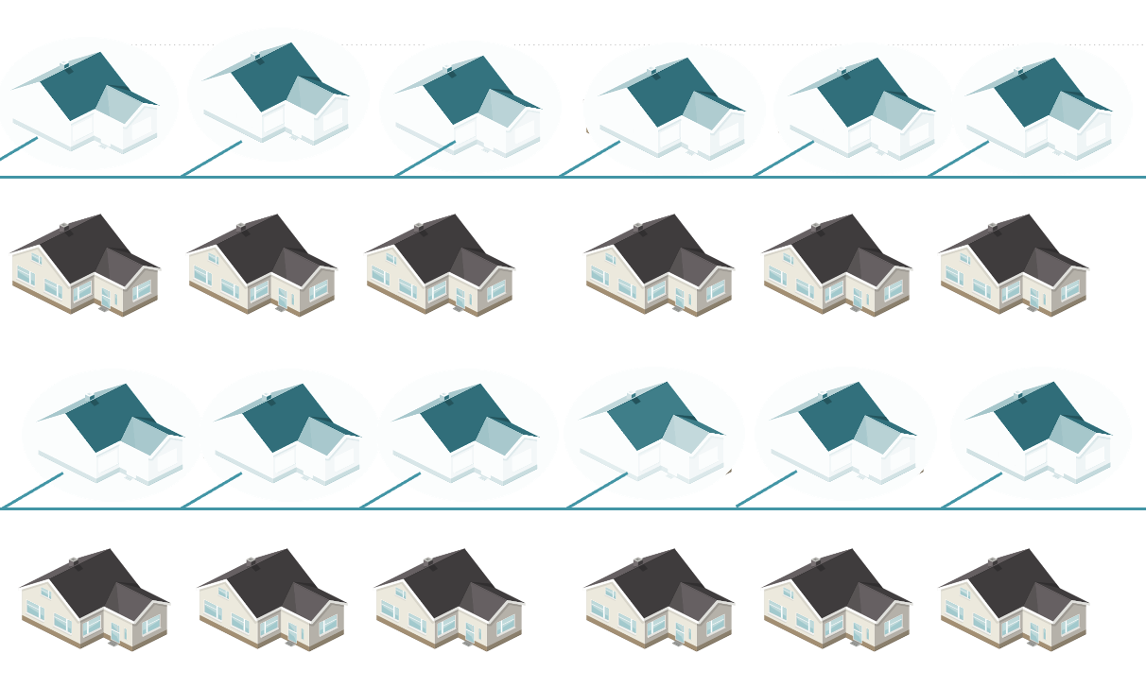
GAS TO GEO
The upgrade of a branch of the gas system to geo is similar to the upgrade from coal gas to natural gas – it increases safety, reliability and affordability. A path to zonal building modernization.
This evolutionary business model strategy also allows for the stabilization of the gas ratepayer base and planned or managed system-wide upgrades that include all.

Slide 147
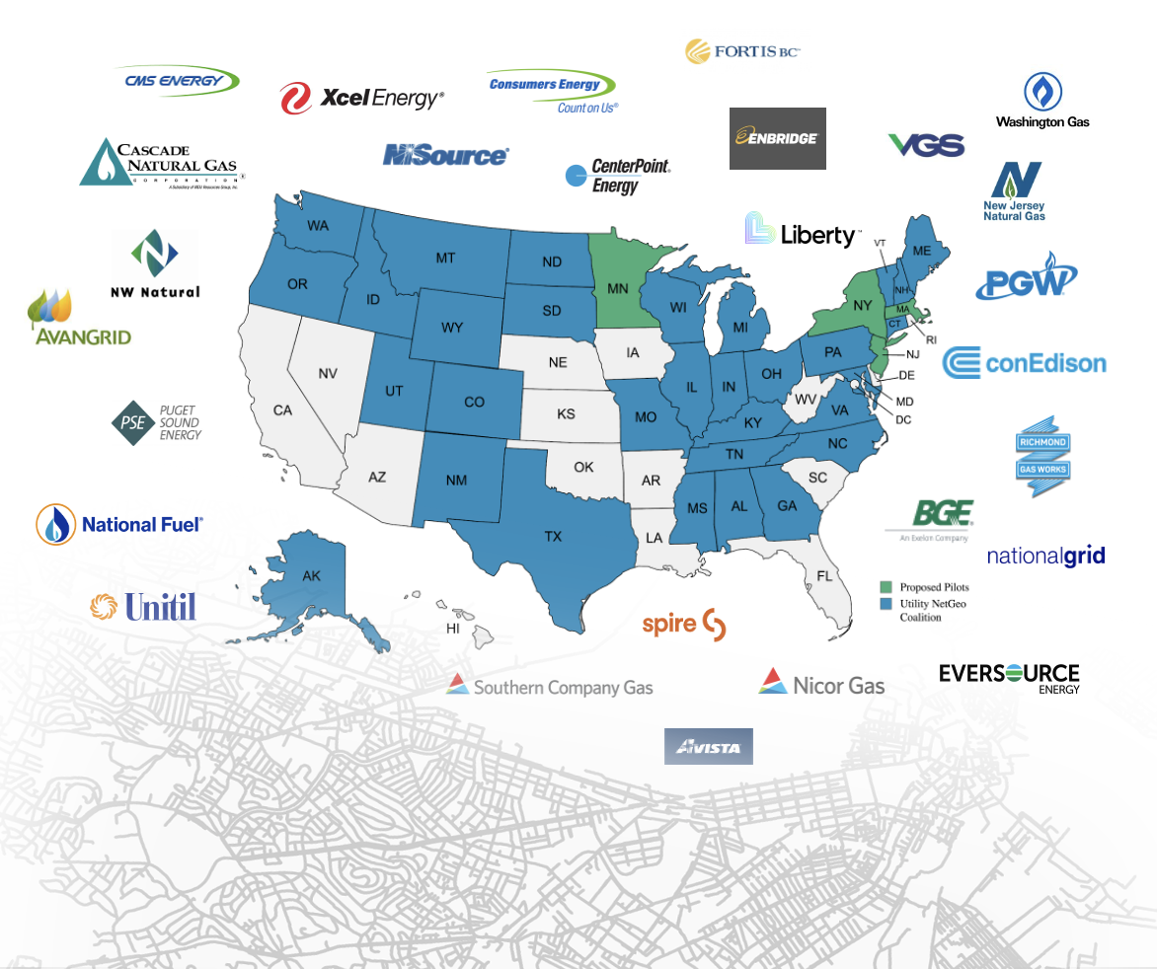
GAS UTILITY INTEREST
This is a late 2025 snapshot of the gas utilities participating in the Utility Networked Geothermal Collaborative. There are two regional subgroups that meet regularly as well. Purpose varies by region from expanding customer base under gas capacity constraints to expanding business model to cooling to addressing legislative or regulatory electrification requirements.

Slide 148
POLICY PATHWAY: LEGISLATION
MA - 2021, 2022, 2024, 2025
MN - 2021, 2024, 2025
NY - 2022, 2025
CO - 2023, 2024
WA - 2024, 2025
MD - 2024
VT - 2024
CA - 2024
NJ - 2024 (study)
ME - 2025 (study)
TX - 2025
This is a snapshot of the thirteen state laws passed by late 2025. Each enables thermal energy networks or specifically the gas to geo pathway. However, some states do not need legislative permission to move forward. There is, for example a great project in Oklahoma with no related policy changes.

Slide 149


POLICY PATHWAY: REGULATION
A NY Commissioner described this as the first new utility in 100 Years. The technology is proven but there is no proven regulatory framework to ensure cost and service optimization. As Massachusetts moves from Demonstration to Development they have written a geo pipeline safety ruling and are now considering the first geothermal ratecase:
Eversource / NSTAR Gas Proposed Geothermal Tariff Analysis (MA D.P.U. 25-86)

Slide 150
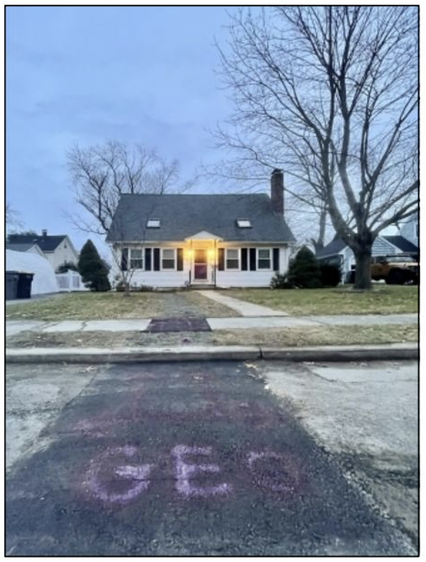
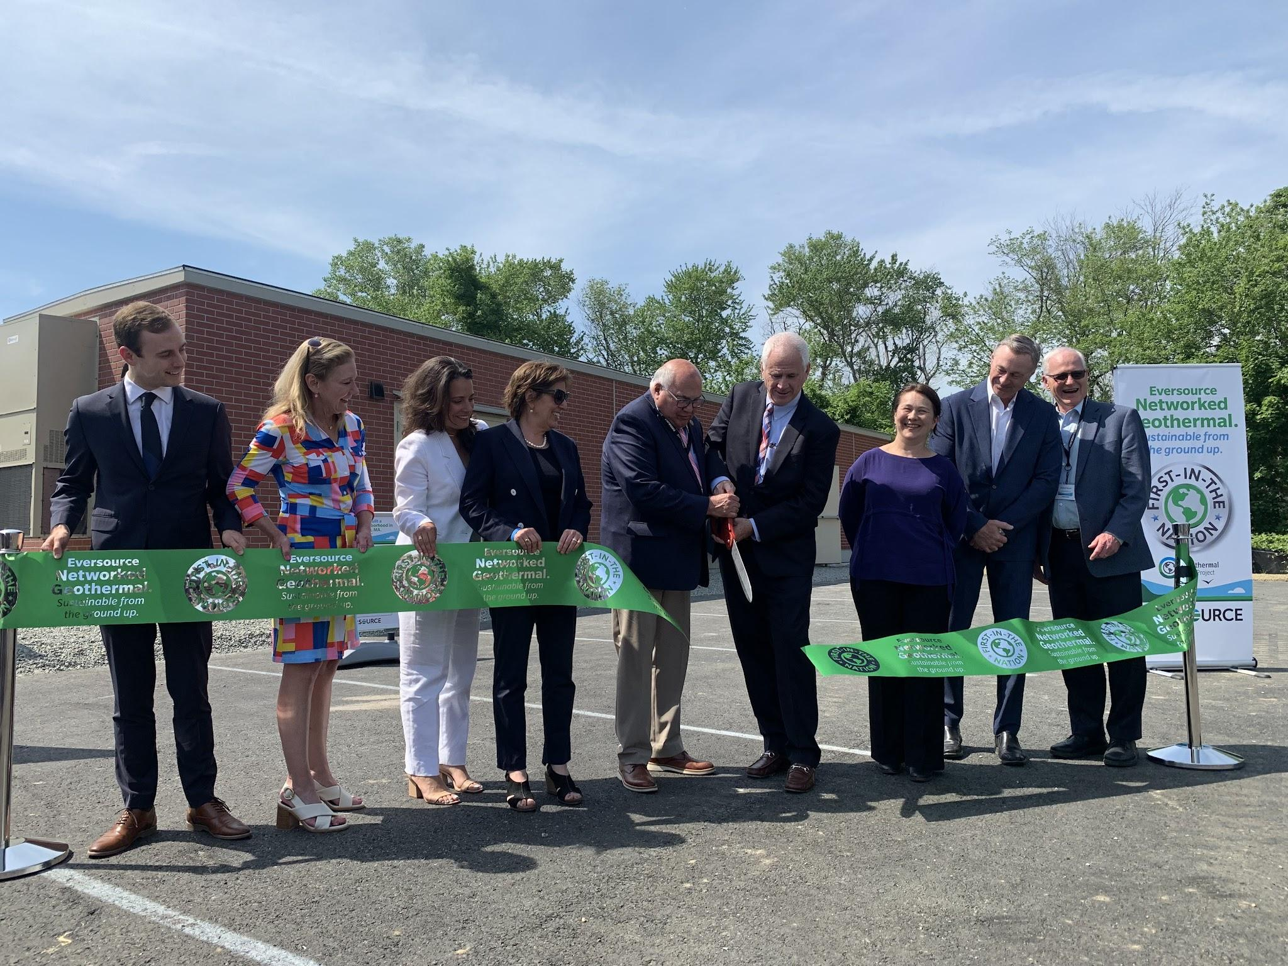
FRAMINGHAM PROJECT
Eversource Gas installed a geothermal network connecting 140 residential and commercial customers to a one mile loop of pipe in the street. It has successfully met the coldest and hottest days since commissioning at the end of 2024, using only 90 boreholes for 375 tons of load.

Slide 151
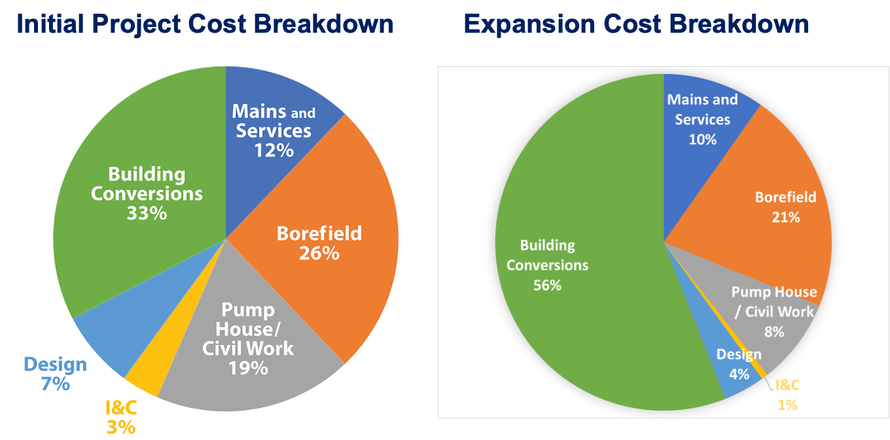




FRAMINGHAM EXPANSION PROJECT
HEET, with Eversource Gas and partners, was awarded $8.5 million for an expansion project, demonstrating utility growth by interconnecting the two ‘loops’ to increase efficiency. The system cost dropped 40% despite a 120% increase. The loop and borefield went from $12M to $6M. Fewer boreholes, more load!
Notes:
Engineering, site work, and permitting simplified, research learnings applied, approach to procurement changed.

Slide 152

DATA? DATABANK!
Consistent and comparable data across every project is necessary to maximize the cost margin between geo and alternatives, to optimize deployment and scale, and to ensure prudent and fair regulation and ratemaking.
Massachusetts funded HEET’s LeGUp Research Consortium which recently launched a national Databank hosted on Harvard’s Dataverse. Other states have begun to require submission.

Slide 153

SCALING ?
Scaling requires coordinated effort across multiple sectors.
To provide some sense of scale, very roughly, based on the #s from the Merrimack Valley Gas Collapse, it would take 377K workers to replace all 2 million miles of gas pipe in the U.S. with geo pipe by 2050. Which decarbonizes approximately 40% of U.S. energy use.

Slide 154



THERMAL MOMENTUM
The social feasibility, technical feasibility, together with the possibility of delivering affordable modern thermal at costs lower than gas are all driving a thermal revolution with growing interest globally. The World Bank Group has launched a program for 10,000 building scale geothermal networks for in the Middle East and Central Asia.

Slide 155


#ThinkThermalTogether
HEET licenses all materials for open sharing & adapting under Creative Commons CC BY-AS 4.0

Slide 156
APPENDIX SLIDES

Slide 157

UA National support for electrification by thermal networks, check out the great video

Slide 158

CLARIFYING NOMENCLATURE BETWEEN DISTRICT ENERGY & TENS!
Geothermal Energy Networks (GENs)
are a subset of
Thermal Energy Networks (TENs)
which are a subset of
5G Districts.
Notes:
Putting it all together in one chart – what is a thermal energy or geothermal energy network? It is a specific type of district energy that uses geothermal energy. This is provided here for your reference and was created to address the very variable and/or missing definitions in state laws and regs. Also, just because we get SO MANY questions on this. ☺

Slide 159

CLARIFYING COST COMPARISONS:
These components are essential to understand costs and benefits and how to compare apples to apples as we make infrastructure investment decisions.

Slide 160


This is an Engineered Solution not a product.
So the first step is a location-specific feasibility study
Like the one BuroHappold Engineering did for Massachusetts
Notes:
Heating and cooling loads:
Based on building energy profiles.
Energy use intensities (EUI) applied to PSS building areas.
Heating and cooling demand calculated for individual buildings.
Coincident heating and cooling demand derived from aggregated peak day hourly loads.

Slide 161


Slide 162

A Gas to Geo pathway can minimize energy burden for the low-income
Future Energy Burden for Low-Income Customers
Building by Building off Gas
Gas to Geo
Source: E3, Report for Massachusetts Gas Utilities, 2022

Slide 163

An out of date Massachusetts Energy Bill Projection
Gas vs. Networked Geothermal
Castigliego, J., Alisalad, S., Stanton & E. (2021). When heating with gas costs more. Applied Economics Clinic. https://aeclinic.org/publicationpages/2021/01/13/inflection-point-when-heating-with-gas-costs-more

Slide 164


Slide 165


According to NOAA data, Boston Harbor is 3.4 degrees Celsius warmer than in 1912.
That is enough heat in the ‘Thermal Commons’ for over 1 Million homes annually.
It might even make lobsters think Boston is cool again.
Buonocore, J. J., Salimifard, P., Magavi, Z., & Allen, J. G. (2022). Inefficient Building Electrification Will Require Massive Buildout of Renewable Energy and Seasonal Energy Storage. Scientific Reports, 12(1), 11931–11931. https://doi.org/10.1038/s41598-022-15628-2
Notes:
A key slide bringing the thermal opportunity into view…
Climate change is a thermal energy management challenge… it causes an increase in ‘ambient geothermal energy’ throughout the earth – in the ocean, in the bedrock, and a wee bit in the air.
That excess thermal energy is ‘anthropogenic’… and tapping it can help BOTH prevent a changing climate and mitigate and restore our climate.

Slide 166

System-scale planning process needed:
Tactical Thermal Transition Tool Needed
Tactical Thermal Transition planning requires:
Transparent Values:
  Cost Distribution
  Benefit Distribution
  Equity of Access
  Environmental Justice
  Generational Justice
Data Layers:
  Gas data
  Electric data
  Thermal Data
  Building Data
  Social Data
System Interactions
Integrated Interface to explore values & data driven evolution paths
Notes:
Grid Decarbonization Scenario:
Undiscounted cumulative savings through 2050 are more than $1 Trillion.
This reduces wholesale electricity prices by 12% ($10/MWh price reduction)
GHPs reduce cost of decarbonization: 47% for grid decarbonization (632 billion cost reduction) and 27% for full electrification (810 billion cost reduction)
We all get to save 19 Billion on heating fuel each year along the way.

Slide 167
Open Forum

Slide 168
Next Steps (Post-Workshop)
Workshop Report (approximately late February to early March)
Stakeholder Feedback on Workshop Report (2-week comment period)
CPUC develops a Proposed Decision
Party comments and reply comments on Proposed Decision
Best Practices and Future Pathways Final Decision (Q3 2026)

Slide 169
Closing Remarks

Slide 170
Resources:
CPUC Building Decarbonization webpage: https://www.cpuc.ca.gov/about-cpuc/divisions/energy-division/building-decarbonization
CPUC Building Decarbonization proceeding: https://apps.cpuc.ca.gov/apex/f?p=401:56:0::NO:RP,57,RIR:P5_PROCEEDING_SELECT:R1901011
Energy Division Building Decarbonization Section contacts:
Nick Zanjani (Supervisor): Nick.Zanjani@cpuc.ca.gov
Abhilasha Wadhwa (Sr Analyst) at awb@cpuc.ca.gov
Alyssa Cheung (Sr Analyst) at Alyssa.Cheung@cpuc.ca.gov
Meghan Cook (Sr Analyst) at meghan.cook@cpuc.ca.gov
Garima Chatrath (Analyst) at Garima.Chatrath@cpuc.ca.gov

Slide 171


