Slide 1
Leap 2024 Load impact evaluation
Demand Response Providers’ 2025 Final Report Workshop
Hosted by the California Public Utilities Commission
May 14, 2025

Slide 2

Agenda
Introduction
Leap portfolio
Events
Ex Post
Methods
Results
Ex Ante
Methods
Results

Slide 3
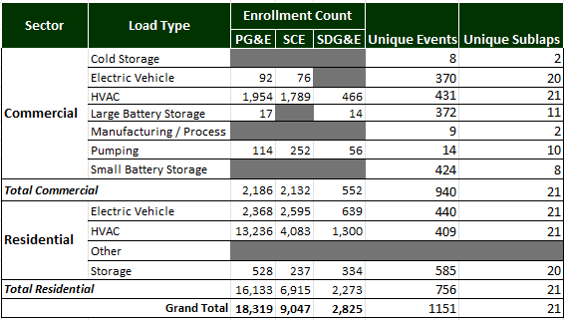
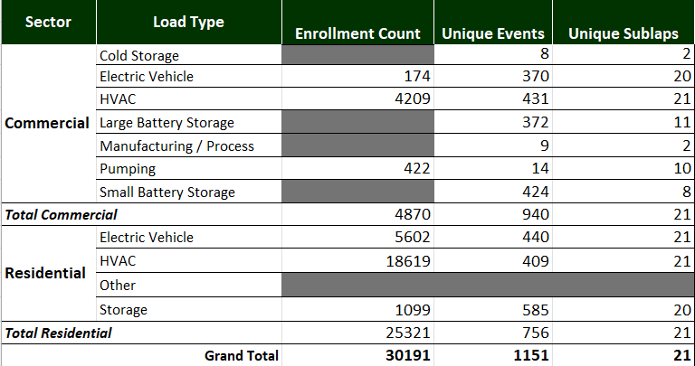
2025 Leap Portfolio
Based on Customer and Event Data
Multiple load types
High frequency of events
Geographic diversity
Notes:
Founded in 2017, with first award of capacity in California in 2018 through DRAM.
Conducted load impact studies since 2020.
Technology company. Hardware-agnostic API platform enables customers of all sizes to participate in demand response programs with a broad variety of load types.
Thousands of customers, the majority in PG&E, followed by SCE and SDG&E as distant third.
31 partners – think of them as aggregators – that collaborate with Leap for the dispatch of resources.
To promote reliable load reductions, Leap makes use of remote automation to notify participating sites of
impending events. At the onset of an event, Leap sends notifications to the control systems for
participating loads, indicating the timing and location of the event. Relevant loads then respond as
specified by the partner and their participating electricity customers, ensuring reliable and customer friendly
dispatch. For additional information on Leap and its services, see Appendix A.
Grid conditions rarely, if ever, require dispatch for the entire state of California. Instead, events are
called for specific locations. This means that DR aggregators like Leap never trigger events for all of
their partners simultaneously -- in what is considered a “full resource” dispatch. Events are scheduled in
the interval between 4 and 9 PM, lasting one to five hours.

Slide 4
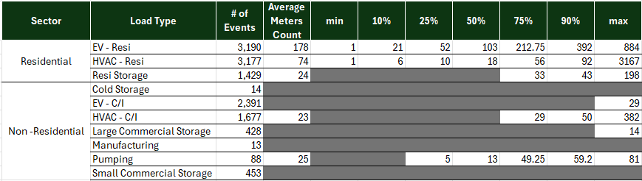
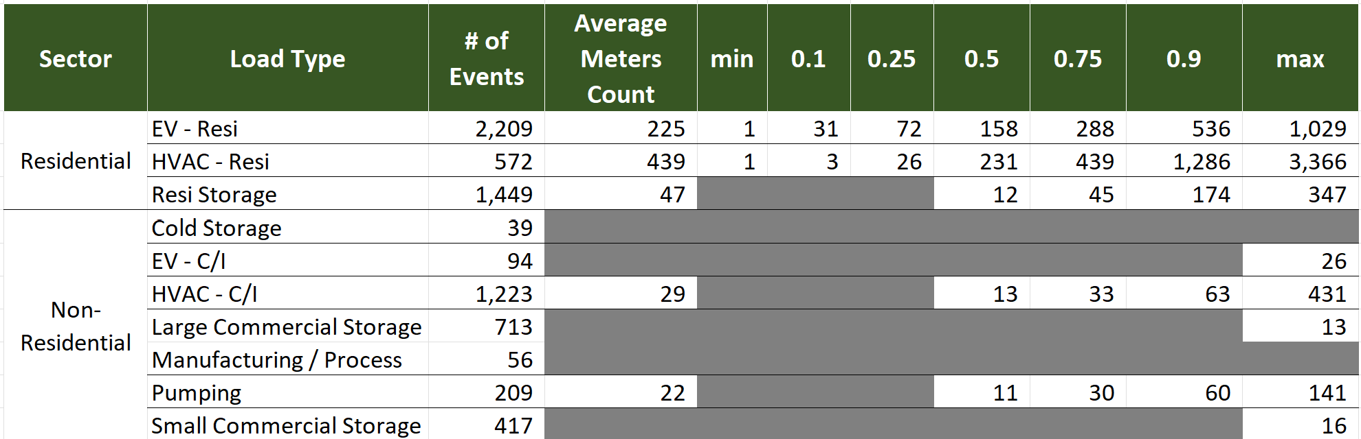
Meters by event
Average and percentiles by load type
For residential load type, use of panel data models make low-participation events more difficult to model.
Notes:
Percentiles are presented to show the variation in meter counts for different events.
For non-residential, irrelevant, but for residential load types, this did have implications for the ability/success of panel data models.
Deemed better to have SubLAP-specific results to capture how impacts do vary (inland versus coastal)…
For 2023, we also segmented by PV status, so counts are even lower. However, can model more successfully with smaller sample by PV status.

Slide 5
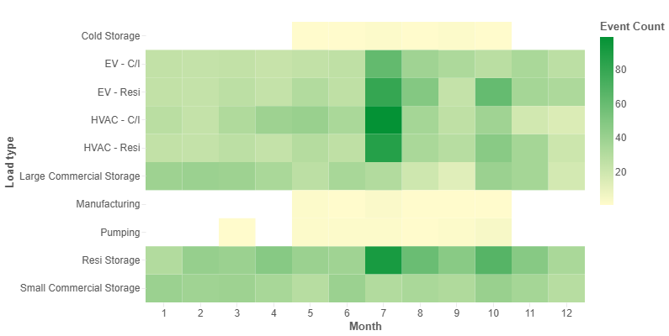
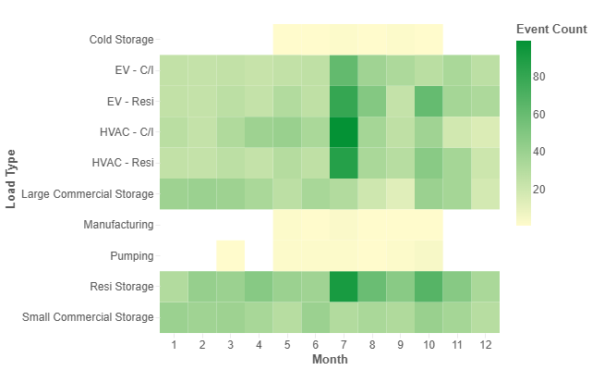
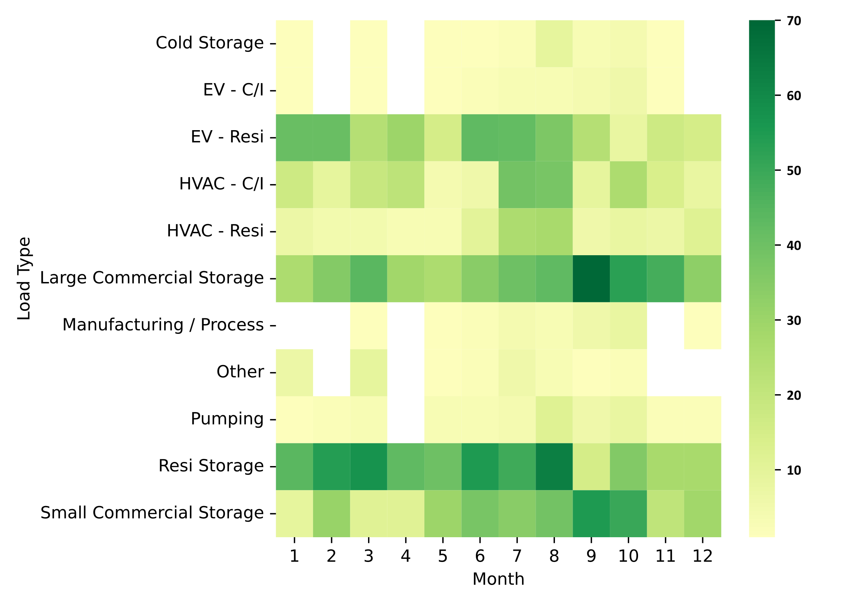
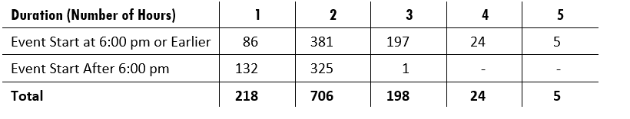
Events by Load Type and Month
Based on unique “event IDs”
More events during summer, but not nearly as stark as previous years.
Storage and Residential EV most evenly distributed over the year.

Slide 6
Data Sources
Both Non-Residential and Residential Load Types
Ex post impacts relied on the following data sources:
Customer/meter information: Load type, location, etc.
Meter data: hourly delivered kWh readings.
Event data: Event ID, event type, start and end time, program by meter.
Weather data: Hourly temperature and irradiance readings, mapped to meters by nearest coordinates. Changed source to www.calmac.org to add the irradiance.
Ex ante impacts relied on the above sources, plus:
Ex ante weather scenarios, provided the utilities and CAISO.
Low, medium, and high enrollment forecasts by load type (from Leap).
Notes:
Worth mentioning that no data were available to develop control groups.

Slide 7
Ex Post impacts

Slide 8
Residential approach
Three load types: HVAC, EV, storage.
Panel data models for each event modeled by SubLAP and PV presence
Model selection based on a proxy event day to select best model based on out-of-sample performance.
Events differentiated by type (Test, Market, Combined) and program (CCA vs. DRAM)
Event IDs can have a mix of CCA and DRAM meters, but shares are overwhelmingly one or the other (e.g., >95% of meters DRAM).
Notes:
Each event month also included data from surrounding months, but those excluded the event days in those months.
Rationale for estimating by SubLAP and month: SubLAP is a domain of interest related to grid needs and also controls from some climate variability. Months will also result in different impacts due to seasonality of end use consumption. Because not every SubLAP and month will have sufficient meters to estimate impacts, this allows for the extrapolation of modeled SubLAPs-month impacts to those not modeled.
Rationale for allowing non-event day data from neighboring months: Because they are close enough and allow for better models.

Slide 9
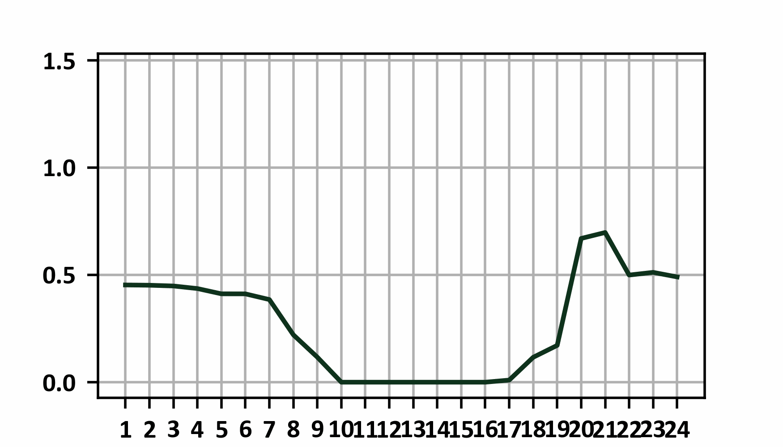
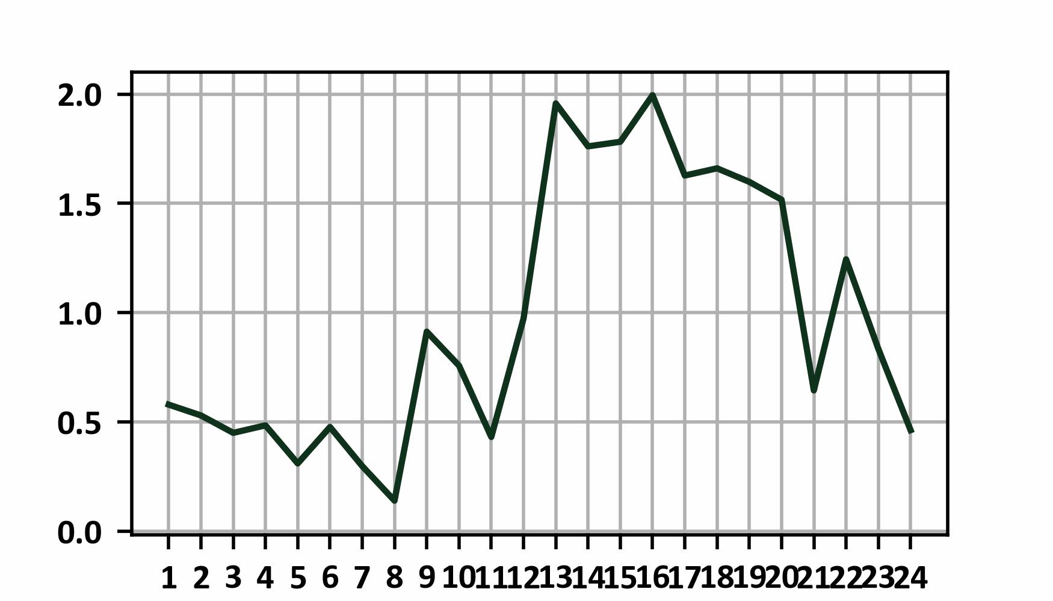
PV Customers
Additional Segmentation
Large representation of meters with PV in customer population.
Not flagged, so identified based on high share of zero kWh reads during PV production hours.
Modeled separately:
Model results better for non-PV segments.
Incorporated irradiance into the models for PV segments.

Slide 10
Non-Residential approach
Individual regression models for each meter
Analysis to assess weather sensitivity of meters to determine a model family, done seasonally.
Model selection based on a proxy event day to select best model based on out-of-sample performance.
Separate models could be selected based on time of the year (based on quarter). All event specific events within a quarter are estimated simultaneously for each meter.

Slide 11
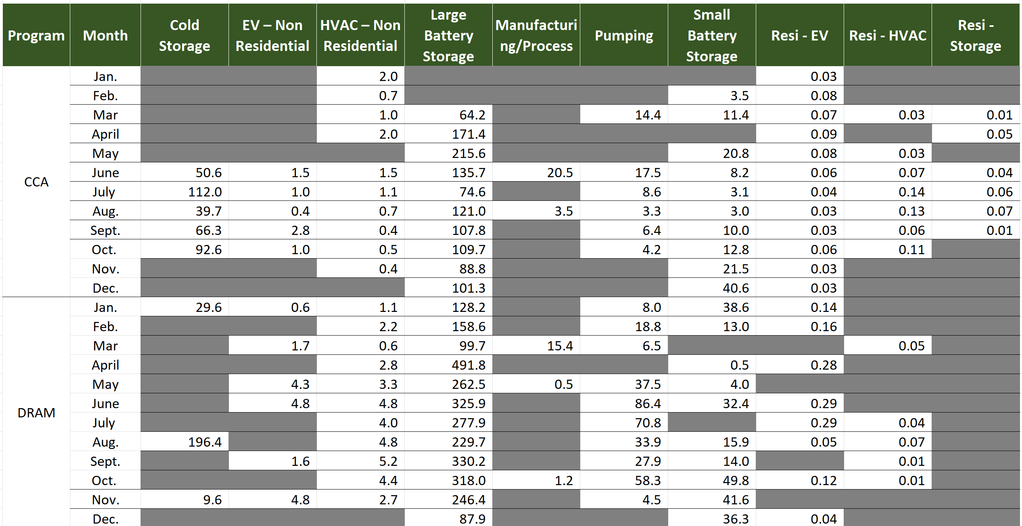
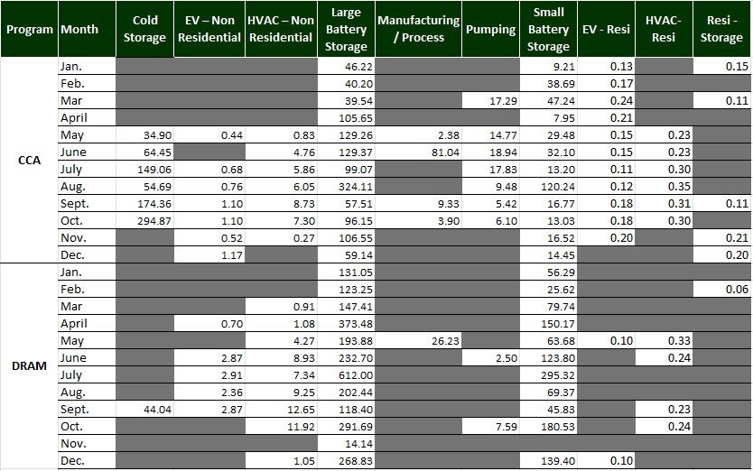
Ex Post Impacts
Per Capita kW by Program, Load Type, and Month
Notes:
For residential, HVAC impacts mainly follow an intuitive seasonal pattern. EV are mostly consistent over the year with no clear seasonal influence.
For non-residential, we see seasonal influence with HVAC, but for other load types the impacts are highly varied, driven more by which meters participated.

Slide 12
Ex Ante impacts

Slide 13
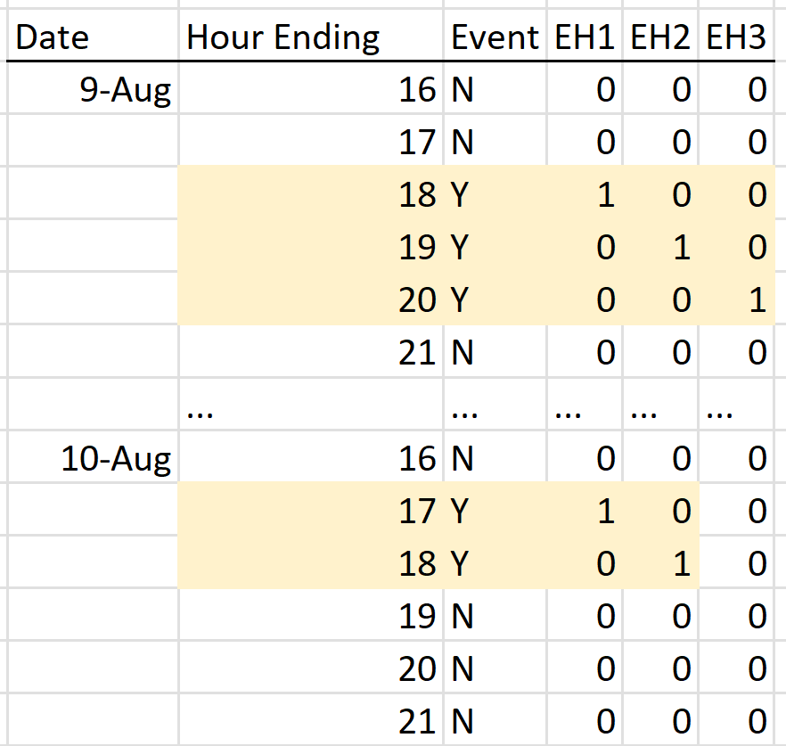
Ex ante Approach
Models informed by ex post, but modified as follows:
Events interacted with a weather term
Specification employs and “hour-of-event” approach.
Unmodeled RA hours use derated impacts from modeled hours.
Model impact parameters applied to weather scenarios to reflect impacts under different conditions.
Per-capita impacts multiplied by low and high enrollment scenarios.
Notes:
More important than the hour of the day is the hour of the event.
Reference loads estimated using hottest non-event days. These parameters are used with the weather scenarios to develop the various 1-2 and 1-10 load profiles. Also use the load on these days for any time of day load (morning, afternoon, etc.)
Derate factors – load type matters. Pumping versus HVAC.

Slide 14
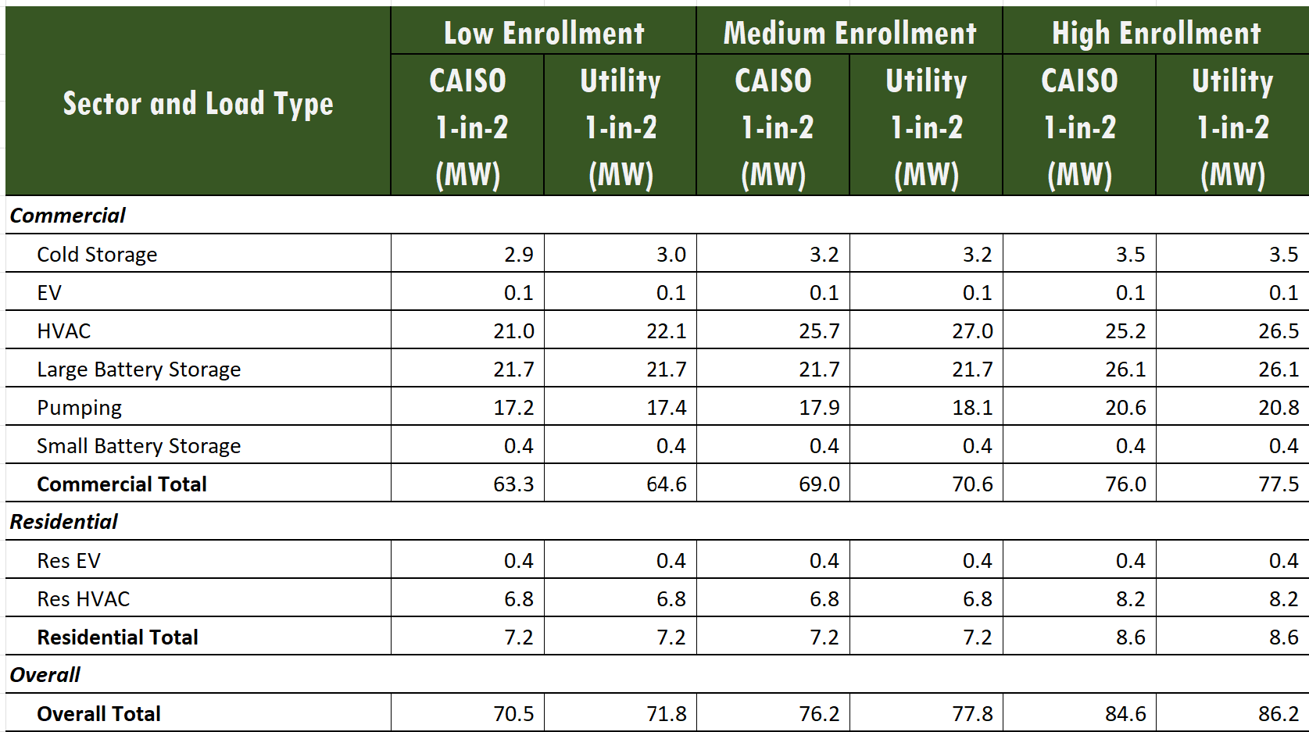
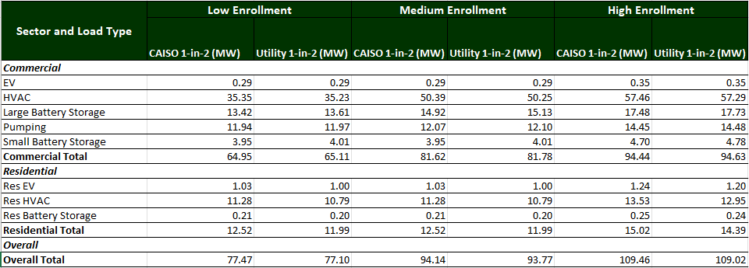
Ex ante impacts by load type
August Aggregate Impacts
Notes:
Medium for residential is the same as low.

Slide 15
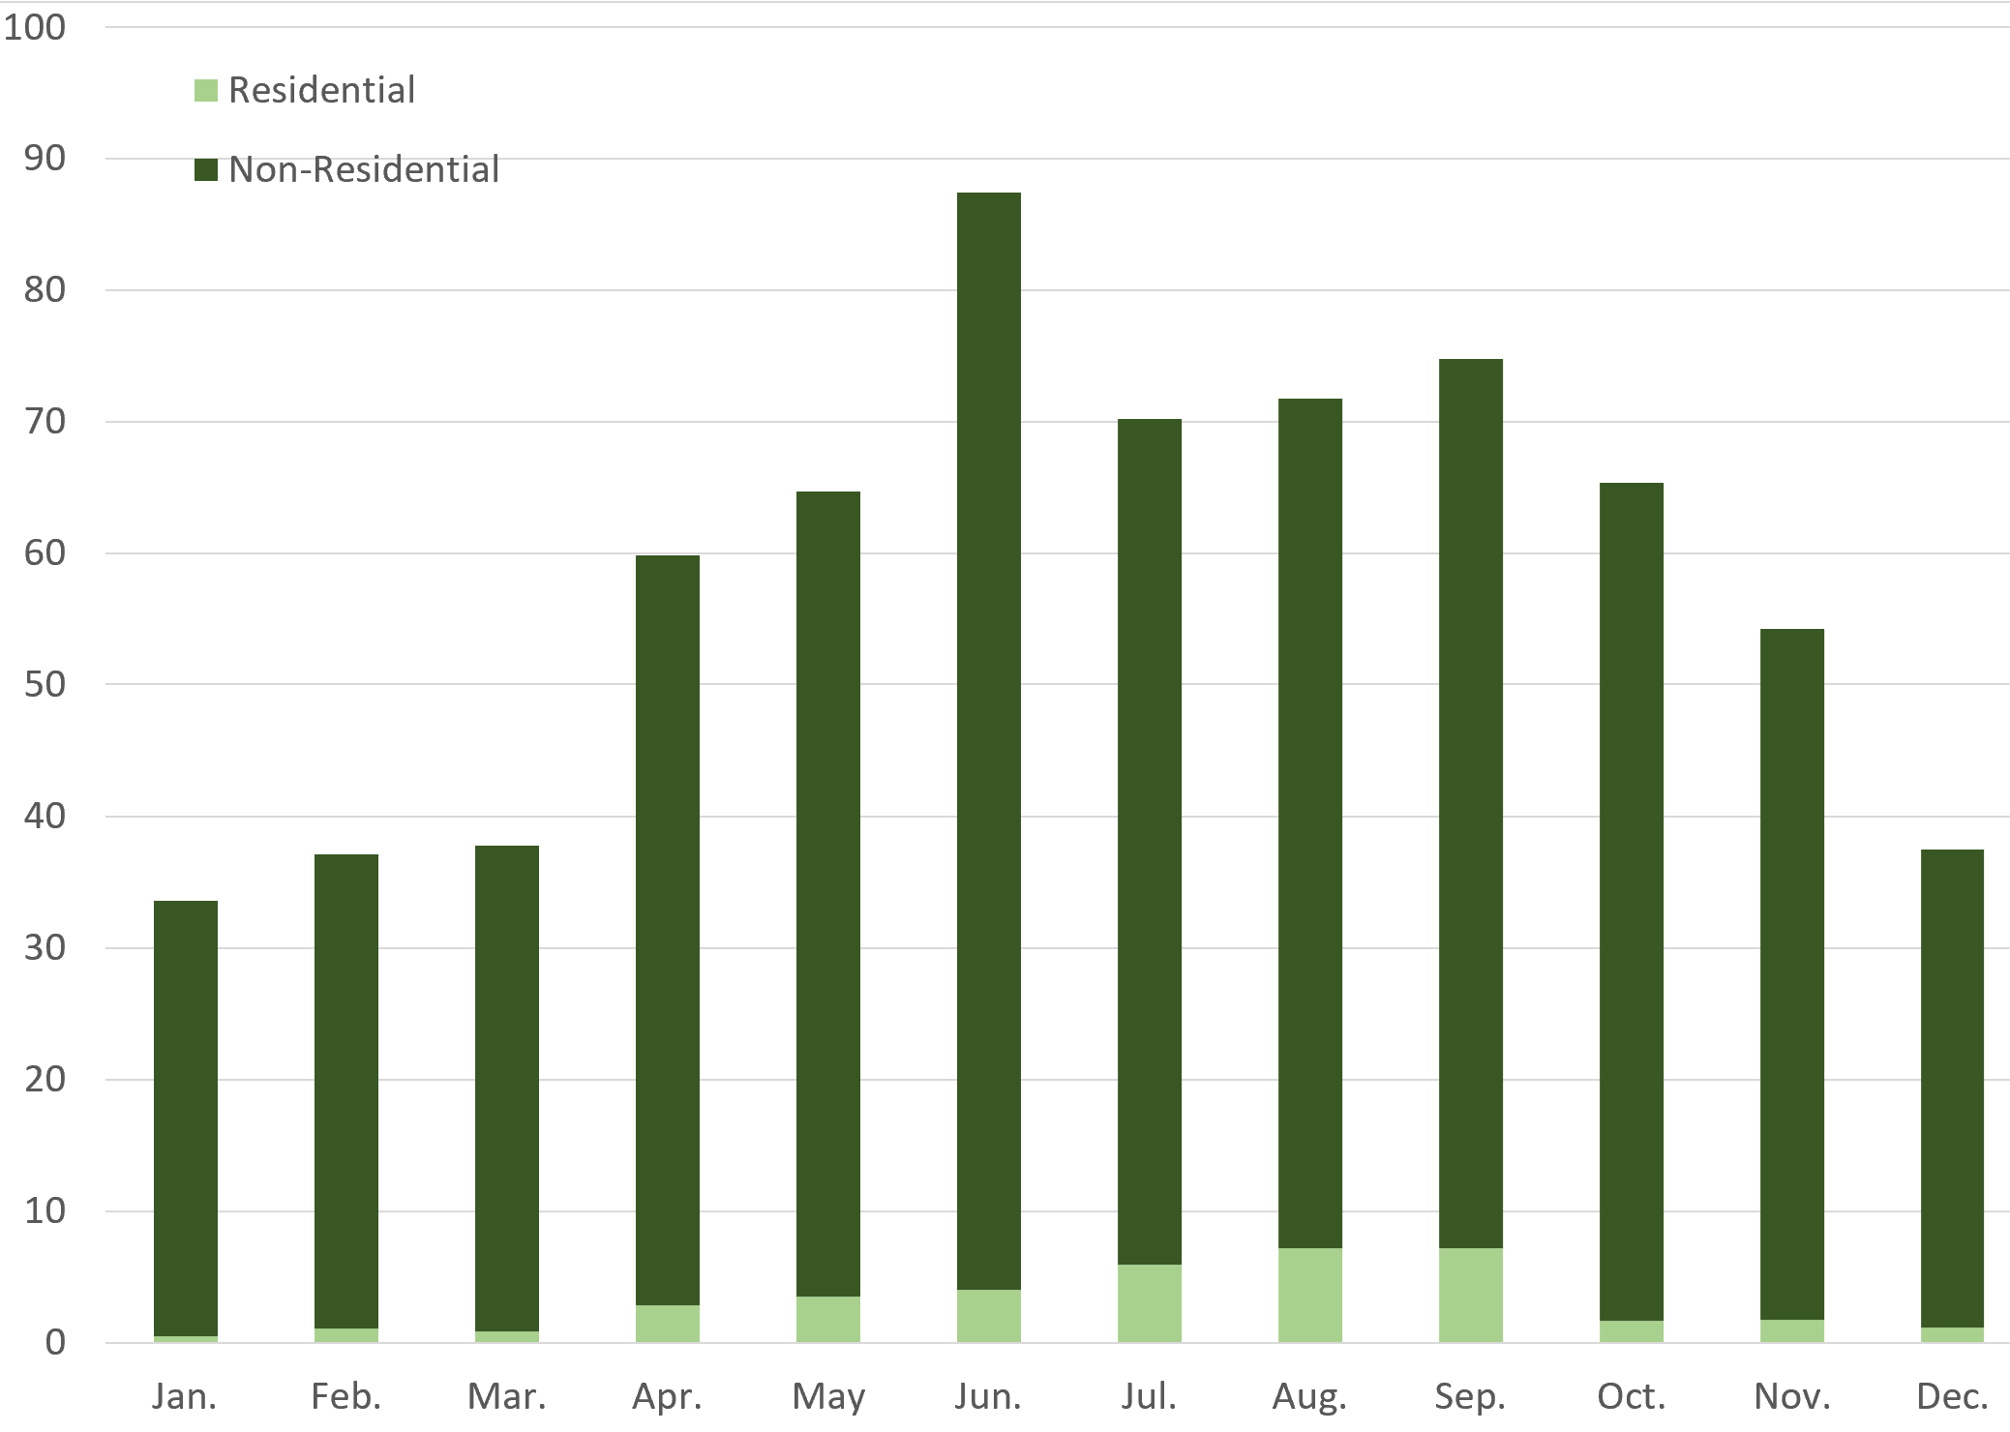
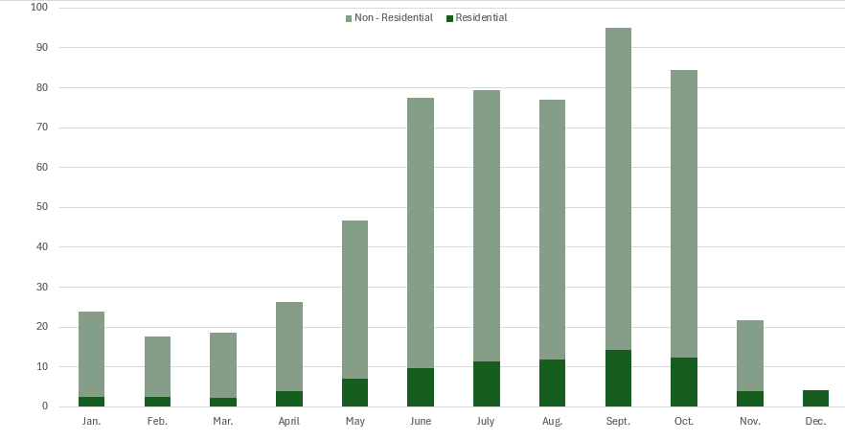
Ex Ante by Month and sector
MW in 2026
Low enrollment forecast.
Utility 1-in-2 weather.
Notes:
Seasonality in residential is evident.
Not reflective of actual resource dispatch, as there are seasonal differences in meters-per-event.

Slide 16
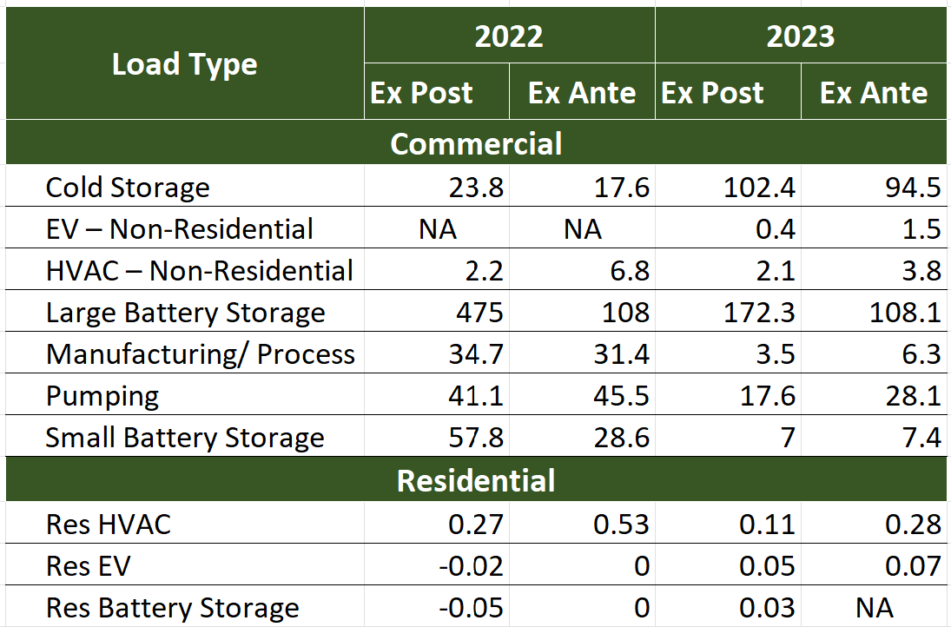
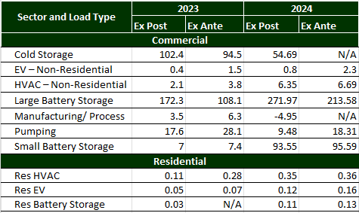
Impact reconciliation
2023 to 2024, Ex Post and Ex Ante
Load Type | FY 2022 Ex Ante | FY 2023 Ex Post
Cold Storage | 168 | 23.80
Non-Res HVAC | 7.0 | 2.2
Large Battery Storage | 1,322 | 475
Pumping | 83 | 41.1
Small Battery Storage | 13 | 57.8
Res HVAC | 0.60 | 0.27
Per-capita impacts, FY 2023 ex ante for August utility 1-2 with FY 2024 ex post results
Results are as modeled with each year’s data

Slide 17
Impact reconciliation
Caveats
For non-residential load types, the ex post impacts are highly sensitive to customer makeup.
For the residential HVAC, impacts highly sensitive to geography, so weighting of ex ante results versus actual meters dispatched influences results.
Methods a small factor – reasonable baselines should yield similar results.
For some load types, weather was a major difference
Notes:
I have a couple requests for the DRPs:
1. If applicable, we would appreciate if you could include a “reconciliation” slide or two comparing ex post for 2022 to your ex ante projections for 2022 from years prior. This will include a discussion about what you may have gotten wrong in years past and how you are improving your regression methodologies this year to account for those inaccuracies before.
Leap Comments: Some initial thoughts: * Cold Storage - there are very few meters in this load type so impacts vary considerably based on who we actually have enrolled. * small/large bess - the definition between small + large changed between the two years, in short bringing more ‘smaller’ batteries (>100kW) into the large category which diluted the impacts of the handful of >1MW systems that previously comprised the category. *for the others - I wonder if it’s in part a result of using ‘replacement months’ impacts in last year’s analysis.

Slide 18
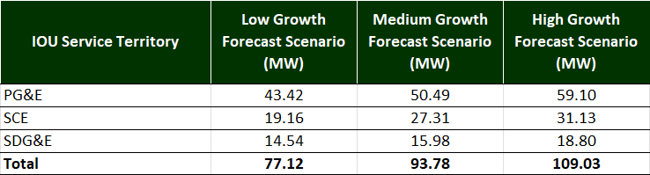
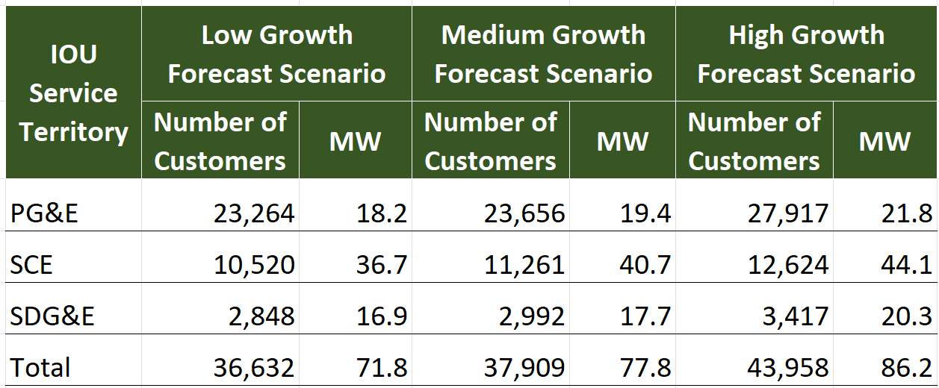
Qualifying capacity values
August 1-in-2 weather year
Utility weather scenario
Low and high growth scenarios in 2026
Notes:
Just a high-level summary table, consistent with the requirements for the final report.

Slide 19
Conclusion and recommendations

Slide 20
Conclusion and recommendations
Full extent of ex post impacts incomplete.
Some events could not be estimated due to insufficient data or load volatility.
Appropriate extrapolation for volatile customers/load types merits investigation.
Some resources would benefit from having net load, particularly residential EV and battery storage:
Very high presence of net energy metering customers.
Adjusted method to segment by likely presence of PV
Ex ante methods could better portray how resources perform – importance of start time, length of events, and other factors are all obscured by current methods.

