Slide 1
Load Impact Evaluation: PG&E’s Automated Response Technology (ART) Program
Xueting (Sherry) Wang
Michael Vigdor
Corey Goodrich
Mike Clark
DRMEC Spring Workshop
May 12, 2025

Slide 2
Agenda:
Program Description
Ex-Post Analysis
Ex-Ante Analysis
Key Findings

Slide 3
ART Program Description
The ART program is a voluntary residential demand response program for customers with smart home technologies such as
Smart Communicating Thermostats (SCTs), Heat Pump Water Heaters (HPWH), Electric Vehicle (EV) chargers, Battery Storage (Battery)
Customers enroll in ART through a PG&E-contracted Provider.
In PY2024, there is only one Provider, so all ex-post results are confidential.
PG&E
Pay for
Third-Party Providers
Dispatch Smart
Customers
Performance
Technologies

Slide 4
ART Program Description (2)
Smart Thermostat Control Pilot 2022-2023
Official Launch of ART Sep 18, 2024
ART Test Event in PY2024 Oct 25, 2024
By the end of PY2024 (October 2024), the only technology enrolled is smart thermostat, and these customers were transitioned from the Smart Thermostat Control Pilot (BYOT).
ART event may be called year-round for all hours and seven days a week for the following reasons:
CAISO market award dispatch
PG&E system emergencies or near-emergencies for distribution service
Test event for the purpose of calculating incentive payments for third-party providers

Slide 5
ART Program Description (3)
A Daily Load-Shifting (DLS) strategy is required for customers on a time-varying rate, using the automated technology to reduce loads during the hours with time-varying rates.
ART customers may opt out of the DLS strategy after 12 months.
Many ART customers already had DLS implemented during the Smart Thermostat Control Pilot.
DLS may have continued after the conclusion of the Pilot.

Slide 6

ART PY2024 Participation
Participation Counts by Billing Rate
Over 12k customers enrolled by the Oct 25th Test Event.
Enrollment continued (increased) after the Oct 25th Test Event.
DLS Analysis included over 13k TOU customers by the end of PY2024 (Oct 31st).

Slide 7
Ex-Post Methodology – Event Day
Matched Control Group + Difference-in-Differences
Event-Like Non-Event Days
Control Group Matching
Difference-in-Differences
Only one event day on October 25, 2024
Select October days that are closest to the average temperature on the event day
Control pool: a sample of ~200,000 customers
Propensity score matching:
Within the same LCA and NEM status
Match on load profile on event-like non-event days, weather sensitivity, solar installation size, and battery storage
Intuitively, load impacts are the difference between the following:
Event day loads between ART and control customers
Non-event day loads between ART and control customers

Slide 8
Ex-Post Load Impacts – Event Day
Date | Trigger | Event Hours | Sub-LAPs Dispatched | # Customers Dispatched
Oct 25 | Test | 4:00-5:00 p.m. | All Sub-LAPs | 12,138
Number of Customers
Dispatched by Sub-LAP
Avg. Event Hour Temp (°F)
by Sub-LAP

Slide 9
Ex-Post Load Impacts – Event Day (2)
The average temperature during the event was only 77°F.
Load impacts are low across sub-LAPs and subgroups.
We observe an increase in loads before the event hour, similar to the “pre-cooling” observed in the Smart Thermostat Control Pilot study.
Loads did not increase after the event, likely due to the mild temperature.
Customers on E-TOU-C rate (largest share of customers) had lower load reduction than customers on E-1 rate (non-TOU).
Reference loads without Event
4-5 p.m.

Slide 10
Ex-Post Methodology – Daily Load-Shifting
Matched Control Group + Simple Difference
Control Group Matching
Simple Difference
Control pool: a sample of ~200,000 customers
Mahalanobis distance matching:
Within the same billing rate and NEM status
Match on average monthly billed usage, average cooling degree days, and solar installation size
Intuitively, load-shifting impacts are the difference between:
Average daily loads between ART and control customers
We assume that there are no changes in overall consumption.

Slide 11
Ex-Post Load Impacts – Daily Load Shifting
DLS strategy produced statistically significant load reductions during the TOU peak period.
There are increases in loads during early and late hours of the day.
There is evidence that DLS continued after the end of Smart Thermostat Control Pilot (prior to ART Launch).
Reference loads without DLS
4-9 p.m.

Slide 12
Ex-Post Load Impacts – Combining the Two Impacts
For customers on TOU rates, on the Oct 25th Test Event, both DLS and the event occurred.
To estimate both effects, we estimated the incremental DLS impacts on the Oct 25th Test Event using weather and parameters from the DLS regression model.
Reference loads with DLS and Event
4-5 p.m.

Slide 13
Ex-Ante Methodology – Overview
Enrollment Forecast
Provided by PG&E
By technology
Per-Customer Reference Loads
Estimated based on interval data of existing customers
By sub-LAP
Per-Customer Load Impacts
By technology
Assumptions of load impacts based on the pilot program or other studies.
By sub-Lap

Slide 14
Ex-Ante Methodology – Develop Load Impacts
Technology | Assumed Impact | Adjustments
SCT | Smart Thermostat Control Pilot ex-ante load impacts for the same month and weather scenario | The load impacts were scaled by the ratio of the maximum net daily reference loads estimated using the current ART population to the Smart Thermostat Control Pilot reference loads.
 |  | For April (or October), we apply the percentage load impacts from May (or September).
Battery | 2.5 kWh/customer/hour | Load impacts equal to the reference loads if reference loads are smaller than 2.5 kWh/customer/hour.
EV | 0.35 kWh/customer/hour | None.
HPWH | 0.05 kWh/customer/hour | None.
CEC Flex App | 0.05 kWh/customer/hour | None.

Slide 15
Ex-Ante Per-Customer Load Impacts
RA Window Per-Customer Load Impacts,
PG&E 1-in-2 August System Worst Day in 2025
Technology | Per-Customer Load Impacts
SCT | 0.40 kWh/customer/hour
Battery | 1.60 kWh/customer/hour
EV | 0.35 kWh/customer/hour
HPWH | 0.05 kWh/customer/hour
CEC Flex App | No customer enrolled

Slide 16
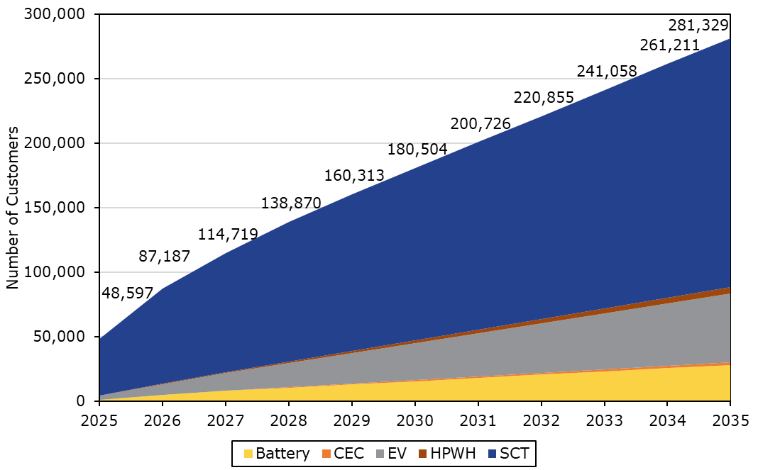
Enrollment Forecast – by Technology Type
Assumptions of PG&E’s enrollment forecast:
By the end of 2027
Aiming for ~100,000 newly enrolled customers
79% SCTs, 12% EV chargers, 7% batteries, 1.5% HPWHs, and 0.5% CEC Flex App
By the end of 2035
Diminishing marginal growth rate
Reaching ~288,000 customers
68% SCTs, 19% EV chargers, 10% batteries, 2% HPWH, and 1% CEC Flex App

Slide 17
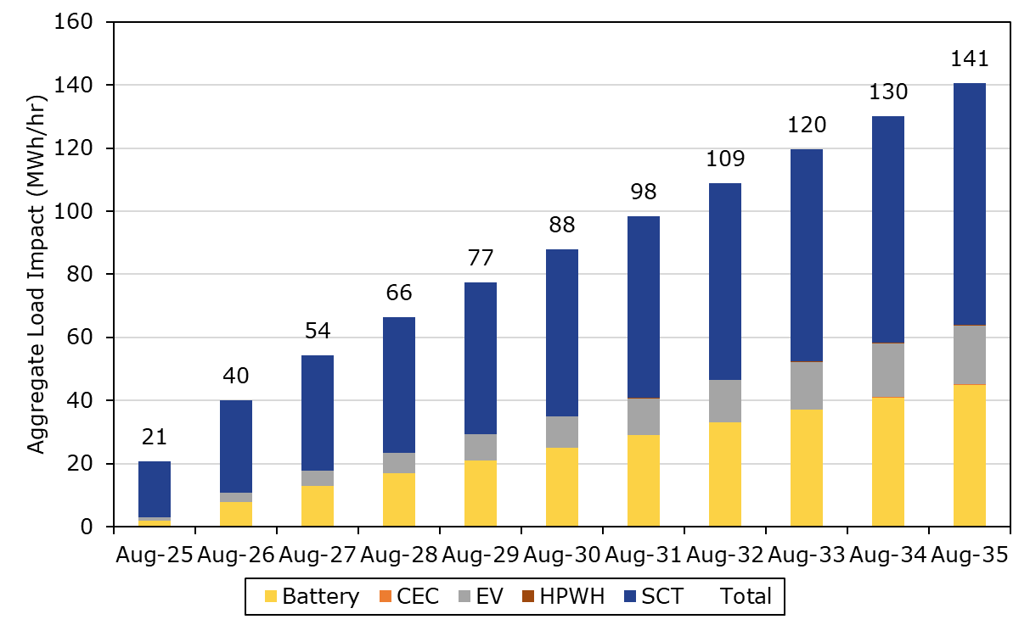
Ex-Ante Load Impacts – by Technology Type
RA Window, PG&E 1-in-2 August System Worst Day
(2025-2035)
Technology | 2025 | 2035
SCT | 85% | 54%
EV Charger | 5% | 13%
Battery | 10% | 32%
HPWH | 0.02% | 0.18%
CEC | 0% | 0.07%

Slide 18
Ex-Ante Load Impacts – All Technologies
RA Window, PG&E 1-in-2 August System Worst Day
(2025-2035)
Year | # Enrolled | Per Customer |  | Aggregate
 |  | Event Load Impact (kWh/cust/hr) | Event Ref. Load (kWh/cust/hr) | Event Load Impact (MWh/hr) | Event Ref. Load (MWh/hr)
2025 | 48,597 | 0.42 | 1.63 | 20.64 | 79.33
2026 | 87,187 | 0.46 | 1.63 | 40.01 | 142.29
2027 | 114,719 | 0.47 | 1.63 | 54.27 | 187.24
2028 | 138,870 | 0.48 | 1.63 | 66.37 | 226.66
2029 | 160,313 | 0.48 | 1.63 | 77.40 | 261.63
2030 | 180,504 | 0.49 | 1.63 | 87.94 | 294.60
2031 | 200,726 | 0.49 | 1.63 | 98.50 | 327.62
2032 | 220,855 | 0.49 | 1.63 | 109.00 | 360.45
2033 | 241,058 | 0.50 | 1.63 | 119.55 | 393.44
2034 | 261,211 | 0.50 | 1.63 | 130.07 | 426.33
2035 | 281,329 | 0.50 | 1.63 | 140.57 | 459.15

Slide 19
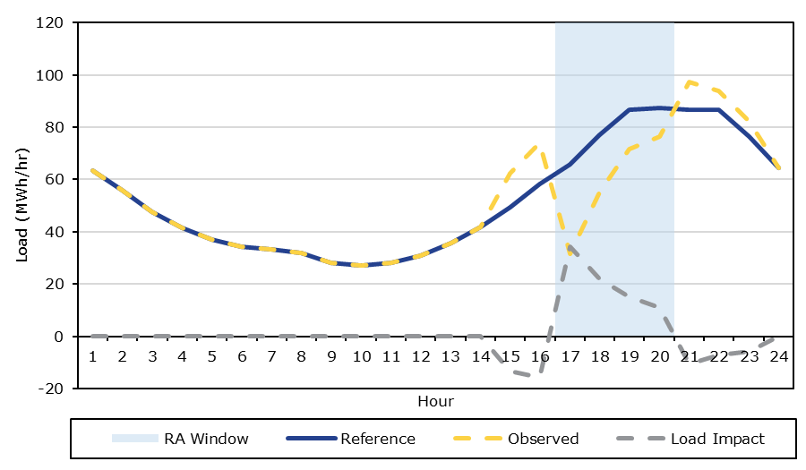
Ex-Ante Load Impacts – Hourly Load Impacts
Aggregate Hourly Loads and Load Impacts,
PG&E 1-in-2 August System Worst Day in 2025

Slide 20
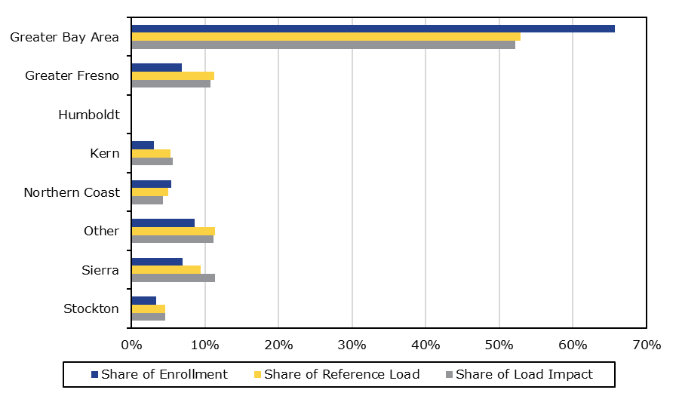
Ex-Ante Load Impacts – by LCA
RA Window Load Impacts by LCA,
PG&E 1-in-2 August System Worst Day in 2025

Slide 21
Key Findings and Recommendations
Ex-Post Load Impacts:
Small impacts from the single test event in PY2024, likely due to low temperatures.
DLS strategy produced statistically significant load reductions during the peak period for customers on TOU rates.
Ex-Ante Load Impacts:
Significant growth of load impacts over the forecast window from 2025-2035 due to
Increased enrollments
Changing technology mix
Going Forward:
We recommend calling events across sub-LAPs and varying weather conditions to help understand how performance varies by location and weather for each technology type.

Slide 22
Questions?
Contact
Sherry Wang: swang@caenergy.com
Christensen Associates Energy Consulting Madison, Wisconsin
608-216-7110

