Slide 1
Statewide (PG&E and SCE) BIP PY2024 Load impact Evaluation
IOU LIP Workshop - May 12, 2025

Slide 2
Agenda
PY2024 BIP Program Overview
Ex Post Evaluation Methodology
PY2024 Ex Post Results
Ex Ante Evaluation Methodology
Enrollment Forecasts
PY2025 – 2035 Ex Ante Results
Cross-year comparisons

Slide 3
py2024 BIP Program
Availability
Year round
One event per day (up to six hours)
Up to 10 events per calendar month
Up to 180 hours per calendar year
Compensation
Earn a monthly incentives for commitment to reduce load when called
Penalties are given if a participant fails to reduce to their established FSL during an event
Non-Residential Emergency Program (TOU-BIP)
Day-Of Notification
15-minute and 30-minute options
Events may occur at any time and any day
Participants select their FSL (Firm Service Level) and must drop load to their FSL during called events

Slide 4
Program Enrollment
PG&E BIP Participants |  | SCE BIP Participants
Industry Group | Count of Customers | Industry Group | Count of Customers
Agriculture, Mining and Construction | 72 | Agriculture, Mining and Construction | 29
Institutional/Government | 0 | Institutional/Government | 1
Manufacturing | 66 | Manufacturing | 215
Office, Hotels, Finance, Services | 4 | Office, Hotels, Finance, Services | 6
Retail Stores | 1 | Retail Stores | 1
Schools | 0 | Schools | 1
Wholesale, Transport and other Utilities | 52 | Wholesale, Transport and other Utilities | 62
Other/Unknown | 3 | Other/Unknown | 22
Total | 198 | Total | 337

Slide 5
Event Information
IOU | Event Date | Program Options Deployed​ | Event Start and End Times | Event Duration (Hours) | Event Type​ | Customers Dispatched
PG&E | February 4th | BIP30 | 6:00PM-10:23PM | 4.4 | Transmission Emergency | 12
 | February 4th​ | BIP15, BIP30 | 6:15PM-10:23PM | 4.1 | Transmission Emergency | 23
 | September 24th | BIP15, BIP30 | 4:00PM-6:00PM | 2 | Test Event | 163
 | October 21st | BIP30 | 4:00PM-6:00PM | 2 | Re-test Event | 31
Note: There were no dual-program + BIP event days in PY2024

Slide 6
Event Information
IOU | Event Date | Program Options Deployed​ | Event Start and End Times | Event Duration (Hours) | Event Type​ | Customers Dispatched
PG&E | February 4th | BIP30 | 6:00PM-10:23PM | 4.4 | Transmission Emergency | 12
 | February 4th​ | BIP15, BIP30 | 6:15PM-10:23PM | 4.1 | Transmission Emergency | 23
 | September 24th | BIP15, BIP30 | 4:00PM-6:00PM | 2 | Test Event | 163
 | October 21st | BIP30 | 4:00PM-6:00PM | 2 | Re-test Event | 31
SCE | September 6th | BIP30 | 5:09PM-8:00PM | 2.9 | Transmission Emergency | 21
 | September 9th​ | BIP30 | 3:30PM-8:10PM | 4.7 | Transmission Emergency | 21
 | September 24th | BIP15, BIP30 | 3:20PM-6:00PM | 2.7 | Test Event | 314
Note: There were no dual-program + BIP event days in PY2024

Slide 7
PY2024 Ex-Post Analysis

Slide 8
Ex-Post Methodology Overview
Regression based approach
Hourly models where each hour of the day is modelled separately from other hours
Individual customer specific regressions for non-residential customers
Four Main Steps
Participant Analysis
Proxy Day Selection
Model Selection
Impact Estimation

Slide 9
Ex-Post Analysis Methodology
Step 1: Participant Analysis
Step 4: Model Selection
Step 5: Impact Estimation
Step 2: Proxy Day Selection
Participant Analysis
Precursory exploratory data analysis to determine the validity of approach for estimating ex-post load impacts.
Weather Sensitivity Analysis
Proxy Day Selection
Exploration of event-like day conditions
Selecting 12 weekdays and 6 weekend proxy days at various times of the year.
Select proxy days based on a distance metric between non-event days and event day temperatures

Slide 10
Ex-Post Analysis Methodology
Step 1: Participant Analysis
Step 4: Model Selection
Step 5: Impact Estimation
Step 2: Proxy Day Selection
Model Selection
Use catalog of models and select one to be used based on model performance
Model Performance was determined by iteratively holding out proxy event days with presumed event hours.
Bias and Error estimated by comparing actual proxy day load to predicted load
Removed candidate models that consistently generate statistically significant impact parameters on non-event days.
Reviewed coefficients magnitude and direction. For example, weather coefficients should not be negative.
Selected and reviewed models that minimized bias and error. While rejecting models that fail validity tests.
Models selected separately per customer, season, and day type (weekday versus weekend)
Impact Estimation
Selected Models were then used to model event day load impacts

Slide 11
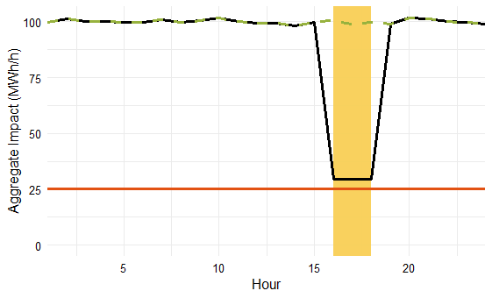
Firm Service Level (FSL) Achievement Rate
* Hypothetical event day, not representative
of any PY2024 events or forecasts
Baseline
Observed Impact
FSL Achievement
Rate
=
Impact at FSL
Observed
FSL
Baseline
Observed
FSL
Event window
FSL Achievement Rate = 100% if event load exactly reaches FSL
FSL Achievement Rate = 0% if event load does not differ from baseline

Slide 12
Ex-Post impacts Overview
PG&E
Event Date (2024) | Num. of Participants Dispatched | Aggregate (MWH/h) |  | Per Capita (kWh/h) |  | Percent Load Reduction (%) | FSL (MW) | FSL Achievement Rate (%)
 |  | Reference Load | Load Impact | Reference Load | Load Impact
February 4th | XX | XX | XX | XX | XX | XX | XX | XX
September 24th​ | 163 | 144.7 | 99.1 | 887.6 | 607.7 | 68% | 45.6 | 100%
October 21st | XX | XX | XX | XX | XX | XX | XX | XX

Slide 13
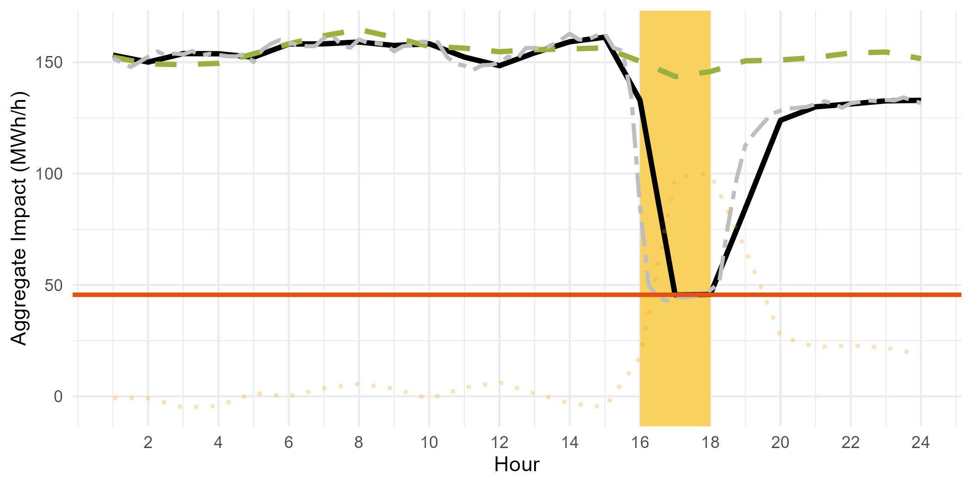
Ex-Post impacts
FSL Achievement Rate = 100% if event load exactly reaches FSL
FSL Achievement Rate = 0% if event load does not differ from baseline
PG&E 9/24/2024 Event Day, Aggregate Load Shape
Number of dispatched customers: 163
Event Hours: HE 17-18
Aggregate Impact during event: 99.1 MWh/h
Average impact per customer during event: 608 kWh/h
FSL Achievement Rate: 100%
Pct. Load Impact: 68%

Slide 14
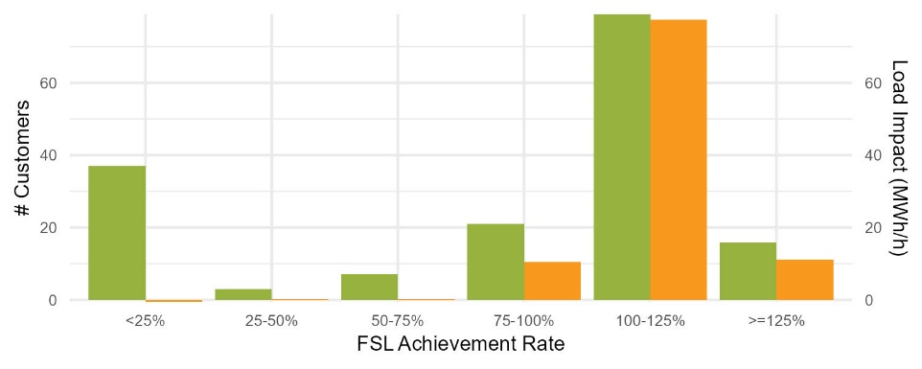

Distribution of FSL achievement rates
PG&E 09/24 event

Slide 15
Ex-Post impacts Overview
SCE
Event Date (2024) | Num. of Participants Dispatched | Aggregate (MWH/h) |  | Per Capita (kWh/h) |  | Percent Load Reduction (%) | FSL (MW) | FSL Achievement Rate (%)
 |  | Reference Load | Load Impact | Reference Load | Load Impact
September 6th | 21 | xxx | xxx | xxx | xxx | xxx | xxx | xxx
September 9th​ | 21 | xxx | xxx | xxx | xxx | xxx | xxx | xxx
September 24th | 314 | 535.5 | 396.4 | 1,705.4 | 1,262.5 | 74% | 146.4 | 102%

Slide 16
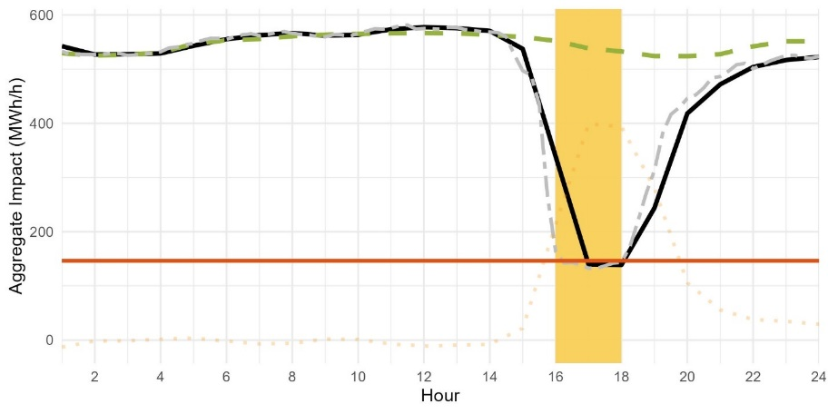
Ex-Post impacts
FSL Achievement Rate = 100% if event load exactly reaches FSL
FSL Achievement Rate = 0% if event load does not differ from baseline
Number of dispatched customers: 314
Event Hours: HE 16-18*
Aggregate Impact during event: 396.4 MWh/h
Average impact per customer during event: 1262 kWh/h
FSL Achievement Rate: 102%
Pct. Load Impact: 74%
SCE 9/24/2024 Event Day, Aggregate Load Shape
*HE 16 was a partial event hour

Slide 17
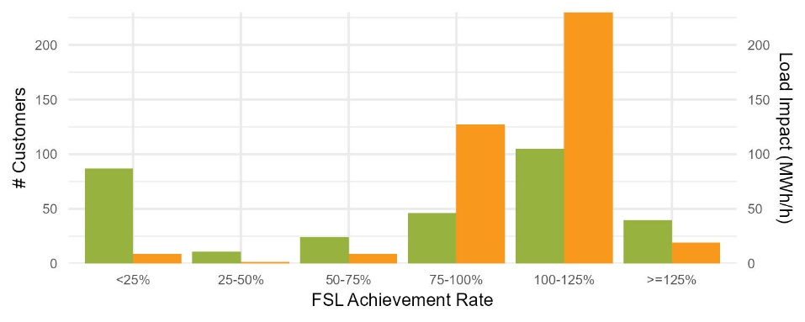
Distribution of FSL achievement rates
SCE 09/24 event

Slide 18
PY2024 Ex-Ante Analysis

Slide 19
Ex-Ante Methodology - Overview
Ex-Ante Impacts were modeled with modified ex-post model specifications and FSL achievement rates
Four Main Steps
Develop Ex Ante Drivers
Estimate Ex Ante Per Capita Reference Loads
Estimate Ex Ante Per Capita Impacts
Develop Ex Ante Forecast

Slide 20
Ex-Ante Methodology
Step 1: Ex Ante Driver Development
Step 3: Estimate Ex Ante Per Capita Impacts
Step 4: Develop Ex Ante Forecasts
Step 2: Ex Ante Per Capita Reference Loads
Ex Ante Driver Development
Dataset that contains assumptions about ex ante event day characteristics for each month
Presumed event hours
Ex ante weather scenarios (1-in-2, 1-in-10)
Used to predict the ex ante reference loads and impacts for each customer or group of customers.
Estimate Ex Ante Per Capita Reference Loads.
Using the ex post model and the ex ante drivers, estimated ex ante reference loads for each customer.
This produced the weather adjusted ex ante reference loads.
Validated the reference loads by comparing them to reference loads observed in the ex post analysis and historic load shapes.
Additional model selection occurred for seasons without BIP participation.

Slide 21
Ex-Ante Methodology
Step 1: Ex Ante Driver Development
Step 4: Develop Ex Ante Forecasts
Step 2: Ex Ante Per Capita Reference Loads
Step 3: Estimate Ex Ante Per Capita Impacts
Estimate Per Capita Impacts
Based on historical FSL achievement rates and updated participant FSLs.
The achievement rates were multiplied by the expected impacts for full FSL achievement, which provides estimated hourly event impacts during ex ante event hours.
Apply Participant Forecasts
Apply the participant forecasts to pre capita reference loads and impacts to develop MW forecasts for each scenario.
To compute Portfolio-level impacts, FSL achievement rates are capped at 100% for customers dual enrolled in ELRP (until the ELRP forecasted sunset)

Slide 22
Ex-Ante Methodology
Event Assumptions
PG&E
Four-hour event, comprising the first four hours of the RA period
March - May: HE 18-21
Otherwise: HE 17-20
SCE
Modeled both four-hour and six-hour events
HE 18-21
HE 17-22
Modeled for CAISO and utility-specific weather scenarios, 1-in-2 and 1-in-10 Monthly System Worst Day
Assumed weekday, non-holiday event

Slide 23
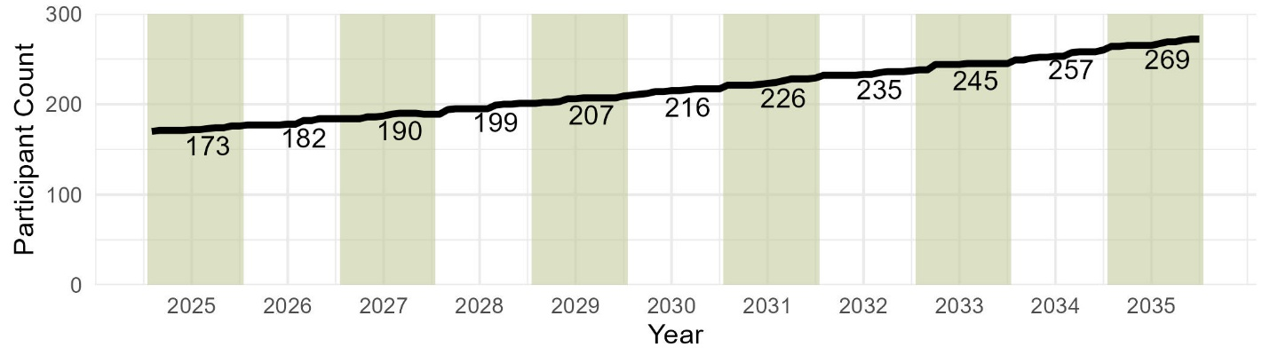
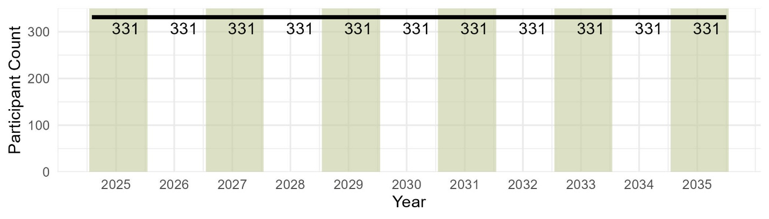
Enrollment Forecasts
PG&E
Does not differentiate between BIP15 and BIP30
SCE
48 BIP15 and 283 BIP30 customers
Note: Participant counts are labeled for August of each year. Background color alternates by calendar year.

Slide 24
Ex-Ante Impacts Overview
PG&E August Monthly System Worst Day 2025 – Average over 4 hour event
Program
Weather Source | Weather Year | Event Dispatch (HE) | Number of Participants | Aggregate (MWh/h) |  | Per Capita (kWh/h) |  | Percent Load Reduction (%) | FSL (MWh/h) | FSL Achievement Rate (%)
 |  |  |  | Ref. Load | Load Impact | Ref. Load | Load Impact
CAISO | 1-in-10 | 17 - 20 | 173 | 187.2 | 133.1 | 1,082.1 | 769.2 | 71% | 54.9 | 101%
CAISO | 1-in-2 | 17 - 20 | 173 | 186.7 | 132.5 | 1,079.4 | 765.8 | 71% | 54.9 | 101%
Utility | 1-in-10 | 17 - 20 | 173 | 187.1 | 132.9 | 1,081.6 | 768.0 | 71% | 54.9 | 101%
Utility | 1-in-2 | 17 - 20 | 173 | 186.6 | 132.4 | 1,078.6 | 765.4 | 71% | 54.9 | 101%
Portfolio
Weather Source | Weather Year | Event Dispatch (HE) | Number of Participants | Aggregate (MWh/h) |  | Per Capita (kWh/h) |  | Percent Load Reduction (%) | FSL (MWh/h) | FSL Achievement Rate (%)
 |  |  |  | Ref. Load | Load Impact | Ref. Load | Load Impact
CAISO | 1-in-10 | 17 - 20 | 173 | 187.2 | 131.2 | 1,082.1 | 758.6 | 70% | 54.9 | 99%
CAISO | 1-in-2 | 17 - 20 | 173 | 186.7 | 130.7 | 1,079.4 | 755.6 | 70% | 54.9 | 99%
Utility | 1-in-10 | 17 - 20 | 173 | 187.1 | 131.1 | 1,081.6 | 757.6 | 70% | 54.9 | 99%
Utility | 1-in-2 | 17 - 20 | 173 | 186.6 | 130.7 | 1,078.6 | 755.5 | 70% | 54.9 | 99%

Slide 25
Ex-Ante Impacts Slice of Day Table
PG&E Program 1-in-2 System Worst Day 2025, Aggregate Hourly Impact (MWh/h)
Hour Ending | Jan. | Feb. | Mar. | Apr. | May | June | July | Aug. | Sept. | Oct. | Nov. | Dec.
16 | 20.5 | 22.9 | 0.0 | 0.0 | 0.0 | 25.0 | 25.1 | 25.5 | 25.2 | 25.7 | 24.4 | 20.8
17 | 117.3 | 122.5 | 22.6 | 23.5 | 26.7 | 132.2 | 129.5 | 130.7 | 133.0 | 132.7 | 131.5 | 119.7
18 | 122.0 | 125.6 | 123.8 | 126.5 | 129.6 | 137.9 | 133.2 | 133.3 | 136.8 | 144.4 | 138.9 | 124.1
19 | 122.0 | 126.2 | 134.2 | 136.9 | 138.4 | 138.2 | 133.2 | 134.4 | 133.7 | 145.0 | 138.9 | 124.3
20 | 118.7 | 123.7 | 131.6 | 136.1 | 136.2 | 136.1 | 130.3 | 131.2 | 134.4 | 143.3 | 136.2 | 120.6
21 | 80.5 | 83.6 | 128.3 | 138.4 | 137.9 | 89.4 | 85.7 | 92.0 | 92.3 | 91.3 | 87.8 | 80.2
22 | 50.9 | 54.2 | 87.2 | 93.5 | 93.7 | 53.5 | 50.3 | 55.9 | 56.1 | 55.8 | 55.0 | 49.6
23 | 46.5 | 49.8 | 51.8 | 53.3 | 53.5 | 48.0 | 45.8 | 52.0 | 52.3 | 51.4 | 50.5 | 45.4
24 | 49.4 | 51.5 | 45.2 | 45.0 | 28.4 | 49.0 | 45.9 | 53.6 | 50.7 | 53.0 | 55.1 | 48.7
Event hour in RA window
Non-event hour in RA window

Slide 26
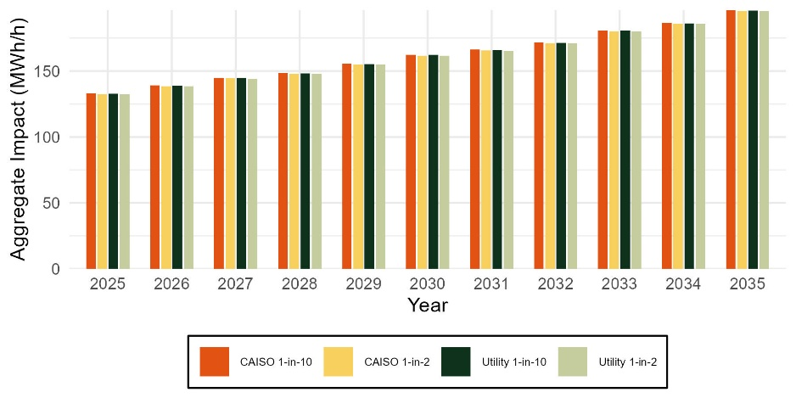
Ex-Ante Impacts Across the Forecast period
PG&E Program-level August Monthly System Worst Day
Min 132.4
Max 195.4

Slide 27
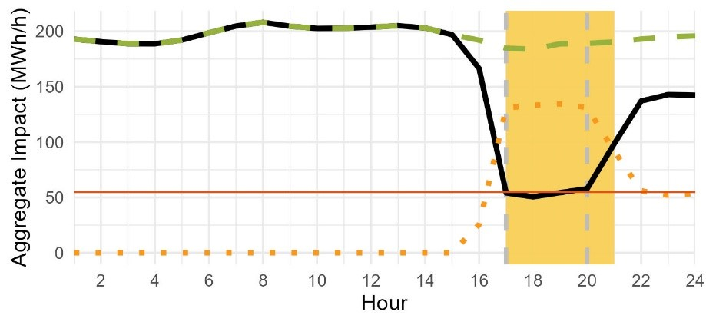
Ex-Ante Load Shape
PG&E Program-level August Monthly System Worst Day, 2025

Slide 28
Ex-Ante Impacts Overview
Because SCE enrollment is not forecasted to grow during the forecast window, these values are representative of the PY2025-2035 forecast
SCE August Monthly System Worst Day – Average over six hour event
Program
Weather Source | Weather Year | Event Dispatch (HE) | Number of Participants | Aggregate (MWh/h) |  | Per Capita (kWh/h) |  | Percent Load Reduction (%) | FSL (MWh/h) | FSL Achievement Rate (%)
 |  |  |  | Ref. Load | Load Impact | Ref. Load | Load Impact
CAISO | 1-in-10 | 17 - 22 | 331 | 580.9 | 419.4 | 1,755.0 | 1,267.2 | 72% | 140.4 | 95%
CAISO | 1-in-2 | 17 - 22 | 331 | 580.5 | 419.2 | 1,753.9 | 1,266.6 | 72% | 140.4 | 95%
Utility | 1-in-10 | 17 - 22 | 331 | 581.0 | 419.6 | 1,755.2 | 1,267.5 | 72% | 140.4 | 95%
Utility | 1-in-2 | 17 - 22 | 331 | 580.7 | 419.3 | 1,754.3 | 1,266.7 | 72% | 140.4 | 95%
Portfolio
Weather Source | Weather Year | Event Dispatch (HE) | Number of Participants | Aggregate (MWh/h) |  | Per Capita (kWh/h) |  | Percent Load Reduction (%) | FSL (MWh/h) | FSL Achievement Rate (%)
 |  |  |  | Ref. Load | Load Impact | Ref. Load | Load Impact
CAISO | 1-in-10 | 17 - 22 | 331 | 580.9 | 413.8 | 1,755.0 | 1,250.1 | 71% | 140.4 | 94%
CAISO | 1-in-2 | 17 - 22 | 331 | 580.5 | 413.5 | 1,753.9 | 1,249.5 | 71% | 140.4 | 94%
Utility | 1-in-10 | 17 - 22 | 331 | 581.0 | 413.9 | 1,755.2 | 1,250.4 | 71% | 140.4 | 94%
Utility | 1-in-2 | 17 - 22 | 331 | 580.7 | 413.6 | 1,754.3 | 1,249.6 | 71% | 140.4 | 94%

Slide 29
Ex-Ante Impacts Overview
Because SCE enrollment is not forecasted to grow during the forecast window, these values are representative of the PY2025-2035 forecast
SCE August Monthly System Worst Day – Average over a Six-hour event
Program
BIP Option | Weather Source | Weather Year | Event Dispatch (HE) | Number of Participants | Aggregate (MWh/h) |  | Per Capita (kWh/h) |  | Percent Load Reduction (%) | FSL (MWh/h) | FSL Achievement Rate (%)
 |  |  |  |  | Ref. Load | Load Impact | Ref. Load | Load Impact
All | CAISO | 1-in-10 | 17 - 22 | 331 | 580.9 | 419.4 | 1,755.0 | 1,267.2 | 72% | 140.4 | 95%
All | CAISO | 1-in-2 | 17 - 22 | 331 | 580.5 | 419.2 | 1,753.9 | 1,266.6 | 72% | 140.4 | 95%
All | Utility | 1-in-10 | 17 - 22 | 331 | 581.0 | 419.6 | 1,755.2 | 1,267.5 | 72% | 140.4 | 95%
All | Utility | 1-in-2 | 17 - 22 | 331 | 580.7 | 419.3 | 1,754.3 | 1,266.7 | 72% | 140.4 | 95%
BIP15 | CAISO | 1-in-10 | 17 - 22 | 48 | 251.1 | 220.5 | 5,230.3 | 4,593.0 | 88% | 34.5 | 102%
BIP15 | CAISO | 1-in-2 | 17 - 22 | 48 | 251.1 | 220.5 | 5,232.2 | 4,594.8 | 88% | 34.5 | 102%
BIP15 | Utility | 1-in-10 | 17 - 22 | 48 | 251.1 | 220.5 | 5,230.7 | 4,593.4 | 88% | 34.5 | 102%
BIP15 | Utility | 1-in-2 | 17 - 22 | 48 | 251.1 | 220.5 | 5,231.1 | 4,593.8 | 88% | 34.5 | 102%
BIP30 | CAISO | 1-in-10 | 17 - 22 | 283 | 329.8 | 198.9 | 1,165.5 | 703.1 | 60% | 105.9 | 89%
BIP30 | CAISO | 1-in-2 | 17 - 22 | 283 | 329.4 | 198.7 | 1,163.9 | 702.0 | 60% | 105.9 | 89%
BIP30 | Utility | 1-in-10 | 17 - 22 | 283 | 329.9 | 199.0 | 1,165.7 | 703.3 | 60% | 105.9 | 89%
BIP30 | Utility | 1-in-2 | 17 - 22 | 283 | 329.6 | 198.8 | 1,164.6 | 702.4 | 60% | 105.9 | 89%

Slide 30
Ex-Ante Impacts Overview
Because SCE enrollment is not forecasted to grow during the forecast window, these values are representative of the PY2025-2035 forecast
SCE August Monthly System Worst Day – Average over six hour event
Portfolio
BIP Option | Weather Source | Weather Year | Event Dispatch (HE) | Number of Participants | Aggregate (MWh/h) |  | Per Capita (kWh/h) |  | Percent Load Reduction (%) | FSL (MWh/h) | FSL Achievement Rate (%)
 |  |  |  |  | Ref. Load | Load Impact | Ref. Load | Load Impact
All | CAISO | 1-in-10 | 17 - 22 | 331 | 580.9 | 413.8 | 1,755.0 | 1,250.1 | 71% | 140.4 | 94%
All | CAISO | 1-in-2 | 17 - 22 | 331 | 580.5 | 413.5 | 1,753.9 | 1,249.5 | 71% | 140.4 | 94%
All | Utility | 1-in-10 | 17 - 22 | 331 | 581.0 | 413.9 | 1,755.2 | 1,250.4 | 71% | 140.4 | 94%
All | Utility | 1-in-2 | 17 - 22 | 331 | 580.7 | 413.6 | 1,754.3 | 1,249.6 | 71% | 140.4 | 94%
BIP15 | CAISO | 1-in-10 | 17 - 22 | 48 | 251.1 | 217.8 | 5,230.3 | 4,536.4 | 87% | 34.5 | 101%
BIP15 | CAISO | 1-in-2 | 17 - 22 | 48 | 251.1 | 217.8 | 5,232.2 | 4,538.2 | 87% | 34.5 | 101%
BIP15 | Utility | 1-in-10 | 17 - 22 | 48 | 251.1 | 217.8 | 5,230.7 | 4,536.8 | 87% | 34.5 | 101%
BIP15 | Utility | 1-in-2 | 17 - 22 | 48 | 251.1 | 217.8 | 5,231.1 | 4,537.2 | 87% | 34.5 | 101%
BIP30 | CAISO | 1-in-10 | 17 - 22 | 283 | 329.8 | 196.0 | 1,165.5 | 692.7 | 59% | 105.9 | 88%
BIP30 | CAISO | 1-in-2 | 17 - 22 | 283 | 329.4 | 195.7 | 1,163.9 | 691.6 | 59% | 105.9 | 88%
BIP30 | Utility | 1-in-10 | 17 - 22 | 283 | 329.9 | 196.1 | 1,165.7 | 692.9 | 59% | 105.9 | 88%
BIP30 | Utility | 1-in-2 | 17 - 22 | 283 | 329.6 | 195.9 | 1,164.6 | 692.0 | 59% | 105.9 | 88%

Slide 31
Ex-Ante Impacts Slice of Day Table
SCE Program 1-in-2 System Worst Day, Six-hour event Aggregate Hourly Impact (MWh/h)
Hour Ending | Jan. | Feb. | Mar. | Apr. | May | June | July | Aug. | Sept. | Oct. | Nov. | Dec.
16 | 33.0 | 33.7 | 28.1 | 39.7 | 40.2 | 47.8 | 45.4 | 46.8 | 41.9 | 44.0 | 43.8 | 34.6
17 | 414.4 | 413.6 | 395.5 | 402.1 | 410.4 | 448.8 | 426.9 | 426.3 | 437.7 | 443.9 | 465.1 | 453.2
18 | 391.3 | 391.4 | 378.2 | 397.8 | 393.2 | 424.9 | 409.7 | 414.3 | 418.9 | 423.7 | 447.0 | 428.5
19 | 393.0 | 392.5 | 377.6 | 405.5 | 397.8 | 425.1 | 407.0 | 414.8 | 397.6 | 420.4 | 449.7 | 425.7
20 | 393.6 | 390.8 | 377.8 | 411.0 | 397.5 | 425.2 | 406.9 | 413.4 | 403.3 | 413.3 | 451.3 | 421.3
21 | 394.1 | 391.3 | 375.2 | 419.4 | 399.1 | 429.0 | 409.1 | 415.8 | 407.0 | 408.5 | 448.4 | 422.7
22 | 398.1 | 397.4 | 386.3 | 433.2 | 400.1 | 436.2 | 421.6 | 430.9 | 422.8 | 418.8 | 441.6 | 424.7
23 | 268.9 | 275.5 | 234.2 | 286.8 | 280.3 | 300.4 | 293.8 | 298.7 | 301.3 | 299.9 | 306.9 | 296.5
24 | 179.6 | 185.2 | 95.6 | 134.8 | 137.5 | 140.6 | 137.4 | 136.2 | 136.2 | 138.5 | 141.6 | 201.8
Event hour in RA window
Event hour outside RA window

Slide 32
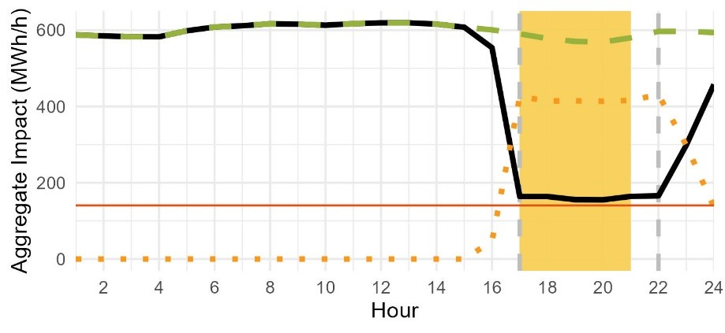
Ex-Ante Load Shape
SCE Program-level August Monthly System Worst Day, 2025

Slide 33
Comparison of PY2024 and PY2023 results

Slide 34
Previous Versus Current Ex-Post
PG&E
Evaluation Year | Estimate Type | Number of Customers per Event | Aggregate (MWh/h) |  | Per Capita (kWh/h) |  | Percent Load Reduction (%) | FSL (MWh) | FSL Achievement Rate (%)
 |  |  | Reference Load | Load Impact | Reference Load | Load Impact
2022* | Sept. 6th | 258 | 203 | 149 | 787 | 577 | 73% | 51 | 98%
2023** | Avg. Event Day | 214 | 164 | 36 | 766 | 168 | 22% | 48 | 31%
2024 | Sept. 24th | 163 | 145 | 99 | 888 | 608 | 68% | 46 | 100%
The PY2023 ‘average’ event represented only a single five-minute event that dispatched 214 customers, but impacts are reported at the hourly level. The difference in event duration likely explains most of the difference in performance between PY2024 and PY2023 when examined at the hourly level
PY2024 impacts show an improvement relative to PY2022 impact levels for per capita impacts and FSL achievement rates
Aggregate impacts are lower in PY2024 than in PY2022 due to reduced program enrollment
* 2022 Load Impact Evaluation of California Statewide Base Interruptible Programs (BIP) for Non-Residential Customers: Ex-post and Ex-ante Report
** 2023 Load Impact Evaluation of California Statewide Base Interruptible Programs (BIP) for Non-Residential Customers: Ex-post and Ex-ante Report
Notes:
From PY2023: When assessed at the 8:30-8:45 p.m. 15-minute level, the load impact increases to 54.4 MW, which represented 47 percent of the reduction required to meet the aggregate FSL.

Slide 35
Previous Ex-Ante Versus Current Ex-Post
PG&E
Evaluation Year | Estimate Type | Number of Customers per Event | Aggregate (MWh/h) |  | Per Capita (kWh/h) |  | Percent Load Reduction (%) | FSL (MWh) | FSL Achievement Rate (%)
 |  |  | Reference Load | Load Impact | Reference Load | Load Impact
2023* | Ex-ante for 2024* | 195 | 194 | 144 | 999 | 739 | 74% | 50 | 97%
2024 | Ex-post Sept. 24th | 163 | 145 | 99 | 888 | 608 | 68% | 46 | 100%
PY2024 ex-post FSL achievement rates exceeded PY2023 ex-ante forecasts
However, per capita reference loads were lower in PY2024 than forecasted
Per capita FSLs in the ex-post average event day are higher on a per capita basis in PY2024 than they were in the PY2023 forecast
The lower per capita reference load with a higher per capita FSL leads to a smaller ex-post load
*Ex-ante estimates estimated in PY2023 were based on PY2022 customer performance
*Ex-ante estimates are based on 1-in-2 utility-specific weather scenario
* 2023 Load Impact Evaluation of California Statewide Base Interruptible Programs (BIP) for Non-Residential Customers: Ex-post and Ex-ante Report

Slide 36
Previous Versus Current Ex-Ante
PG&E
Evaluation Year | Estimate Type | Number of Customers per Event | Aggregate (MWh/h) |  | Per Capita (kWh/h) |  | Percent Load Reduction (%) | FSL (MWh) | FSL Achievement Rate (%)
 |  |  | Reference Load | Load Impact | Reference Load | Load Impact
2023* | Ex-ante for 2025 | 205 | 205 | 151 | 999 | 738 | 74% | 52 | 99%
2024 | Ex-ante for 2025 | 173 | 187 | 132 | 1,079 | 765 | 71% | 55 | 101%
Aggregate impacts are forecasted to be 19MW lower in PY2025 than previously anticipated
The PY2024 participant forecasts include a drop in BIP enrollment for PY2025, based on observed de-enrollments at the end of 2024.
The difference in per capita impacts between the two ex-ante forecasts (27 kWh/h) is within the typical error bounds for these measurements
*Ex-ante estimates estimated in PY2023 were based on PY2022 customer performance
*Ex-ante estimates are based on 1-in-2 utility-specific weather scenario
* 2023 Load Impact Evaluation of California Statewide Base Interruptible Programs (BIP) for Non-Residential Customers: Ex-post and Ex-ante Report

Slide 37
Previous Versus Current Ex-Post
SCE
Evaluation Year | Estimate Type | Number of Customers per Event | Aggregate (MWh/h) |  | Per Capita (kWh/h) |  | Percent Load Reduction (%) | FSL (MWh) | FSL Achievement Rate (%)
 |  |  | Reference Load | Load Impact | Reference Load | Load Impact
2022* | Sept. 6th | 343 | 590 | 463 | 1,721 | 1,349 | 78% | 122 | 99%
2023* | Avg. Event Day | 351 | 616 | 344 | 1,755 | 980 | 56% | 136 | 72%
2024 | Sept. 24th | 314 | 536 | 396 | 1,705 | 1,262 | 74% | 146 | 102%
The PY2023 average event represents a single 34 minute, but impacts are reported at the hourly level. The difference in event duration explains most of the increase in performance in PY2024 relative to PY2023
PY2024 impacts show a return to nearly PY2022 impact levels
* 2022 Load Impact Evaluation of California Statewide Base Interruptible Programs (BIP) for Non-Residential Customers: Ex-post and Ex-ante Report
** 2023 Load Impact Evaluation of California Statewide Base Interruptible Programs (BIP) for Non-Residential Customers: Ex-post and Ex-ante Report
Notes:
When assessed over the 15-minute interval from 8:00 to 8:15 p.m., SCE’s customers reduced their load by 377 MW, which represents a 61 percent decrease relative to the reference load and 79 percent of the reduction required to meet the aggregate FSL

Slide 38
Previous Ex-Ante Versus Current Ex-Post
SCE
Evaluation Year | Estimate Type | Number of Customers per Event | Aggregate (MWh/h) |  | Per Capita (kWh/h) |  | Percent Load Reduction (%) | FSL (MWh) | FSL Achievement Rate (%)
 |  |  | Reference Load | Load Impact | Reference Load | Load Impact
2023* | Ex-ante for 2024* | 325 | 584 | 416 | 1,797 | 1,280 | 71% | 170 | 101%
2024 | Sept. 24th | 314 | 536 | 396 | 1,705 | 1,262 | 74% | 146 | 102%
PY2024 ex-post impacts are within estimation error bounds for per capita load impacts
Aggregate impacts are lower than anticipated largely due to a difference in expected and realized number of customers observed
*Ex-ante estimates estimated in PY2023 were based on PY2022 customer performance
*Ex-ante estimates are based on 1-in-2 utility-specific weather scenario
* 2023 Load Impact Evaluation of California Statewide Base Interruptible Programs (BIP) for Non-Residential Customers: Ex-post and Ex-ante Report

Slide 39
Previous Versus Current Ex-Ante
SCE
Evaluation Year | Estimate Type | Number of Customers per Event | Aggregate (MWh/h) |  | Per Capita (kWh/h) |  | Percent Load Reduction (%) | FSL (MWh) | FSL Achievement Rate (%)
 |  |  | Reference Load | Load Impact | Reference Load | Load Impact
2023* | Ex-ante for 2025 | 325 | 584 | 416 | 1,797 | 1,280 | 71% | 170 | 101%
2024 | Ex-ante for 2025 | 331 | 581 | 419 | 1,754 | 1,266 | 72% | 140 | 95%
Aggregate impacts are forecasted to be 3MW higher in PY2025 than previously anticipated
The PY2024 participant forecasts include an increase in BIP enrollment for PY2025.
While the per capita impacts between forecasts are virtually the same, there is a difference in FSL achievement rates between program years
This change is largely attributable to customers de-enrolling from the program and a small number of customers reducing their FSL commitments by multiple MWs
*Ex-ante estimates estimated in PY2023 were based on PY2022 customer performance
*Ex-ante estimates are based on 1-in-2 utility-specific weather scenario
* 2023 Load Impact Evaluation of California Statewide Base Interruptible Programs (BIP) for Non-Residential Customers: Ex-post and Ex-ante Report

Slide 40
Final Takeaways
PG&E
On September 24th, almost all BIP customers were dispatched for a test event. On average these customers provided 99.1 MWh/h of load reductions during event hours with an FSL achievement rate of 100%.
The ex-ante analysis finds that PG&E’s BIP is anticipated to provide an average hourly load reduction of between 132.4 MWh/h to 133.1 MWh/h during a four-hour dispatch of all customers in August 2025
Per capita impacts in PY2025 are expected to increase relative to the average PY2024 ex-post events due in part to de-enrollment from under-performing participants. This trend is also driven by the fact that the “average” ex-post event includes the re-test event, which emphasizes lower performing customers relative to the ex-ante analysis.

Slide 41
Final Takeaways
SCE
On September 24th, the majority of SCE BIP customers were dispatched for a test event. On average, these customers provided 396.4 MWh/h of load reductions during event hours with an FSL achievement rate was 102%.
The ex-ante analysis finds that SCE’s BIP is anticipated to provide an average hourly load reduction of between 419.4 MWh/h to 419.6 MWh/h during a six-hour dispatch of all customers in August 2025 depending on the weather scenario.
The ex-ante analysis also finds that BIP15 customers are expected to provide more load impacts than BIP30 customers, despite having substantially lower forecasted enrollment (48 versus 283 customers). BIP15 customers are expected to provide 220.5 MWh/h of load impacts over a 6 hour event window while BIP30 customers are expected to provide 198.7 MWh/h to 199.0 MWh/h, dependent on weather year.

