Slide 1


Renew Home 2024 LIP Evaluation
Presented at the Demand Response Providers’
2025 Load Impact Protocol Final Report Workshop
hosted by the California Public Utilities Commission
May 14, 2024
Co-authors:
Sam Borgeson
Phil Price

Slide 2


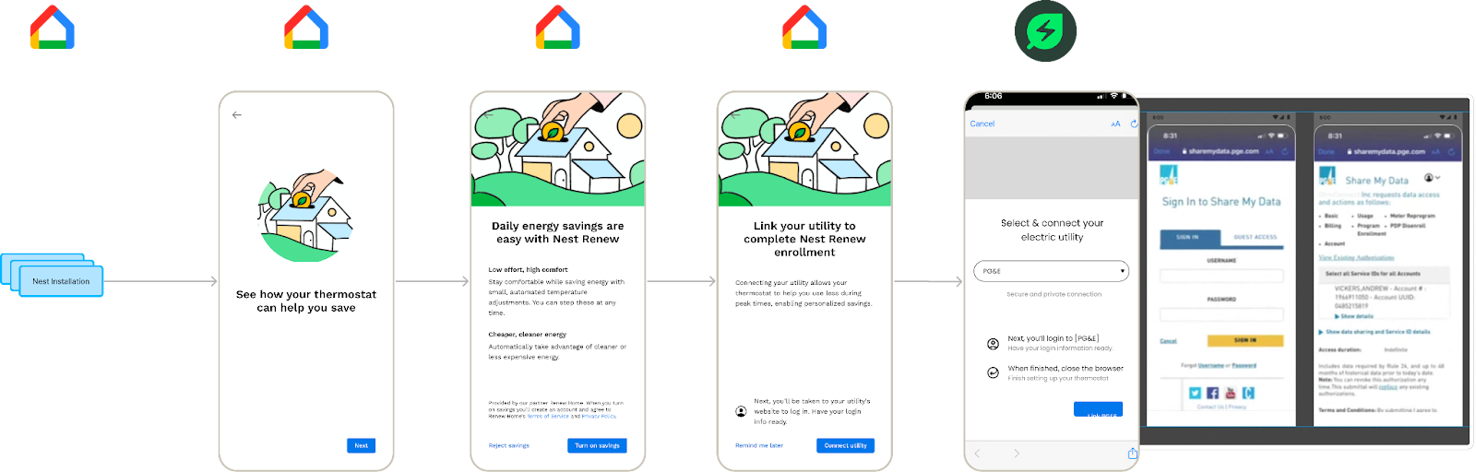
= +
Renew home was created by a merger between OhmConnect and Google Nest Energy Services
Google Home App → OhmConnect utility linking:

Slide 3
Resource plans and implications
The new company continues to operate the OhmConnect “legacy resource”
  Mix of behavioral and device-based DR
Upcoming recruitment will focus on Nest Thermostat customers
New customers will become part of the Renew Home “VPP resource” operated by the company
VPP customers will divide into two different dispatch types, both operating with pre-cooling and set-point changes
  “base” (2/3 or new customers)
  “rewards” (1/3 of new customers)

Slide 4
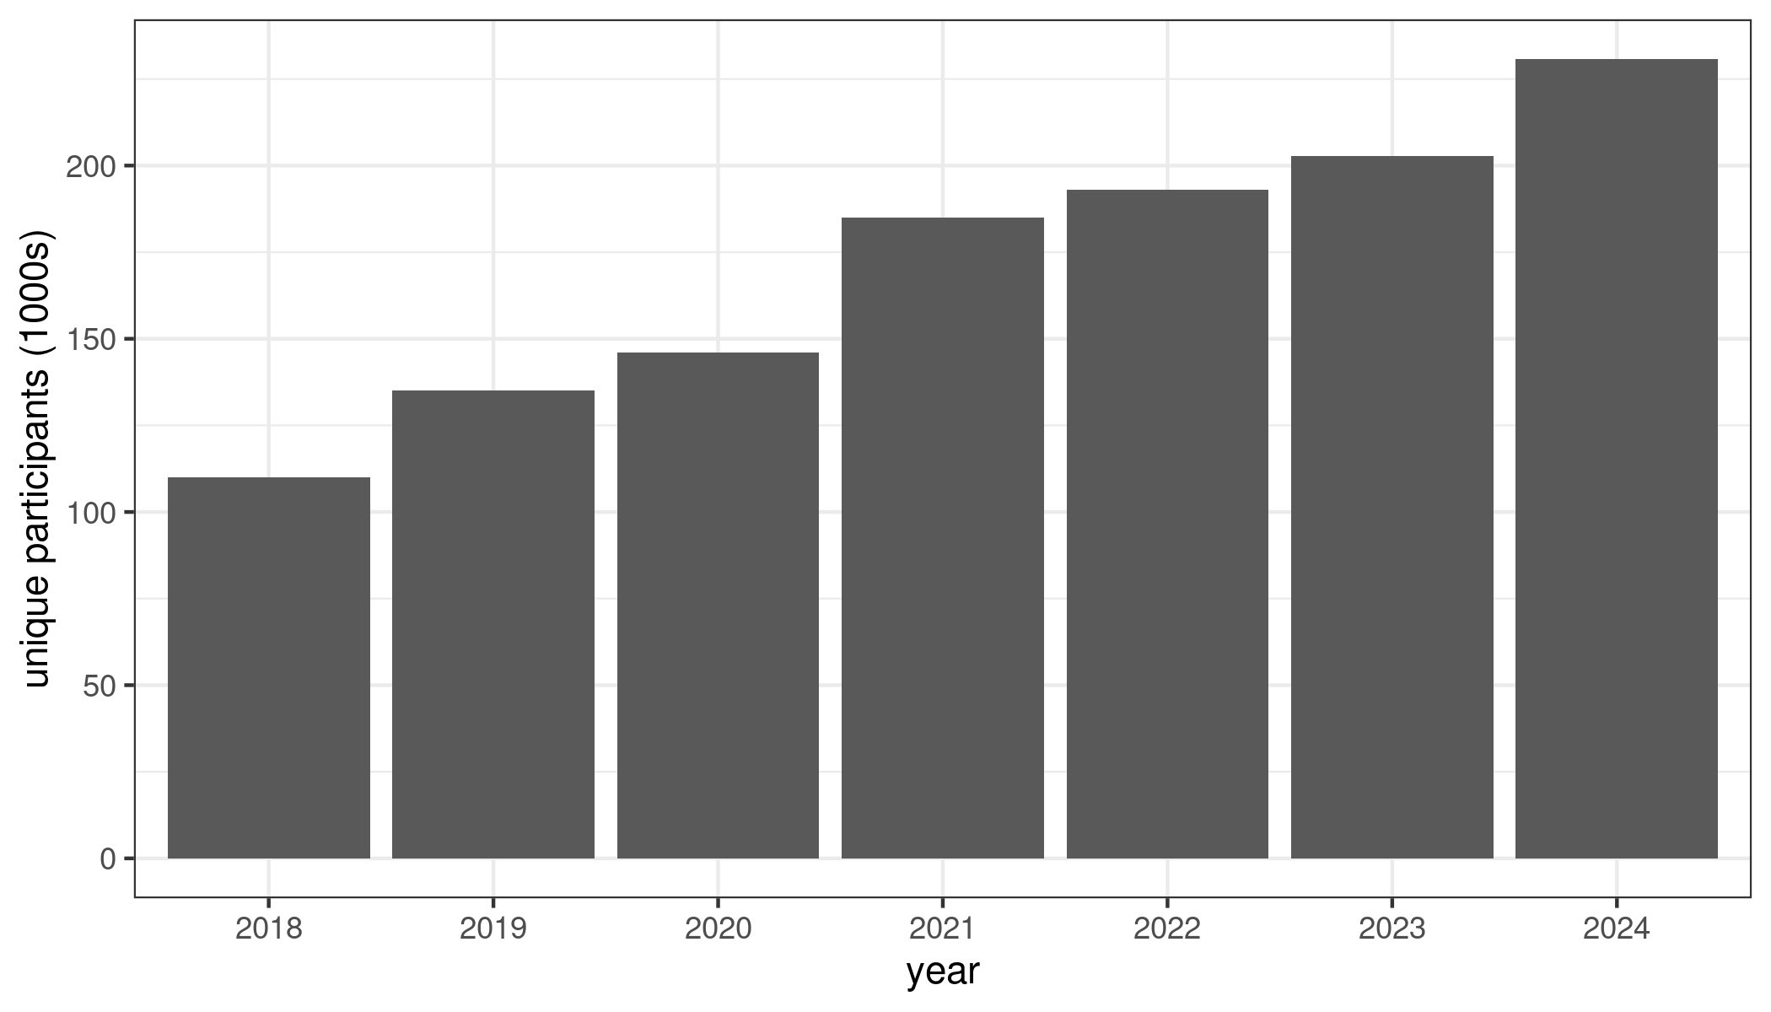
Annual unique participants
Growing participation tracks enrollment
Unique Participants

Slide 5
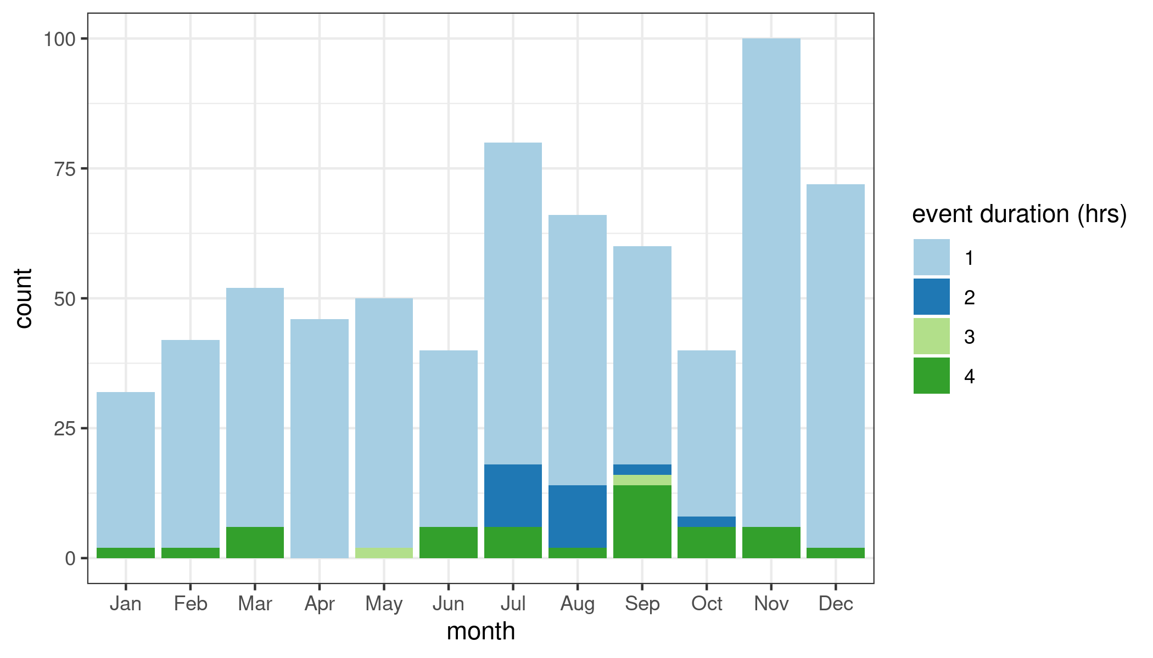
Events called in 2024
Events are defined by a unique combination of date, utility, event types, and start and end times.
Most events started between 5 and 7pm and were 1-hour in duration
Significant number of multi-hour events well distributed throughout the year as well

Slide 6
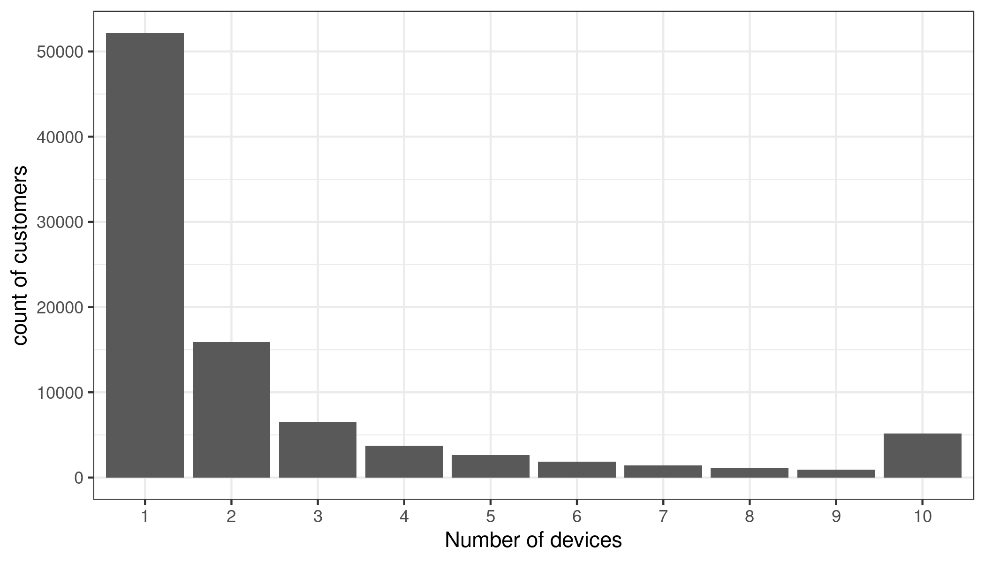
Controllable devices and tiers
Just over 60% of OhmConnect customers have no device
Of device customers, approximately 1/3 are thermostat-only
the remainder are mixed or other device types, primarily smart plugs

Slide 7
Ex post

Slide 8
Thermostat only customers
Presence of “other” devices would have been problematic for ex ante
Ex ante basis for future VPP customers
Prior grouping | Enrolled device(s) | New Grouping
Thermostat | Only thermostat(s) | Thermostat only
 | Thermostat with other devices | Mixed/Other
Other | Only non-thermostat device(s)
None | Behavioral customers | None
By definition, VPP customers will have only thermostats enrolled
  OhmConnect customers were re-grouped this year to isolate the performance of thermostat-only customers
  The per-customer event performance was used as the basis for future VPP resource customers

Slide 9
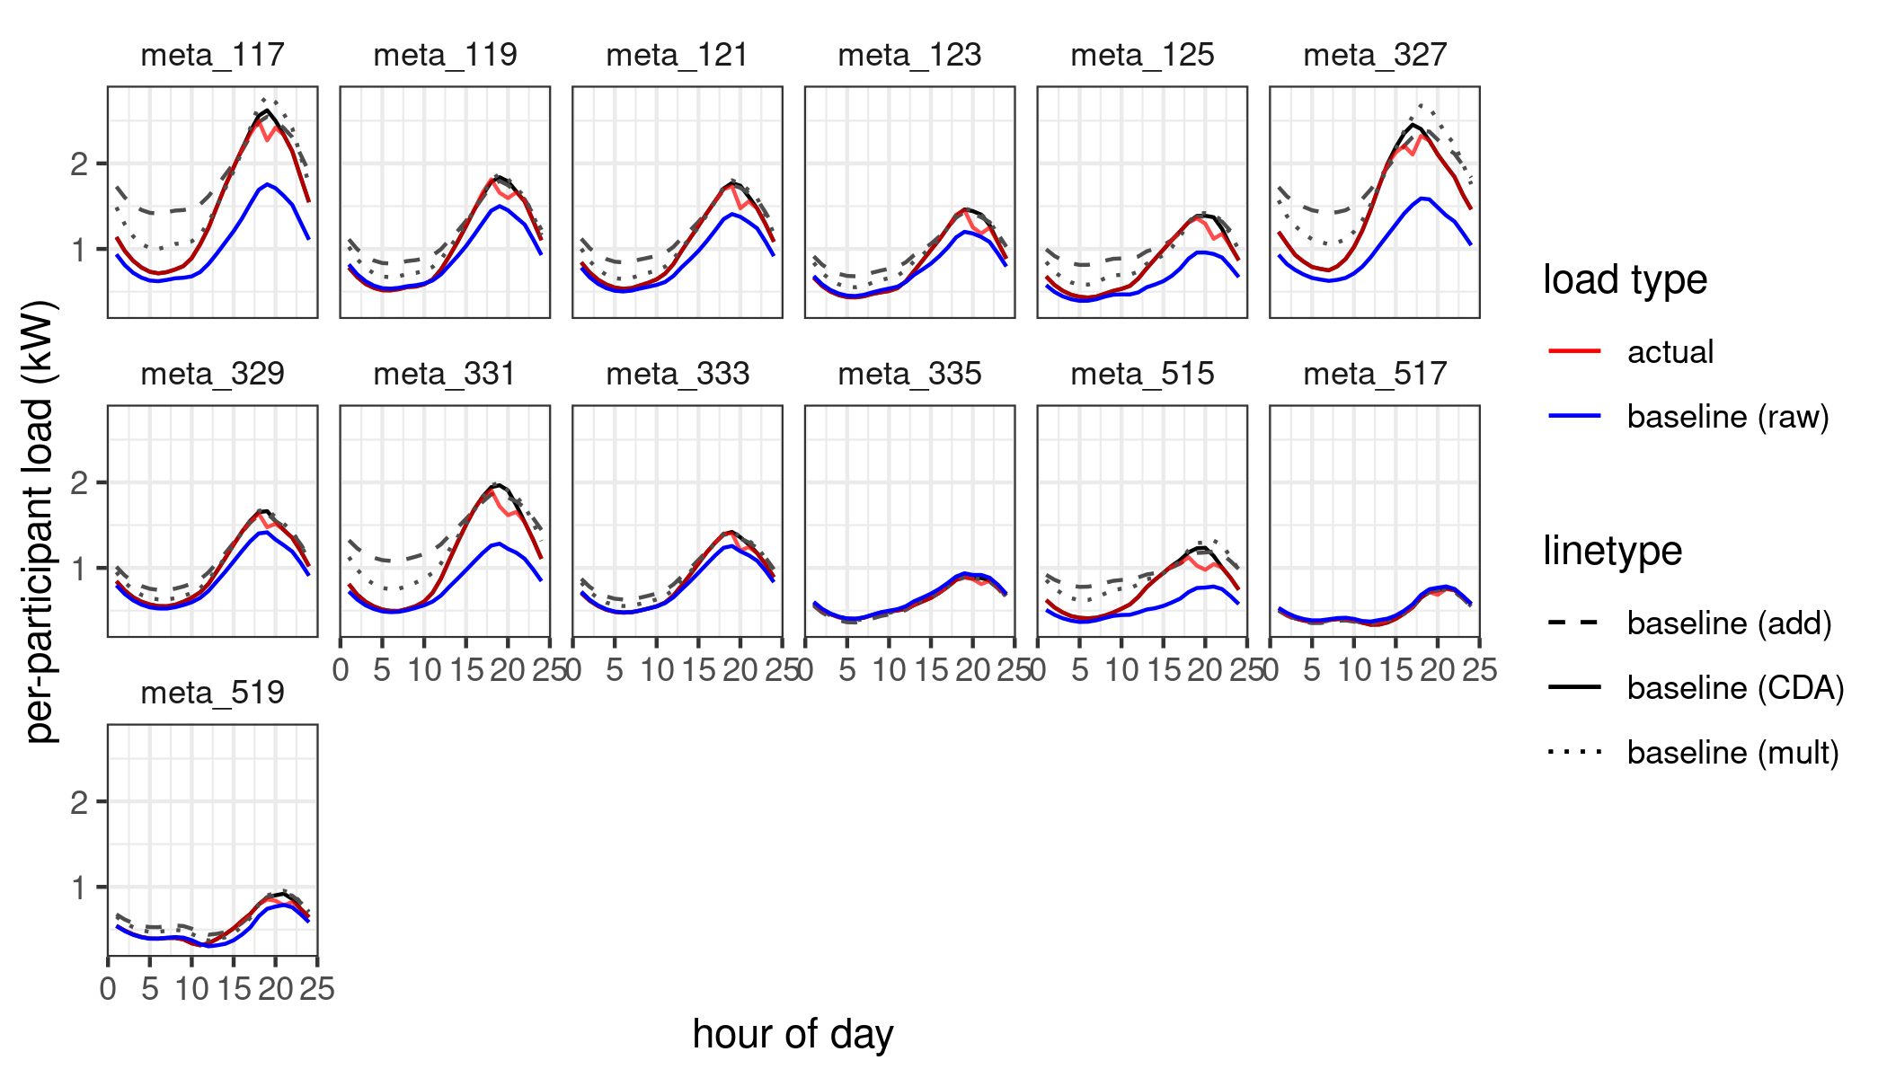
Ex post methods
10 of 10 baselines
  Average of usage for the past 10 non-holiday weekdays
    Adaptive additive same day adjustments
  Aligns the baseline and event day data using the 2nd and 3rd hours before an event

Slide 10
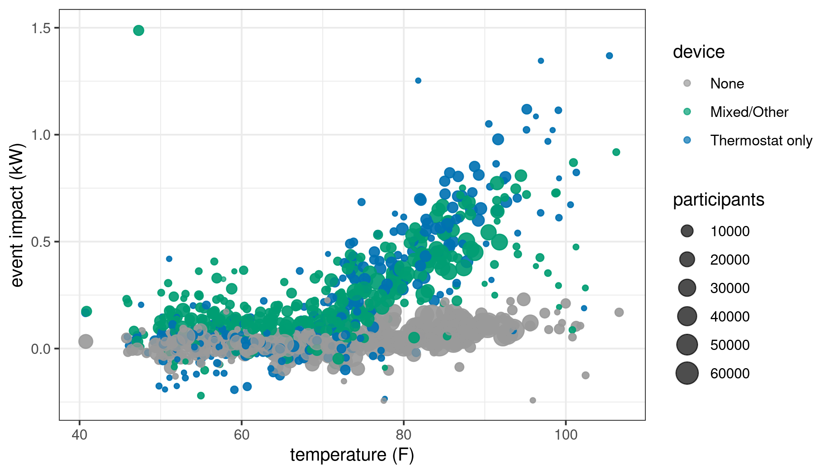
Ex post: patterns in impacts due to temperature and device category
The overall resource is clearly temperature responsive/dependant
Thermostat only customers are the most temperature responsive

Slide 11
Ex post summary
Device owners respond more reliably and with larger impacts than non-device owners
Thermostat-owning customers average larger impacts than owners of other load control device types
customers with multiple/mixed devices out perform thermostat-only customers on average, but not at higher temperatures
All else being equal, customers in hotter subLAPs have higher average impacts than customers in cooler ones.
PY2024 featured impacts consistent with prior years, after controlling for temperature

Slide 12
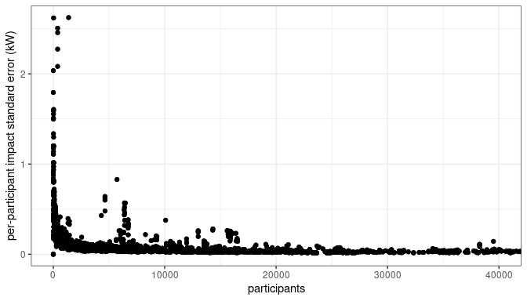

Estimated standard error of impacts
${se}_{impact}= \sqrt{\frac{1}{n}\left({ sd(baseline)}^{2}+{ sd(event)}^{2}\right)}$.
criteria | % of event hrs
se > 50w | 61.55
se > 100w | 23.68
se > 250w | 3.06
se > 500w | 0.51
se > 1000w | 0.15
se > impact | 16.26
se > impact/2 | 41.25

Slide 13
Ex ante

Slide 14
Ex ante methods
Ex post events as inputs into ex ante regression model
Fit separately for each of the three device categories (none, t-stat only, mixed/other)
  Primary explanatory variables: temperature, hour of day, sub-LAP
Ex ante VPP resource customer performance estimated based on “thermostat-only” customers
“24x7x12” Secondary model based on hourly thermostat setpoint and duty-cycle data extrapolates resource potential dispatched hours to all hours for all months

Slide 15
Projected enrollment
Renew Home is forecasting continued growth in enrollment focused on Nest-owners, assigned to a new “VPP resource”
The fraction of thermostat-only customers is projected to increase into the future with the VPP resource consisting of device owning customers exclusively
In the future, an “average customer” will be more likely to have a thermostat and per-customer impacts will more and more closely resemble today’s thermostat owners

Slide 16
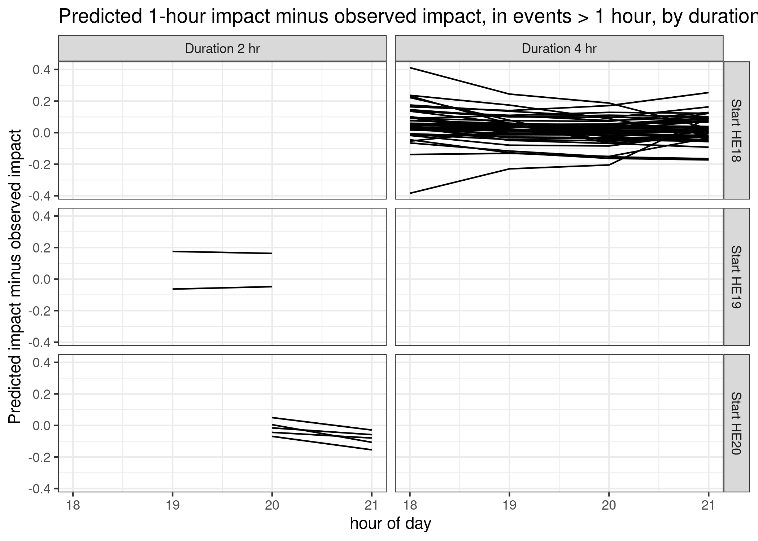
No evidence of systematic fatigue
one-hour event predicted impact minus the observed impact for each multi-hour summertime event
No consistent indication of fatigue across 4-hour events, BUT events include multiple waves of customer dispatch not representative of “full resource dispatch”
Fatigue values applied from the full dispatch during PY2021
Fatigue adopted amounts to a ~15% reduction in the fourth hour

Slide 17
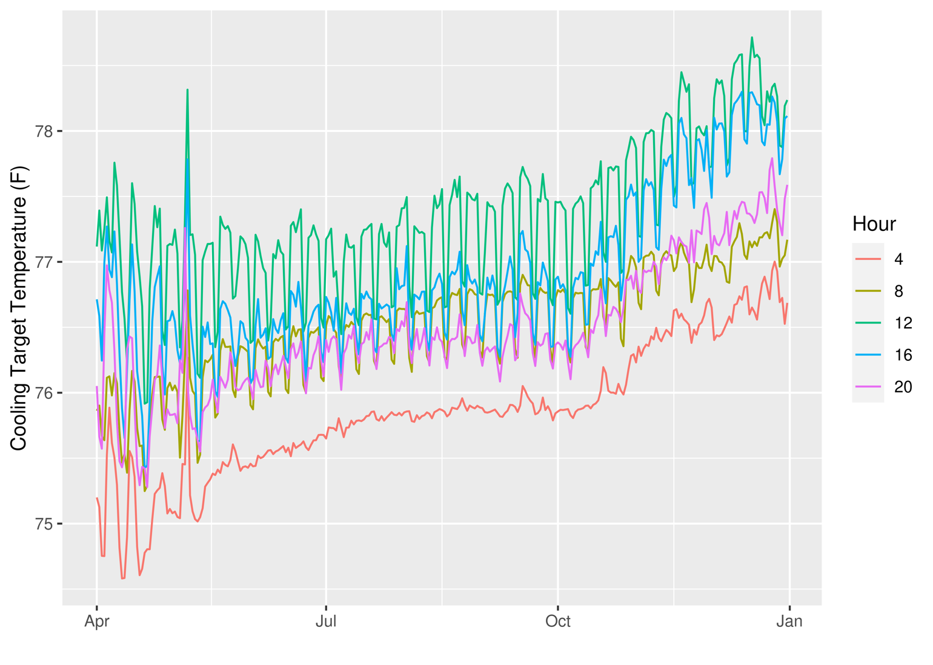
24x7 load impact
AC impact assumed proportional to cooling duty cycle
Hourly historical setpoints and duty cycle minutes available for Nest Thermostats in CA
Predictive model of duty cycle given temperatures, hour of day, and sub-LAP predicts duty cycle for 24x7x12 hours
Duty cycle ratios used to re-scale impacts from dispatched hours to all other hours

Slide 18
Planned VPP customer dispatch
Renew Home states:
OhmConnect dispatched Nest Thermostats in two different ways:
  Rush Hour Rewards API. 3.6 degree F (2 degree C) offset for the event; no preconditioning
  Smart Device Management API. Thermostat in Eco mode (no cooling) for the event; in practice, this group doesn't perform better than the 1st group because a 3.6 F offset is pretty large
Renew Home dispatch includes two cohorts of users:
  Rewards: preconditioning for day or hour ahead dispatches; offsets of 4 F
  Base: 2 F preconditioning for day or hour ahead dispatches; additional offsets up to 2.5 F
CDA concludes: Renew Home Rewards and Base customers will have comparable offset from their pre-event conditions; thermostat-only customers should be representative of future customers.

Slide 19
Per-customer predicted monthly load impact
Per-customer impacts are predicted to increase between now and 2028
  This is largely due to a higher percentage of future customers having devices subject to direct load control
  Impacts are temperature sensitive, with elevated impacts from May-October
  IOU weather impacts are higher than CAISO weather impacts

Slide 20
Ex Ante aggregate forecast
Due to greater device participant fractions and growing enrollment, aggregate capacity is predicted to increase over the coming years
Overall impacts are expected in similar proportions from each of the IOU territories
Greatest impacts are predicted for the afternoon through early evening
May through October are predicted to have larger impacts than cooler months

Slide 21
Questions?
sam@convergenceda.com

