Slide 1
Load Impact Evaluation:
SCE Demand Response Aggregator Contracts
Dan Hansen and Corey Goodrich
May 2025

Slide 2
Presentation Outline
Resource Description
Ex-post Methodology
Ex-post Load Impacts
Ex-ante Methodology
Ex-ante Load Impacts

Slide 3
1. Resource Description
Three Demand Response Aggregators (DRAs) had active contracts during the 2024 program year:
  Hybrid Electric Building Technologies (Hybrid)
  Stem Energy (Stem)
  Swell Energy (Swell)
Hybrid and Stem enrolled commercial and industrial customers to provide demand response within SCE’s service territory; Swell enrolled residential and small commercial customers
  DRAs nominate customers on a monthly basis
  SCE dispatched the contracts according to the associated terms
  DRA is responsible for meeting the contract obligations

Slide 4
2. Ex-post Methodology
Estimated customer-specific regression models with the customer’s hourly usage as the dependent variable
Two models are used to simulate reference loads that would have occurred in the absence of events, one for weekday events and another for weekend events
The explanatory variables include:
  Temperatures, expressed in several ways (e.g., current hour, average daily, maximum daily)
  Irradiance
  Holiday (only on weekend model) and near holiday (only on weekday model)
  Hour of day
  Day of week
  Month of year
  A morning load variable (average load from midnight to 10 a.m., except for customers with early event hours)

Slide 5
2. Ex-post Methodology (2)
October 2023 through September 2024 data included in the model
  Exclude event hours plus at least 3 hours following the event
    If the event starts at 5 p.m. or later, the rest of the day is excluded
    Needed to include some event-day data to improve estimates for contracts with a high frequency of events
  Exclude data prior to the customer’s first nominated month, which ensures that storage is in place (if applicable)
Model validation
  Estimated a common specification excluding ~15% of the data (randomly selected non-event days)
  Compared predicted and observed values on withheld days and adjusted the customer’s regression specification as needed
Estimated load impact = the model’s predicted load for the event hour minus the observed load

Slide 6
3. Ex-post Results
Average of 4-Hour Events Starting HE 18
The table includes customers participating under the two continuing providers (Hybrid and Stem)
Unable to show load impacts and contract quantities in MW due to confidentiality
Performance declines during later event hours

Slide 7
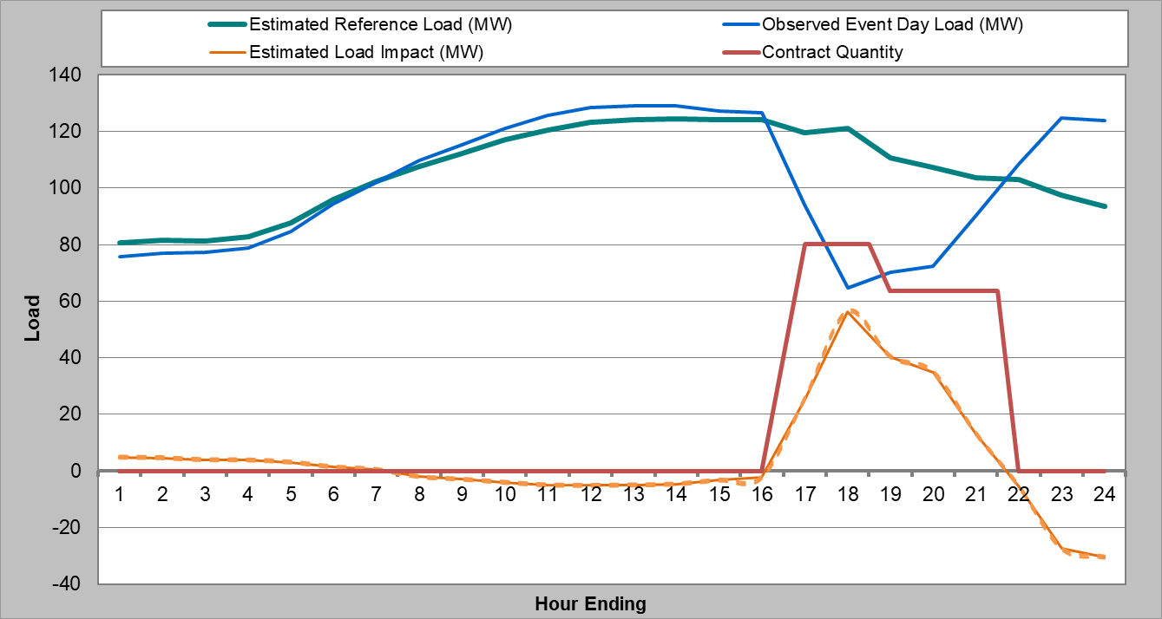
3. Ex-post Results
August 5, 2024, Hourly Load Impacts
All Dispatch IDs called on August 5th
6 Dispatch IDs called HE17-20
7 Dispatch IDs called HE18-21

Slide 8
4. Ex-ante Methodology
SCE provided a forecast of monthly capacity commitments by contract
  Replaces the enrollment forecast typically used in a load impact study
Simulate customer-specific reference loads for all required scenarios (by month and weather scenario)
  Same as ex-post regression model but omitting the morning load, irradiance, and near holiday variables
  Ex-ante results include only 1-in-2 weather scenarios and Swell contracts are dropped

Slide 9
4. Ex-ante Methodology (2)
Ex-ante load impacts are a straightforward translation of the ex-post estimates
  No weather effect on load impacts, so no statistical modeling is needed
  Use average impacts across four-hour events from HE17-20 or HE18-21
  Hourly forecast impacts are built up from contract level estimates
Contracts have a maximum 4-hour event duration, whereas the Resource Adequacy window is 5 hours long
  Simulate HE18-21 events only (shifting HE17-20 ex-post impacts when calculating the average for ex-ante)
Forecast contract quantities matched ex-post contract quantities, so no adjustment was needed for that

Slide 10
5. Ex-ante Load Impacts
Comparison of PY2023 to PY2024 forecasts for Aug. 2025
Load impacts, and thus the contract achievement percentage, are slightly lower in the current forecast vs. the previous forecast
This is consistent with differences in the ex-post load impact estimates in the two evaluations

Slide 11
Questions?
Contact
Dan Hansen
Christensen Associates Energy Consulting
Madison, Wisconsin
  dghansen@CAEnergy.com
  (608)231-2266

