Slide 1
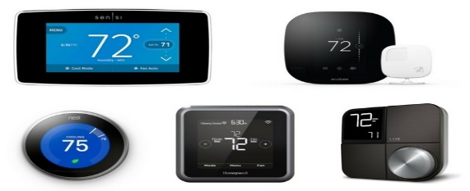
Southern California Edison
Smart Energy Program:
2024 Load Impact Evaluation
May 12, 2025

Slide 2
PY 2024 SEP Overview
Overview
Segmentation Variable | Segment Description | Participants
All Customers |  | 79,626
LCA | Big Creek/Ventura | 11,106
 | LA Basin | 66,174
 | Outside LA Basin | 2,346
Low Income | CARE | 19,049
 | Non-CARE | 60,578
NEM | NEM Customer | 28,378
 | Non-NEM Customer | 51,248
Size | Above Median (2.11 kW) | 39,912
 | Below Median (2.11 kW) | 39,715
SubLAP | SCEC | 35,032
 | SCEN | 8,985
 | SCEW | 31,142
 | SCHD | 2,291
 | SCLD | 55
 | SCNW | 2,121
Tariff | Dynamic | 52,521
 | Flat | 27,106
Thermostats | 1 Thermostat | 67,239
 | 2 Thermostats | 10,722
 | 3+ Thermostats | 1,665
Zone | Remainder of System | 38,664
 | South Orange County | 13,430
 | South of Lugo | 27,532
SEP operates through temporary thermostat adjustments which reduce AC usage and lowers electric demand.
Events can be called year-round, though customers only receive bill credits for June through September participation.
SEP includes multiple vendors and smart thermostat manufacturers (OEMs)
  For analysis purposes, we only focus on thermostat vendors
New SEP participants receive a one-time $75 bill credit for enrolling and a daily bill credit of $0.3275 per day June to September.

Slide 3
Ex-Post Analysis

Slide 4
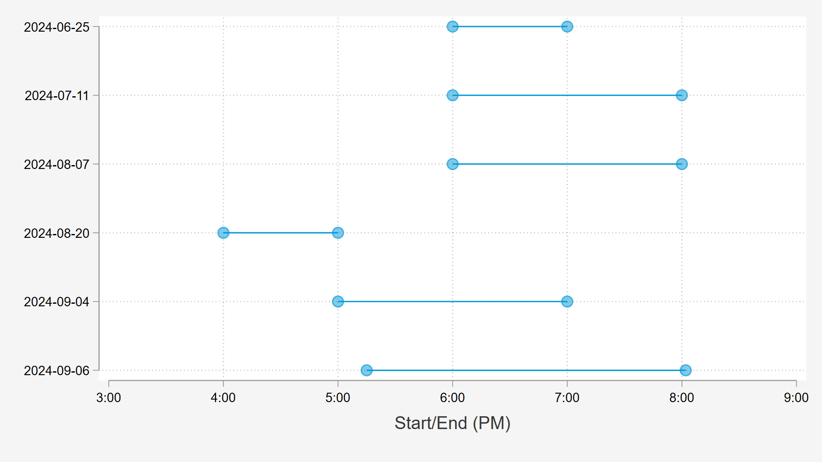
2024 SEP events varied in timing and duration; Event hours spanned most of the RA Window Hours
Partial Mira Loma dispatch

Slide 5
SEP Ex Post Methodology
Proxy Day Selection
Three proxy days were selected for each event day based on SCE system load
Matched Controls
A control customer was chosen for each participant based on individual load during all proxy days
Regression Analysis
Difference-in-differences panel regression
Hourly event impacts estimated by subcategory and across all customers
Separate regression for each event day hour using event day and it’s 3 proxy days
Hard matched within NEM status, climate zone, size quartile, and tariff rate (Dynamic vs. Flat) groups
Propensity score matching model with replacement
Climate Zones 5, 6, and 8 were bundled together to improve matching
Proxy days are have similar characteristics to event days, but there were no events called.

Slide 6
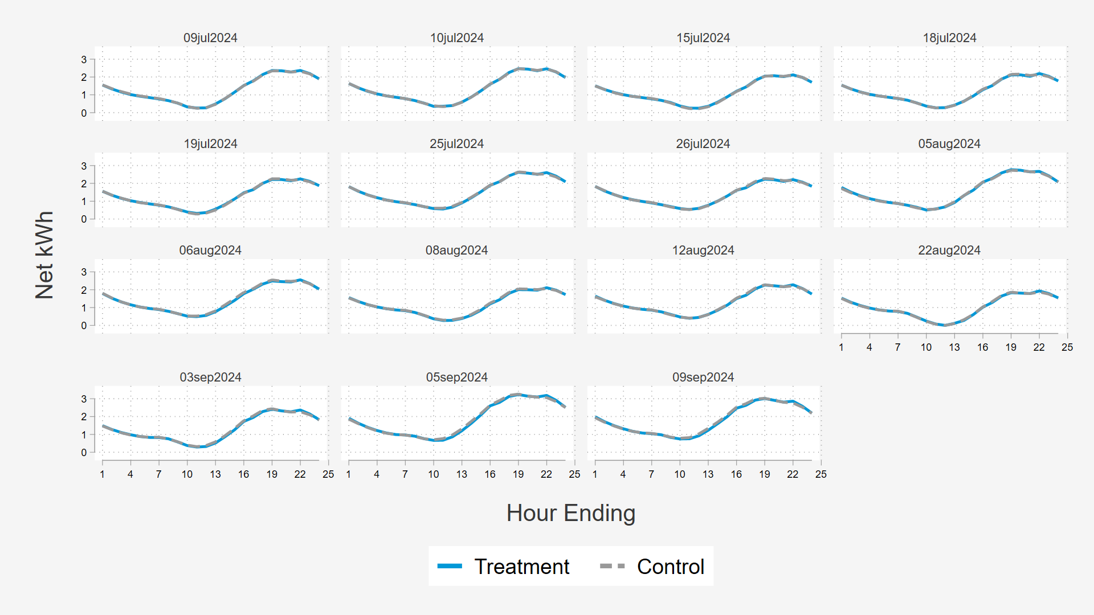
Treatment and Matched Control Group
Average Hourly kW on Proxy Days
Control matches were assigned characteristics (including sub-LAPs and vendor) from their treated counterpart
Matches are done with replacement
Ideally, if the control customers are a good match for the participants, their loads on the proxy days would be identical.

Slide 7
Ex Post Results
All events, but 09/06, in 2024 were called territory-wide, and included a pre-cooling period
The partial hour event on September 6th was a distribution level dispatch to the Mira Loma area.
  The event had the lowest aggregate reduction because of the lower participant count
Program participation continued to grow over the summer

Slide 8
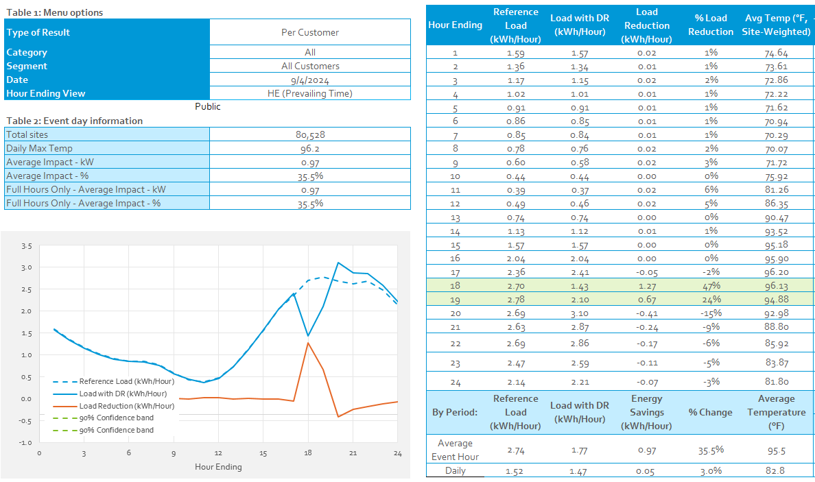
Warmest Territory Wide Event Day – September 4th
Two-hour dispatch
  Hour 1 impacts well above 1 kW per-customer
  Average per-customer impact of 0.97 kW
Aggregate Impact of 103.4 MW in Hour 1
SCE system peak was on September 6th. The event called that day was a targeted distribution relief event.

Slide 9
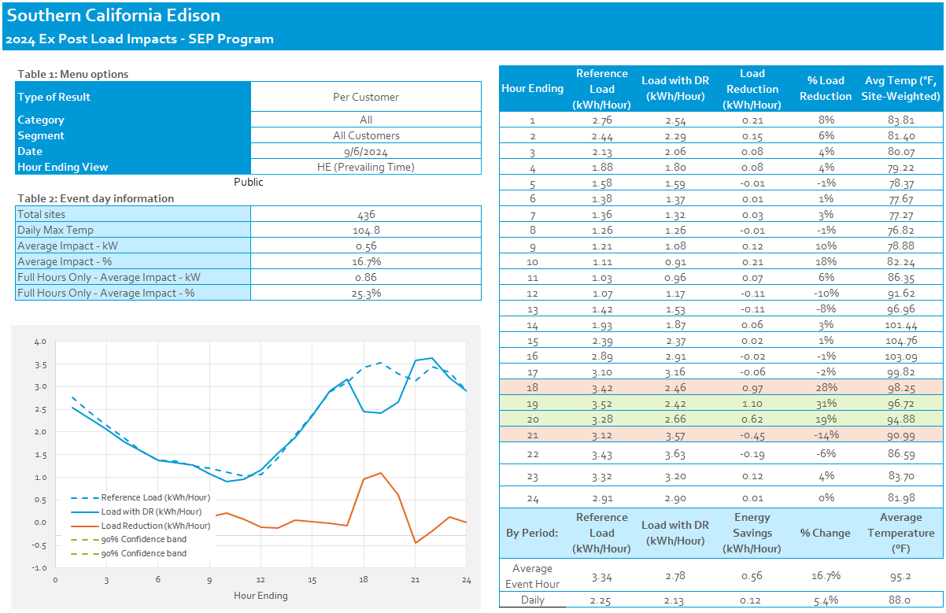
Distribution level event – September 6th
Dispatch was meant to be for all participants in the Mira Loma A-bank, but only a subset of the customers were dispatched.
  Only 435 of the 3,094 customers who should have been dispatched were dispatched.
The small number of customers makes modeling a good counterfactual difficult.
Distribution level events can provide valuable targeted relief to specific locations on the grid

Slide 10
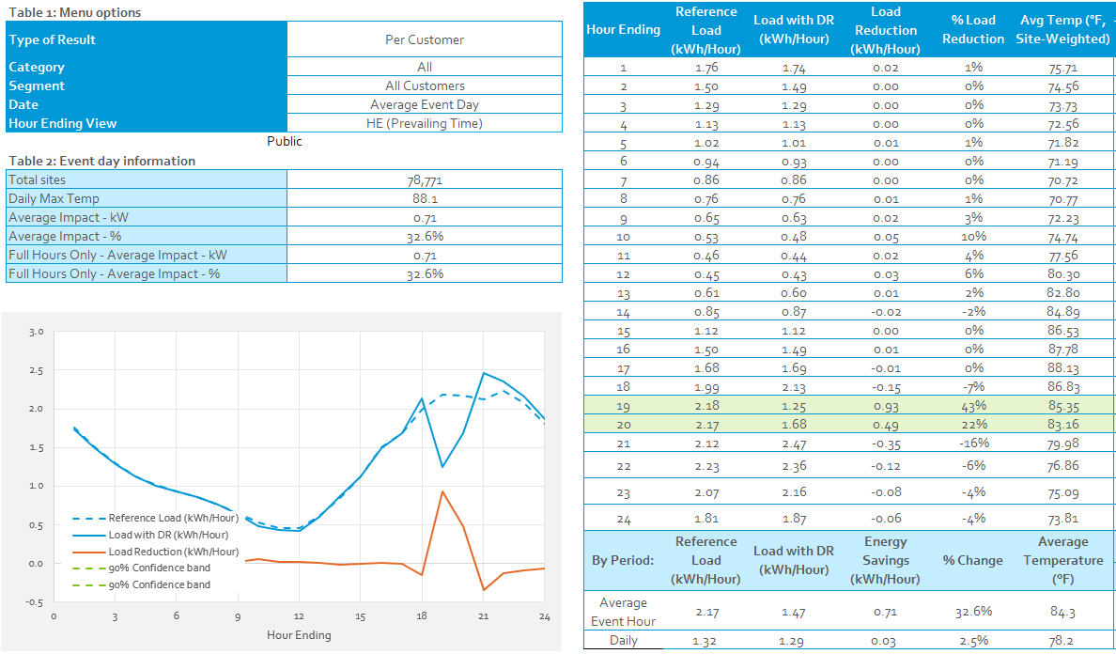
Average Event day 6-8PM
Average includes two event days
  7/11/2024
  8/7/2024
Neither of these events were called on extreme days.
Per customer impact estimates are consistent with past years at ~1 kW in hour 1 and ~0.5 kW in hour 2

Slide 11
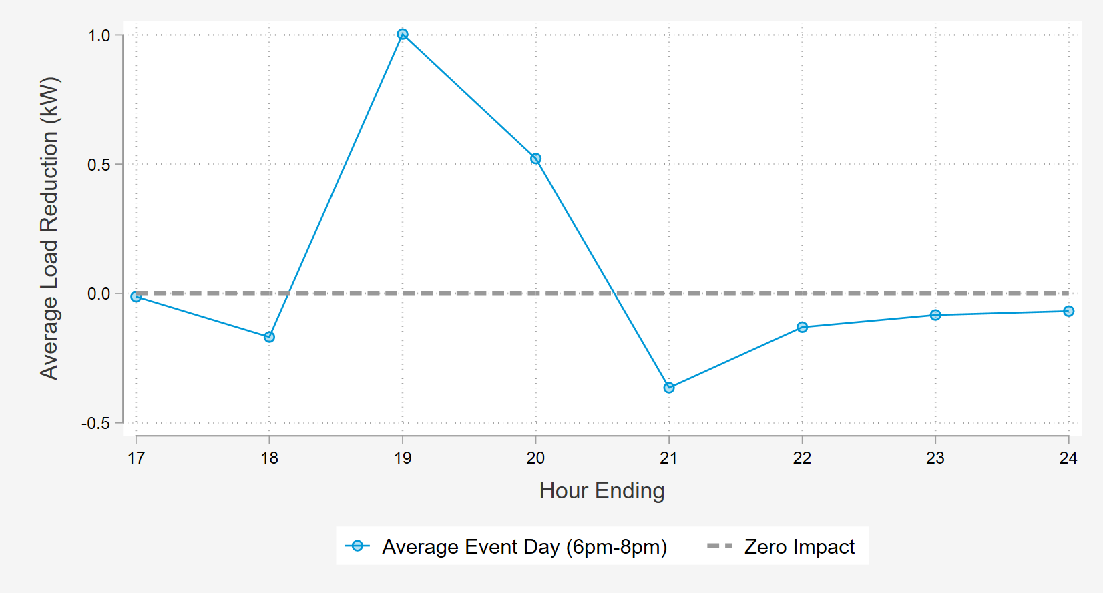
Event Impacts Are Largest During the first Hour of Dispatch and fade in subsequent hours
Pre-Cooling effects

Slide 12
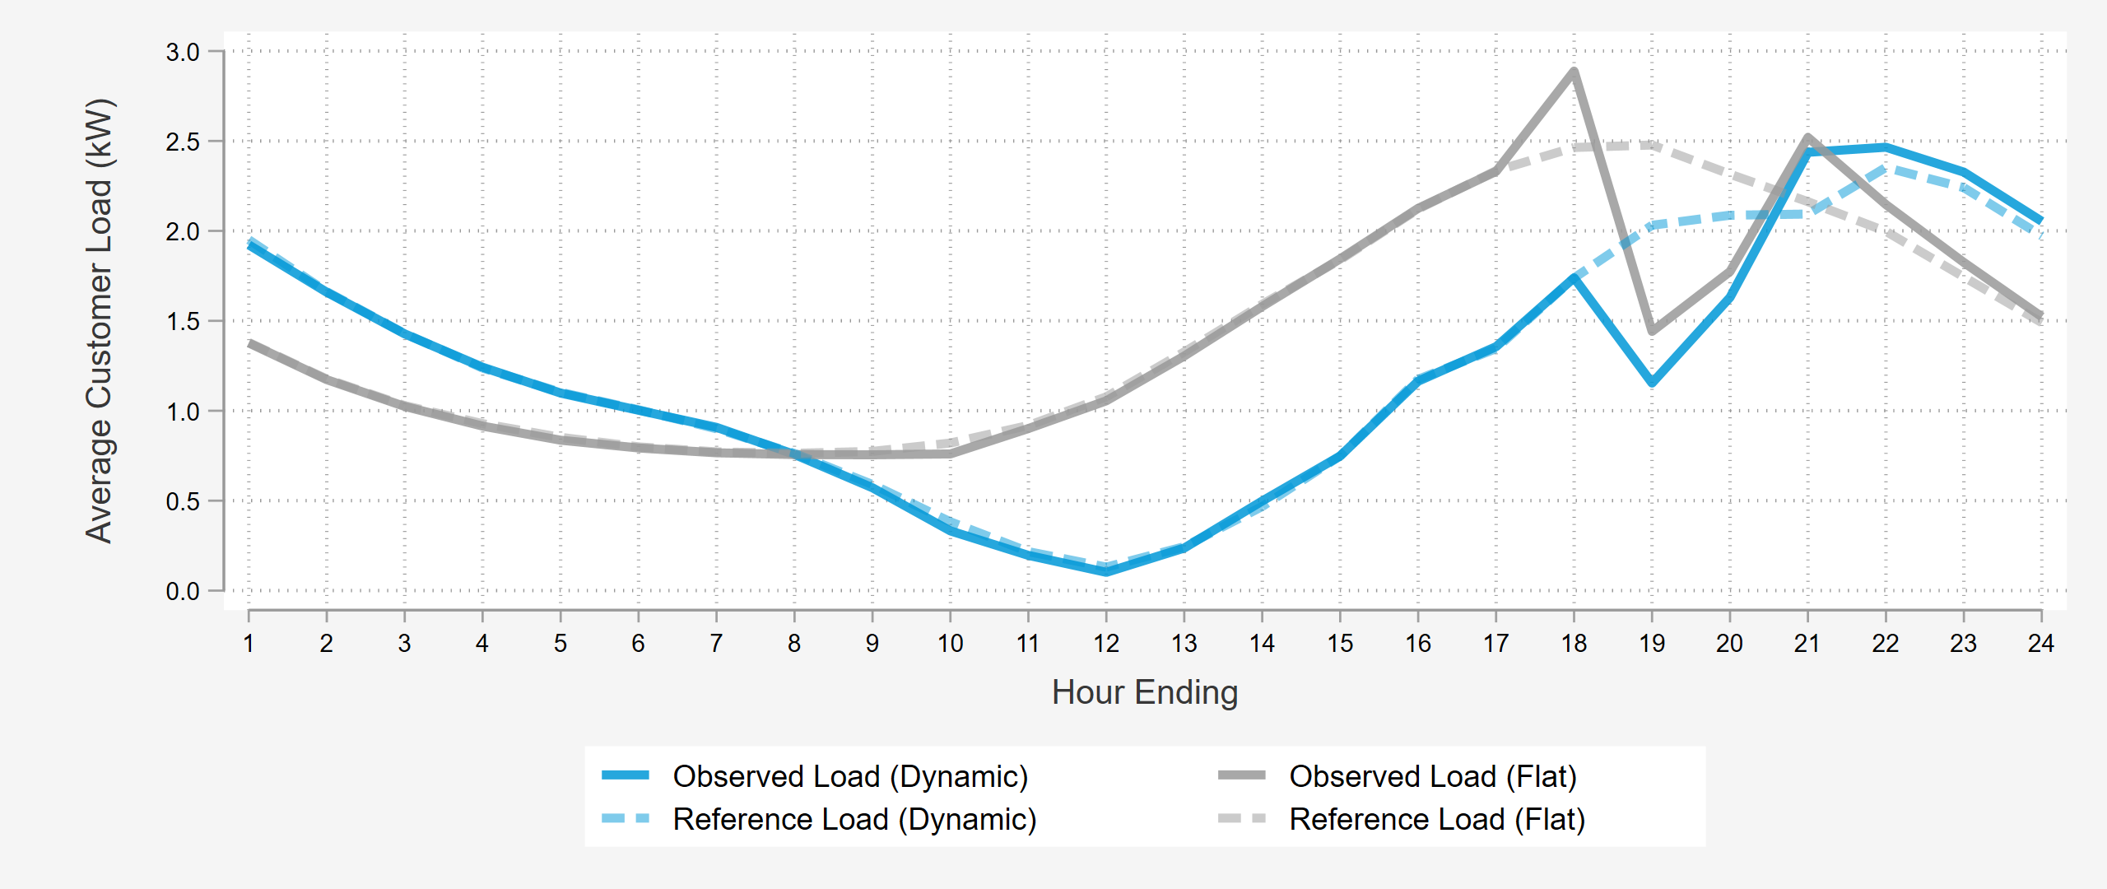
Results by Tariff Rate – Average Event day 6-8PM
Flat rate customers drop an average of 1.04 kW in hour 1 while dynamic rate customers only drop 0.88 kW
Pre-cooling is allowed for the flat rate customers regardless of event start time while dynamic rate customers cannot be pre-cooled during their “peak” rate periods
The ability to pre-cool before a DR event makes a big difference in hour 1 impacts

Slide 13
Ex Post Comparison to Prior years – Average Event Days
2024 impacts were in line with previous years in terms of percentage of the reference load
Lower event temperatures for the average event in 2024 lead to lower average reference loads and absolute impacts than previous years.
SEP program enrollment increased by nearly 10,000 customers in the offseason between 2023 and 2024. Strong enrollment numbers mean that the SEP program can continue to grow in its delivery capabilities.
Measure | 2022 (6-8 PM) | 2023 (6-8 PM) | 2024 (6-8 PM)
Avg. Reference Load (kW) | 2.67 | 2.37 | 2.17
Avg. Load Impact (kW) | 0.86 | 0.73 | 0.71
% Load Impact | 32.40% | 30.88% | 32.6%
Avg. Event Temperature | 92.0 | 87.8 | 84.25
Heat Buildup (Avg. F, 12 AM to 5 PM) | 79.3 | 79.0 | 77.41
Enrollment | 56,668 | 69,286 | 78,771

Slide 14
2024 Ex-Post vs 2023 Ex-ante, how did we do?
7/11/2024 (6:00-8:00 PM) |  |  | Per-Customer Impact (kW)
Results | Event Average Temp (F) | Customers | Hour 1 | Hour 2 | Hour 3 | Hour 4
SCE 1-in-2 July Peak Day (2023 Ex-Ante Predictions for 2024) | 90.1 | 76,312 | 1.15 | 0.65 | 0.38 | 0.26
Ex-Post | 89.0 | 77,876 | 0.99 | 0.51
8/7/2024 (6:00-8:00 PM) |  |  | Per-Customer Impact (kW)
Results | Event Average Temp (F) | Customers | Hour 1 | Hour 2 | Hour 3 | Hour 4
SCE 1-in-2 August Peak Day (2023 Ex-Ante Predictions for 2024) | 90.1 | 76,886 | 1.12 | 0.63 | 0.37 | 0.27
Ex-Post | 86.1 | 79,647 | 0.88 | 0.48
9/4/2024 (5:00-7:00 PM) |  |  | Per-Customer Impact (kW)
Results | Event Average Temp (F) | Customers | Hour 1 | Hour 2 | Hour 3 | Hour 4
SCE 1-in-2 September Peak Day (2023 Ex-Ante Predictions for 2024) | 91.9 | 77,380 | 1.19 | 0.67 | 0.41 | 0.3
SCE 1-in-10 September Peak Day (2023 Ex-Ante Predictions for 2024) | 98.4 | 77,380 | 1.52 | 0.85 | 0.51 | .0.31
Ex-Post | 96.2 | 80,528 | 1.27 | 0.67
These comparisons use the 4-9pm ex-ante predictions from the 2023 load impact evaluation
Events shown from July, August, and September
  Ex-ante events begin at 4pm, but these events ranged their starts from 5pm to 6pm
Customer enrollment in 2024 is ahead of the expectations from the 2023 Ex-Ante forecasts.
Overall, impacts from 2024 events, controlling for temperature differences, are similar to 2023 ex-ante predictions

Slide 15
Ex-Ante Analysis

Slide 16
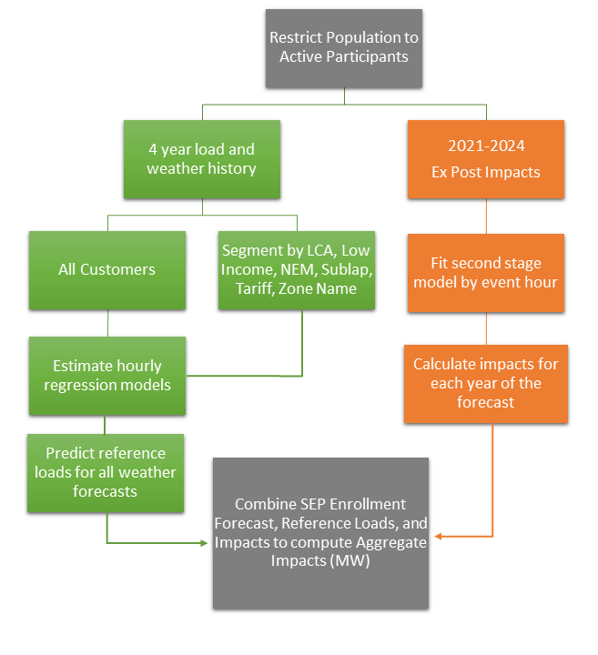
Ex Ante Estimation Process Diagram
We only include full event hours in the second stage model
Event hours affected by pre-cooling are included in the second stage model
High event temperatures help predict events under the more extreme ex-ante weather conditions
  PY2024 Ex-Ante no longer uses 2020 event data due to age, which means we have less information on program performance at higher temperatures

Slide 17
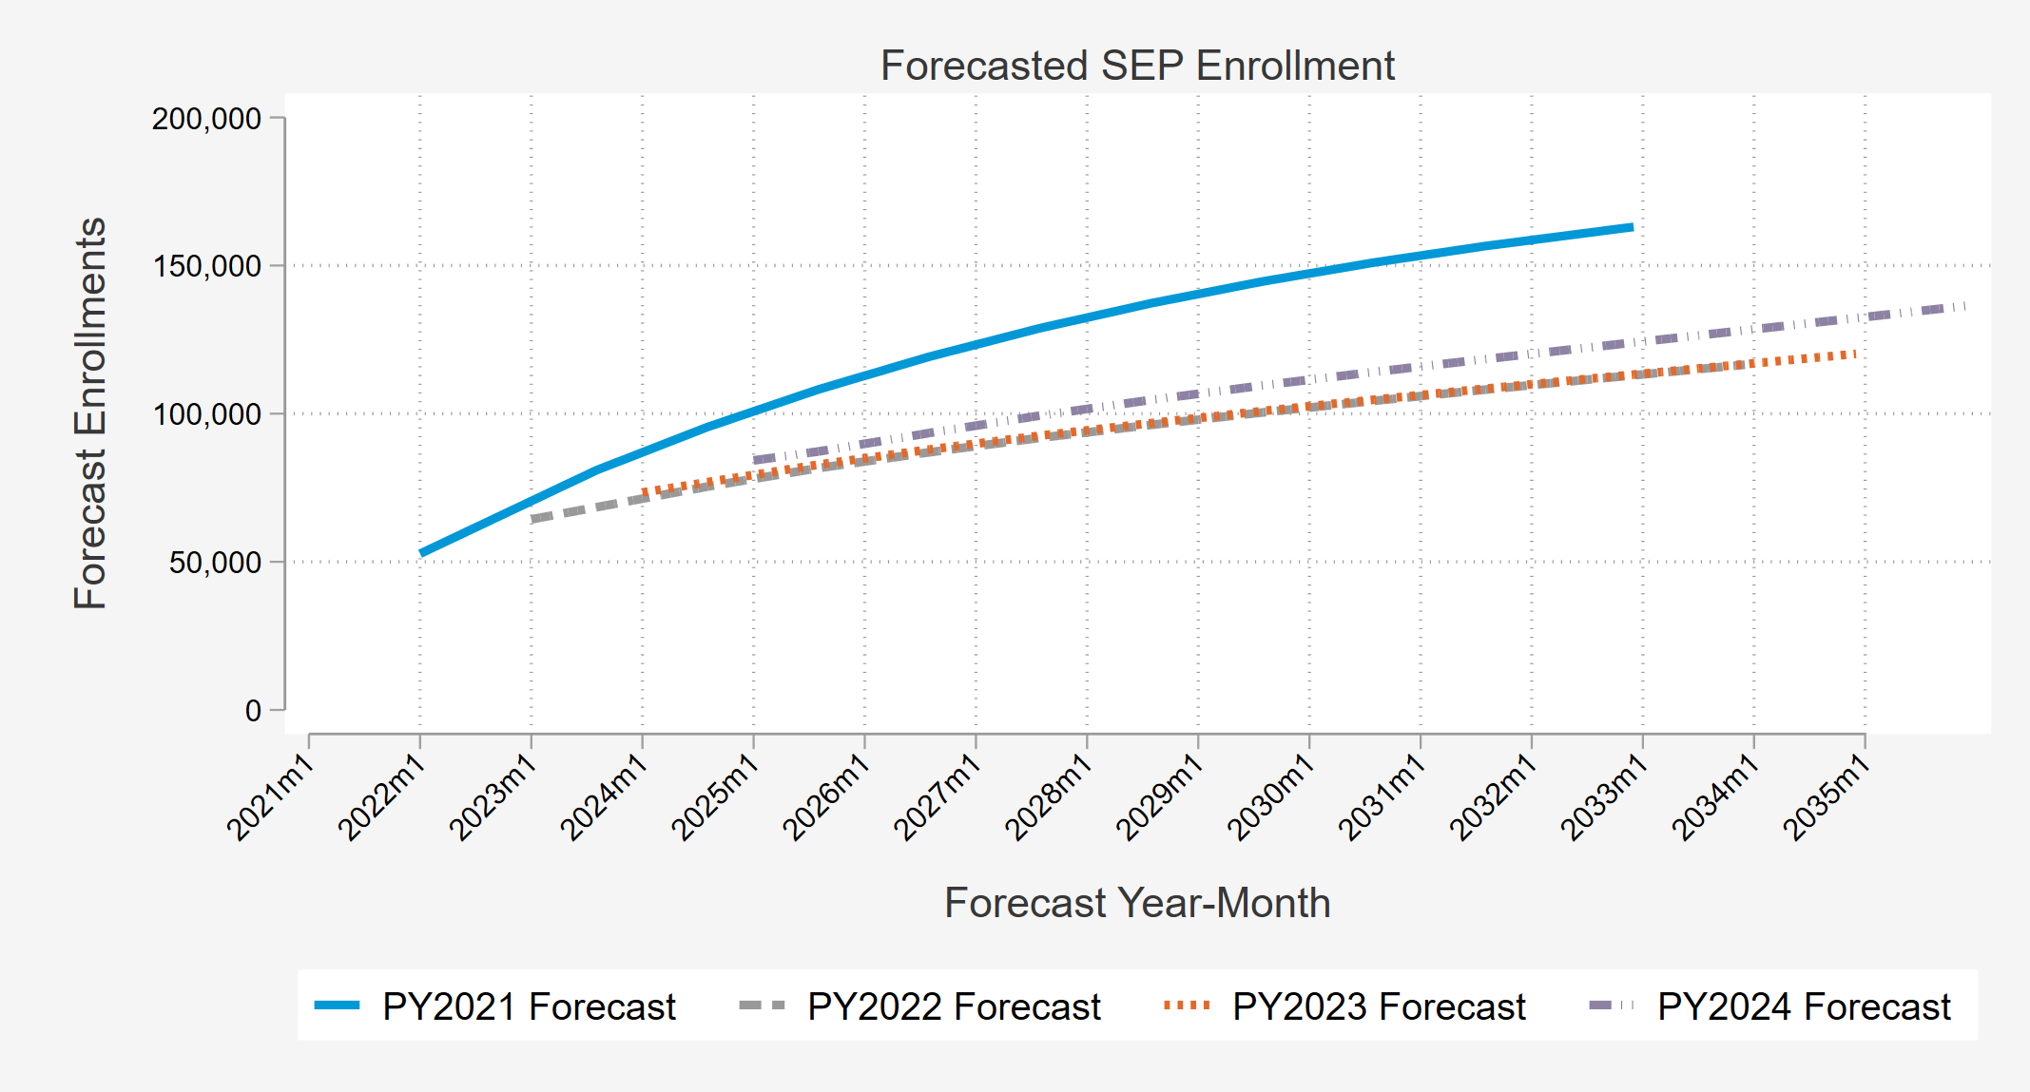
Enrollment Forecast
Forecast Notes
Comparison of 2024 Enrollment Forecast with Past Years
Used to convert average customer kW impacts to program MW capability
PY2024 enrollment forecast is slightly higher than from PY 2023
  Enrollment in 2024 was in line with expectations from PY2023
We assume growth follows the distribution of enrollments at the end of summer 2024

Slide 18
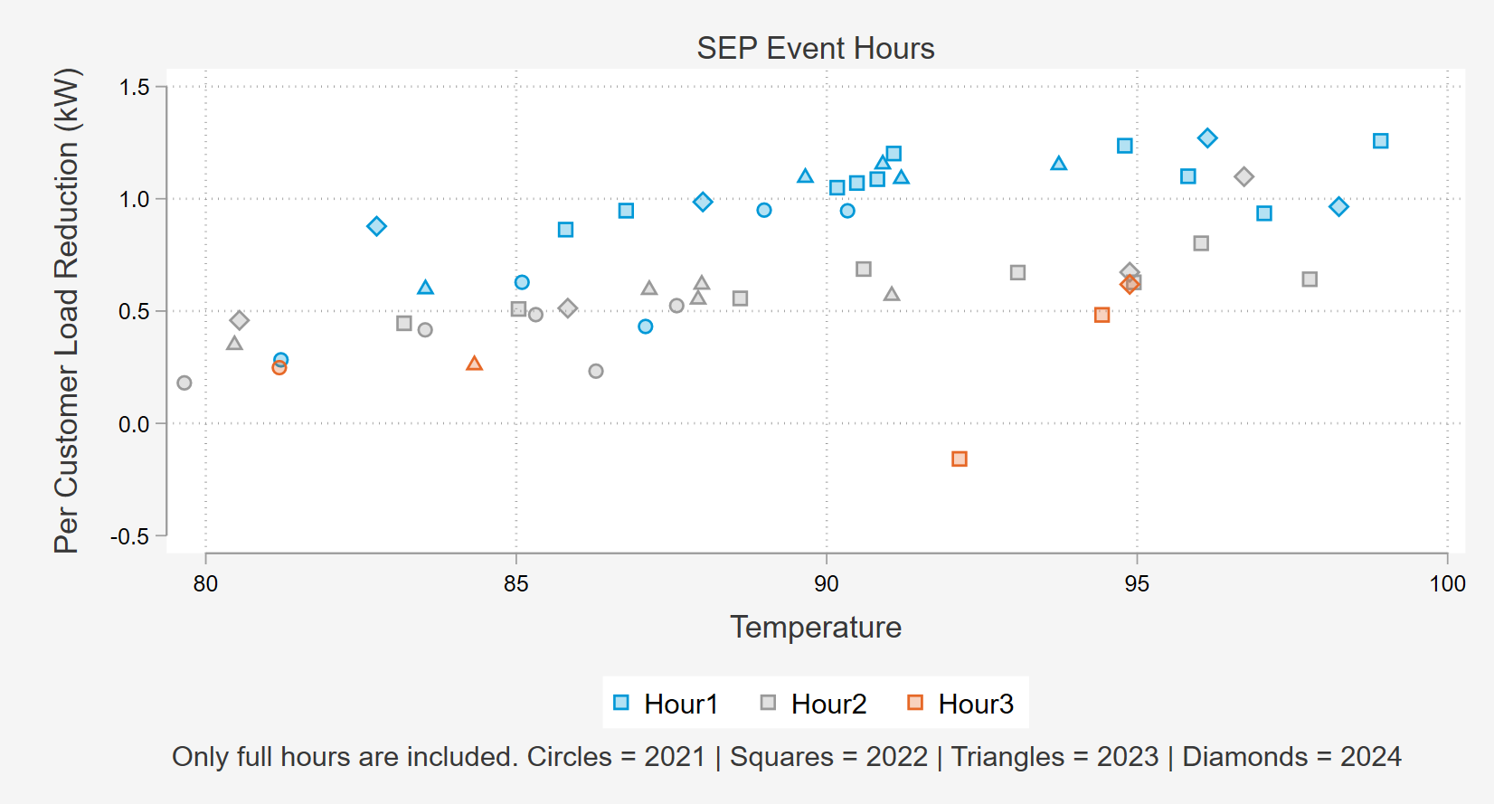
Relationship between Load Impacts, Temperature, and Event Hour
Event hour is the most important predictor of impacts
2021 - 2024 impacts are used with more recent years having more weight
Models are run separately for each customer category
Second stage model regresses kW impacts on temperature (°F)
  Temperature increases magnitude of impact
  Each event hour has its own relationship with temperature

Slide 19
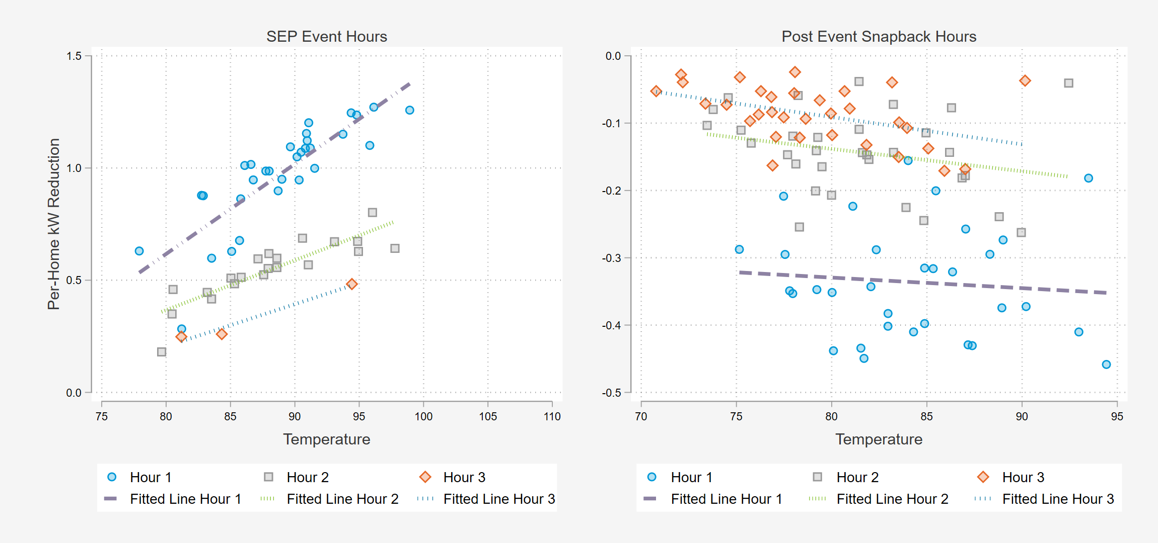
Approach to Second Stage Modeling of kW Impacts in 2024
Separate model for each subcategory which estimates impacts for each hour
Due to event data limitations, we treat hours 4 and 5 as if they were hour 3s
  2021 – 2024 event data only includes a single event with an event hour 4 and no events with 5 hours.

Slide 20
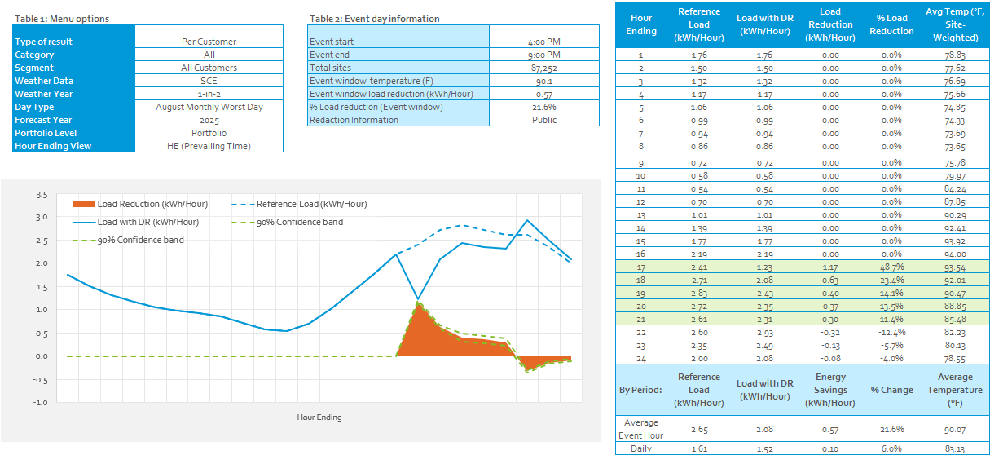
2025 Average Customer SCE 1-in-2 Conditions (August Peak Day)

Slide 21
Comparison of PY2023 and PY2024 SCE 1-in-2 projections.
Hour Ending | SCE 1-in-2 August Worst Day 2025
 | Per Customer Impact |  | Expected enrollment |  | Aggregate Impact
 | 2023 (kW) | 2024 (kW) | PY2023 | PY2024 | PY2023 | PY2024
17 | 1.12 | 1.17 | 76,886 | 87,252 | 86.4 | 102.3
18 | 0.63 | 0.63 | 76,886 | 87,252 | 48.3 | 55.3
19 | 0.37 | 0.40 | 76,886 | 87,252 | 28.8 | 34.8
20 | 0.27 | 0.37 | 76,886 | 87,252 | 21.0 | 31.9
21 | 0.23 | 0.30 | 76,886 | 87,252 | 17.4 | 26.0
RA Window Average | 0.52 | 0.57 | 76,886 | 87,252 | 40.4 | 50.1
Average per-customer impacts over the RA window have increased slightly, especially in hours 1, 4, and 5.
Aggregate impacts are expected to be higher due to an increase in the per-customer impacts and the enrollment forecast

Slide 22
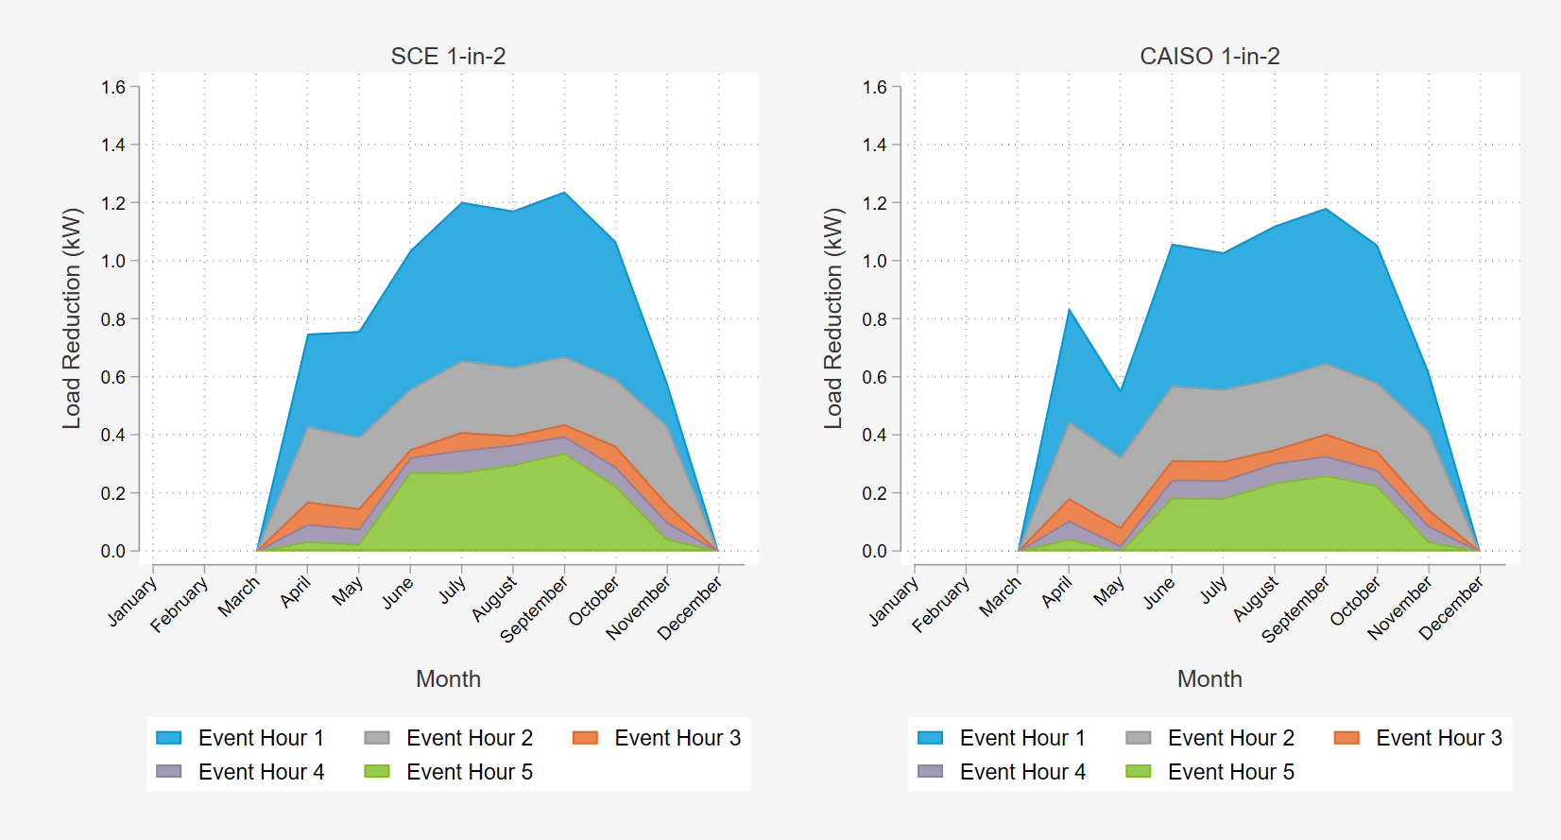
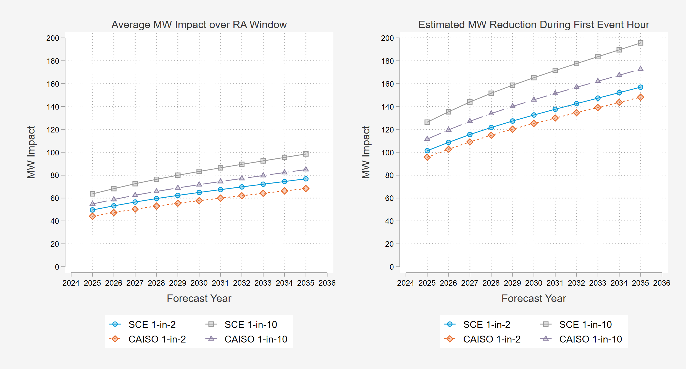
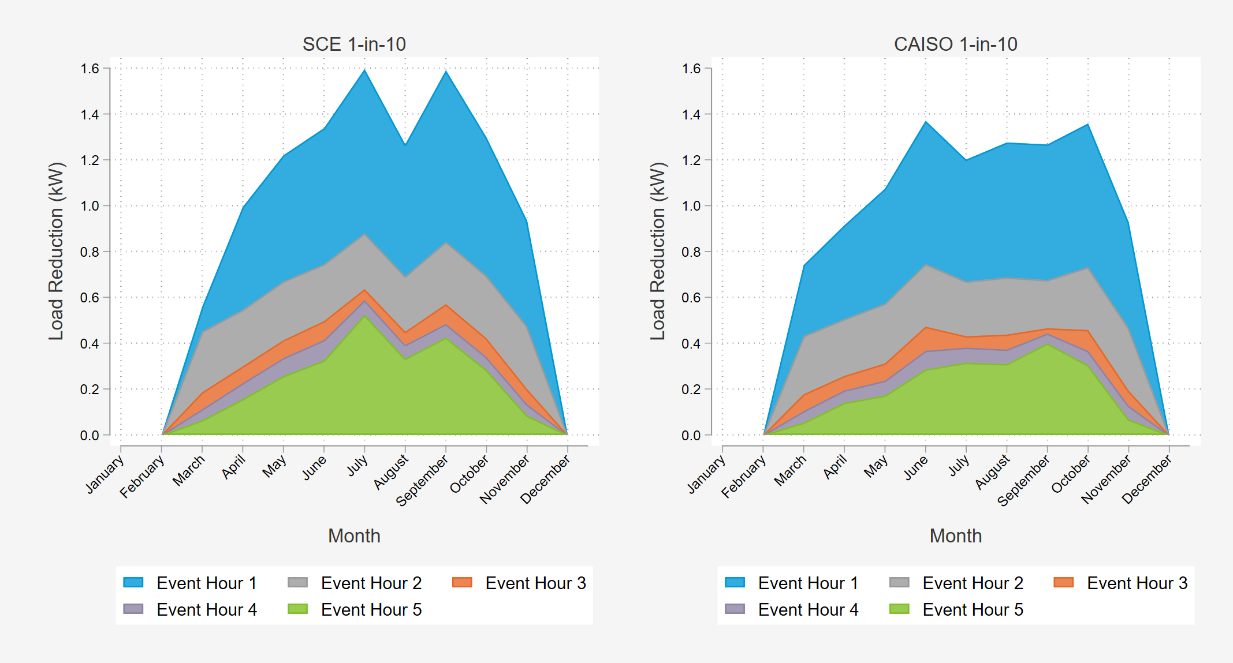
Ex Ante Impacts
Aggregate Impacts – Typical Event Day
Per Customer Impacts by Month
By 2035 SEP is expected to be a ~ 160 MW resource during the first hour of dispatch. ~ 80 MW average over RA window
Event impacts peak in warmer months but decline with each event hour in all months

Slide 23
Takeaways
The number one predictor of SEP load impacts is the position of an hour within an event.
  Largest during the first hour, in large part due to pre-cooling that took place prior to the event
  Shorter events that are more common can prove to be less useful in predicting potentially longer (up to 5 hours) events
PY2024 was a relatively mild year with no event reaching the level of 1-in-2 weather year:
  Incorporating multiple years of historic event results becomes more essential for building robust and reliable estimates for future program performance.
  All but the distribution level event on 9/6 included pre-cooling effects, which has a positive effect on impacts.
The PY2024 ex-ante forecasts are generally higher than the PY2023 impacts.
  Strong enrollment numbers mean that the SEP program can continue to grow in its delivery capabilities.
  SEP program staff remove customers who opt out or do not perform, assuring that only high performing customers are left in the program.
The September 6th localized dispatch event highlights the program’s ability to dispatch at granular geographic levels and shows that SEP has the potential to play an important part in distribution system reliability in the future.

Slide 24

Questions?
Davis Farr
Consultant
Demand Side Analytics, LLC
dfarr@demandsideanalytics.com

