Slide 1
Voltus - Load Impact Protocols
Third Party DRP LIP Workshop – May 14th, 2025
Confidential Information Excluded

Slide 2
Agenda
Voltus Load Impact Protocols Workshop
Voltus Background
Portfolio and Program Descriptions
Ex Post Methodology
Ex Post Load Impacts
Ex Ante Methodology
Ex Ante Load Impacts

Slide 3
Voltus Background

Slide 4

Background
Voltus History
Demand Response Provider across North America since 2016
Track record of successful DR programs
Entered PG&E CBP and PG&E BIP in 2019
Awarded DRAM capacity in PG&E and SCE territory from 2020 until program ended in 2024
Became scheduling coordinator in 2020 and currently providing RA to CCAs in California.
Actively engaged in the 3rd party CCA RA contracts, PG&E and SDG&E CBP, PG&E and SCE BIP, and PG&E and SCE DSGS (Option 2 and Option 3)

Slide 5
Importance of DR qc in light of dram sunset
Voltus DRAM MW are currently ‘stranded’ from providing supply-side RA
The DRAM program concluded in 2024, resulting in double-digit MW of Voltus’s DR contracts needing to be migrated to other similar day-ahead DR programs such as:
  Capacity Bidding Program
  CEC DSGS Option 2 Program
  CCA RA contracts via LIP
However, Voltus’s 2025 QC award was less than portfolio capabilities
  Resulted in our CCA RA program being over-subscribed for 2025, and no DRAM customers could migrate to CCA RA
  Thus double-digit MW had to migrate away from providing supply-side RA and are now enrolled in CEC DSGS 2 instead
Key Takeaway: in light of DRAM sunsetting, an increase in QC award is key to supplying additional supply-side RA to deliver least-cost, clean capacity resources and increased reliability

Slide 6
Voltus and Program Descriptions

Slide 7
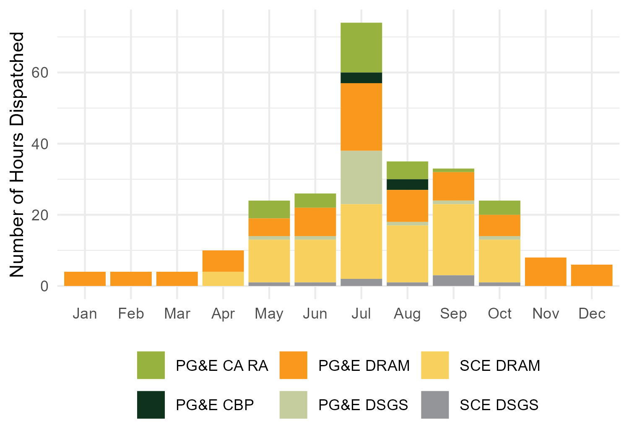
California DR Participation
PY 2024 Programs and Dispatches
 | PG&E DRAM | PG&E CBP | PG&E CA RA | PG&E DSGS | SCE DRAM | SCE DSGS
Num. of Voltus Event Days | 34 | 3 | 14 | 12 | 26 | 8
Num. of 1 to 2 Hour Dispatches | 52 | 4 | 11 | 14 | 40 | 8
Num. of Dispatches 3 Hours or Longer |  |  | 5 | 1 | 6
2024 Enrolled Facilities by IOU | 389 (All PG&E) |  |  |  | 232 (All SCE)
IOU | Participant Event Hours | Participant Event Hours
Program | HE 17 | HE 18 | HE 19 | HE 20 | HE 21
PG&E | 1,718 | 1,616 | 981 | 1,106 | 66
SCE | 1,441 | 1,612 | 1,216 | 1,084 | 4

Slide 8
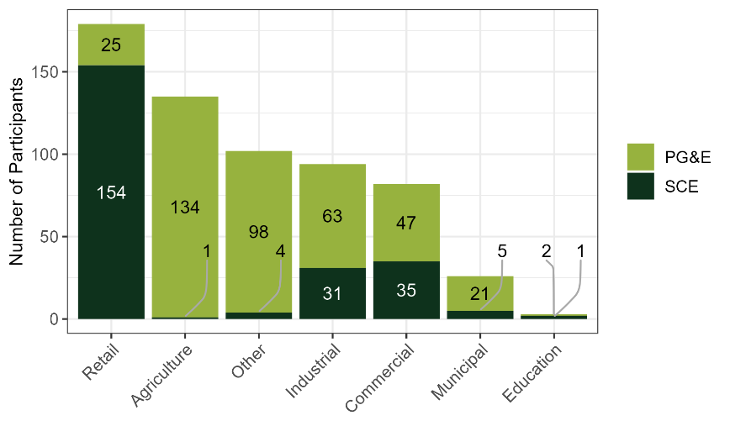
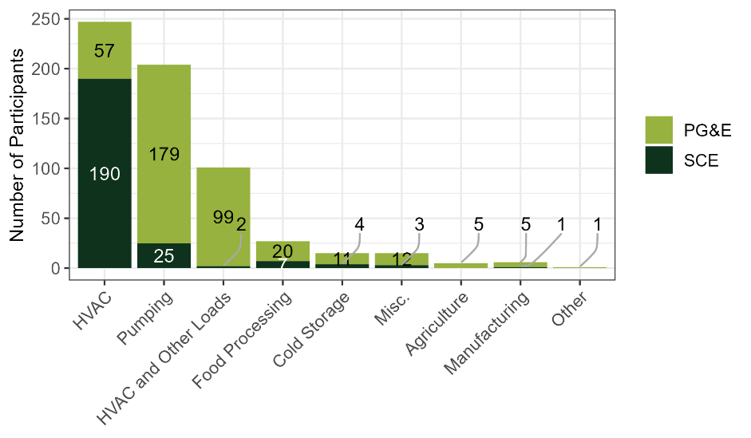
Participant Characteristics
Load and Industry Types
Industry Type
Load Type

Slide 9
Ex Post Methodology
And Impacts

Slide 10
Ex Post Methodology
Overview
Individual, hourly regression models were used to estimate ex post impacts.
Individual models were selected for several reasons:
  Event Variability
  Participant Load Variability
  Reporting Granularity
Individual customers received their best fitting model specification in each quarter for several applicable scenarios which include:
  Summer Models
  Winter Models
Model fits (MAPE and CV RMSE) were examined on a set of event like holdout days. The model with the best out-of-sample predictions for each facility was chosen as the final model.

Slide 11
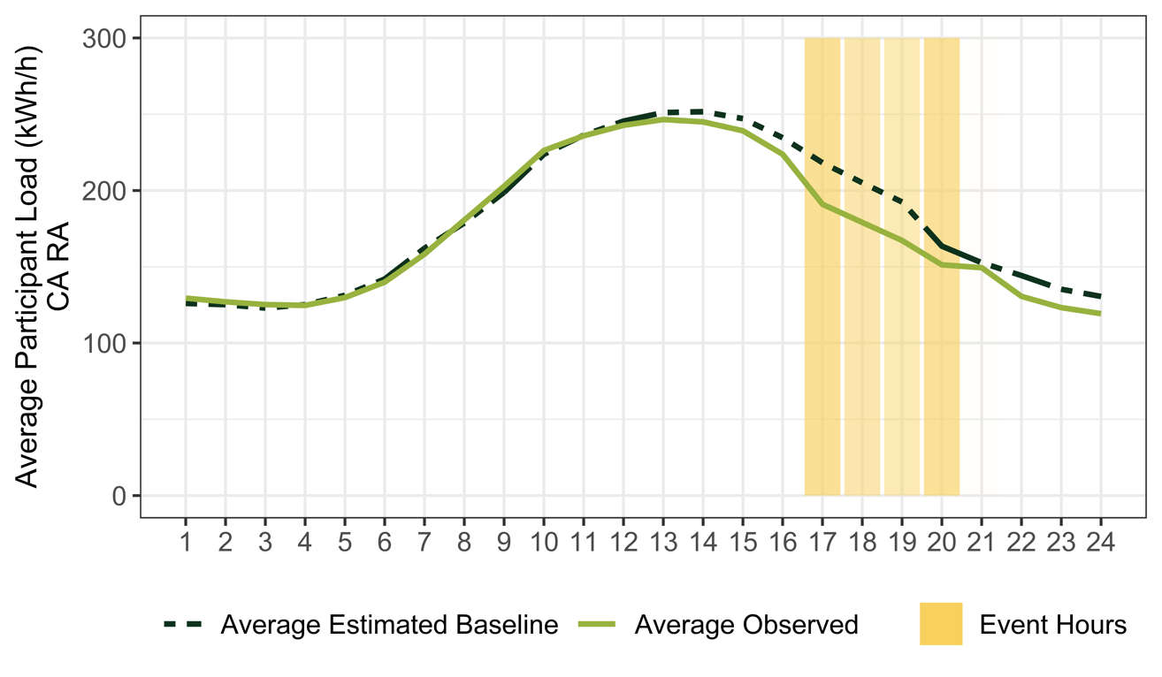
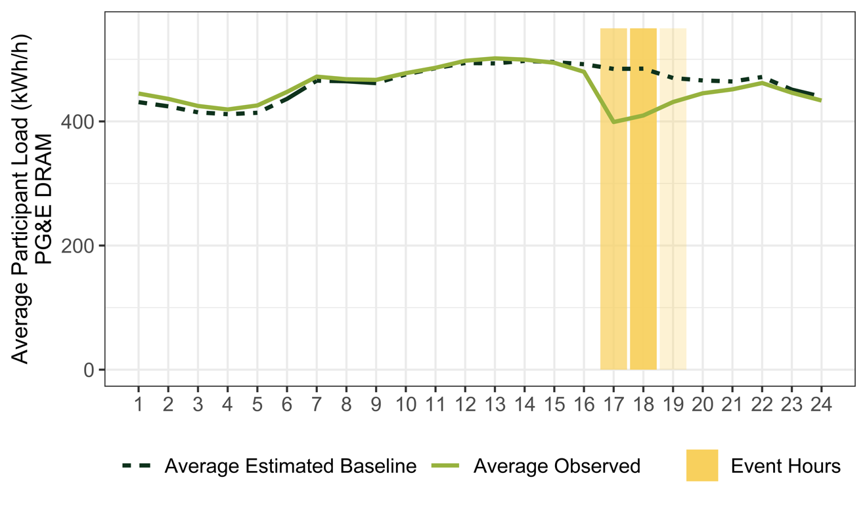
Ex Post Impacts
PG&E CCA RA and DRAM Average Event Day
Program | Avg. Number of Facilities | Mean Reference Load (kWh/h) | Avg. Facility Impact (kWh/h) | Pct. Load Reduction | Avg. Total Reduction MWh/h | Avg. Event Temperature (F)
PG&E CCA RA | 107.2 | 227.9 | 33.8 | 15% | 3.62 | 83.5
PG&E DRAM | 51.4 | 215.9 | 18.5 | 9% | 0.95 | 72.7
Note: Event dispatches occur for varying times and durations. To minimize the dilution of impacts, only dispatches with hours HE 17 through HE 20 for CA RA and HE 17 for DRAM as event hours are included in the average event day load shapes for PG&E programs. Average event day load shapes may vary from impacts reported in the table due to the inclusion of different events and exclusive inclusion of event hours in the average impacts. PG&E CBP and DSGS excluded on 15/15 reporting rule for confidentiality.

Slide 12
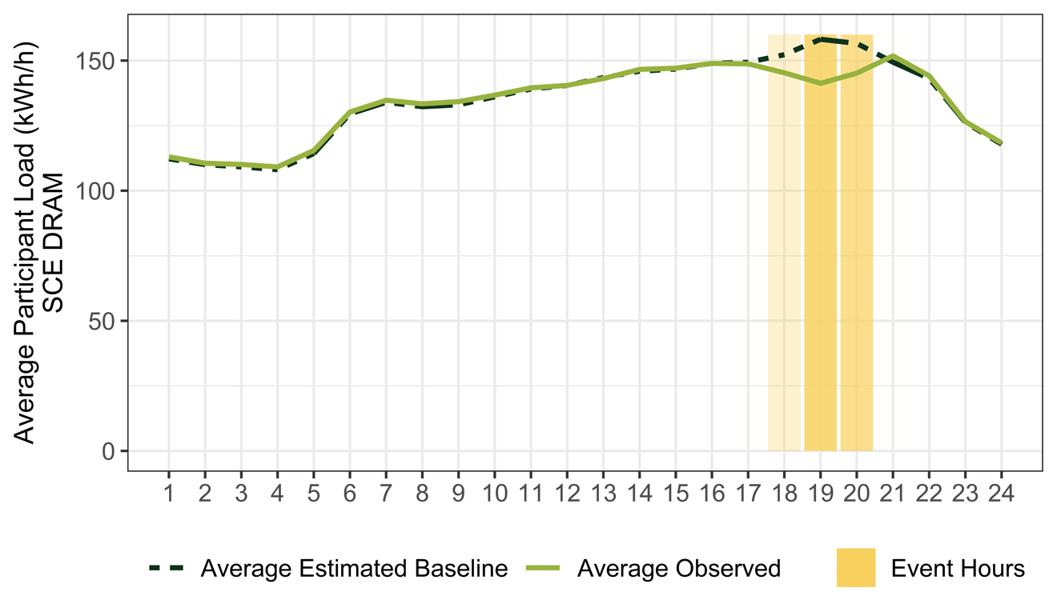
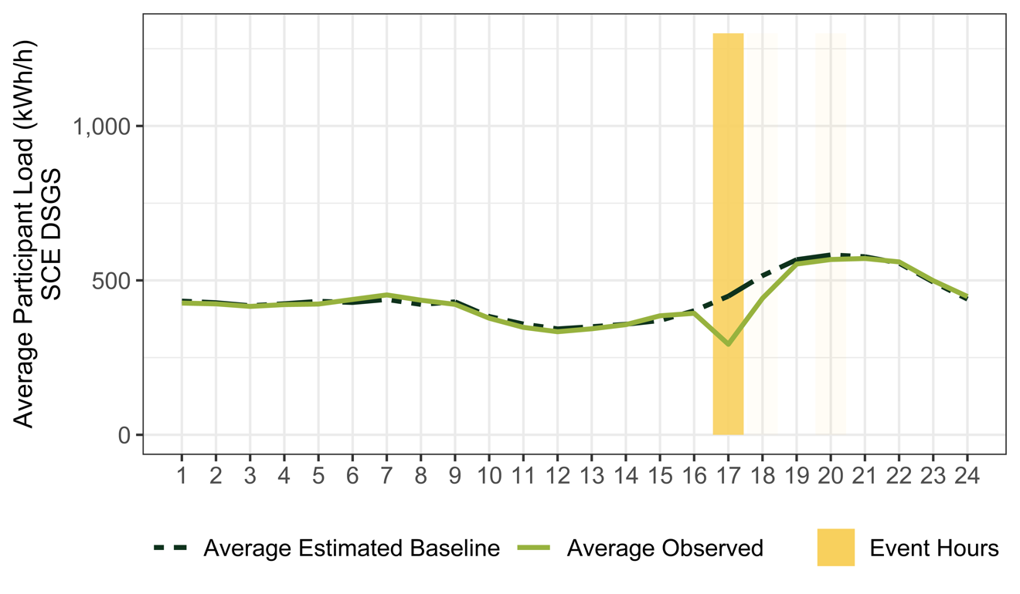
Ex Post Impacts
SCE DRAM and DSGS Average Event Day
Program | Avg. Number of Facilities | Mean Reference Load (kWh/h) | Avg. Facility Impact (kWh/h) | Pct. Load Reduction | Avg. Total Reduction MWh/h | Avg. Event Temperature (F)
SCE DRAM | 51.4 | 215.90 | 18.5 | 9% | 0.95 | 72.7
SCE DSGS | 45.1 | 274.97 | 86.4 | 31% | 3.90 | 80.8
Note: Average impacts. Event days not meeting 15/15 reporting rules are excluded from event specific hourly per capita impacts.

Slide 13
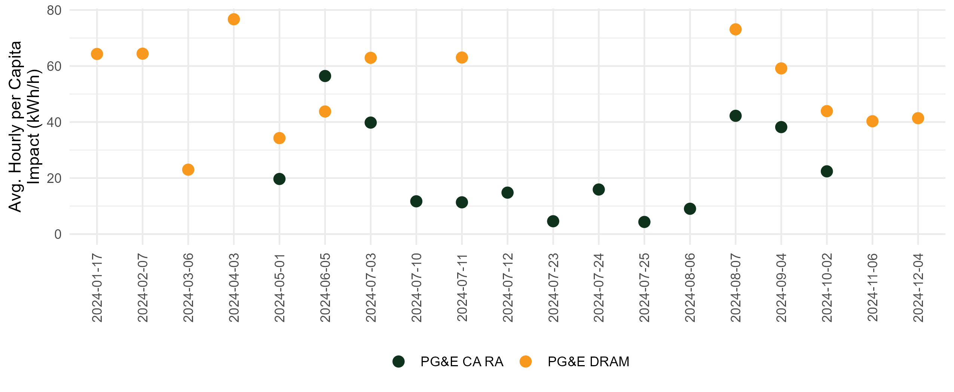
Ex Post Impacts
PG&E Average Event Impact
Average per facility impacts by PG&E event day. Event days and programs not meeting 15/15 reporting rules are excluded.
Event days with multiple dispatches are averaged together

Slide 14
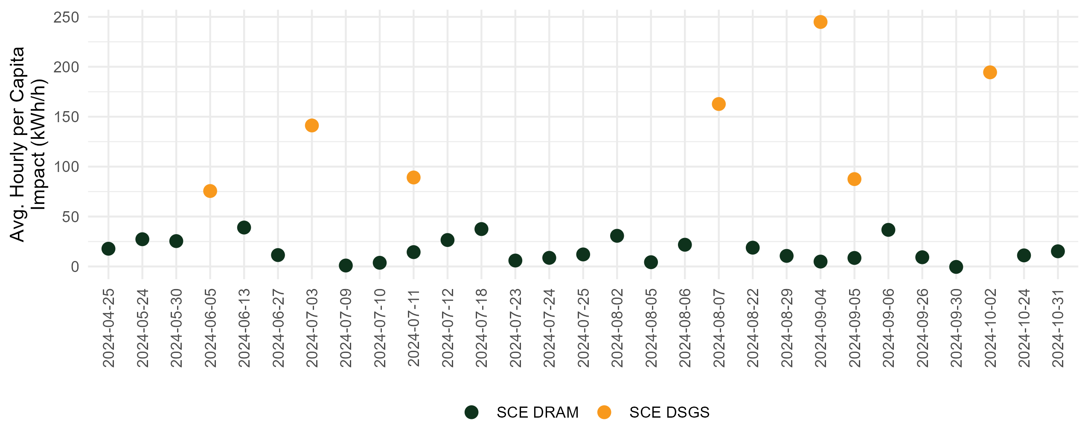
Ex Post Impacts
SCE Average Event Impact
Average per facility impacts by SCE event day. Event days and programs not meeting 15/15 reporting rules are excluded.
Event days with multiple dispatches are averaged together

Slide 15
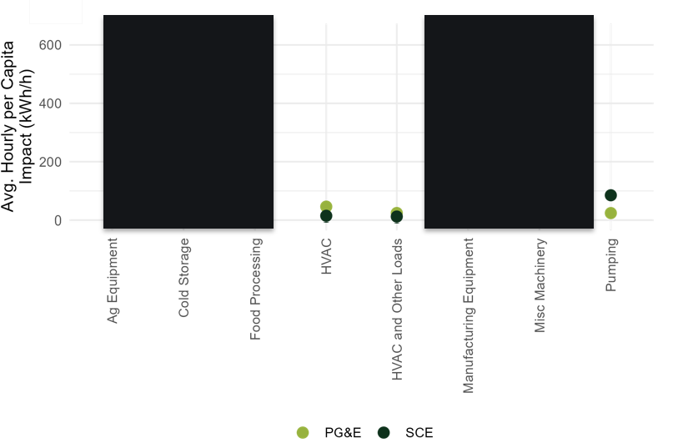
Ex Post Impacts
Average Impacts By Load Type
Misc. Machinery and Manufacturing Equipment provided the largest load reduction, followed by Food Processing and Agriculture Equipment. (All redacted)
HVAC and Pumping loads lower per capita reductions, but it’s balanced by a larger number in the portfolio.
Note:. Segments not meeting 15/15 reporting rules are excluded.

Slide 16
Ex Ante Methodology
And Impacts

Slide 17
Ex Ante Methodology
Overview
The ex ante methodology used adjusted ex post customer-specific regressions.
Step 1: Predicted per-customer weather-adjusted reference loads
Step 2: Estimate Ex Ante Impacts as a percent load reduction for each group of participants for each load type and SubLap combination
Step 3: Apply percent load reductions to reference loads, include degradation for events longer than estimated event hours
Step 4: SubLAP and Load Type hourly per capita impacts are applied to the participant enrollment forecast to calculate total ex ante MW
Total Participant Event Hours By IOU and Hour
Hour Ending | PG&E | SCE
HE 17 | 1,718 | 1,441
HE 18 | 1,616 | 1,612
HE 19 | 981 | 1,216
HE 20 | 1,106 | 1,084
HE 21 | 66 | 4

Slide 18
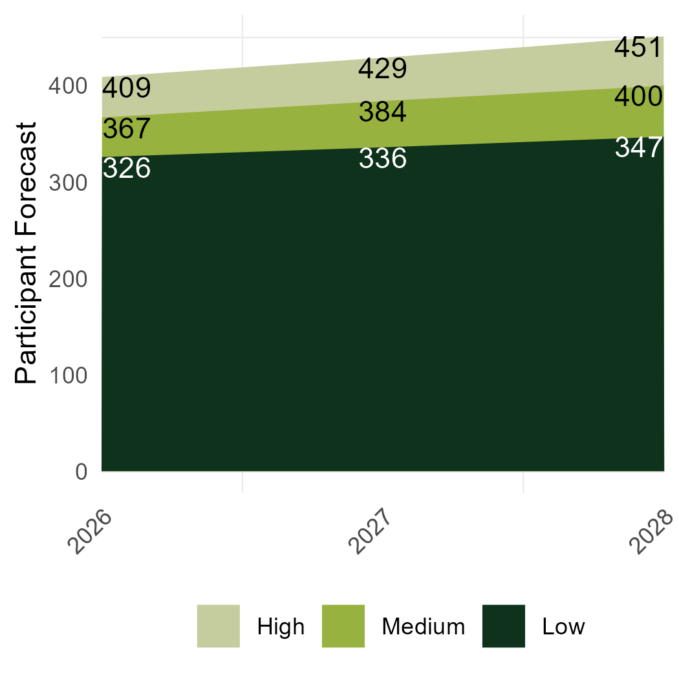
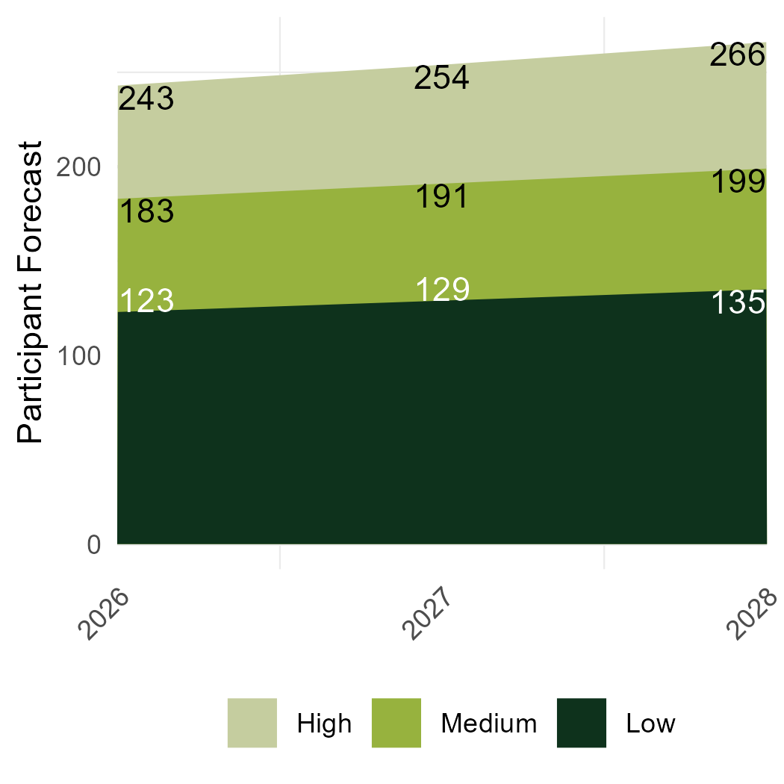
Ex Ante Forecasts
Participant Forecasts 2026 through 2028
Ex Ante forecasts were provided by High, Medium, and Low Scenarios and Load Type
Verdant allocated these to forecasts to specific SubLAPs based on 2024 allocation
Voltus expects participant growth for both PG&E and SCE Portfolio of customer from 2026 through 2028

Slide 19
DSGS Option 2 to CCA RA conversion
Assumptions of customers converting from DSGS 2 to CCA RA in 2026
2025 DSGS (Option 2) participation is a result of Voltus shifting resources into the program to avoid stranding MW after a lower-than-expected 2025 RA award
Pending the 2026 RA award, Voltus envision a shift of resources from DSGS into CCA RA
  DSGS has similar availability, dispatch triggers, and event duration requirements
The High, Medium, and Low projections are indicative of conversion assumptions from DSGS into CCA RA due to program similarities AND portfolio growth

Slide 20
Ex Ante Impacts
PY 2026 & 2028 Ex Ante Impact Estimates – August Monthly Worst Day
Year | Low: 50% Conversion |  |  | Medium: 75% Conversion |  |  | High: 100% Conversion
 | Participant Forecast | CAISO | Utility | Forecast Participant Count | CAISO | Utility | Participant Forecast | CAISO | Utility
 |  | 1-in-2 | 1-in-2 |  | 1-in-2 | 1-in-2 |  | 1-in-2 | 1-in-2
 |  | (MW) | (MW) |  | (MW) | (MW) |  | (MW) | (MW)
PG&E
2026 | 326 | 18.9 | 19.5 | 367 | 22.0 | 22.5 | 409 | 23.3 | 23.8
2028 | 347 | 20.6 | 21.2 | 400 | 23.0 | 23.6 | 451 | 25.1 | 25.6
SCE
2026 | 123 | 4.8 | 5.5 | 183 | 6.5 | 7.5 | 243 | 9.0 | 10.3
2028 | 135 | 4.9 | 5.7 | 199 | 7.1 | 8.1 | 266 | 9.4 | 10.8

Slide 21
Ex Ante Impacts
PY 2026 Ex Ante Impact Estimates By Utility Worst Day
Portfolio Average Hourly MW Reduction
Month | Low: 50% Conversion |  | Medium: 75% Conversion |  | High: 100% Conversion
 | PG&E | SCE | PG&E | SCE | PG&E | SCE
Jan. | 4.5 | - | 4.8 | - | 5.6 | -
Feb. | 4.9 | - | 5.7 | - | 6.9 | -
Mar. | 6.0 | - | 6.6 | - | 7.7 | -
Apr. | 15.0 | 3.6 | 19.0 | 4.5 | 20.4 | 6.1
May | 13.6 | 2.9 | 15.9 | 3.3 | 17.6 | 4.4
Jun. | 20.4 | 5.4 | 24.1 | 7.1 | 26.6 | 9.4
Jul. | 21.7 | 5.7 | 25.2 | 6.6 | 27.0 | 9.5
Aug. | 19.5 | 5.5 | 22.5 | 7.5 | 23.8 | 10.3
Sep. | 18.3 | 3.1 | 22.0 | 4.0 | 23.2 | 5.6
Oct. | 20.1 | 4.7 | 24.0 | 6.6 | 25.4 | 8.3
Nov. | 3.4 | - | 3.8 | - | 4.1 | -
Dec. | 2.7 | - | 3.1 | - | 3.5 | -

Slide 22
Reconciliation
With Previous Ex Ante

Slide 23
Reconciliation
Causes for Difference
Reasons for Differences
  MW forecasts are similar
  Changing participant mix drives differences and subsequent projections
    Larger participation in load types with lower per capita impacts
Updates to Ex Ante
  Enrollment scenarios based on conversion from DSGS
  SCE Incremental RA estimates
  Proportional Participation outside of summer months

Slide 24
Reconciliation
PY 2023 Vs PY 2024 Ex Ante Forecasts
IOU | Report Year | Participants | CAISO Monthly Worst Day (Month of August) | Utility Monthly Worst Day (Month of August)
 |  |  | 1-in-2 | 1-in-2
PG&E | PY 2024 (FY 2025) | 409 | 23.3 | 23.8
PG&E | PY 2023 (FY 2024) | 296 | 26.8 | 25.8
IOU | Report Year | Participants | CAISO Monthly Worst Day (Month of August) | Utility Monthly Worst Day (Month of August)
 |  |  | 1-in-2 | 1-in-2
SCE | PY 2024 (FY 2025) | 243 | 9.0 | 10.3
SCE | PY 2023 (FY 2024) | 287 | 8.8 | 8.3

