Slide 1



Pay for a Load Shape
Peter Alstone
Schatz Energy Research Center / Lawrence Berkeley National Laboratory
CPUC Workshop on Dynamic and Real Time Pricing (RTP)
October 15, 2019

Slide 2

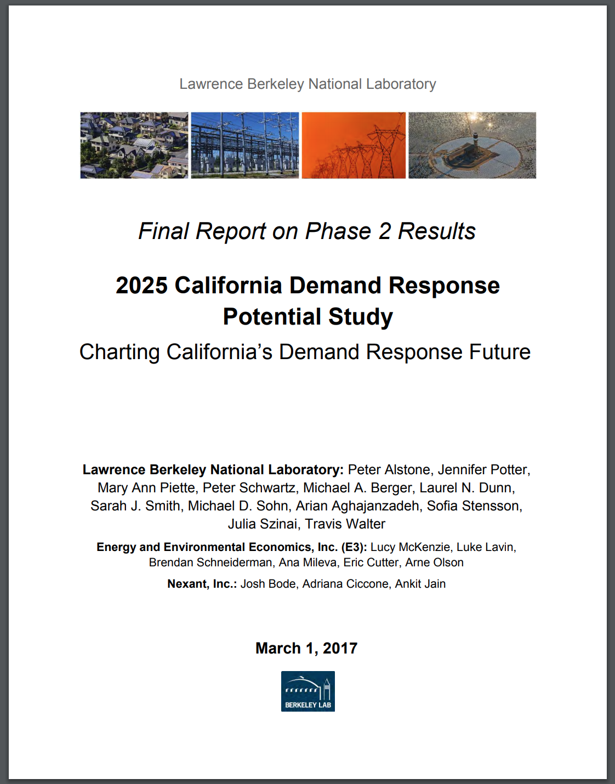
Context
Developed in the Load Shift Working Group.
In addition to market-integrated “PDR-LSR” LSWG identified options for organizing load flexibility that were:
Not market integrated (lower control & telemetry costs)
Not based on rates (since it was not a rate proceeding)
Pay-for-a-load-shape envisions a program that sets a grid-friendly target load shape and pays incentives to customers who match it well.
Inspired by results of California Demand Response Potential Study (supporting CPUC R.13-09-011)

Slide 3
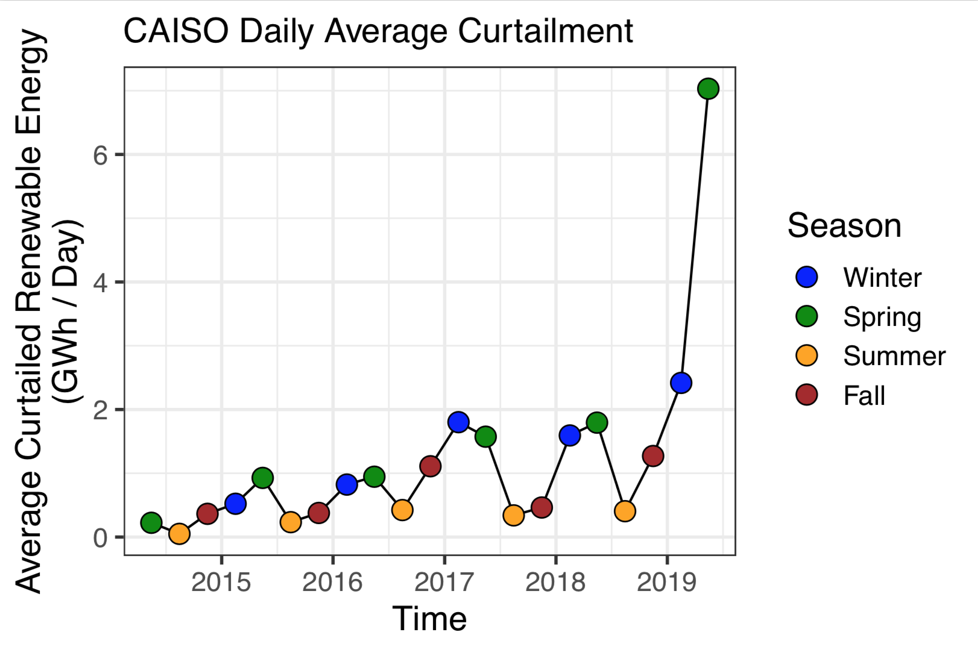
Curtailment concepts:
Associated with low net loads
Typically results in zero or negative prices in energy market
Expected to increase significantly as RPS goes up
An opportunity to capture zero cost, low carbon resources
Becoming predictable
Renewable curtailment is a key driver
for the value of flexible load shifts
At $40/MWh solar LCOE replacement value: ~300k/day in Spring 2019
Data on this and next several slides from CAISO “Managing Oversupply” Production and Curtailment Reports

Slide 4
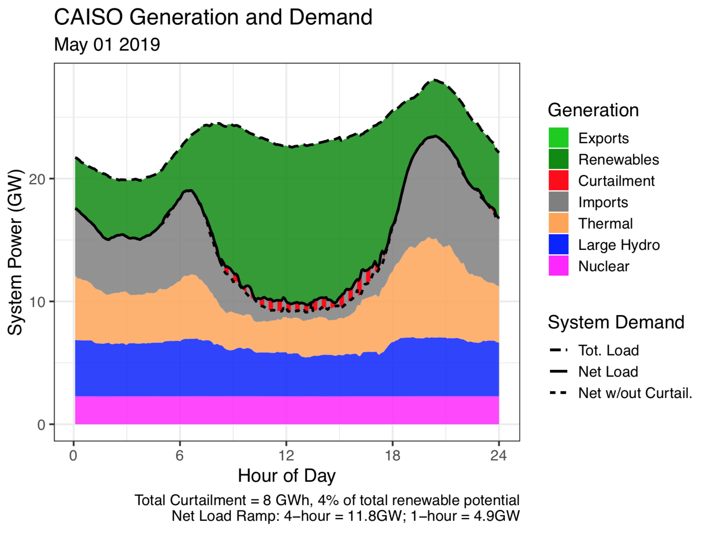
CAISO operations data reveal scale of curtailment today
Typical Spring 2019 day with mid-day curtailment.
(May 1st)

Slide 5
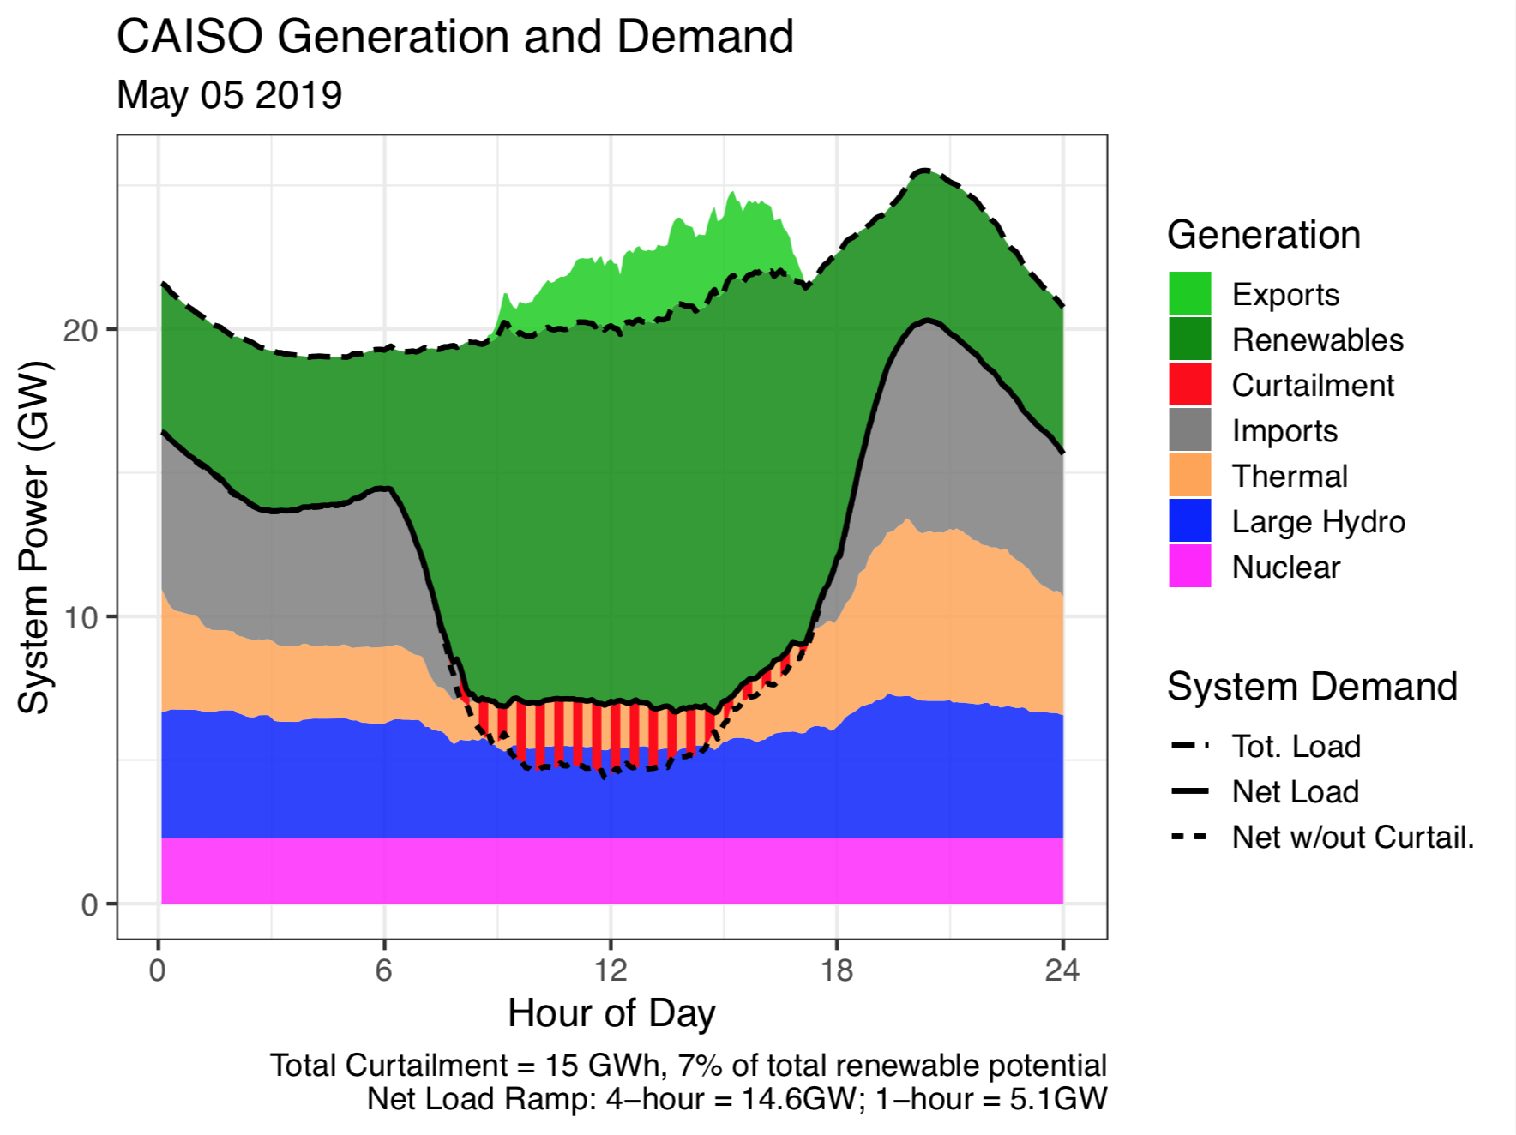
Lower demand leads to ~2x the curtailment as is typical.
Exports help avoid additional curtailment.
(May 5th)

Slide 6
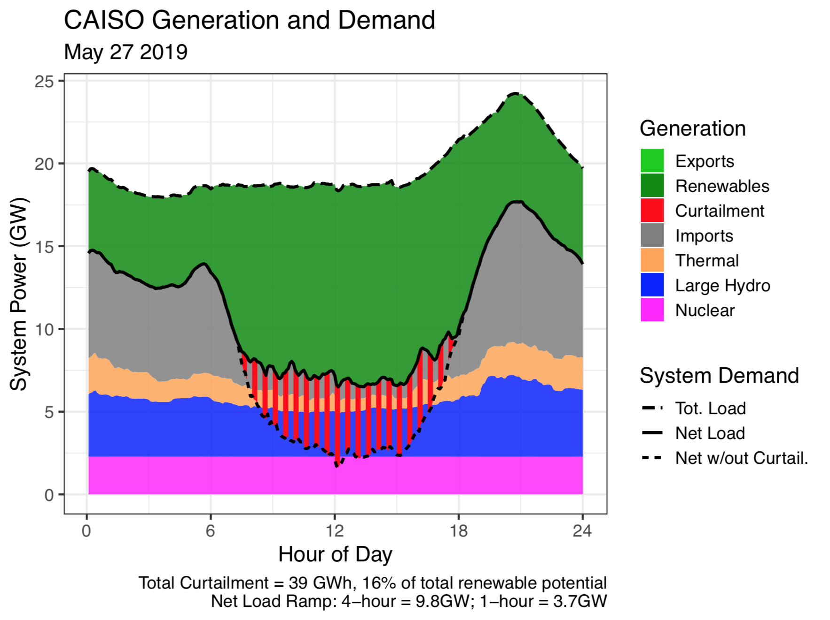
Memorial Day is an extreme case with nearly 40 GWh curtailment:
Low demand
Sunny day
(good for the holiday!)
No exports
(May 27th)

Slide 7
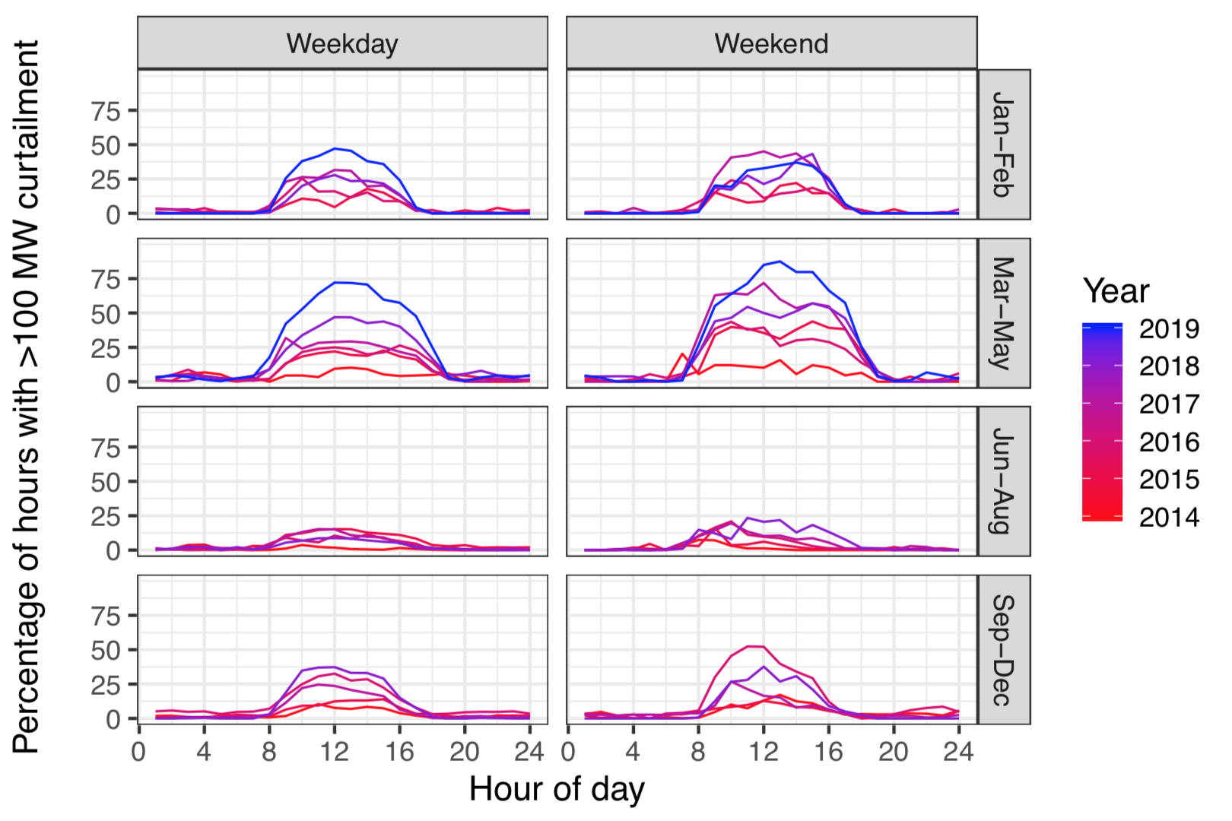
As curtailment grows, the timing becomes predictable day-to-day
Plot shows the percentage of hours with curtailment by season & day type
~75% of days in Spring 2019 had significant mid-day curtailment

Slide 8

“Pay for a Load Shape” (P4LS) Concept
Incentivize the “anti-duck curve”* by asking customers to restructure and/or change the daily timing of demand and match a target.
Utilities provide target load shapes that are updated periodically.
These targets could incorporate both energy market marginal prices and infrastructure costs (peak load reduction, etc.)
Customers modify loads and are compensated based on reduced cost to serve loads. Not just avoided curtailment, but also reduced fuel cost, peak cost, etc.
*In the DR Potential study we found the “optimal” dispatch of shift was quite similar to the inverse of the duck curve --- the “anti-duck”

Slide 9
Cartoon Version
Typical DAM price
Target Load (inverted Prices)
Start with cost driver
Determine Target
Load Shape
Hour of the day (0-24)
Hour of the day (0-24)
Assess performance and pay incentives based on reduced cost to serve load
Customer C
(Poor match)
Customer A
(Great match)
Customer B
(OK match)
Demand
Demand
Demand
$$$$
☺
$$
☺
0
Hour of Day
Hour of Day
Hour of Day

Slide 10
There are many ways to configure P4LS
Target Basis: Loads, Prices, and Marginal Emissions could all be the basis (they are correlated in California)
Spatial graunlarity: Local Factors like nodal prices, excess renewables or distribution system constraints could be used to define local targets
Update periods: Targets could be updated daily, weekly, monthly, etc. There are diminishing returns to more frequent updates (analysis follows).

Slide 11
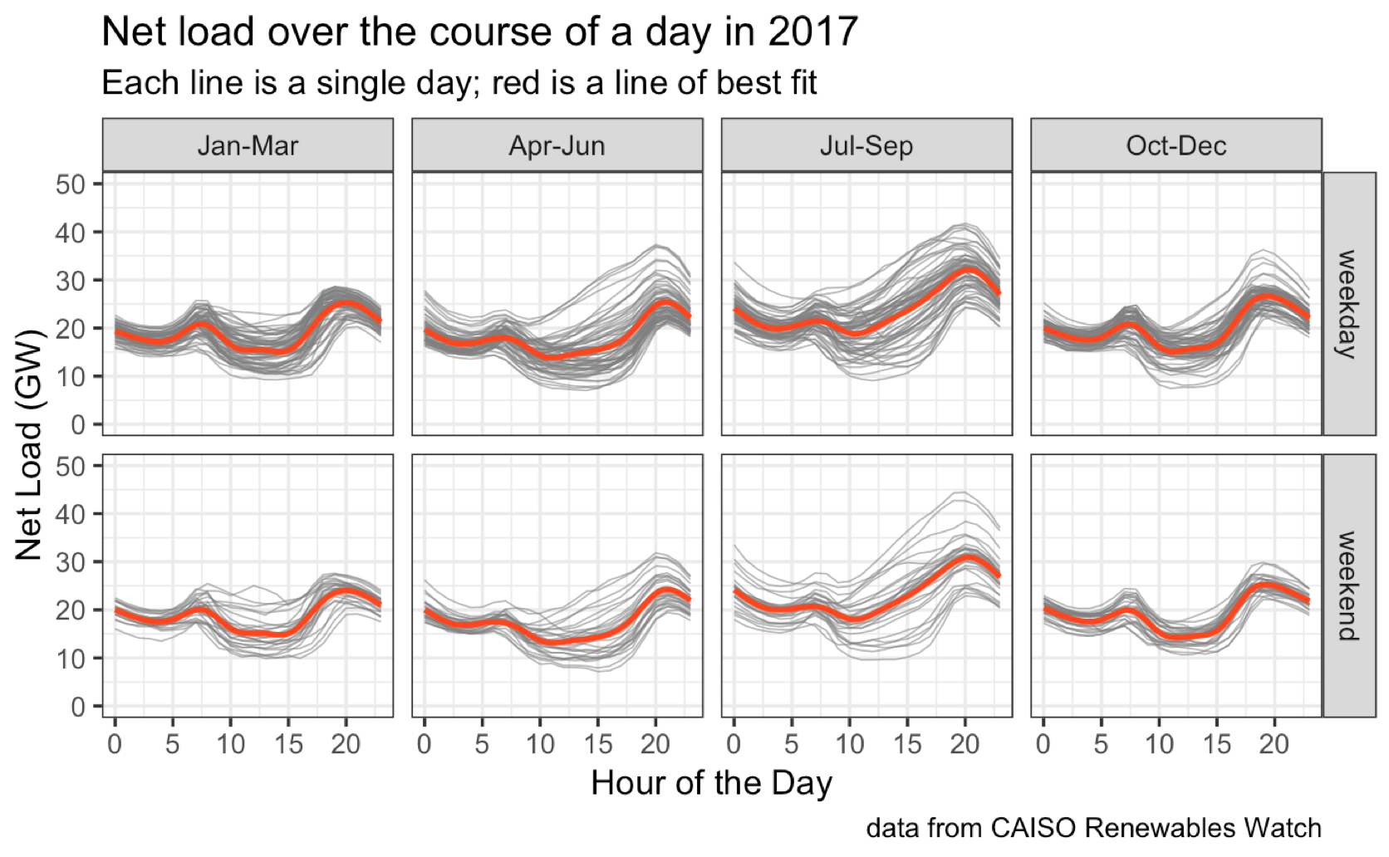

Slide 12
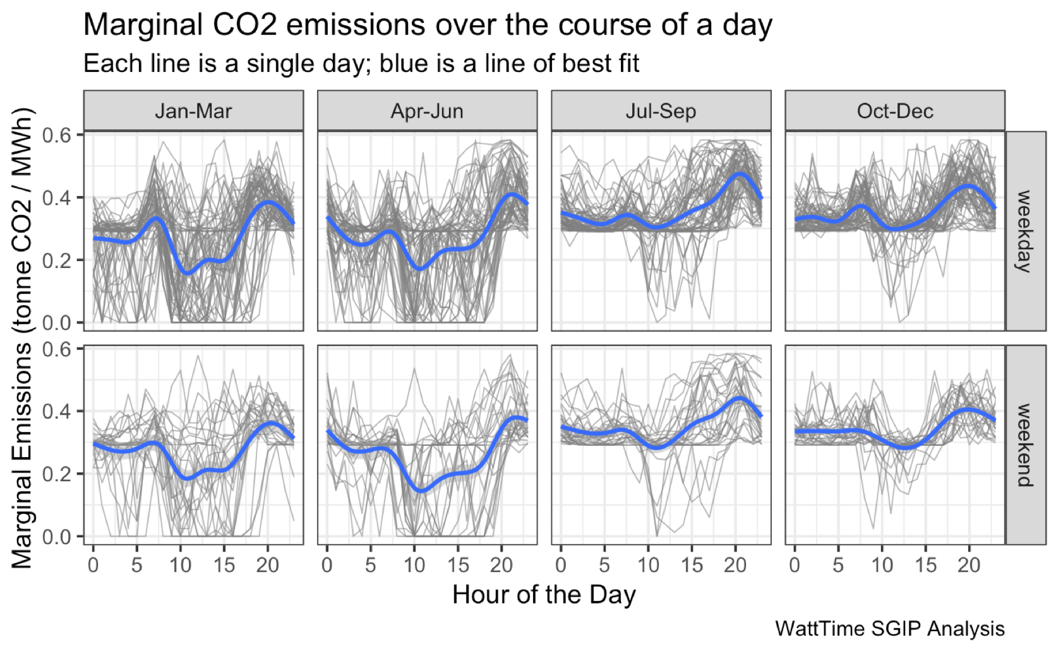

Slide 13
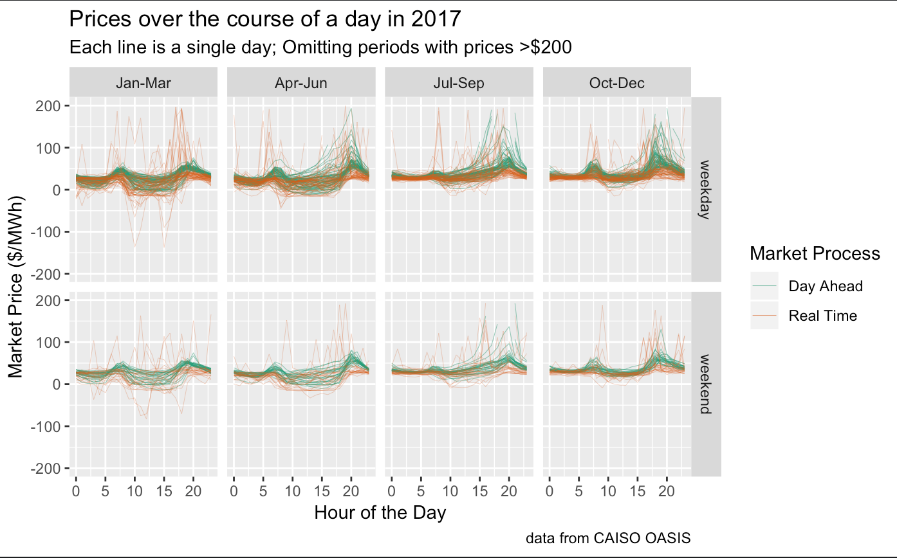

Slide 14
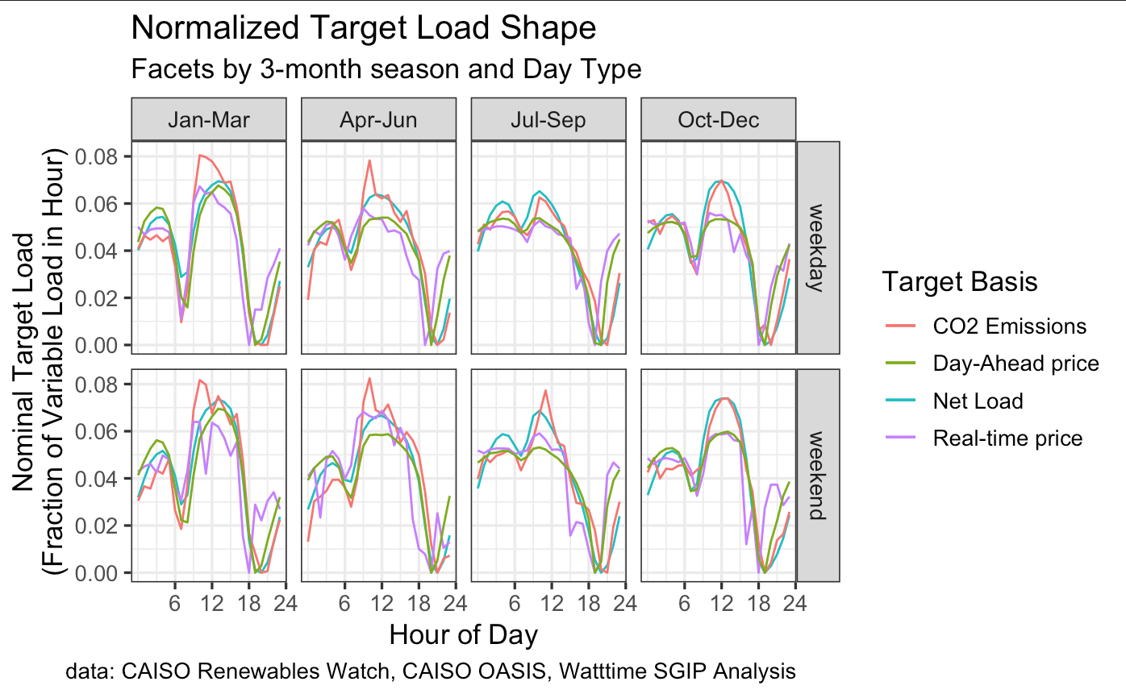
The target is similar with loads, prices, and emissions. We don’t have to pick between prices and emissions in CA.

Slide 15
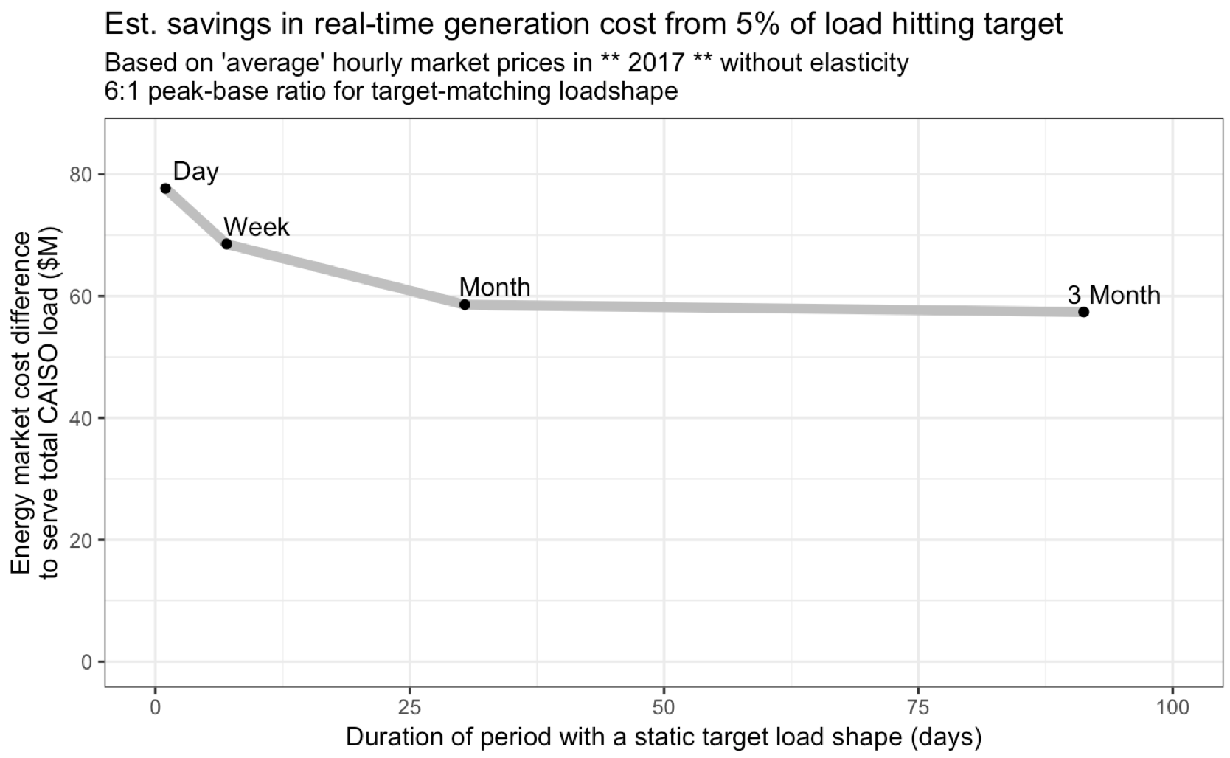
The duration of target load shape persistence changes the estimated energy market savings, but not by much.
Notional analysis:
5% of daily load participating and exactly matching the target (based on prices).
$60-80 M/year annual savings in energy costs given 2017 grid.
~30% better outcomes if the targets are updated daily vs. monthly.
This plot shows different “duration” target load shapes based on the daily net load, weekly average, monthly average, and three-month average.

Slide 16
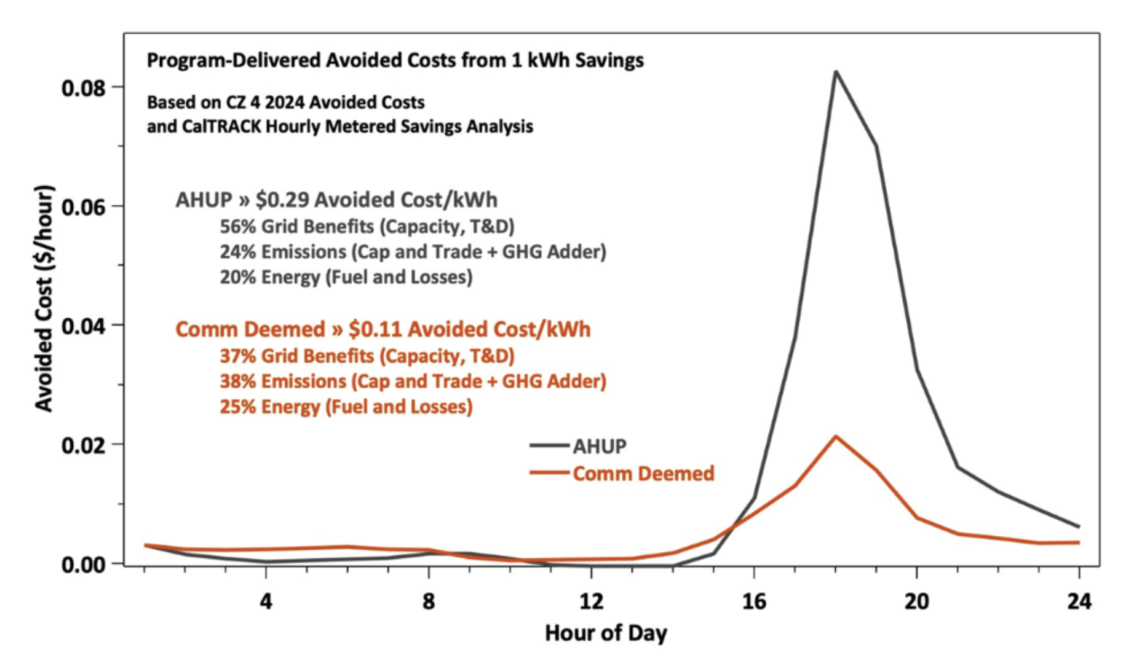
P4LS and Pay for Performance
Example Pay for Performance EE benefits from two different upgrades
P4LS is closely aligned with “Pay for Performance” (P4P) concept in energy efficiency, where EE outcomes are valued based on the time of day for demand.
Since curtailment and prices are often predictable day-to-day, there are significant benefits from this kind of structural change.
Figure from: Golden, Matt, Adam Scheer, and Carmen Best. 2019. “Decarbonization of Electricity Requires Market-Based Demand Flexibility.” The Electricity Journal, Special Issue: Energy Optimization is the Key to Affordable, Reliable Decarbonization, 32 (7): 106621. https://doi.org/10.1016/j.tej.2019.106621.

Slide 17
P4LS and RTP
P4LS was originally developed to get similar outcomes if we can’t use RTP (e.g., because RTP is unavailable or customer class does not respond well).
In principle, both P4LS and RTP get to the same result (customers with cheaper loads to serve ultimately pay less, either with incentive or bill savings).
P4LS can be updated more frequently than TOU but not so unpredictable as RTP, which may balance grid needs vs. customer ability to respond.
A key challenge to P4LS is the need to assess avoided costs from customer responses (similar to the “baseline” challenge for other demand response). RTP avoids these baselines, but requires careful work to structure the rate up front.

Slide 18
Thank you!
Contact information:
Peter Alstone
peter.alstone@humboldt.edu
www.schatzcenter.org
DR Potential Study:
https://drrc.lbl.gov/publications/2025-california-demand-response
Potential Discussion Points
Could aggregators put together a portfolio of customers?
Should different customer classes have different targets?
Are “slow changing” targets easier for managing power system?
Is there synergy between P4LS and RTP?
  e.g., Pay an aggregator to help customers meet a target load. The customers get bill savings and the aggregator gets some payment based on portfolio response.

Slide 19
Appendix: Extra Analysis

Slide 20
Possible Organizational Roles
Customer | Participate, Invest in enabling technology, Respond, Get Incentives.
Third Party / Aggregator | Design and deliver retail programs / products for aggregations of small and medium customers. Incorporate into existing DR portfolios and business models.
Load Serving Entity (CCA or IOU or DA provider) | Define SubLAP or DLAP level target load shape that minimizes cost of service. Publish target load shape (if appropriate)
Distribution utility / service territory LSE | Refine target based on distribution system constraints. Provide incentives for modified targets. Provide AMI meter data access to support settlement. Participate in publication of target load shapes and ensuring cybersecurity.
CAISO | Support forecasts of net load / price and market data access. Support program evaluation and valuation of response with CAISO analysis.
CPUC | Provide regulatory oversight for target load shape definition, publication, and verification processes? Editorial Note: Defining the target load shape for the system-scale (before any local modifications) would weigh costs, pollution, and customer experience. How to balance public oversight need with the need for maintaining nimble response to changes in grid needs? How will non-IOU LSE’s be treated in any regulatory oversight?

Slide 21
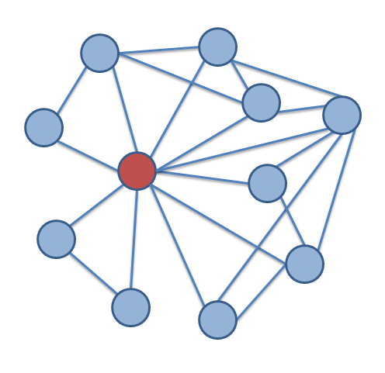
A straw-proposal process concept
Every 3 months*, LSE’s work to establish an updated target load shape that supports grid needs (possibly different targets for different customer classes and different geographic areas). These are published publicly after any needed modification by distribution system operators to ensure reliability, a month in advance of changes from one target shape to another.
Participating customers and/or aggregators work to match loads to the target using automated, structural, and behavioral approaches .
The total savings from the reduced cost of serving customer loads is estimated and returned to participants through incentives and performance payments.
  Incentive pool could include energy market operations savings, avoided generation capacity cost, avoided T&D, avoided curtailment based on evaluation of the performance of the portfolio.
  Performance based (or mixed fixed+performance based) incentives provide nudges for participating customers / sites to continue improving compared to the average participating customer.
*the period is a design choice and could in principle be anywhere from days to months. On a supporting slide, show a preliminary analysis of market prices to show the order of magnitude different in the cost to serve load.

Slide 22
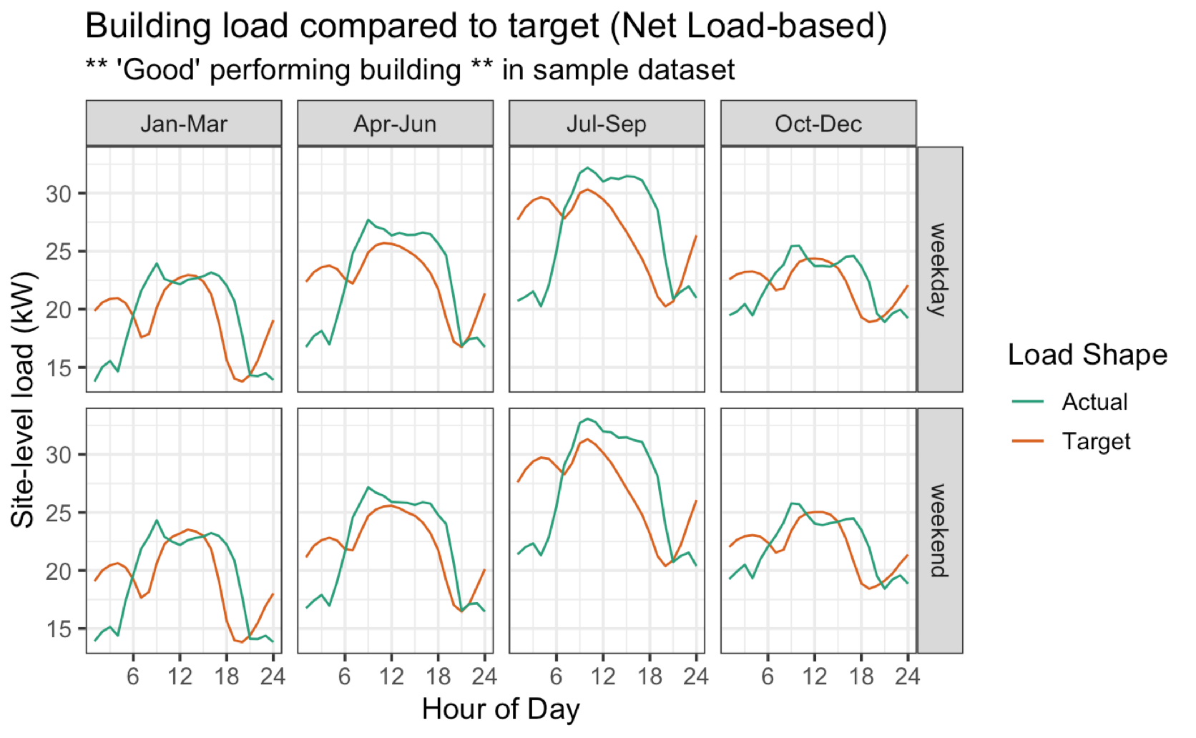
For Illustrative Purposes – Look at 24 grocery store load shapes to see variability within a sector – “good” match here (a “structural winner”)
Setting the “target”:
Find the “average” shape in the period.
Identify the baseload (the minimum of the average shape).
The target is the baseload plus a “new” variable load that is rescaled to match the system target shape.
The total load is the same in target vs. actual.

Slide 23
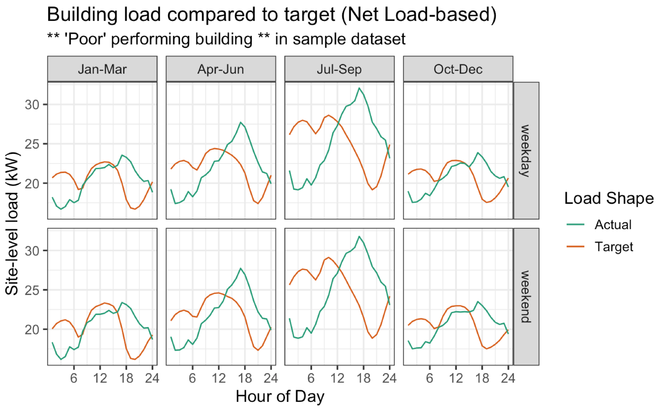
Poorly performing sites have worse match between actual and target loads

Slide 24
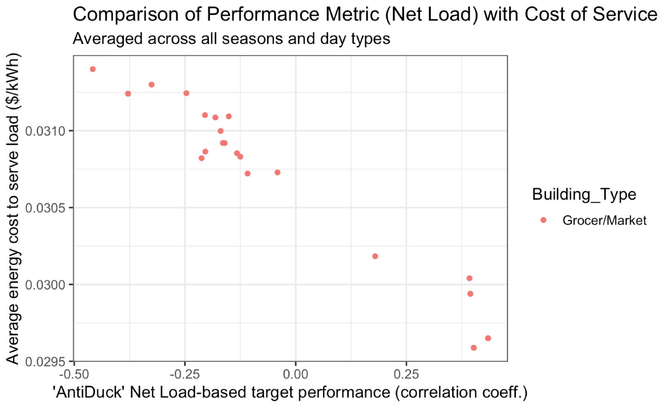
A correlation-based performance metric (comparing target to actual load) is strongly related to the cost to serve loads at the sites.
Better-performance (higher scoring) sites are less costly to serve.

Slide 25
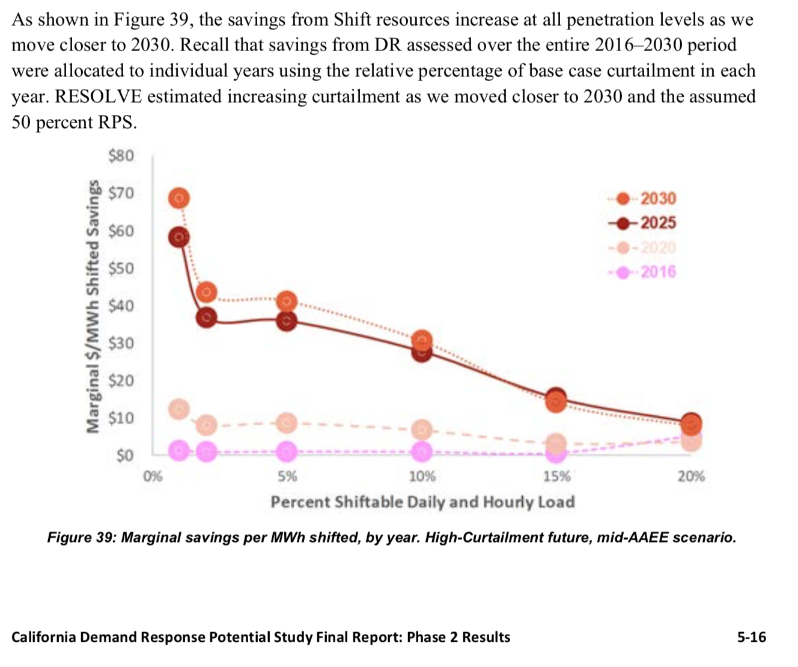
Point of reference for scale:
The unit cost savings ($/MWh) from shifting estimated on the previous slide are $25-30 per Shifted MWh.
These are roughly consistent with E3 RESOLVE model estimates used in the DR Study (to the right)
A relatively low value in the market is consistent with DR potential study results for current-day grid operations. As curtailment (and average price differentials) increase over time, this value should go up.
FIGURE FROM THE DR Potential Study

