Slide 1

SEM PY2021-22 Evaluation
Draft Results
DNV: Amit Kanungo, Ismail Omer, Chad Telarico, Susan Haselhorst, David Bluestein
CPUC: Lisa Paulo
Notes:
This presentation covers the key findings of the Strategic Energy Management (SEM) program impact evaluation conducted by DNV and Guidehouse (the DNV team) on behalf of the California Public Utilities Commission (CPUC) for program years (PY) 2021 and 2022.

Slide 2

Agenda
Introduction (2 min) – 3:00 – 3:02
Overview
    Evaluation team (2 min) – 3:02 – 3:04
    Overview of results (5 min) – 3:04 – 3:09
    Review structure of report (4 min) - 3:09 - 3:13
Methodology
    Summary of gross methods (5 min) - 3:13 - 3:18
    Summary of net methods (5 min) - 3:18 - 3:23
Findings
    Summary of gross findings (6 min) - 3:23 - 3:29
    Summary of net findings (6 min) - 3:29 - 3:35
Conclusions and recommendations (10 min) - 3:35 - 3:45
Questions and next steps (15 min) - 3:45 – 4:00

Slide 3






Study team
Representing the team today
  DNV Energy
Ismail Omer,
Project Manager
David Bluestein
Net Analysis Lead
  DNV team:
Amit Kanungo
Chad Telarico
Ismail Omer
Kaylee Schrickel
Kevin Cracknell
Susan Haselhorst
Guidehouse:
David Bluestein
Karen Maoz
Dustin Bailey
  CPUC
Chad Telarico
Project Sponsor
Amit Kanungo
Principal Engineer and SME
  CPUC team:
  Lisa Paulo, Study Manager - Group D Contract Manager
  Leanne Hoadley, ED Planning and Forecasting Supervisor
Susan
Haselhorst
Subject Matter
Expert
Kevin Cracknell
Data Analytics Lead
Notes:
I am Ismail Omer, the project manager for this SEM evaluation study. On the panel with me today from DNV, is Chad Telarico (project Sponsor), Susan Haselhorst and Amit Kanungo as (SMEs). From Guidehouse, we have David Bluestein as the net analysis lead.
This project was supported by the DNV team of analysts, engineers, and policy experts listed in the middle of the screen.
Representing the CPUC, we have Lisa Paulo who serves as both the study manager and the Group D Contract Manager, and Leanne Hoadley.

Slide 4

Overview of Results

Slide 5
Overview of results – gross
 | First year |  |  |  | Lifecycle
 | Forecasted savings | Evaluated savings | GRR | Relative precision | Forecasted savings | Evaluated savings | GRR | Relative precision
Energy (MWh)
Statewide | 42,076 | 41,384 | 98% | ±1% | 210,364 | 226,971 | 108% | ±2%
Demand (MW)
Statewide | 6.1 | 5.8 | 95% | ±3% | 30.4 | 31.5 | 103% | ±3%
Natural Gas (Million Therms) | Demand (MW) | Demand (MW) | Demand (MW) | Demand (MW) | Demand (MW) | Demand (MW) | Demand (MW) | Demand (MW)
Statewide | 3.1 | 2.5 | 79% | ±4% | 15.5 | 14.4 | 93% | ±4%
Table ES-2

Slide 6
Overview of results – net
SEM method
The SEM method included a modification of the standard surveys to incorporate a series of NTG questions for capital measures . In addition to the new questions, we introduced a revised method for scoring the NTGR (SEM scoring).
 | First year |  |  | Lifecycle
 | Evaluated savings | NTGR | Relative precision | Evaluated savings | NTGR | Relative precision
Energy (MWh)
Statewide | 41,384 | 98% | ±1% | 226,971 | 98% | ±1%
Demand (MW)
Statewide | 5.8 | 99% | ±1% | 31.5 | 98% | ±1%
Natural Gas (Million Therms) | Demand (MW) | Demand (MW) | Demand (MW) | Demand (MW) | Demand (MW) | Demand (MW)
Statewide | 2.4 | 98% | ±3% | 14.4 | 98% | ±2%
Table ES-3
Notes:
The notion “SEM Method” refer to the updated methodology we used to calculate the net results for this study, which is an adaption of the standard net to gross method to account for SEM’s immersive delivery.
We will cover this more down the line here and provide some comparison in the NTGR results calculated between this methodology and the standard “AKA CIAC” methodology.
The resulting NET TO GROSS RATIO is essentially 98% with slight decimal differences, except for the demand NTGR which rounded up to 99%.
In addition to the new questions, we introduced a revised method for scoring the NTGR (SEM scoring). All these revisions to the questions and scoring method were made in order to account for the immersive nature of SEM. The new SEM scoring more heavily relies on the respondent’s assessment of the factors influencing the measure installation whereas the standard scoring averages the factors.

Slide 7
Review structure of evaluation report
Executive Summary
Introduction and Study Background
Results
Conclusions and Recommendations
Appendices
Methodology
Gross Electric
Gross Natural Gas
Net Savings
Gross Specific
Net Specific
Overall
Supplemental methodologies and results
Common Core Template (AKA CCT)
High level project summary
Workplan and Sampling Memo
Review of core evaluation approach for PY2021-22
Project eligibility
MAT/EUL/baseline review
EM&V summary
Impact results
Discrepancy analysis
Provides additional detail on sampling targets and precision estimates

Slide 8

Methodology

Slide 9
Summary of gross methods
Sample design:
  SEM projects that completed a full two-year cycle in PY2021 or PY2022.
Overall methods overview
  Overall sample confidence and precision target of 90/10 at the Statewide level
  Review of 37 gross sample points
SEM savings calculation methodologies:
  Top-down
  Bottom-up
  Mixed analysis.
The evaluators adopted the same methodology used by participants to calculate evaluated savings.
Gross methods
  Custom core template (CCT) and M&V plans
  Recruitment and data collection
  Model review
  Measure-level analysis
Notes:
The sample design focused on SEM projects that completed a full two-year cycle in PY2021 or PY2022.
PY2021 projects are made up of two years’ worth of savings claims from both PY2020 (Year 1) and PY 2021 (Year 2) and,
PY2022 projects are made up of savings claims from both PY2021 (Year 1) and PY2022 (Year 2).
…………………………………………………………………………………………………………………………………………………………………………………………………………………………………
For sites sampled for evaluation; we targeted a census sample; however, we dropped sites that either were not recruited for the site contact interview, or sites for which we were not able to obtain data that we deemed essential to inform our evaluation.
**********************************************************************************************
Top down (45%) Bottom Up (38% ) Mixed Analysis (17%)
**********************************************************************************************
Excel-based CCT—also used by other evaluation teams such as CIAC—to organize and communicate evaluation information for each sample project that was selected for evaluation. The CCT served as the final site-specific evaluated savings deliverable and was the common source for reference material the engineering team used to create M&V plans and document data collected in developing estimates of impacts.

Slide 10
Summary of net methods
Net-to-gross (NTG) approach:
  Hybrid approach combining separate NTG ratios for capital and non-capital measures
    Non-capital measures: NTGR of 1.0 was used for the component of project savings attributed to non-capital measures. This value was taken from the prior evaluation, which developed a SEM NTGR using a theory-driven approach.
    Capital measures: A NTGR was developed for capital measures using participant surveys based on the existing NTGR scoring methods. The study team calculated capital NTGR using both the existing algorithm (standard scoring method ) and a modified algorithm, which may better account for the immersive nature of SEM (SEM scoring method).
NTG data collection
  A total of 13 completed surveys were used to establish a capital NTGR.
NTG ratio estimation approach and scoring
  NTG ratios were computed using the standard method and the SEM method (see next slide)

Slide 11
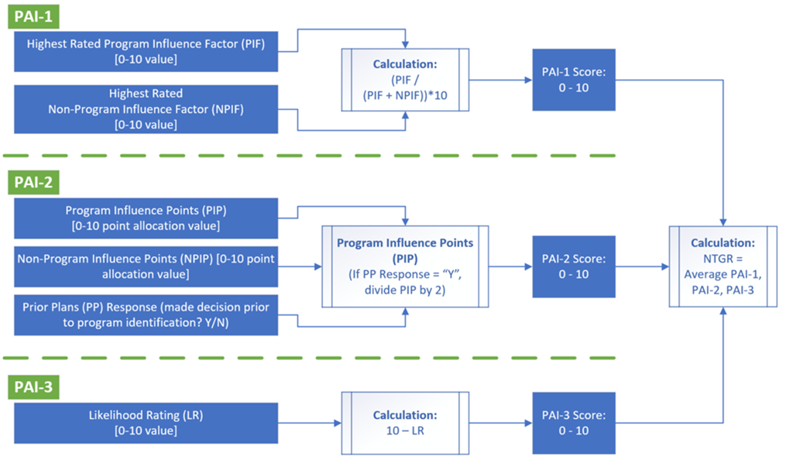
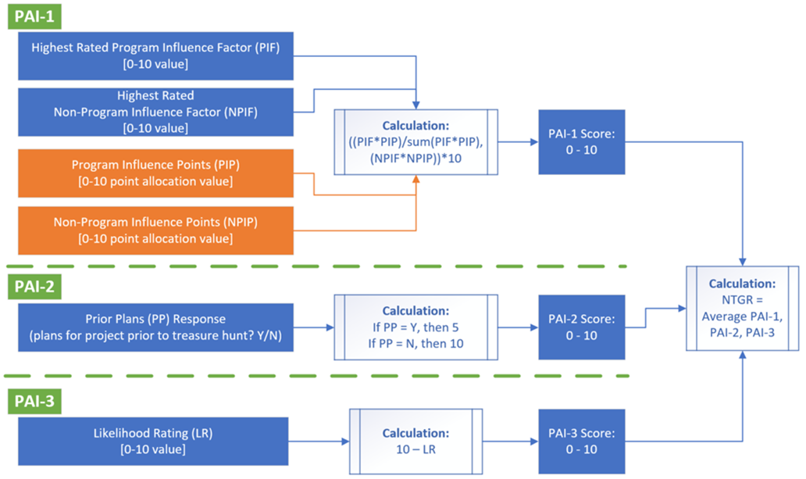
Standard scoring SEM scoring
Primary difference
  Standard method averages the program and nonprogram factors from PAI-1
  SEM method weights the program and nonprogram factors using the response to PA1-2
    “If you were given 10 points to award in total, how many points would you give to the importance of the group of program factors and how many points would you give to the group of non-program factors?”
In this population, the NTGR using the SEM scoring was 0.15 higher than the standard scoring
Notes:
More details on this figure in Appendix A of the report.

Slide 12

Summary of Gross Findings

Slide 13
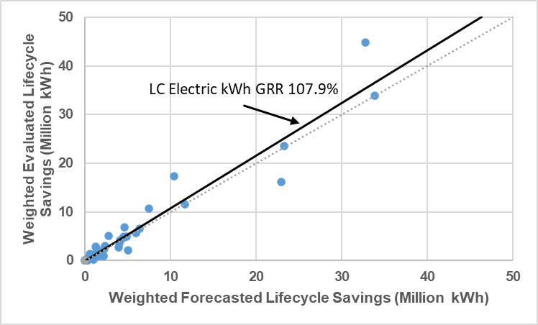
Summary of gross electric lifecycle results
Notes:
The dotted/dashed line in this chart represents the realization rate of 100%. The bold line represents the calculated electric lifecycle realization rate for this evaluation, which was calculated at 108%.
We can observe that all data points are scattered around the line which reflects good precision.
We found that the majority of the capital projects had an effective useful life (EUL) higher than the SEM program-designated EUL of 5 years, which drove the lifecycle GRR higher.

Slide 14
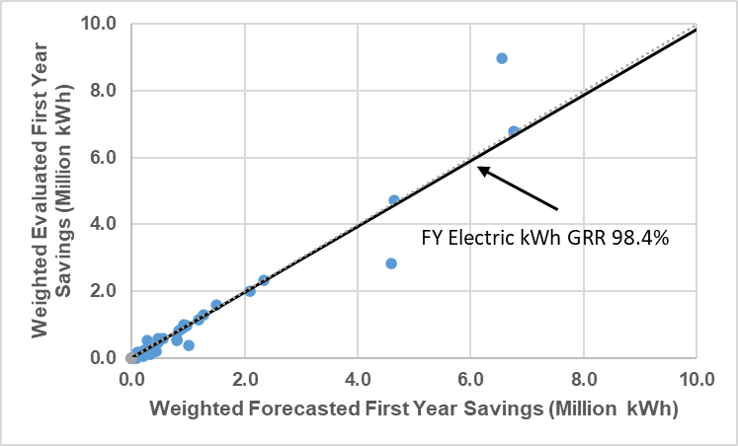
Summary of gross electric first year results
Notes:
This chart shows the calculated gross electric first year realization rate at 98.4%
The main drive for the difference between forecasted and evaluated savings was annualization adjustments, in which participants calculated the energy savings by prorating the savings calculated within a short period (3-5 months) of time to annual savings, instead of using all available valid data points recorded within the year.
Other key drivers included using as-built parameters such as hours of operation, compressed air systems setpoints, and load profiles.

Slide 15
Summary of gross electric findings by PA and Statewide
Program Administrator | First-year |  |  |  | Lifecycle
 | Forecasted savings | Evaluated savings | GRR | Relative precision | Forecasted savings | Evaluated savings | GRR | Relative precision
Energy (MWh)
MCE | 2,660 | 2,406 | 90% | 5% | 13,301 | 12,704 | 96% | 5%
PG&E | 28,765 | 29,238 | 102% | 1% | 143,825 | 152,935 | 106% | 1%
SCE | 6,220 | 5,616 | 90% | 3% | 31,098 | 31,323 | 101% | 2%
SDG&E | 4,431 | 4,123 | 93% | 4% | 22,141 | 30,008 | 136% | 12%
Statewide | 42,076 | 41,384 | 98% | 1% | 210,364 | 226,971 | 108% | 2%
Table ES-2
Notes:
For PG&E were slightly higher than forecasted savings mainly due to updated inputs and parameters based on verified as-built conditions.
MCE’s realization rates were impacted by model adjustments made by the DNV team which largely impacted two sites (Removal of data points for statistical, and removal of period in baseline due to COVID).
MCE’s demand savings were higher than forecasted as several sites that implemented SEM projects in PY2021 did not claim any demand savings
SCE’s realization rates were impacted by annualization adjustments.
SCE’s demand savings were smaller than forecasted primarily due to tracking errors as the incremental demand savings for multiple sites were not calculated correctly
SDG&E’s realization rates were impacted by updated operating conditions such as operation hours and setpoints. The DNV team updated the savings calculation for sites based on as-built data and information collected from SEM participants
SDG&E’s demand savings

Slide 16
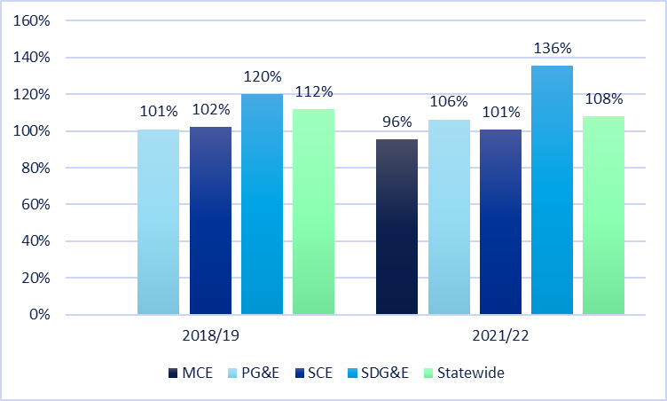
Statewide electric energy lifecycle GRR results by program year and program administrator
Notes:
This chart here provides a comparison between the results of this evaluation study in comparison to the previous study (2018/19).
As we can see, there are some swings; however, there are no major shifts.

Slide 17
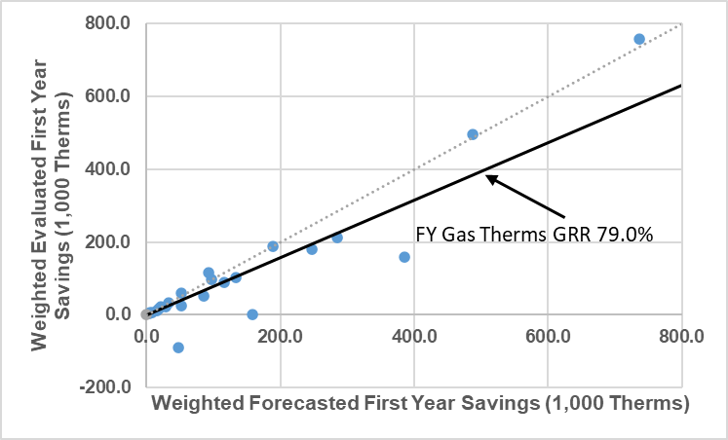
Summary of gross gas first-year results
Notes:
The main drive for the discrepancy between forecasted and evaluated natural gas savings was annualization adjustment and model adjustments that our team performed to improve the statistical significance of the models and to accurately model typical facility operation.
We can see that there is one site for which the calculated evaluated savings were negative. This site used top-down approach however neither the site contact nor the project documentation provided further insight into the reasoning of this result.

Slide 18
Summary of gross gas findings by PA and statewide
Program Administrator | First-year |  |  |  | Lifecycle
 | Forecasted savings | Evaluated savings | GRR | Relative precision | Forecasted savings | Evaluated savings | GRR | Relative precision
Energy (Therms/1,000)
MCE | 315 | 139 | 44% | 6% | 1,575 | 867 | 55% | 27%
PG&E | 1,931 | 1,611 | 83% | 5% | 9,655 | 9,947 | 103% | 5%
SCG | 765 | 610 | 80% | 7% | 3,823 | 3,208 | 84% | 6%
SDG&E | 90 | 89 | 98% | 2% | 451 | 444 | 98% | 2%
Statewide | 3,101 | 2,449 | 79% | 4% | 15,504 | 14,466 | 93% | 4%
Table ES-3
Notes:
For PG&E’s realization rates were impacted by removal of annualization
MCE’s realization rates were impacted by model adjustments one site -largest gas saver in the MCE sample- by removing outlier data points that were above the observed statistical threshold.
SCG’s realization rates were impacted by annualization adjustments.
SDG&E’s realization rates were impacted by updated operating conditions such as operation hours and setpoints. The DNV team updated the savings calculation for sites based on as-built data and information collected from SEM participants

Slide 19
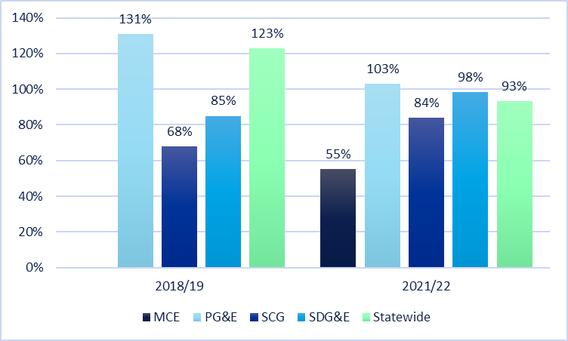
Statewide gas lifecycle GRR results by program year and program administrator

Slide 20
Summary of gross findings – discrepancy review
Discrepancy Factor | Description
Tracking data | Differences attributed to inconsistencies between savings claimed and savings calculated in the provided models and/or completion report. This also includes discrepancies in savings due to unexplained or non-documented changes.
Inoperable measure | Measures approved and installed by PA were not consistent with CPUC policies, guidance, and rulebook eligibility.
Inappropriate baseline | Represents a difference in evaluated and reported baseline, including any baseline periods adjustment in the models used to estimate forecasted and evaluated savings. This also includes any savings deviation due to a different ISP, code, or pre-existing baseline.
SEM-specific discrepancies | Differences attributed to annualization errors, non-routine adjustments, long-term and short-term operational changes, incremental savings adjustment.
Operating conditions | Collected trend data or photographs of setpoints informs different operating parameters, including hours of use, setpoints, efficiency, etc.
Calculation methods | Differences attributed to changes in calculation methodology between that used for forecasting savings and evaluation analysis. The evaluator only changed analysis methodology when necessary to accurately calculate savings such as employing an 8760 model.

Slide 21
Summary of gross findings – discrepancy review
  Units are combined electric and gas in site MMBtu.
Table 4-5
Notes:
SEM-specific discrepancies: Annualization errors accounted for most of this discrepancy; we have a total of 19 sites for which we eliminated the annualization from the savings calculation model.
Calculation methods: Modeling adjustment and calibration accounted for most of this discrepancy
Tracking discrepancy: Deviations between the savings claimed and savings forecasted in the participant models were a major contributor to this discrepancy
Inoperable measure: The major contributors to this discrepancy are sites that experienced business closure or change of ownership where the SEM measures were removed.
Operating conditions: The major contributors to this discrepancy are sites for which the DNV team collected as-built trend data or documentation of setpoints that were different from values and parameters used to estimate the forecasted savings
Inappropriate baseline: The impact of this discrepancy was minimal and was attributed to sites for which the DNV team adjusted the baseline period in the model to improve the model’s statistical significance.

Slide 22
Summary of Net Findings

Slide 23
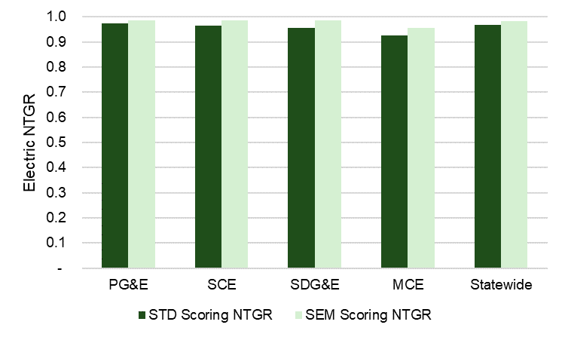
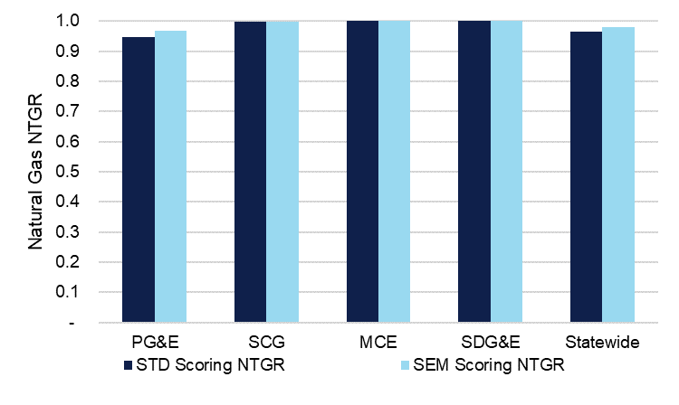
Comparison of NTGR algorithms
1.0 NTGR
1.0 NTGR
Standard scoring NTGR values are about 2% lower than the NTGR developed using the SEM scoring
Regardless of method, NTGR clusters around 1.0

Slide 24
Net electric findings by PA and statewide
SEM method
Program Administrator | First-year |  |  |  | Lifecycle
 | Evaluated Gross Savings | Net Savings | NTGR | Relative precision | Evaluated Gross Savings | Net Savings | NTGR | Relative precision
Energy (MWh)
MCE | 2,406 | 2,304 | 96% | 1% | 12,704 | 12,164 | 96% | 1%
PG&E | 29,238 | 28,811 | 99% | 1% | 152,935 | 150,368 | 98% | 1%
SCE | 5,616 | 5,537 | 99% | 1% | 31,323 | 30,820 | 98% | 1%
SDG&E | 4,123 | 4,068 | 99% | 2% | 30,008 | 29,376 | 98% | 2%
Statewide | 41,384 | 40,721 | 98% | 1% | 226,971 | 222,728 | 98% | 1%
Standard method
Program Administrator | First-year |  |  |  | Lifecycle
 | Evaluated Gross Savings | Net Savings | NTGR | Relative precision | Evaluated Gross Savings | Net Savings | NTGR | Relative precision
Energy (MWh)
MCE | 2,406 | 2,227 | 93% | 2% | 12,704 | 11,759 | 93% | 2%
PG&E | 29,238 | 28,508 | 98% | 2% | 152,935 | 148,310 | 97% | 2%
SCE | 5,616 | 5,427 | 97% | 1% | 31,323 | 30,113 | 96% | 1%
SDG&E | 4,123 | 3,943 | 96% | 5% | 30,008 | 27,932 | 93% | 7%
Statewide | 41,384 | 40,105 | 97% | 1% | 226,971 | 218,112 | 96% | 1%
Tables 4-7 & 4-8

Slide 25
Net gas findings by PA and statewide
SEM method
Program Administrator | First-year |  |  |  | Lifecycle
 | Evaluated Gross Savings | Net Savings | NTGR | Relative precision | Evaluated Gross Savings | Net Savings | NTGR | Relative precision
Energy (Therms/1,000)
MCE | 139 | 139 | 100% | 0% | 867 | 867 | 100% | 0%
PG&E | 1,611 | 1,559 | 97% | 4% | 9,947 | 9,654 | 97% | 4%
SCG | 610 | 609 | 100% | 0% | 3,208 | 3,201 | 100% | 0%
SDG&E | 89 | 89 | 100% | 0% | 444 | 444 | 100% | 0%
Statewide | 2,449 | 2,396 | 98% | 3% | 14,466 | 14,167 | 98% | 2%
Standard method
Program Administrator | First-year |  |  |  | Lifecycle
 | Evaluated Gross Savings | Net Savings | NTGR | Relative precision | Evaluated Gross Savings | Net Savings | NTGR | Relative precision
Energy (Therms/1,000)
MCE | 139 | 139 | 100% | 0% | 867 | 867 | 100% | 0%
PG&E | 1,611 | 1,527 | 95% | 6% | 9,947 | 9,414 | 95% | 6%
SCG | 610 | 608 | 100% | 0% | 3,208 | 3,192 | 100% | 1%
SDG&E | 89 | 89 | 100% | 0% | 444 | 444 | 100% | 0%
Statewide | 2,449 | 2,363 | 97% | 4% | 14,466 | 13,917 | 97% | 4%
Tables 4-9 & 4-10

Slide 26
Contribution of capital measures to SEM savings
PA | Total MMBtu savings | Percent of capital MMBtu | Total kWh savings | Percent of capital kWh | Total therm savings | Percent of capital therm
MCE | 40,561 | 12% | 2,660,252 | 21% | 314,916 | 9%
PG&E | 291,213 | 16% | 28,764,984 | 8% | 1,931,087 | 20%
SCE | 21,222 | 11% | 6,219,519 | 11% | 0 | 0%
SCG | 76,435 | 11% | 0 | 0% | 764,536 | 11%
SDG&E | 24,134 | 22% | 4,428,144 | 36% | 90,268 | 0%
Statewide | 453,565 | 18% | 42,072,898 | 23% | 3,100,807 | 16%
Table 4-13

Slide 27

Conclusions and Recommendations

Slide 28
Conclusions and recommendations
Overall
Gross Specific
Net Specific

Slide 29
Conclusions and recommendations
Finding/conclusion | Recommendation
Only 45% of the sites used top-down methods to calculate savings. | Prioritize calculating energy savings using top-down approach to bottom-up calculations.
Not all sites that used bottom-up calculations were sufficiently justified. Only 40% of the sites that used bottom-up calculations reported having attempted a model. | Prioritize identifying and addressing issues that impede creating a valid top-down model. Attempt top-down models and include them in the project files even when using bottom-up calculations. Adequate measure-level documentation is required when using bottom-up calculations.
Savings annualization was one of the major contributors to the savings discrepancy. | Follow the current SEM M&V guidelines that recommended limiting the annualization to only when the model is being retired or a customer will not be participating in the SEM program after the current reporting period, with PA authorization.
Several models did not use site-specific input parameters. | Follow the SEM M&V guidelines on creating top-down models and assess their validity. This is covered in sections 4, 6, and 7 of the SEM M&V Guide.
Notes:
(1) Conc: The SEM M&V guide states that the top-down modeling approach is the preferred methodology to calculate SEM savings. The top-down modeling approach is more capable of capturing the full impact of SEM BRO measures since these types of measures can affect different spaces and pieces of equipment throughout a facility
Rec: Bottom-up calculations should only be used when a top-down model is proven to not be feasible.
(2) Conc: We reviewed and agreed with the majority of the provided bottom-up justifications. However, some were preventable and should be addressed and resolved before future cycles.
Rec #2: This will allow the PAs and the evaluators an opportunity to review those models to confirm the reasons for using bottom-up calculations.
(3) Conc: We acknowledge that program participants who used annualization followed the SEM M&V guidelines. However, the annualization approach often overlooks seasonality in the typical annual operation for facilities, which results in inaccurate savings estimation.
(4) Conc: Either required adjustments and calibration to improve the model statistical significance, reflect typical operation, and account accurately for SEM projects savings

Slide 30
Conclusions and recommendations continued
Finding/conclusion | Recommendation
In several instances, the claimed and reported savings were different. | Update relevant project documents such as the completion report and the calculation models. Include any updated models or final savings estimates in the project documentation package.
The measure cost and measure savings in the Opportunity Register were not consistently well populated. | Populate the OR’s applicable fields for any completed measure with estimated savings and costs.
The NTGR of the SEM program as 1.0 essentially stands. | Use the combined SEM NTGR (based on both capital and non-capital measures) and to apply it to all sites and to all measures regardless of the combination of capital or non-capital present.
The new SEM scoring method resulted in an increase of about 0.15 points in the average capital NTGR. | Evaluation should adopt updated SEM survey instruments and scoring method to estimate NTG for future capital NTG research.
Notes:
(1) Conc: For example, based on the conducted technical review and were different than the provided modeled savings. Final documentation, including the completion report, was not updated based on the technical review findings.
Rec #1: to reflect any changes implemented during the technical review phase.
(2) Conc: Despite small variations between fuels and PAs.
(3) Conc: Both fields can be used to inform EUL calculations and program cost-effectiveness and can aid in the customer’s prioritization of measures.
REC: The savings and costs are effective tools for customers to prioritize measures and can streamline identification of capital measures as the program scales.
(4) Conc: Compared to the standard scoring method. Because capital measures account for only about 16% of programs savings, the SEM program NTGR changes only by 1-2%..
REC: for SEM capital measures and in this study.
The NTG approach used in this study is a hybrid approach that combines the 1.0 NTGR for non-capital measures, as initially allowed for in D.16-08-019 and found through research as part of the prior evaluation, with a NTGR developed from participant surveys for capital measures determined in this study

Slide 31

Questions

Slide 32
Next Steps
Comments are due by close of business May 1, 2024
Responses will be compiled in a workbook that will be uploaded on pda.energydataweb.com with the final report.
Final Report
Final report is scheduled to be posted May 13, 2024.

