Slide 1
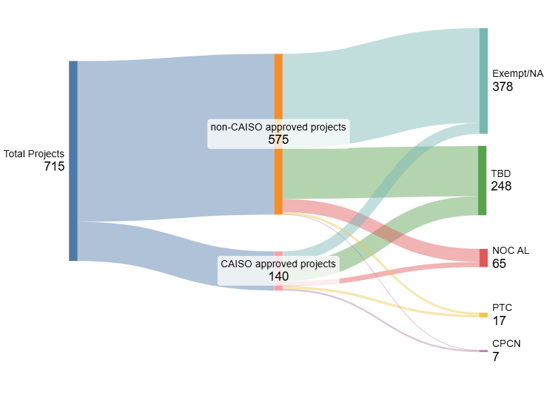
Expected CPUC Permitting Types of Transmission Projects in Development by IOUs
Projects shown have projected In-Service dates between 2025-2033
Projects all have an expected cost $1 million or greater
The majority of transmission projects are not permitted by CPUC
339
39
180
68
47
18
Exempt NA – Permit Exempt or Permit not needed
TBD – To be determined by IOU
NOC AL – Notice of Construction or Advice Letter
PTC – Permit to Construct
CPCN – Certificate of Public Conveyance of Necessity
8
9
6
1
Source: Transmission Project Review Data as of 3/1/2025
with updates from CEQA team

