Slide 1
Resource Data Template
December 2025 Status and Updates
November 14, 2025

Slide 2
Logistics
Office Hours slides, recording, and all supporting material are available on the IRP Procurement Webpage:
Questions: We invite clarifying questions at the end of the meeting.
Please keep yourself muted throughout the presentation.
Please “type your question in the chat” and then “raise your hand” to ask questions.
Please unmute yourself when Webex host will announce your name and ask your question.
Afterwards, please lower your hand.
For attendees joining by phone: You may either hold your question until the end and unmute to ask it or share it after office hours.
Note: This office hour is intended only for questions related to IRP-MTR December 2 filings, NOT FOR THE IRP BIENNIAL FILING.

Slide 3
Agenda
Topic | Duration (minutes)
Introduction & Logistics | 5
Overview of IRP Procurement Orders and Filing Requirements | 5
RDTv3_5 Guidance & Updates | 5
Required Vs Optional RDT Sheets | 5
Key Features of RDT Sheets | 5
Summary of Changes to the RDT | 5
RDT Walk-Through | 30
Q&A and Feedback | 30

Slide 4
IRP Procurement Orders and Filing Requirements

Slide 5
IRP Procurement Orders and Compliance Review Schedule
Table 1. CPUC Procurement Orders (Applies to all CPUC-jurisdictional LSEs. No opt-outs allowed)
CPUC Orders | Total | 2021 | 2022 | 2023 | 2024 | 2025 | 2026 | 2027 | 2028
D.21-06-035 (MTR) | 11,500 MW NQC | n/a | n/a | 2,000 MW by Aug | 6,000 MW by Jun 1 | 1,500 MW¹ by Jun 1 | n/a² | n/a | 2,000 MW by Jun1
D.23-02-040 (Supplemental MTR) | 4,000 MW NQC | n/a | n/a | n/a | n/a | n/a | 2,000 MW by Jun 1 | 2,000 MW by Jun 1 | n/a
Cumulative Procurement Ordered | 18,800 MW NQC | 1,650 MW | 2,475 MW | 5,300 MW | 11,300 MW | 12,800 MW | 14,800 MW | 16,800 MW | 18,800 MW
Table 2. Timelines for CPUC Review of LSE Contracting
Progress | 2021 | 2022 | 2026 | 2023 | 2024 | 2025 | 2027 | 2028
CPUC Reviews LSE Compliance Filings and CPUC could order Backstop Procurement | Feb 2021 | Feb 2022 | Dec 2026 | Feb 2023 & Dec 2023 | Dec 2024 | Dec 2025 | Dec 2027 | Dec 2028
CPUC Reviews LSE Compliance Filings only | Aug 2021 | Aug 2022 | Jun 2026 | Aug 2023³ | Jun 2024 | Jun 2025 | Jun 2027 | Jun 2028
Dec 2025
(1) D.21-06-035 required 2,500 of the 9,000 MW NQC required between 2023-2025 be "Diablo-Canyon Replacement".
(2) D.21-06-035 required 2,000 MW NQC of Long-Lead Time Procurement by 2026, with an option to extend to 2028: 1,000 MW NQC of long-duration storage and 1,000 MW NQC of firm zero-emitting. D.23-02-040 automatically extends the procurement obligation to 2028.

Slide 6
Dec 2, 2025, Filing Requirements
Filings Include:
  Public and Confidential RDTv3_5_3 : RDTv3_5_3 released
  Supplemental Documents:
    1. Contracts
    2. Milestone documentation
    3. Engineering assessments as required
  Remediation Plan
  Relevant Documents
  User Guide: IRP Procurement Track
  Filing Requirement Overview: IRP Procurement Track
  Decision: 25-09-007
  Resolution E-5426: 585357875.PDF

Slide 7
Dec 2, 2025, Filing Requirements
  File Naming Requirements:
  Use the LSE abbreviation from the “lse_names” sheet in the workbook
  Indicate “confidential” or “public”
  Include version number as v1, v2, etc.
  Increase version number each time you resubmit
  <LSE Abbreviation>_rdtv3_38mmt_<confidential/public>_v#
  Example: XYZ_rdtv3_38mmt_confidential_v1

Slide 8
RDTv3_5 Guidance & Updates

Slide 9
Required Sheets vs. Optional RDT Sheets
  The RDTv3_5_3 consists of 14 sheets. LSEs are only required to fill sheets relevant to IRP- MTR filings.
  Required sheets
  “Unique_Contract” sheet, MTR NQC Validation Tool sheet, MTR NQC Summary sheet.
  Signed Certification Form: Complete all required fields, and ensure the form is signed before submission.
Not required for this filing:
  Sheets: “Calcs”, “Reliability- Planning”, “Reliability RCPPP-Option I”, “Reliability RCPPP-Option II” and “CSPReportSheet”.

Slide 10
Key Features of RDT Sheets
  Unique_Contracts Sheet
  The “unique_contracts” sheet is the only sheet in RDTv3 for reporting the LSE’s existing and planned energy and capacity contracts.
  Please use separate rows for every contract reported.
  Hybrid contracts should be listed on separate rows, with a different row for each resource.
  Not Required: “Unique_contract” sheet columns: “csp_resource_category”; “csp_annual_2028”; “csp_annual_2030”; “csp_annual_2035”; “csp_annual_2040” “csp_annual_2045”.
  MTR NQC Validation Tool Sheet
  LSEs are required to complete the MTR NQC Tool and Summary Sheet for every contract and for each tranche to which they intend to apply that contract.
  Contracts used to meet multiple compliance obligations should be listed on separate rows, with a different row for each compliance obligation targeted.
  Each bridge contract (long-term or short-term) should be entered in a separate row. If a bridge is used to bridge for two resources, use separate rows to identify the bridging NQC for each resource.

Slide 11
Avoiding Errors in RDT
Unique_contracts Sheet
Do not delete rows from the “unique_contracts” tab — this will cause errors in linked sheets.
Each contract row must include:
1. A unique “lse_contract_id” is required for every contract.
2. For hybrid contacts, only show the contracted attributes and compliance targets relevant to resource type and Resource ID.
3. Hybrid resources with different Resource IDs may continue to use the same “lse_unique_contract_id”.
Columns including total and contracted nameplate capacity, resource mix, and storage depth should not be left empty.

Slide 12
Avoiding Errors in RDT
Data Entry and Pasting
Avoid pasting values directly, as it can bypass data validation and create errors. When pasting is necessary, paste values only.
Columns may change (added or removed) between RDT versions.
Complete all columns unless a field can be explicitly marked as not applicable.
Run macros after completing the “unique_contracts” sheet and before using the MTR NQC Validation Tool.
Reminder: Outputs in the MTR NQC Validation Tool (Summary Sheet) depend entirely on the accuracy of information entered by the LSE in the “unique_contracts” sheet.

Slide 13
Summary of Changes to the Dec 2025 RDT
“Unique_Contracts” Sheet: Updated “mtr_contract_changed”.
“LSE_Names” Sheet: Updated list of included LSE names.
Resource Sheet: Added hybrid resources with assigned CAISO Resource IDs.
Misc Sheet:
Updated LSE ELCC lookup key.
Updated MTR obligations to reflect adjustments after baseline swaps and obligation trade.

Slide 14
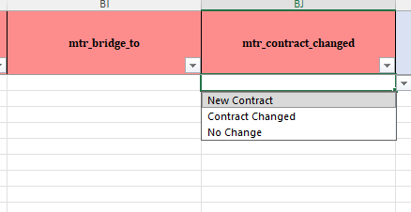
Unique Contracts Sheet
“mtr_contract_changed” column: updated to include the following dropdown options: “New Contract,” “Contract Changed,” and “No Change”.
Use, New Contract, if it is a new contract (i.e., not reported previously), or
Contract Changed, if it is an existing contract that has been modified from what was previously reported, or
Not Changed, If there has been no change, indicate that the contract remains unchanged from the prior filing.

Slide 15
Lse_names & Resource Sheet
  Updated list of LSE names.
  Additional hybrid resources with assigned CAISO Resource IDs.
  Increased resolution for geothermal resources.
DSFLWR_2_W9CSB1_LESR | Willy 9 Chap 1 | 52 | caiso_li_battery | CISO
DSFLWR_2_W9CSB1_SUN | Willy 9 Chap 1 | 102 | caiso_solar | CISO
DSFLWR_2_W9CSB2_LESR | Willy 9 Chap 2 | 36 | caiso_li_battery | CISO
DSFLWR_2_W9CSB2_SUN | Willy 9 Chap 2 | 72 | caiso_solar | CISO
EDWARD_2_ESSSB1_LESR | Sanborn Solar 2 Edwards 5 | 47 | caiso_li_battery | CISO
EDWARD_2_ESSSB1_SUN | Sanborn Solar 2 Edwards 5 | 68 | caiso_solar | CISO
EDWARD_2_ESSSB2_LESR | Sanborn Solar 2 | 21.5 | caiso_li_battery | CISO
EDWARD_2_ESSSB2_SUN | Sanborn Solar 2 | 132 | caiso_solar | CISO

Slide 16
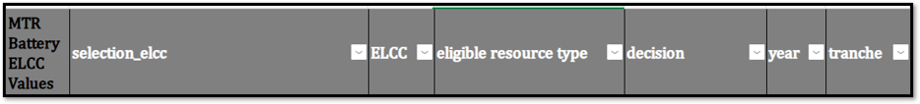
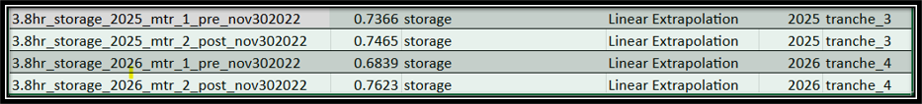
Misc Sheet
  Updated LSE ELCC lookup key.
  Updated MTR obligations to reflect adjustments after baseline swaps and obligation trades.

Slide 17
MTR ELCC Guidance Documents
2021
2021 Staff transmittal memo
  ELCCs for ‘23 (T1) and ‘24 (T2) compliance dates; ’25 (T3) + ‘26 (T4) compliance dates for contracts entered before 11/30/2022.
  Direction on geothermal counting & other clarifications.
2021 Study for Mid-Term Reliability Procurement by E3 and Astrapé (2021 Study)
2023
June 2023 Staff Memo
  Addresses requirements in D.23-02-040 to provide final guidance on procurement adopted in that decision.
  Confirms that ELCC values issued in 2023 MTR Study are still effective.
  Clarifies which ELCCs stakeholders should use for OOS wind resources not explicitly mentioned in previous ELCC studies.
2023 Staff Transmittal Memo
  ELCCs for ’25 (T3) + ‘26 (T4) compliance dates for contracts entered after 11/30/2022.
  ELCCs for procurement adopted in D.23-02-040 – ’27 (T5) + ‘28 (T6).
  Directions for ELCCs for delayed contracts.
Incremental ELCC Study for Mid-Term Reliability Procurement (January 2023 Update)
FAQ Documents
2024 Staff Responses to Frequently Asked Questions on Mid-Term Reliability
2023 Staff Responses to Frequently Asked Questions on Mid-Term Reliability
General Q&A Responses to Frequently Asked Questions on Mid-Term Reliability issued on 5/22/2025

Slide 18
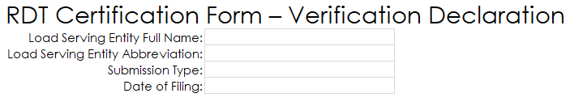
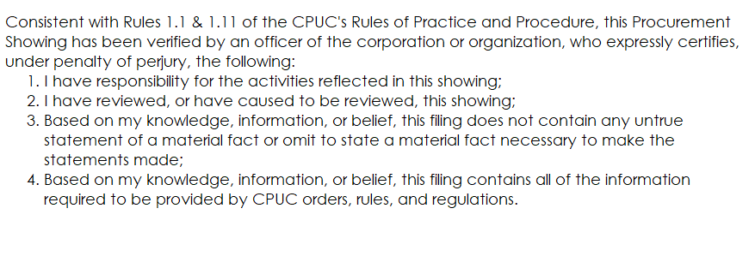
Certification Form-Do Not Forget to Complete
This Form is used to verify the accuracy, reduce data errors and inconsistencies in procurement volumes that LSEs are reporting for their MTR compliance.
LSE must nominate a person/persons verifying and certifying that information provided for MTR compliance.

Slide 19
RDTv3_5_3 Example Walkthrough

Slide 20
Q&A and Feedback

