Slide 1
2026 CPUC Filing Requirements Modeling

Slide 2
Key Input Changes Since 25-26 TPP

Slide 3
Summary of RESOLVE Updates Since 25-26 TPP (1)
Data | Change
Zonal Topology (Disaggregation of CAISO) | CAISO RESOLVE zone disaggregated into PGE, SCE, and SDGE, with associated data updates PGE<>SCE transmission path expansion candidate(s) added to RESOLVE optimization Remote generator representation added to align with SERVM
Default Candidate Resources | Enhanced Geothermal (EGS) and Generic Long Duration Storage (LDES) added as default candidates Pumped Hydro (PHS) and Adiabatic Compressed Air Storage (A-CAES) combined into a single “Location-Constrained Storage” category
Candidate Regions | Updated to align with CAISO study areas used in transmission planning
Resource Cost | Updated to 2024 NREL ATB New capital cost assumptions for solar, onshore wind, and Li-ion battery New financing costs
Resource Potential | Updates to solar potential using 2024 BLM Western Solar Plan Updates to onshore wind potential using latest NREL capacity factor data Additional location-constrained storage potential projects included
Minimum Builds | Near-term minimum build constraints added to RESOLVE to reflect recent LSE contracts incremental to the baseline

Slide 4
Summary of RESOLVE Updates Since 25-26 TPP (2)
Data | Change
Baseline Resources | Updated to latest available data from CAISO, WECC, and LSE filings (as of mid-2024)
Planned External (Non-CAISO) Builds | Updated to reflect most recent IRP reports (as of mid-2024)
Load Forecast & Profiles | Updated to 2024 IEPR Historical baseline profile updated to include 2021 & 2022
Generation Profiles | Updates to wind model used by staff to develop profiles 2021 and 2002 weather years included New generation profiles for enhanced geothermal (EGS)
Day Sampling | Updated 36 RESOLVE sample days incorporating latest load and generation profiles
PRM and ELCC Inputs | Updated target PRM % and resource ELCCs informed by SERVM runs 3D solar-storage surface with dimensions for solar, 4-hr battery, and 8-hr battery (multipliers for longer duration storage relative to 8-hr dimension)
Gas Retention Costs | Updated to increase over time to the cost of repowering
GHG Target | Near-term trajectory updated to reflect historical GHG data up to 2022 Long-term trajectory updated to reflect higher CAISO load share for statewide GHG target
Dollar Year | Costs inflated to 2024 dollar year from 2022 dollar year
Inter-Day Sharing | Functionality in RESOLVE to track long duration storage state of charge over a chronological 8760 hours to enable energy sharing over multi-day and/or seasonal periods

Slide 5
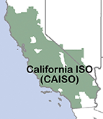
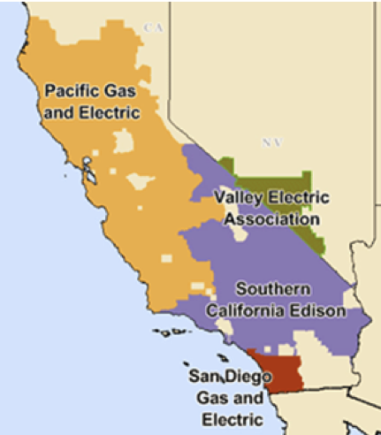




Zonal Disaggregation Overview
Key benefits of disaggregating into PGE, SCE, and SDGE zones include:
  Better alignment between SERVM and RESOLVE topology
  Factor Inter-zonal transmission constraints between the three zones into the optimization of resource builds and non-retention decisions
  Allow the model to evaluate transmission expansion between the three zones

Slide 6
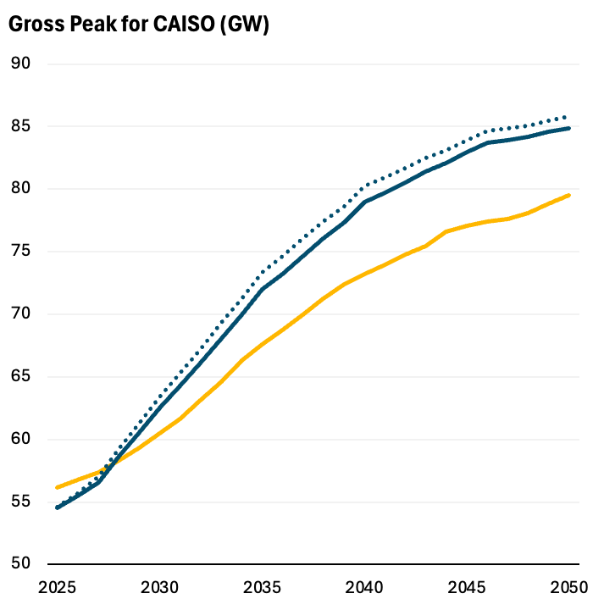
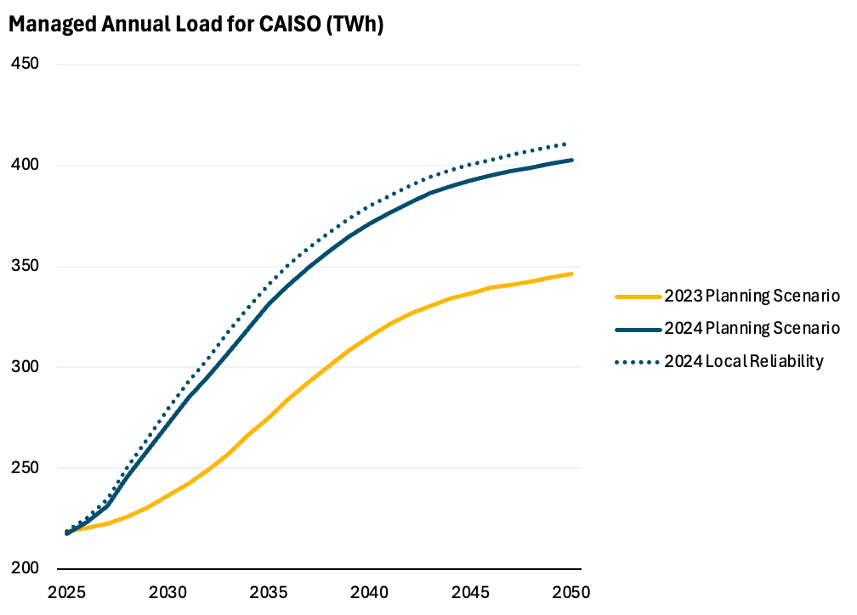
The 2024 IEPR Forecast Drives Additional Resource Needs
Forecasts for both system peak and annual energy grow significantly in the 2024 IEPR, compared to the 2023 IEPR, driving increased capacity and GHG-free energy needs
+5.8 GW
+5.8 GW
+56 TWh
+4.4 GW
+56 TWh
+2.0 GW
+56 TWh
+36 TWh
Note: Gross Peak is Managed Net Load + BTM PV
Note: Assumes no CHP retirement

Slide 7
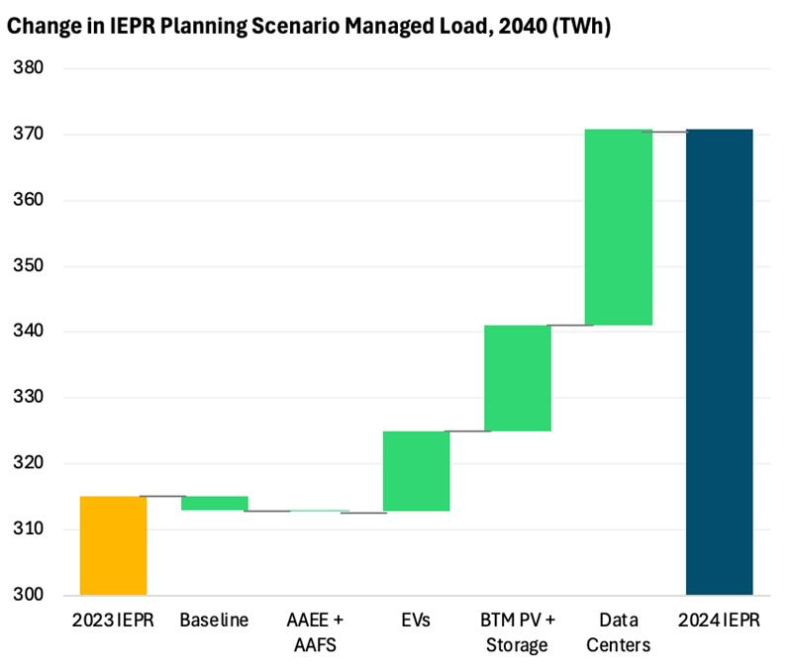
2024 IEPR vs. 2023 IEPR: Managed Load Waterfall
Increases in load are primarily driven by:
  The introduction of significant data center loads in the 2024 IEPR
  Less economic adoption and lower capacity factors for BTM Solar and Storage
  Updates to electric vehicles, including higher vehicle miles travelled (VMT)
Changes to the baseline, energy efficiency (AAEE), and building electrification (AAFS) are relatively small
  In the 2030s, AAFS demand is higher in the 2024 IEPR, but is similar by 2040

Slide 8
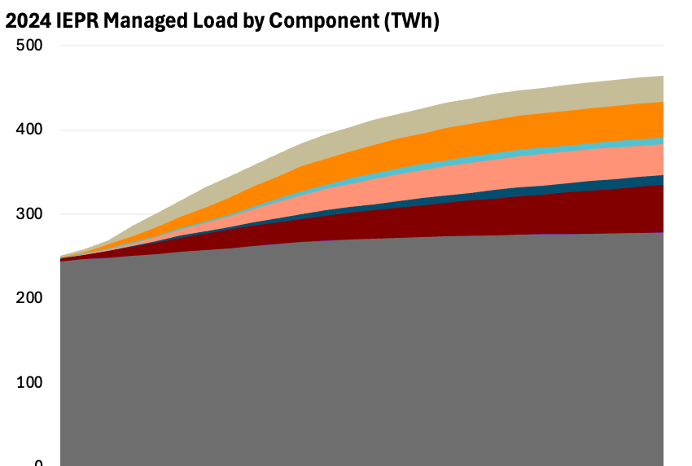
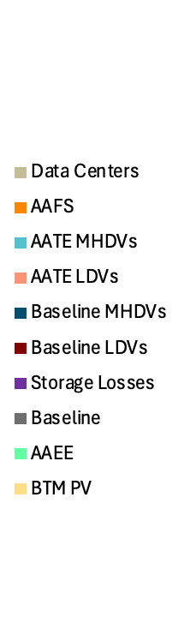
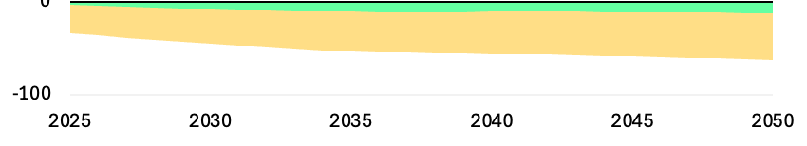
2024 IEPR Load by Component
Total load continues to be dominated by baseline consumption
Electric vehicles (23% of 2040 managed load) and building electrification (9%) are the next largest shares, outpacing data centers (8%)
BTM Solar and Energy Efficiency collectively reduce load by ~13%

Slide 9
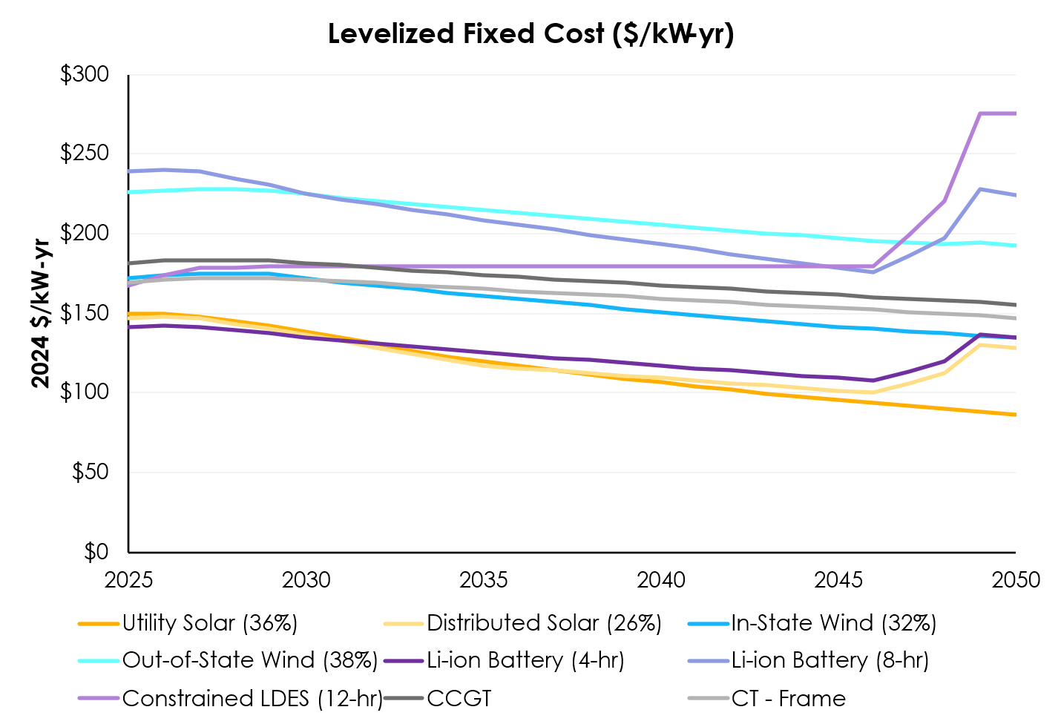
Summary of Total Levelized Fixed Costs
Resource Costs
Total levelized fixed costs (LFC) represent the cost to construct new candidate resources and drive build decisions in RESOLVE
  Includes overnight capital cost, construction financing costs, fixed O&M, interconnection, and the ITC, where applicable
Variable costs, including VO&M, fuel costs, and the PTC for utility-scale onshore wind and solar, are not included in LFC
Note: The resource costs used in Filing Requirements modeling assume federal policy as of January 1, 2025

Slide 10
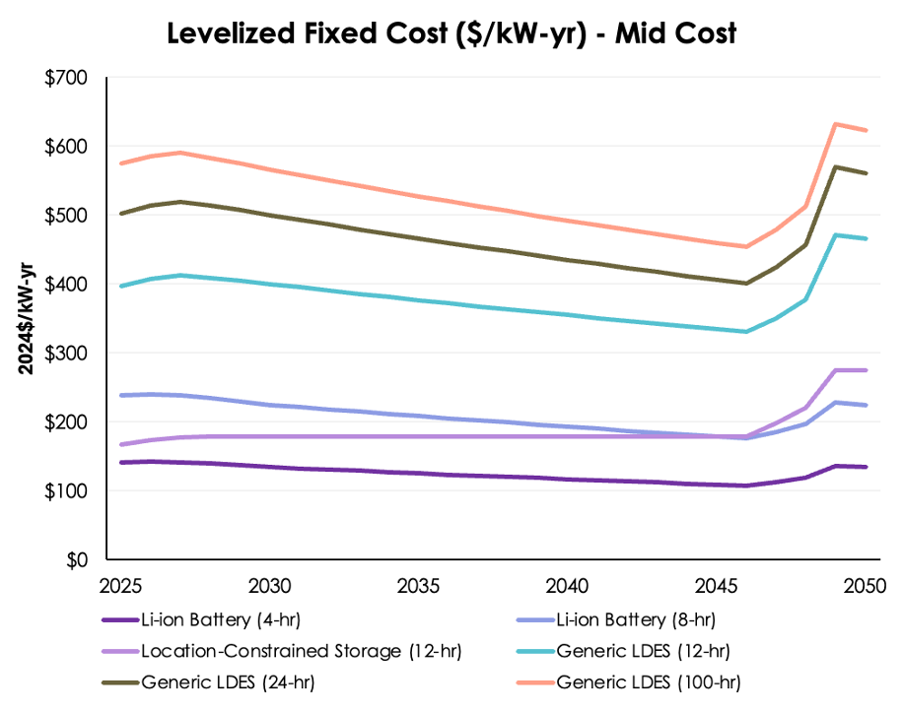
Storage Costs
Location-constrained storage (12-hr) represents the combined potential of pumped hydro storage (PHS) and adiabatic compressed air storage (A-CAES)
A single cost is used for all location-constrained storage (2024 NREL ATB pumped hydro), though in reality costs will be site-specific
The levelized cost of location-constrained storage is lower than 8-hr battery until the 2040s, which, combined with its higher ELCC at 12-hr duration, drives selection by RESOLVE

Slide 11
Summary of Resource Potential by Technology
Technology | PGE (GW) | SCE (GW) | SDGE (GW)
Utility-Scale Solar | 147.5 | 153.4 | 57.8
Distributed Solar | 11.8 | 20.3 | 4.5
Onshore Wind | 4.9 | 4.1 | 1.9
Out-of-State Wind | 4.3 | 15.0 | -
Offshore Wind | 28.9 | - | -
In-State Geothermal | 0.7 | 2.0 | 0.5
Out-of-State Geothermal | 1.0 | 1.3 | -
Biomass | 1.0 | 0.1 | 0.1
Location-Constrained LDES (12-hr) | 5.5 | 10.5 | 0.5
In-State Enhanced Geothermal | 16.1 | 3.1 | 1.0
Out-of-State Enhanced Geothermal | 2.9 | 6.8 | -
Storage (Li-ion, LDES) | Uncapped | Uncapped | Uncapped
Thermal (CCGT, CT, Recip) | Uncapped | Uncapped | Uncapped

Slide 12
First Available Years
Technology | First Available Year
Utility-Scale Solar | 2026-2028
Distributed Solar | 2026 (first model year)
Onshore Wind (In-State) | 2026-2035
Onshore Wind (Out-of-State) | 2026-2040
Offshore Wind | 2032-2040
Conventional Geothermal | 2026-2035
Enhanced Geothermal (Near-Field) | 2030-2035
Enhanced Geothermal (Deep) | 2035
Biomass | 2028
Technology | First Available Year
4-hr Li-ion Battery Storage | 2026
8-hr Li-ion Battery Storage | 2026
12-hr Location-Constrained LDES | 2031-2037
12-hr Generic LDES | 2031
24-hr Generic LDES | 2031
100-hr Generic LDES | 2031
CCGT | 2030
CT – Frame | 2030
CT – Aeroderivative | 2030
Reciprocating Engine | 2030

Slide 13
Near-Term Solar and Wind Build Limits
Staff has increased the near-term solar build limit to 4,000 MW per year for the first three years, based on data from LBNL Tracking the Sun¹ and the CAISO Master Generating Capability List (MGC)²
New to this IRP cycle, staff have developed a build limit for in-state wind reflecting commercial interest and project deployment timelines
  250 MW/year through 2030, 1,000 MW/year from 2031 to 2035
The full resource potential, subject to resource-level near-term build limits and transmission deliverability constraints, will continue to restrict capacity additions after these constraints are relaxed
Technology | 2026 | 2027 | 2028 | 2029 | 2030 | 2031 | 2032 | 2033 | 2034 | 2035 | 2036+
Utility-Scale Solar | 4,000 | 8,000 | 12,000 | Full potential
In-State Wind | 250 | 500 | 750 | 1000 | 1,250 | 2,250 | 3,250 | 4,250 | 5,250 | 6,250 | Full
1 https://emp.lbl.gov/utility-scale-solar; 2 http://oasis.caiso.com/mrioasis/logon.do

Slide 14
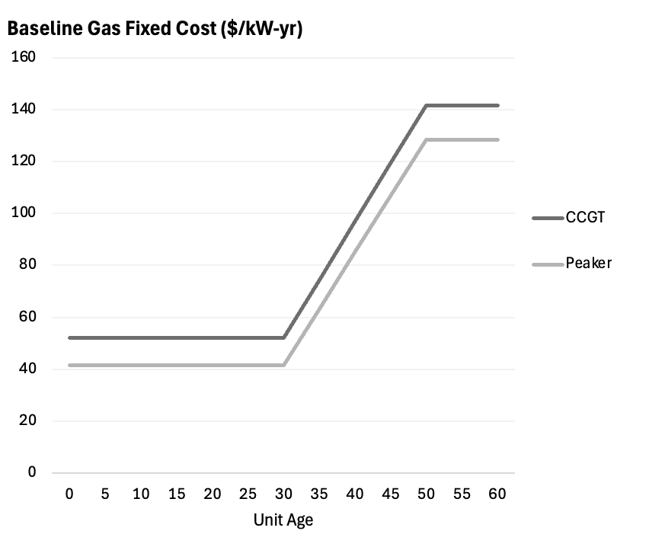
RESOLVE Gas Retention Costs
First 30 years of life use the gas fixed O&M costs from previous cycles, derived from the CEC¹
From the age of 50 years, baseline gas unit costs are equal to the cost of repowering (brownfield costs, as a % of greenfield (new) costs), plus the Fixed O&M of a new unit
  CCGT: Brownfield costs 90% of greenfield
  Peaker: Brownfield costs 86% of greenfield
Linear increase from age 30 to 50
1 CEC Cost of New Generation Report: https://www.energy.ca.gov/sites/default/files/2021-06/CEC-200-2019-005.pdf; costs in real 2022$

Slide 15
Key RESOLVE Model Updates

Slide 16
Main improvements made to the RESOLVE Model
Streamlined upstream data workbooks with a more transparent process and alignment with RESOLVE Scenario Tool format
Overhauled Scenario Tool for more transparent and centralized data structure
Updated documentation and user guide for installation and use of Scenario Tool and Results Viewer
Updated code base with modular code blocks and new features including production tax credit modeling, resource retirement and repowering decisions, additional validations on the backend, etc.
Updated day sampling algorithm with new capabilities for synthetic weather year creation used for storage inter-day sharing
Updated Results Viewer features in excel workbook and hourly dispatch charts in Jupyter Notebook script

Slide 17
RESOLVE Modeling Results

Slide 18
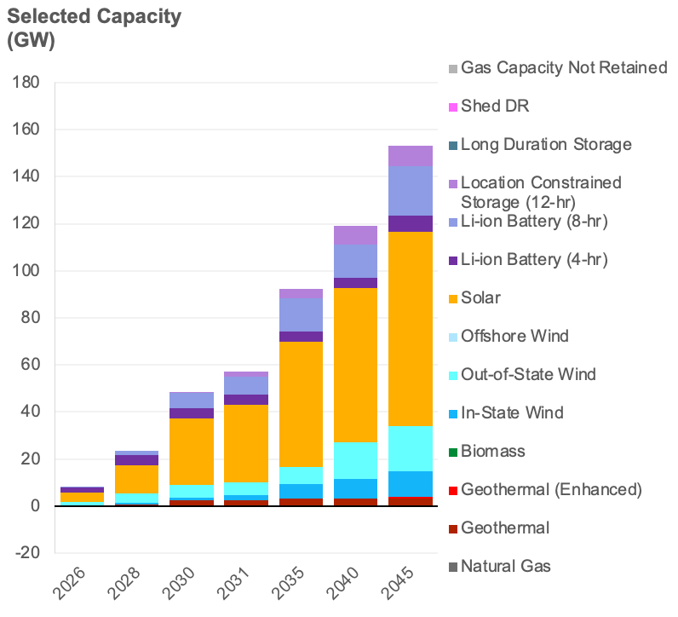
RESOLVE Least Cost Scenario Modeling Results
~70% of selected builds are solar and battery storage
Nearly the full potential of conventional geothermal, onshore wind, and location-constrained storage is built out
Almost all gas capacity is retained for reliability
A small amount of enhanced geothermal (EGS) is built in 2045
The GHG emissions target binds in all model years; the PRM (reliability) target binds in 2026 and 2040-45
  Builds in the 2030s are driven by GHG-free energy needs alone, and the system is over-reliable in these years
  Reliability needs in the 2040s also drive builds, including EGS

Slide 19
Selected Builds
Resource Type | 2026 | 2028 | 2030 | 2031 | 2035 | 2040 | 2045
Natural Gas | - | - | - | - | - | - | -
Geothermal | 0.1 | 0.6 | 2.4 | 2.4 | 3.2 | 3.2 | 3.2
Geothermal (Enhanced) | - | - | - | - | - | - | 0.7
Biomass | 0.0 | 0.0 | 0.0 | 0.0 | 0.0 | 0.0 | 0.0
In-State Wind | 0.3 | 0.8 | 1.3 | 2.3 | 6.3 | 8.3 | 10.9
Out-of-State Wind | 1.4 | 4.0 | 5.5 | 5.5 | 7.0 | 15.8 | 19.0
Offshore Wind | - | - | - | - | - | - | -
Solar | 4.0 | 12.0 | 28.1 | 32.8 | 53.4 | 65.3 | 82.7
Li-ion Battery (4-hr) | 2.3 | 4.4 | 4.4 | 4.4 | 4.4 | 4.4 | 6.8
Li-ion Battery (8-hr) | 0.1 | 1.7 | 6.4 | 7.7 | 14.0 | 14.0 | 21.1
Location Constrained Storage (12-hr) | - | - | 0.3 | 2.1 | 3.9 | 8.0 | 8.5
Generic Long Duration Storage (12-hr) | - | - | - | - | - | - | -
Generic Long Duration Storage (24-hr) | - | - | - | - | - | - | -
Generic Long Duration Storage (100-hr) | - | - | - | - | - | - | -
Shed DR | - | - | - | - | - | - | -
Gas Capacity Not Retained | (0.3) | (0.3) | (0.3) | (0.3) | (0.3) | (0.3) | (0.3)
Geothermal is selected for reliability needs due to its high ELCC; most of the conventional geothermal potential is built out by 2035, and additional EGS is built in 2045
Almost all available onshore wind is selected by 2045; near-term in-state wind build limits through 2035 are met
Solar and storage are the least-cost resources that scale to meet growing GHG-free energy demand
Small amounts of gas with high fixed O&M are not retained early on

Slide 20
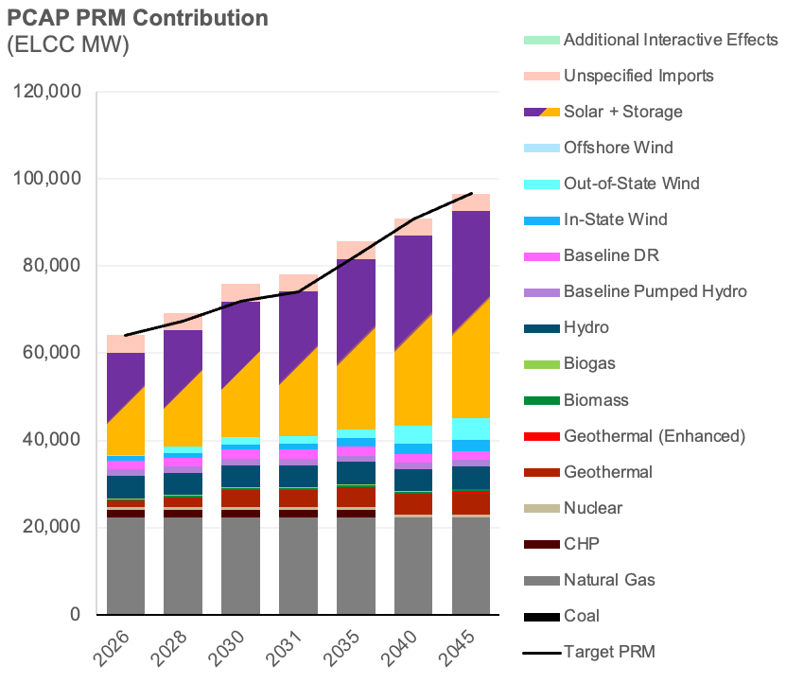
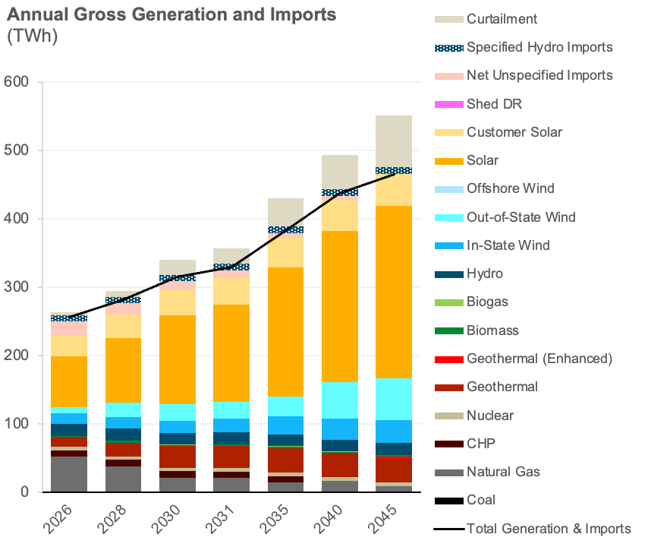
Reliability and Energy Mix
Solar & Storage, followed by gas, have the largest reliability contributions
Gas capacity factor drops to <10% by 2030 and <5% by 2045

Slide 21
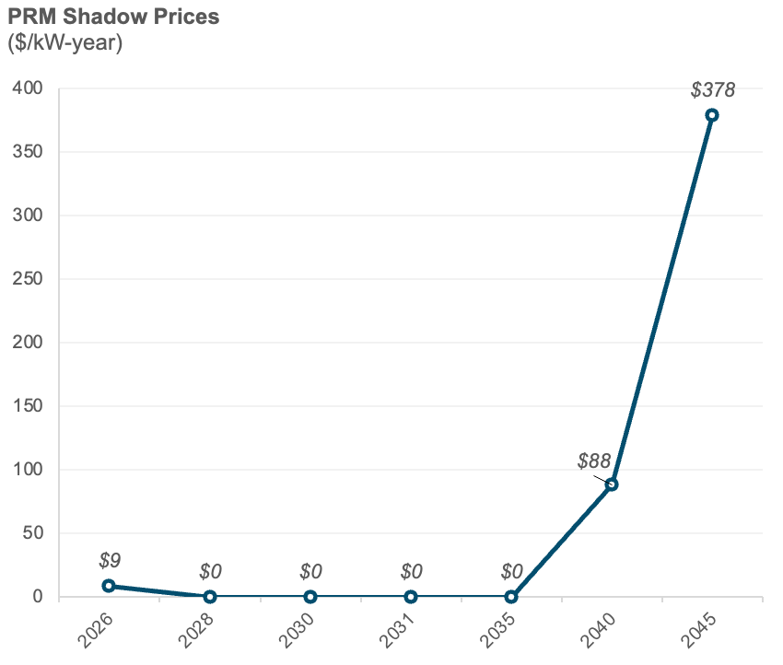
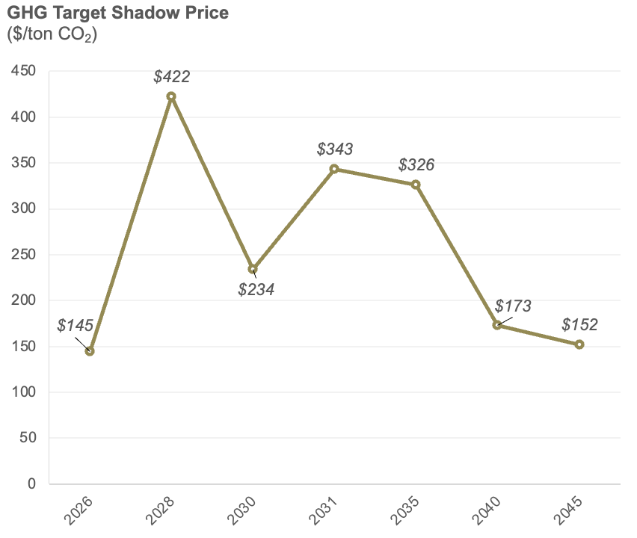
PRM (Reliability) and GHG Constraints
Shadow prices represent the cost of meeting a constraint, i.e. the cost of the last kW of firm capacity or the last ton of GHG emissions reduction
PRM shadow price spikes in 2045, when relatively expensive firm capacity such as enhanced geothermal (EGS) is needed for reliability
GHG shadow price drops in the 2040s as the PRM shadow price increases
The system is over-reliable 2028-35, as builds for GHG reductions exceed those needed for reliability
Near-term build limits for solar and wind drive a high GHG shadow price in 2028

Slide 22
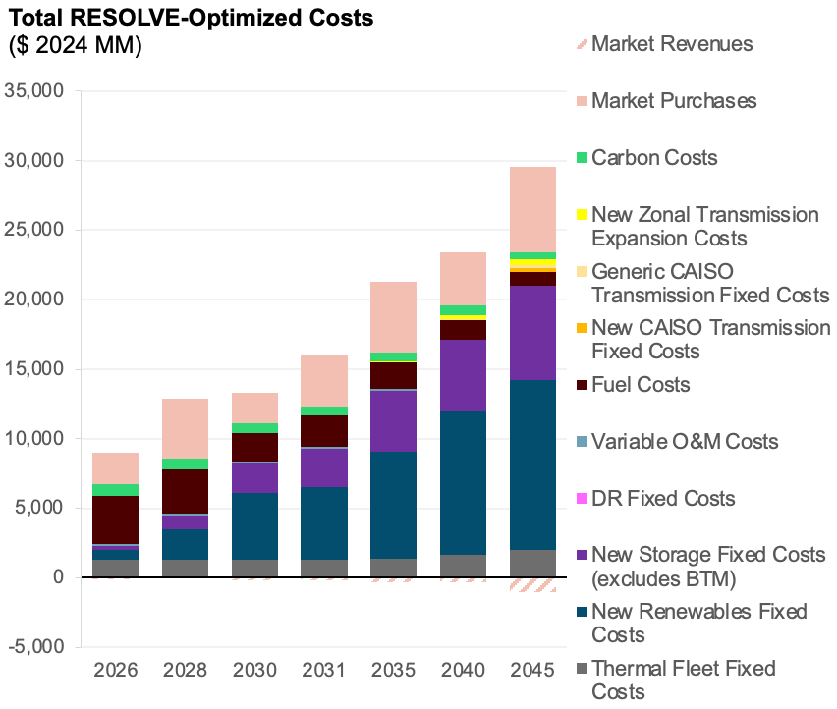
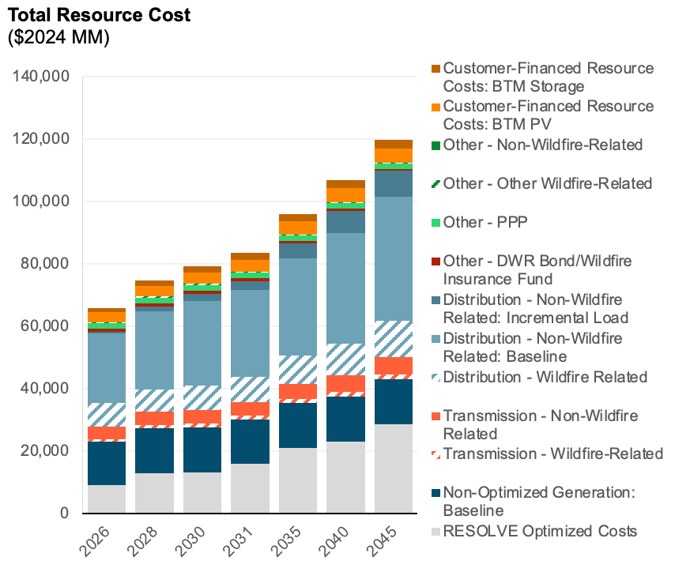
System Cost
RESOLVE-optimized costs account for 15-25% of total system costs (increasing over time); non-optimized baseline generators, T&D, and BTM resources make up the bulk of costs
The largest component of RESOLVE-optimized costs are investment costs for new renewable and storage resources
Note: “Zonal Transmission Expansion” refers to North-South California transmission capability; other ”CAISO Transmission” costs refer to upgrades for resource deliverability; “Market Purchases/Revenues” refer to imports/exports into/out of CAISO

Slide 23
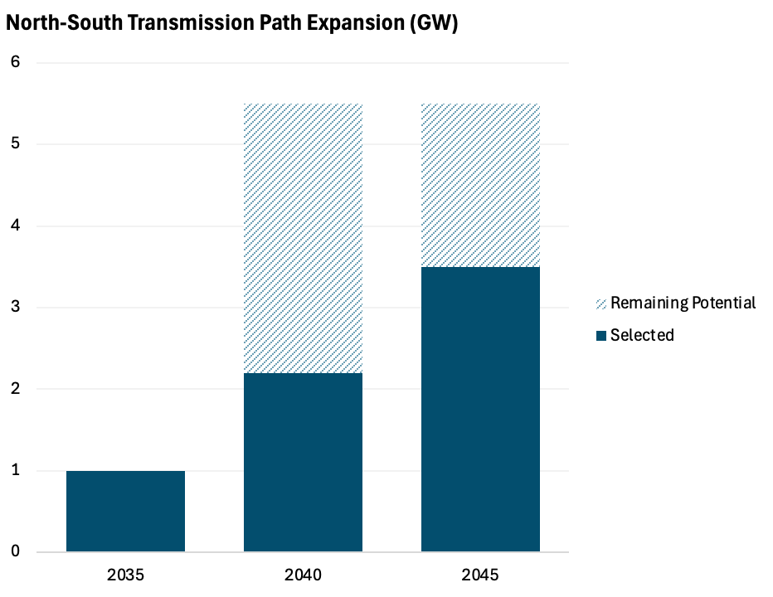
North-South Transmission Expansion
Path 26/Path 15 expansion(s) are selected by RESOLVE primarily to increase import capacity into Northern California (PGE-TAC)
1 GW is selected by 2035 (the first available year in RESOLVE)
A total of ~3.5 GW is selected by 2045, roughly doubling South-to-North transfer capacity

Slide 24
CSP Tool Updates

Slide 25
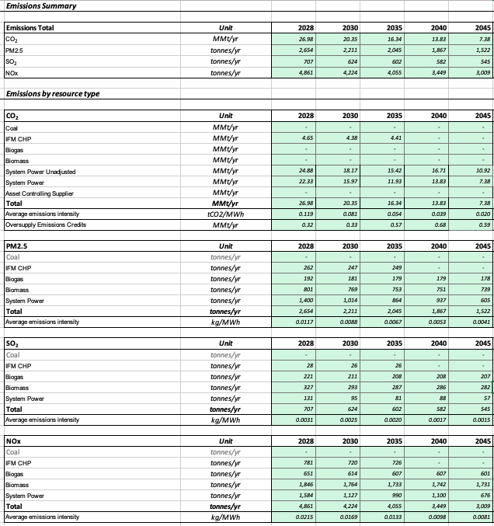
CSP Tool
Sample CSP Tool Outputs
The Clean System Power (CSP) Tool is used by LSEs during Filing Requirements to estimate their GHG and criteria pollutant emissions associated with their resource portfolios
This estimate is used to demonstrate compliance with LSEs' GHG allocations
The CSP Tool estimates both greenhouse gas and criteria pollutant emissions, and includes both emissions directly from an LSE's resource portfolio (criteria pollutants only) as well as emissions from CAISO system power that the LSE relies on

Slide 26
CSP Tool Updates
Key Change | 22-23 IRP Cycle | 24-26 IRP Cycle
Load Forecast | 2021 IEPR vintage | 2024 IEPR vintage
Resource Profiles | SERVM (2021 PSP) | SERVM (2025 LSE Filing Requirements)
Demand Profiles | SERVM (2021 PSP) | SERVM (2025 LSE Filing Requirements)
C&I Profile | CEC's California Commercial End-Use Survey | NREL CA C&I Profile
Emissions Profiles | SERVM (2021 PSP) | SERVM (2025 LSE Filing Requirements)
LSE Demand Allocation and Emissions Benchmarks | ALJ Ruling 2022 | Forthcoming
The CSP Tool has been updated to reflect 2028, 2030, 2035, 2040, and 2045 modeling years
In the 22-23 IRP cycle, LSEs were required to fill out two CSP Tools (for 25 and 30 MMT targets). In the 24-26 IRP cycle, LSEs will only be required to fill out one CSP Tool (25 MMT target)
Additional key input changes are shown in the table

