Slide 1
2024 RA Guide and Templates Workshop
August 3, 2023
1:00 p.m. – 3:00 p.m.

Slide 2
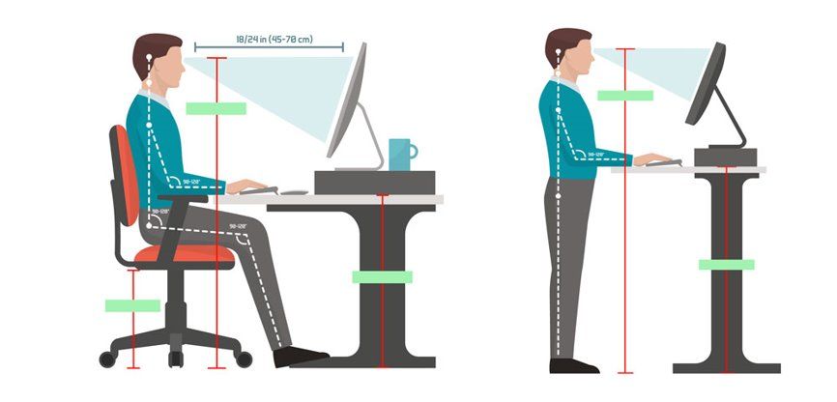
Logistics
Online only​
  Audio through computer or phone
  Toll-free 855-282-6330 or 415-655-0002 Access code: 2494 568 3861
Type password : pdJVw3cdP63
Hosts (Energy Division Staff)​
  Lily Chow
  Jaime Rose Gannon
  The workshop is being recorded
Safety
  Note surroundings and emergency exits
  Ergonomic check

Slide 3
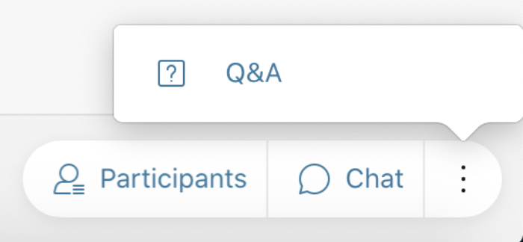

Workshop Logistics
All attendees have been muted
Panelist that are presenting have been identified and will be identified as panelist when their issue/topic is being addressed
To ask questions please use the Q&A function (send "To All Panelists") or raise your hand
Questions will be read aloud by staff; attendees may be unmuted to respond to the answer. (Reminder: Mute back!)
Mute/ Unmute
Participant List
Chat
Audio Options
On the bottom right of screen: click "3 dots" for Q&A

Slide 4
Ground Rules
Workshop is structured to facilitate understanding of the 2024 RA compliance process.
Keep comments friendly and respectful.
Please use Q&A feature only for questions, or technical issues.
Do NOT start or respond to sidebar conversations in the Chat.

Slide 5
Agenda
1:00 pm – 1:15 pm – Introduction and Overview of Agenda
Today’s Objective
          To demonstrate new features of the RA templates and guide for 2024 compliance year
1:15 pm – 1:30 pm - Central Procurement Entity Implementation
1:30 pm – 2:00 pm 2024 RA Guide
Changes in D.23-06-029
Other Modifications to the RA Guide
2:00 pm – 2:30 pm - General Demonstration of RA templates
  Revised Local and Flexible Template
      Changes to the Local and Flexible template - CPE
      Practice entering resource into template for both Local and Flexible compliance
      Practice verifying compliance
      Go through advisory monthly flexible tables
  Month Ahead Load Forecast Template
    Demonstration of entering load migration
    Demonstration of how the load migration values flow into the RA System
  System Template
Changes to the System template
Practice entering load and resource information for both System and Flexible compliance, including CAM/RMR
Practice verifying compliance
2:30 pm – 2:45 pm Wrap Up and Next Steps
  Informal comments due on August 11, 2023
  Finalize Guide and Templates late September 2023
  Overview of Year Ahead allocation and compliance schedule

Slide 6
Central Procurement Entity Implementation
For the 2024 Year Ahead Compliance Process
  LSEs in PG&E and SCE TAC areas will not receive local requirements for 2024-2026
  The CPE will receive local requirement for 2024, 2025, and 2026 in PG&E and SCE’s TAC area
  LSEs in SDG&E’s TAC area will receive local requirements for 2024, 2025, and 2026

Slide 7
Central Procurement Entity Implementation
LSEs may self-show local resources in PG&E and SCE’s TAC area for 2024, 2025, and 2026 to the CPE.
CPEs make local showing to CPUC on August 18, 2023 with LSEs attestations
LSEs will receive CAM credits for system and flexible capacity from the CPE procurement in 2024, 2025, and 2026 by the end of August, 2023. This credit will be updated in September 2023 for the 2024 final YA allocation based on the revised load ratio shares.
CPE Annual Compliance Report due September 19, 2023

Slide 8
2024 RA Guide
Added Ordering Paragraphs from D.23-06-029
Updated MCC bucket table
Changed PRM to 17%
Removed transmission loss factor and PRM adder for DR
Permits LSEs to update their load migration once in February for May to December
Updated dates to 2024

Slide 9
2024 Local/Flexible Template
Removed transmission loss factor adder for DR in the Summary tabs

Slide 10
2024 System Template
Changed PRM from 16% to 17% in the Year Ahead Summary and Month Ahead Summary tab
Removed transmission loss factor adder for DR in the Demand Response tab and PRM for DR in the Year Ahead Summary and Month Ahead Summary tab
Changed the Compliance check in the Year Ahead Summary and Month Ahead Summary tab to be only compliant if both system requirements and 24X7 minimum requirements are met

Slide 11
2024 Multiyear Capacity Documentation Summary
For LSEs that show local resources in 2024, 2025, and 2026 in the San Diego/IV local area

Slide 12
Import Checklist Template
For LSEs that show specified or unspecified import resources in the MA filings.

Slide 13
2024 RA Compliance Materials
2024 RA Compliance Materials have been posted, including 2024-2026 IOU DR LIP, 2024 YA Initial CAM Lists.
Resource Adequacy Compliance Materials (ca.gov)

Slide 14
Upcoming 2023 RA Compliance Timeline
Comments on 2024 Draft RA Guide and Templates due August 11, 2023
Final 2024 YA Load Forecast due August 14, 2023
CPE make local showing for 2024-2026 to CPUC, along with LSE attestations due August 18, 2023
LSEs receive CAM credits for system and flexible capacity procured by the CPE for 2024-2026 by August 2023 by end of August, 2023
CPE Annual Compliance Report due September 19, 2023
LSEs receive 2024 final YA allocations the week of September 18, 2023
Finalize 2024 RA Guide and Templates the week of September 18, 2023
LSEs’ 2024 YA RA filings due October 31, 2023
CPEs and LSEs that committed to self-show make year-ahead showing to CAISO by October 31, 2023

Slide 15

Thank you for attending 2024 RA Guide and Templates workshop.
Feedback welcome.
Hosts contact:​
Lily Chow- lily.chow@cpuc.ca.gov​
Jaime Gannon – jaimerose.gannon@cpuc.ca.gov​

