Slide 1
Rate Change Requests
Interconnection Discussion Forum
October 14, 2020

Slide 2
Rate Changes
Many customers switch rates when they install solar and storage
Customers like having contractors handle administration, so a customer’s online portal is not always the best option
If the rate change option is not on the interconnection application, it can only be done by phone
Phone requests cannot be confirmed – customers and contractors don’t know if it went through until it shows up on a bill, often months later
Utilities should have a standard form that can be e-signed by the customer and submitted to a dedicated portal or email

Slide 3
Program Eligibility
For SGIP, residential customers need to be on specific rates to get incentives
If it takes two months after PTO for a customer to prove they are on the right rate, that is an unreasonable delay in receiving the SGIP rebate

Slide 4
Timing of Rate Changes
Large commercial systems take a long time between application submittal and PTO
Customers normally do not want to switch rates until their system is operational because the new rate may increase bills without solar
Customers should be able to schedule rate changes

Slide 5
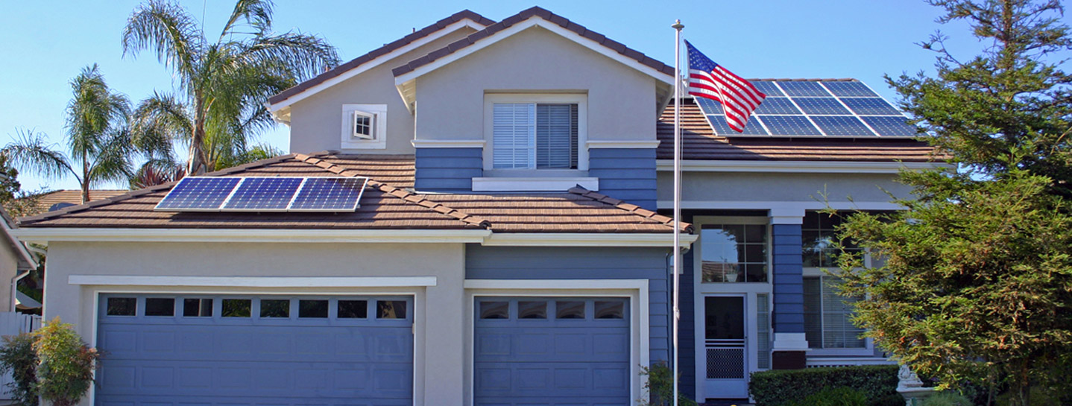
Thank You!
Brad Heavner
Policy Director
California Solar & Storage Association
brad@calssa.org

