Slide 1
Limited Generation Profiles Workshop #2 per Resolution E-5211
November 29, 2022
9:00 AM -- 4:00 PM PST
Please keep yourself muted when not speaking and do NOT put the call on hold. If muted by the leader, press *6 to unmute.

Slide 2
Workshop Logistics
Safety reminder. Make a note of your surroundings and exit routes. Reach out if you need help, either during the call or to an attendee
This meeting is being recorded
Workshop recording and materials will be posted in the CPUC Rule 21 Limited Generation Profiles Web Page.
If you were forwarded the invite and did not receive it directly from Energy Division, and would like to be added to the workshop distribution list, please email Mary Rottman at Mary.Rottman@cpuc.ca.gov
Workshop participants are encouraged to ask questions during the presentation; a dedicated Q&A time slot has also been scheduled after each presentation
Please keep yourself muted when not speaking and do NOT put the call on hold. To speak, unmute yourself from the button at the lower part of your screen
If calling in by phone, use the mute button on your handset and unmute yourself to speak. If muted by the host, press *6 to unmute. To raise your hand press *3
Questions?
Please keep yourself muted when not speaking and do NOT put the call on hold. If muted by the leader, press *6 to unmute.

Slide 3
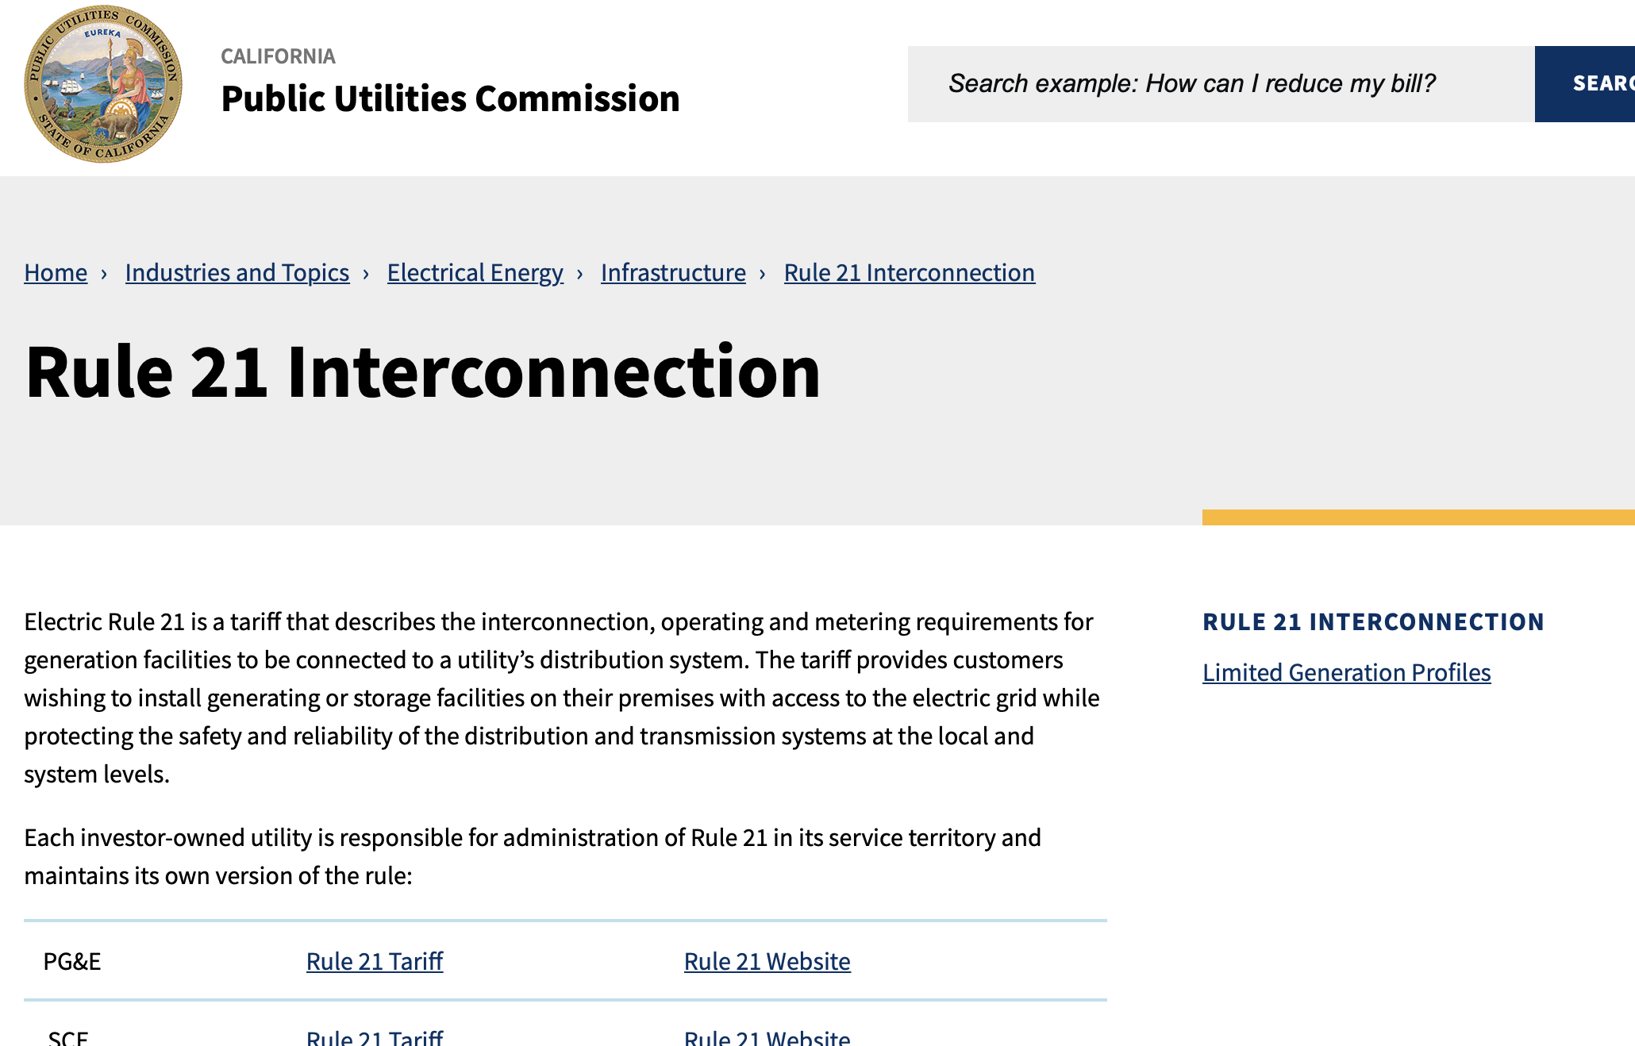
Rule 21 Web Page: Limited Generation Profiles
Main Page: https://www.cpuc.ca.gov/rule21/
Workshop recording and materials will be posted in the Rule 21 Limited Generation Profiles Web Page
Please keep yourself muted when not speaking and do NOT put the call on hold. If muted by the leader, press *6 to unmute.

Slide 4
Agenda
Please keep yourself muted when not speaking and do NOT put the call on hold. If muted by the leader, press *6 to unmute.

Slide 5
Workshop Goals
Arrive at a consensus proposal on “the specifics of whether and how reductions to a customer’s Limited Generation Profile are determined," the process to implement a reduction of export power (OP 15), and address that “Retroactive alterations to generation profiles shall not reduce generation to below a pre-defined static level, i.e., the lowest Integrated Capacity Analysis – Static Grid typical profile value identified at the time of the Interconnection Application.” (OP 16)
The IOU presentation contain the IOUs' proposals but should not be taken as final solutions
Stakeholders are welcome to, based on the information gathered, propose a different process
Rule 21 is an end user of the ICA and changes to the ICA are out of scope--Discussions on the ICA should not center on changes to the ICA
Please keep yourself muted when not speaking and do NOT put the call on hold. If muted by the leader, press *6 to unmute. ​

Slide 6
Background: OP 16 and 15 Requirements of D.20-09-035
OP 16 required the IOUs to provide “the specifics of whether and how reductions to a customer’s Limited Generation Profile are determined. The Advice Letter shall include a description of how the Utilities will implement Ordering Paragraph 15.”
OP 15 adopted the IOUs’ counter proposal for Issue 9 (Limited Generation Profile) with modifications and stated “Retroactive alterations to generation profiles shall not reduce generation to below a pre-defined static level, i.e., the lowest Integrated Capacity Analysis – Static Grid typical profile value identified at the time of the Interconnection Application. As part of the proposal, Utilities shall: i) allow customers to utilize a smart inverter’s ability to increase its output on a monthly basis; and ii) use a10 percent buffer, which shall be revisited.”
Please keep yourself muted when not speaking and do NOT put the call on hold. If muted by the leader, press *6 to unmute.

Slide 7
Next Steps
Discuss:
  Requirements for Workshop #3, TBD—tentative Dec. 15
    AL language
    Outstanding Topics or Clarifications
    Non-IOU Party Proposals
    Other?

Slide 8
Questions?

Slide 9


