Slide 1

NCJPA
Northern California Perspective
Tina Simms
Interim Operations Manager

Slide 2
About The NCJPA
The Northern California Joint Pole Association is a 100+ year old association comprised of various Municipalities, Irrigation Districts, Electric Utilities, Telephone Companies, Wireless Companies and DAS Providers.
Each member has or desires to hold joint equity in utility poles in and around Northern California.
Members of the Association make a voluntary joint undertaking to share expenses regarding ownership, maintenance, use, setting, replacement, dismantling, relinquishment or removal of jointly owned poles.

Slide 3
Our Mission
The Mission of the Northern California Joint Pole Association is to provide accurate and timely pricing for all joint pole transactions while providing ongoing support, ensuring a seamless experience for all joint pole member companies.
The main function of the Association is to calculate the values of each transaction based on each year's authorized costs agreed upon by all members. At the end of each month, the Association prepares monthly Bills of Sales (Form 44) by which each member can then make their monetary settlement.

Slide 4
NCJPA Member Companies
AT&T California / Pacific Bell Telephone
AT&T Mobility/Cellular One/Cingular Wireless
Alameda Municipal Power (City of Alameda)
American Tower
Astound/Wave Broadband/RCN
Calaveras Telephone Company
City and County of San Francisco
City of Biggs
City of Gridley
City of Lodi
City of Lompoc
City of Roseville/Roseville Electric
City of Shasta Lake
ComCast (AT&T Comm. of CA)
Crown Castle Solutions Corp.
Digital West, Inc.
East Bay Municipal Utility District
Extenet/ClearLinx
Frontier Communications
Geysers Power Company
Global Valley Networks (see Frontier)
Happy Valley Telephone Company
Hunter Communications
Kirkwood Meadows Public Utility District
Lassen Municipal Utility District
MCI Metro (AccessTransmissions/Western Union)
MCI Telecommunications
Merced Irrigation District
Mobilitie, LLC
Modesto Irrigation District
Modus, INC
Mpower/Telepacific Communications
New Path Networks
NextG Networks, Inc.
PG&E
Sacramento Municipal Utility District
Sierra Telephone Company
Siskiyou Telephone Company
Sonic
Sprint/Nextel/Ubiquitel
Consolidated / SureWest (Roseville Telephone Co.)
T-Mobile – (PacBell Wireless/PacBell Mobile Svcs)
Trinity Public Utility Dist. (Hayfork Valley PUD)
Turlock Irrigation District
Verizon California Inc. (GTE & Contel of California)
Verizon Wireless (GTE Mobilnet)
Volcano Telephone Company
Western States Teleport (Crosslink Networks)

Slide 5
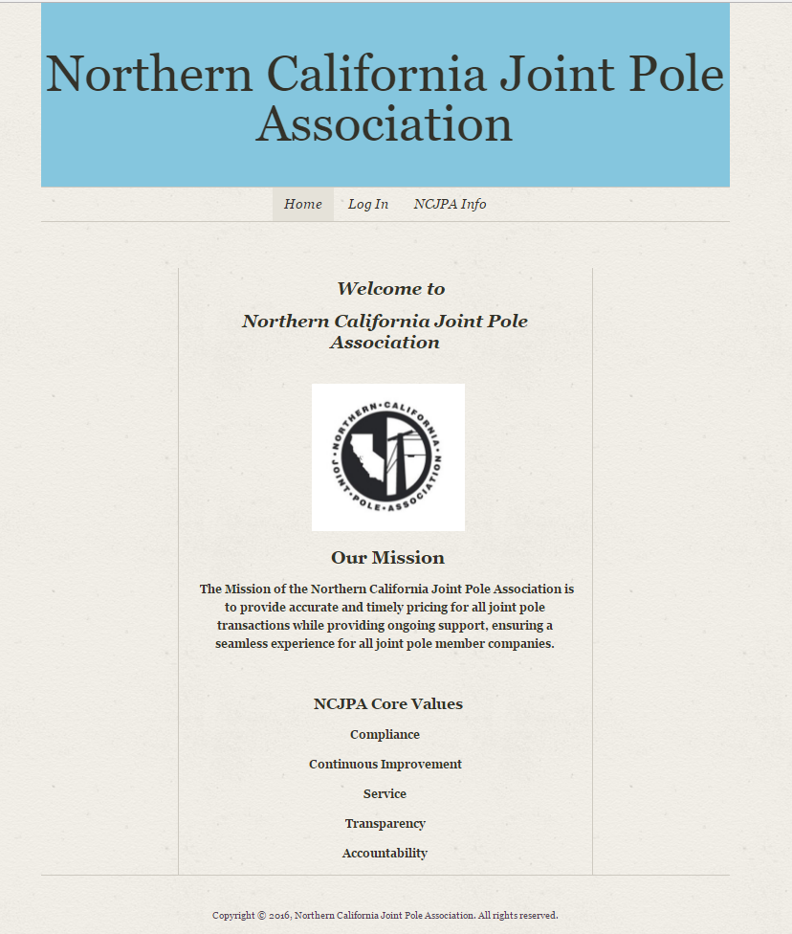
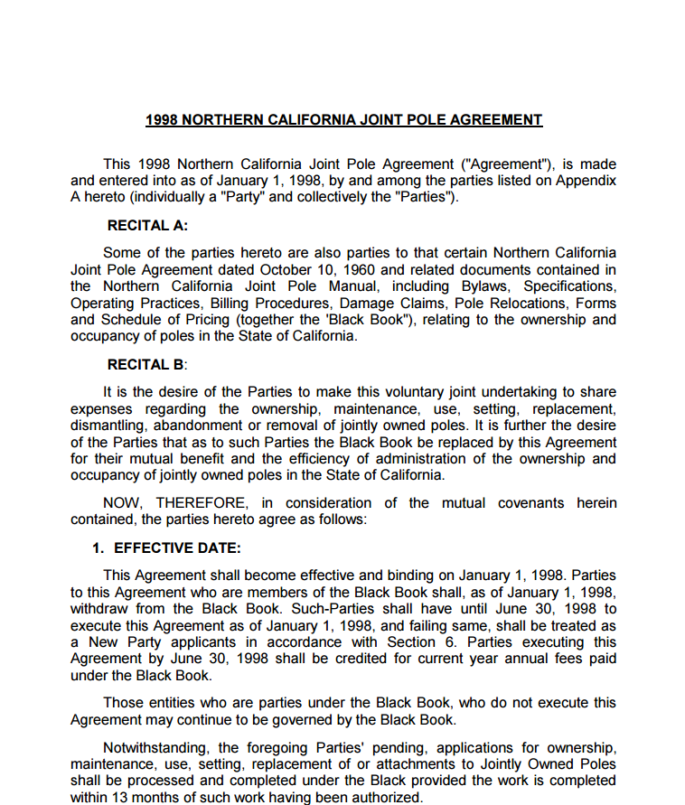
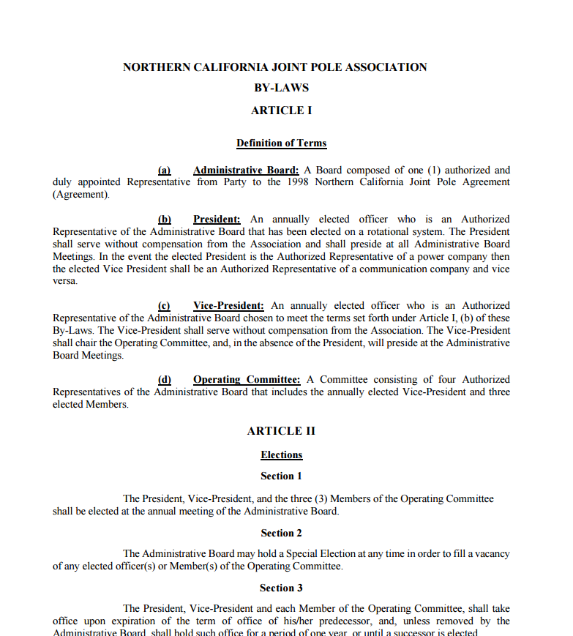
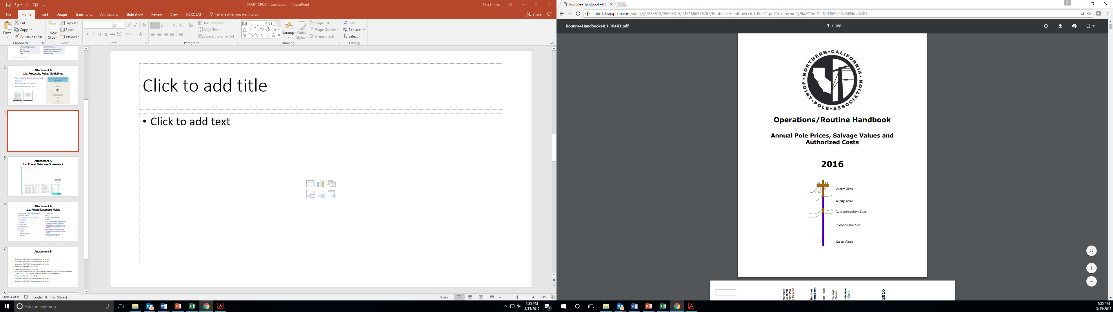
NCJPA Protocols, Rules, Guidelines
[Proprietary]
Agreement [including Amendments]
By-Laws
Routine Handbook
Friend Database

Slide 6
Key NCJPA Purpose Descriptions
Northern California Joint Pole Association (NCJPA): A non-profit organization formedto be formed and supported by the Parties [Members] to accomplish the purposes [Cost Sharing] set forth within the Agreement.
Authorization - Joint Pole Authorization – (Form JP# 2-1) [aka “JPA, Intent, Form 2”]: A document used for proposing and approving work [and associated cost of work] on Jointly Owned Poles, or used to propose the placement of jointly Owned Poles or their apparatus or equipment, or to propose joint Ownership of a solely owned pole.
Billing Cycle' (Form #2-1 Final): The time period during which JPA Authorizations are accepted for billing at the Association, as set by the Association. The end of one Billing Cycle is also the beginning of the next Billing Cycle.

Slide 7
By Laws – NCJPA Purpose
A. Maintain records, for the work connected with recording and pricing of transactions for the joint use of poles and their appurtenances.
B. Prepare Assessments, Bills of Sale (Form 44) to members, and related joint use activities.

Slide 8
Friend Database Input Data Fields
Unique ID (non pole-related)
Pole Number
Pole Replacement Number
Longitude and Latitude
Pole Class
Base Owner
Location and Height
Top Extension
Year Set
Treatment
City
Area Code (obsolete)
Status
JPA (unrelated to the physical characteristics of the pole)
Billed Date (unrelated to the physical characteristics of the pole)
Bill of Sale (unrelated to the physical characteristics of the pole)
Member(s) Code and Grade/Space info

Slide 9
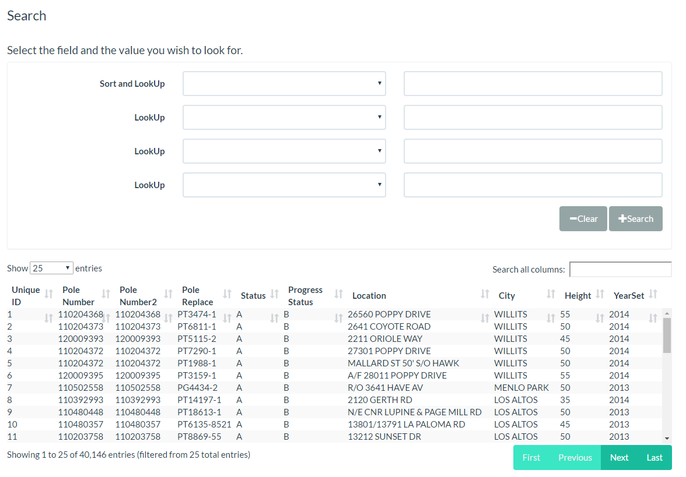
Friend Database Screenshot

Slide 10
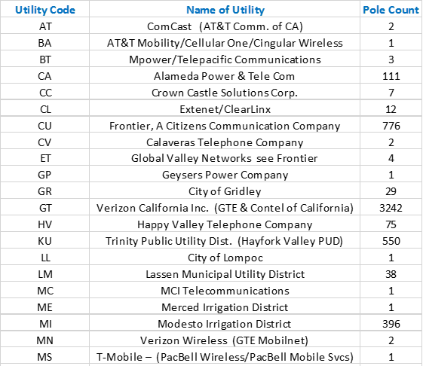
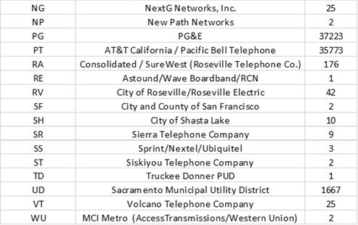
Members With Poles In Friend Database

Slide 11
What NCJPA Does and Does Not Do
NCJPA Office does perform the pricing and billing of physical construction work as directed by the constructing utility and in accordance with the Routine Handbook.
NCJPA Office does react to Joint Pole billing information provided by member(s) on Routine Handbook Forms 2, 7, 44, 48—submission of one of these Forms triggers an NCJPA pricing or billing update to the Friend database.
NCJPA Office does not track total number of California utility poles or their owners and attachers. The Friend database was implemented at the NCJPA in 2015. Thus, the number of poles that have been manually input into the Friend database is 40,072 as of 3/1/17.
NCJPA Office does not track and is not involved in pole loading calculations or facility attributes.

Slide 12
For More Information…
Northern California Joint Pole Association
1800 Sutter Street, Suite 830
Concord, CA 94520
www.ncjpa.org
or email
info@ncjpa.com

