Slide 1
Three IOUs Meet Three Design Thinking Firms…
Bringing the Customer View to TOU Rates
March, 2017

Slide 2
Agenda
Introductions
Background
Objective
Common Ground
Summary

Slide 3
Introductions

Slide 4
Our Research Partners
 | Mike Browning, Senior Vice President Manoj Alipuria, Lead Qualitative Strategist
 | Kyra Bobinet, MD, MPH, Leader Cynthia Barboza, Behavior Designer
 | Brett Newman, Partner Greg Hertz, Researcher and Strategist Pablo Velazquez, Researcher and Strategist

Slide 5
Background

Slide 6
Background
The Energy Division requested that the California IOUs hire a design thinking firm to evaluate the customer perspective on TOU Rates
Each IOU employed a different methodology – each aimed to involve customers into the design of rates and rate adoption
Working with the Energy Division, we included a wide range of customers to ensure a broad prospective
This work is intended to inspire the rates, communications and insights teams, taking into account the needs and learnings across all customer segments

Slide 7
Objective

Slide 8
Explore how Time of Use rate/s would work best for customers, and what tools & solutions would help them manage their bills under this new type of rate

Slide 9
The Common Ground

Slide 10
12 Shared Key Themes Emerged
Choice: Agency and 0ptions
Greater Good: Beyond money
Focus on Gains: Wins not losses
Fairness: We’re all in this together – right?
Feedback: Am I doing this right?
Credit “good behavior”: Recognize/reward my effort
Focus Ask/Action: Simple steps to do
Educate Me and My Family: I need them!
Don’t Know How To Manage my Bill: Don’t know what works
Unengaged with Utility: Don’t pay attention unless something is wrong
Distrust Utility: You don’t have my best interest in mind
12. Keep Messaging Simple: Clear, easy to digest

Slide 11
1
Choice: Agency and Options

Slide 12
Choice: Agency and Options
Choice of Peak
Rates based on size of home
Pre-packaged rates
Rates that increase/decrease around 6pm
Shorter peak/earlier end time
Shorter/steeper peak
Early bird/late bird option preferred
Longer/flatter peak
Utilities that offer choices between 5-hour, 4-hour, and 3-hour peak windows have experienced positive responses from customers
Shorter peak
End peak hours earlier
Discount on non-peak proportional to amount of peak hours selected
People want choice but need tools for effective choice making
Amplify sense of choice in a restrictive setting

Slide 13
Don’t force me into a rate or a behavior that doesn’t work for my life.
PG&E Respondent

Slide 14
Choice: Brain Science Principles
AMBIGUITY AND CONTRAST
STATUS QUO BIAS
Proprietary to engagedIN—Confidential

Slide 15
2
Greater Good: Beyond Money

Slide 16
Greater Good: Beyond Money
Renewable energy = energy of the future. Solves both cost and environmental impact of energy generation
We live in an extremely wasteful culture. We want to be a part of anything that helps us protect our precious resources. Accordingly, we are ready to hear about energy and catapult it into the conservation movement
Customers accept the idea of the greater good on two conditions: 1) they get recognized/rewarded and 2) PG&E makes everyone else do it too
Ways to celebrate community and/or individual efforts on desired energy behaviors
Communicate community impact/comparisons among groups/neighborhoods
Be the utility of tomorrow
Provide significance to the financial reward with environmentalism
Express a vision of the future that customers want to work towards
Frame TOU as the environmental plan
Facilitate opportunities for San Diegans to contribute or volunteer for environmental issues
Explore how to engage customers in the idea of energy as a tangible resource worth conserving (like water)

Slide 17
If Edison can prove they’re creating cleaner energy, I’m happy to pay more.
SCE Respondent

Slide 18
Greater Good: Brain Science Principles
SCARCITY
SOCIAL DESIRABILITY BIAS
SOCIAL NORM
Proprietary to engagedIN—Confidential

Slide 19
3
Focus on Gains: Wins not Losses

Slide 20
Focus on Gains: Wins not Losses
Rebates and incentives for reducing usage
Offer rebates for us who live in inland communities. Make rebates and incentives really explicit on the bill so SCE gets credit for it
Provisions for low-income households
Customers want to avoid financial losses, and see discounted rates during off-peak hours as a motivator for changing their behavior so they can save money
Praise, don’t blame
All incentive TOU: No change in peak price – discount on non-peak
Frame tier one rates as discounted rather than normal

Slide 21
I don’t want to lose a bunch of money, so give me discounts for the things I have to do.
PG&E Respondent

Slide 22
Focus On Gains: Brain Science Principles
REWARD-EXPECTATION DISCONNECT
LOSS AVERSION
DESIRE FOR CERTAINTY
Proprietary to engagedIN—Confidential

Slide 23
4
Fairness: We’re all in this together – right?

Slide 24
Fairness: We’re All In This Together – Right?
It feels like us vs. them
Edison tells us what to do, but they don’t tell us what they’re doing to conserve or create new energy. If our state is in need, let’s work together for a better future
Neighbors don’t always participate in conservation actions
In order to feel better and more impactful about their behavior change efforts, customers want PG&E to hold the surrounding neighbors and communities accountable
Re-design the “neighbor comparison” to achieve its intended purpose

Slide 25
SDG&E should be promoting energy reduction for the region. SDG&E Respondent

Slide 26
Fairness: Brain Science Principles
SOCIAL NORM
SOCIAL PROOF
Proprietary to engagedIN—Confidential

Slide 27
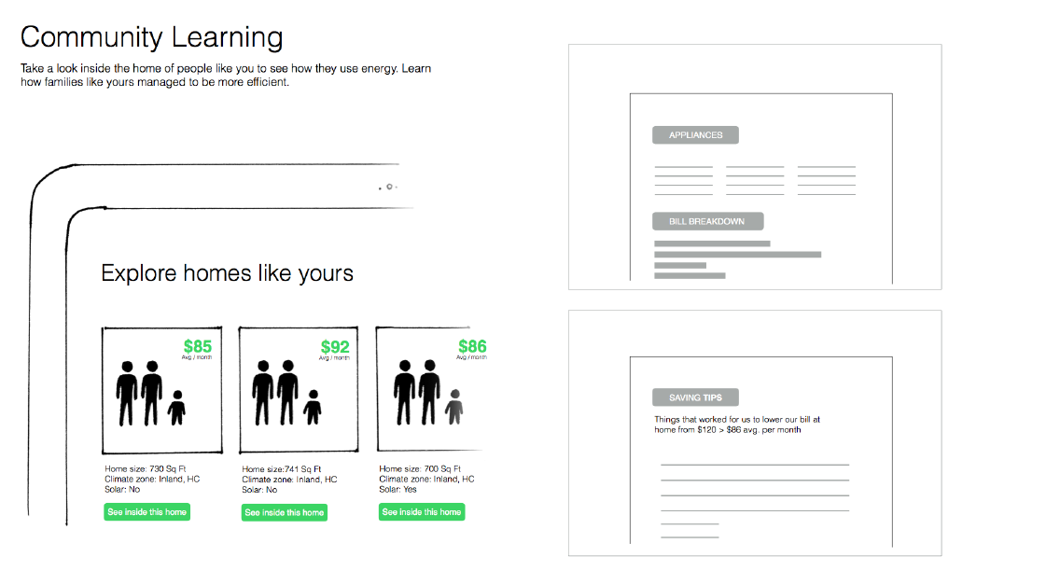
Proprietary to Daylight—Confidential

Slide 28
5
Feedback: Am I Doing This Right?

Slide 29
Feedback: Am I Doing This Right?
Real time metrics, goals, thresholds, notifications & itemization
Text alerts with daily reminders during launch phase
Alerts when you’re reaching high usage thresholds
“Today’s a particularly tough day” messages
Remove any math or calculations burden
Create a trigger system for stop and start times for TOU
Customers also are frustrated when their bill doesn’t move down in light of their efforts, and usage alerts intended to help instead evoke a sense of helplessness because customers justify that they still need to continue using energy through the rest of the month
TOU is more transparent than Tiered rates. Customers understand how to work with time of day
Provide predictive tools that are interactive and easy to use
Make bill accessible and actionable
A small financial incentive will not motivate behavior change

Slide 30
Tiers provide almost no feedback on how our actions translate into saving energy, making us feel powerless/ without control.
SCE Respondent

Slide 31
Feedback: Brain Science Principles
AMBIGUITY EFFECT
CERTAINTY EFFECT
RATIO BIAS
Proprietary to engagedIN—Confidential

Slide 32
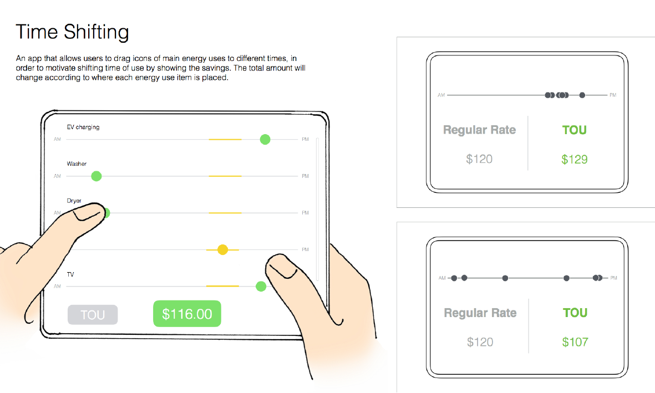
Proprietary to Daylight—Confidential

Slide 33
6
Credit “Good Behavior”

Slide 34
Credit “Good Behavior”
Summer/Inland customers crave bill stability and bill relief
Need for positive reinforcement
Customers are used to being rewarded for good behavior, whether good driver discounts, loyalty shopping cards, or cash back credit cards. The perception that they are getting something in return for their efforts is lacking in their relationship with PG&E
Explore a way to design non-monetary social/emotional credit for good behavior
Environmental reward for “good behavior”
Reward users for compromise

Slide 35
What do I stand to gain from changing, I should be rewarded for my good behavior.
PG&E Respondent

Slide 36
Credit “Good Behavior”
PELTZMAN EFFECT
ENDOWMENT EFFECT
Proprietary to engagedIN—Confidential

Slide 37
7
Focus Ask/Action

Slide 38
Focus Ask/Action
Tell me how to “do my part”
We’re literally in the dark about how to conserve energy and save costs. Should I unplug my stove....oops it’s gas
Would someone just tell us what pulls the most energy?
Too many variables to consider when managing energy and it feels like everything is restricted
Customers should be given only a few tips at a time (constrained choice) and small steps that are easy and layered over time to be more impactful
Suggestions for energy saving behaviors would ideally be designed to be on auto-pilot with a one-time or short span set-up behavior to save effort
Opportunity to reframe change to focus on flexible routines ( not inflexible routines)
Identify high impact, flexible appliances (AC/Dryer/Clothes and Dishwashers)

Slide 39
There’s too much information about changing too many appliances in too many ways.
PG&E Respondent

Slide 40
Focus Ask/Action: Brain Science Principles
DECISION MAKING AS A RESOURCE
CHOICE OVERLOAD
EGO DEPLETION
Proprietary to engagedIN—Confidential

Slide 41
8
Educate Me and My Family

Slide 42
Educate Me and My Family
What if our children learned the importance of this issue? They don’t have a clue now, but they could really motivate parents
Educate those with fixed schedules
Low awareness of finite resources
Customers want PG&E to hold their families accountable too, because it is hard for them to do it
Mindless use of energy
Help users identify luxury without judgement
Promote appreciation of value of necessary energy use
Make SDG&E a hub of lifestyle innovation

Slide 43
Adults tend to live in their own little worlds. When you speak to a child, particularly at a school, they bring that info home, and it seeds through a household, seeds through neighbors. The message blossoms.
SCE Respondent

Slide 44
Educate Me and My Family: Brain Science
SOCIAL NORM
PICTURE SUPERIORITY EFFECT
Proprietary to engagedIN—Confidential

Slide 45
9
Don’t Know How To Manage My Bill

Slide 46
Don’t Know How To Manage My Bill
Lack of knowledge
Inability to compare usage to others
Inertia
Tiered system without timely feedback makes us feel helpless
The link between behavior and bill impact is unclear, making it tough for customers to feel a sense of control over their energy cost
Minimal online engagement
Request for more details
Fear of changing plans
Desire for certainty
Doubt their abilities
Overgeneralized Information for bill reduction causes more harm than good
People don’t know how or where to reduce energy – feel frustration, ineffective, compromise

Slide 47
We are consistently going into a higher tier. It feels like I’m doing something wrong but I don’t know what I would be doing differently. SDG&E Respondent

Slide 48
Don’t Know How to Manage My Bill: Brain Science
REGRET AVERSION
PAST SELF/FUTURE SELF
Proprietary to engagedIN—Confidential

Slide 49
10
Unengaged With Utility

Slide 50
Unengaged With Utility
TOU can be a catalyst for deeper relationships
Create a partnership mentality
Provide progress updates
Have empathy for different schedules and situations
Educate on all things power
Customers only pay attention when their bill exceeds their expectations – or they experience a problem with their power
Don’t connect actions to bills – what has biggest impact?
Bill is not helpful for learning what to change
Apathy towards energy education
Unaware of their rate plan details/name
Everyone thinks their use is “normal”
Make energy experience a partnership
Highlight hidden technologies and experts

Slide 51
People are just too busy with their lives. Whoever gets through their to-do list analyzing when it makes the most sense to do something based on the best rate?
SDG&E Respondent

Slide 52
Unengaged With Utility: Brain Science
DECISION MAKING AS A RESOURCE
PAST SELF/FUTURE SELF
Proprietary to engagedIN—Confidential

Slide 53
11
Distrust Utility

Slide 54
Distrust Utility: Not in My Best Interest
Fear is that TOU = higher bills, greed, lack of information/ transparency
is energy finite, or can they “just make more?”
Customers believe PG&E’s rate changes are to increase profits, and rebel against suggestions to change their behavior
Consumers fear loss and can see PG&E as a losing and sometimes predatory relationship
Already “doing everything they can to save energy/money”
The perception that SDG&E is a profit driven corporation leads to perceiving TOU as gouging
Some view TOU is a costly and unfair burden
Tiered rates are punitive and not transparent
The 4-9 time frame challenges the current perception of peak – think business users drive high demand
Education needs to support the peak demand and associated peak rates

Slide 55
We’re suspicious that corporate greed might be driving this. Edison hasn’t done anything notably groundbreaking or environmental; why start now?
SCE Respondent

Slide 56
Distrust Utility: Brain Science
REWARD/EXPECTATION DISCONNECT
PAST SELF/FUTURE SELF
CHOICE SUPPORTED BIAS
Proprietary to engagedIN—Confidential

Slide 57
12
Keep Messaging Simple

Slide 58
Keep Messaging Simple
Clear & consistent communication of benefits (control, conservation, simplicity, etc.)
Stick to the facts: The people behind water conservation have presented the facts clearly, making saving a no-brainer. Customers think SCE should do the same
Points to emphasize: fresh start each day, give your appliances the evening off, more control; less power, build your own power calendar
Customers respond positively to messaging that is straightforward, visual, and detailed with approachable language
Images and activities should be appealing / memorable to children
Be transparent that TOU is a statewide mandate
Make suggestions home specific

Slide 59
Just tell me what specifically I can cut back on. I don't care about my neighbor that is single and has one dog. I don't feel it’s appropriate for them to tell me I'm less efficient.
SDG&E Respondent

Slide 60
Keep Messaging Simple: Brain Science
DECISION MAKING AS A RESOURCE
Proprietary to engagedIN—Confidential

Slide 61
Summary

Slide 62
Rate Design
Consider choice around time and/or duration of peak
Present choice in a contained setting (not too many choices, simple choice, comparisons)
Rate choices need to differentiate or be organized in some way that makes sense if customers are tasked with attempting to make a rate plan choice
Communications
Keep it simple
Promote the positive (e.g. discount during off-peak, 19 hours a day are off peak, each day a new start, etc.)
Rate Feedback
Consider tools that are engaging and provide details on use and bill impact

Slide 63
Thank You!

